Slide 1
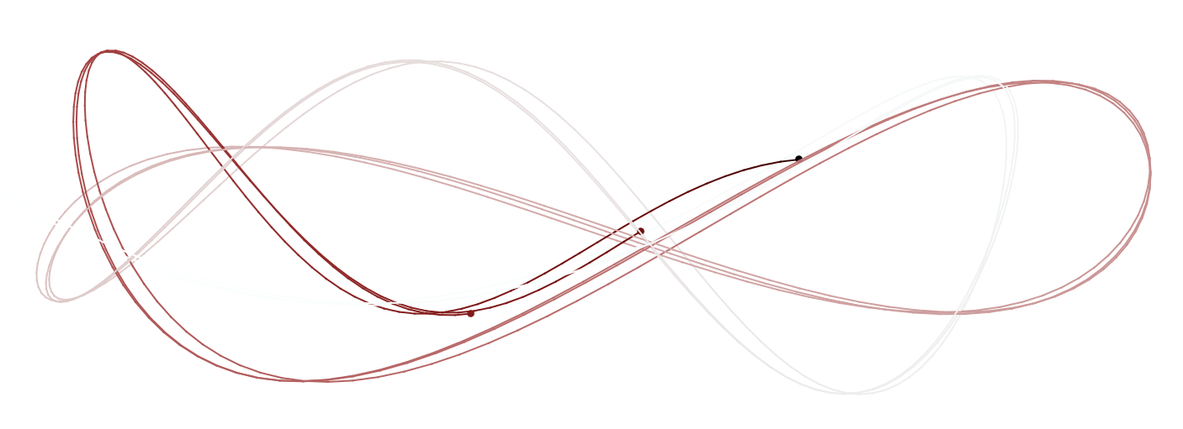

One to rule them all: A beginner’s guide to fitting Bayesian mixed-effects models in Stan using brms
SIPS Rotterdam; Johannes Algermissen, Julian Quandt; 09-07-2019

Slide 2
Table of Content
Philosophy of mixed models
Bayesian vs. Frequentist philosophy of statistics
Markov chain Monte Carlo (MCMC) algorithms
Brms Practical

Slide 3
Philosophy of mixed models

Slide 4
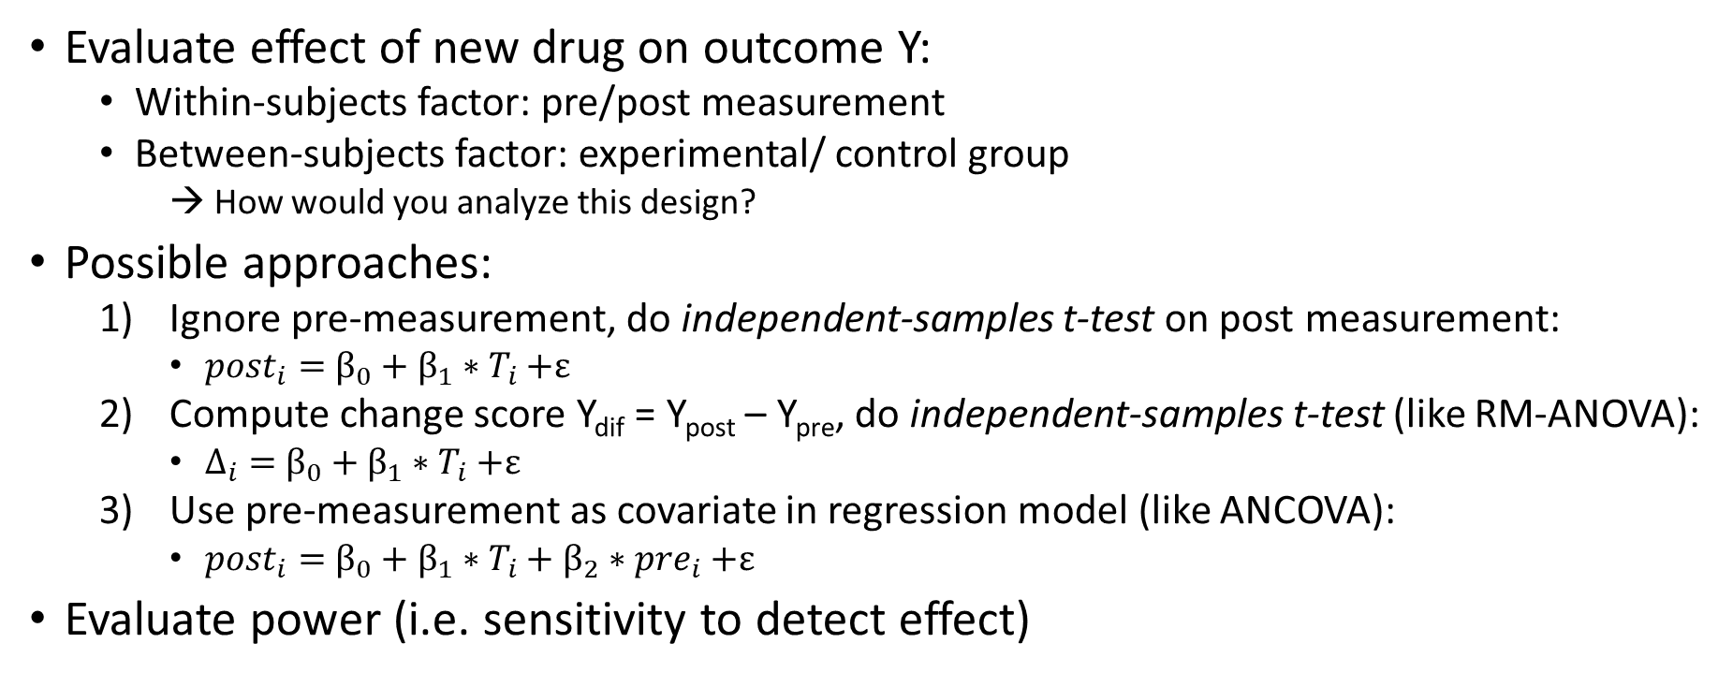
Scenario
Evaluate effect of new drug on outcome Y:
Within-subjects factor: pre/post measurement
Between-subjects factor: experimental/ control group
→ How would you analyze this design?
Possible approaches:
Ignore pre-measurement, do independent-samples t-test on post measurement:
${post}_{i}=$ $β_{0}+β_{1}{∗T}_{i}+ε$
Compute change score Y_{dif} = Y_{post} – Y_{pre}, do independent-samples t-test (like RM-ANOVA):
$Δ_{i}=$ $β_{0}+β_{1}{∗T}_{i}+ε$
Use pre-measurement as covariate in regression model (like ANCOVA):
${post}_{i}=$ $β_{0}+β_{1}∗T_{i}+β_{2}{∗pre}_{i}+ε$
Evaluate power (i.e. sensitivity to detect effect)
Example by Keith Goldfeld, https://www.rdatagen.net/post/thinking-about-the-run-of-the-mill-pre-post-analysis/

Slide 5



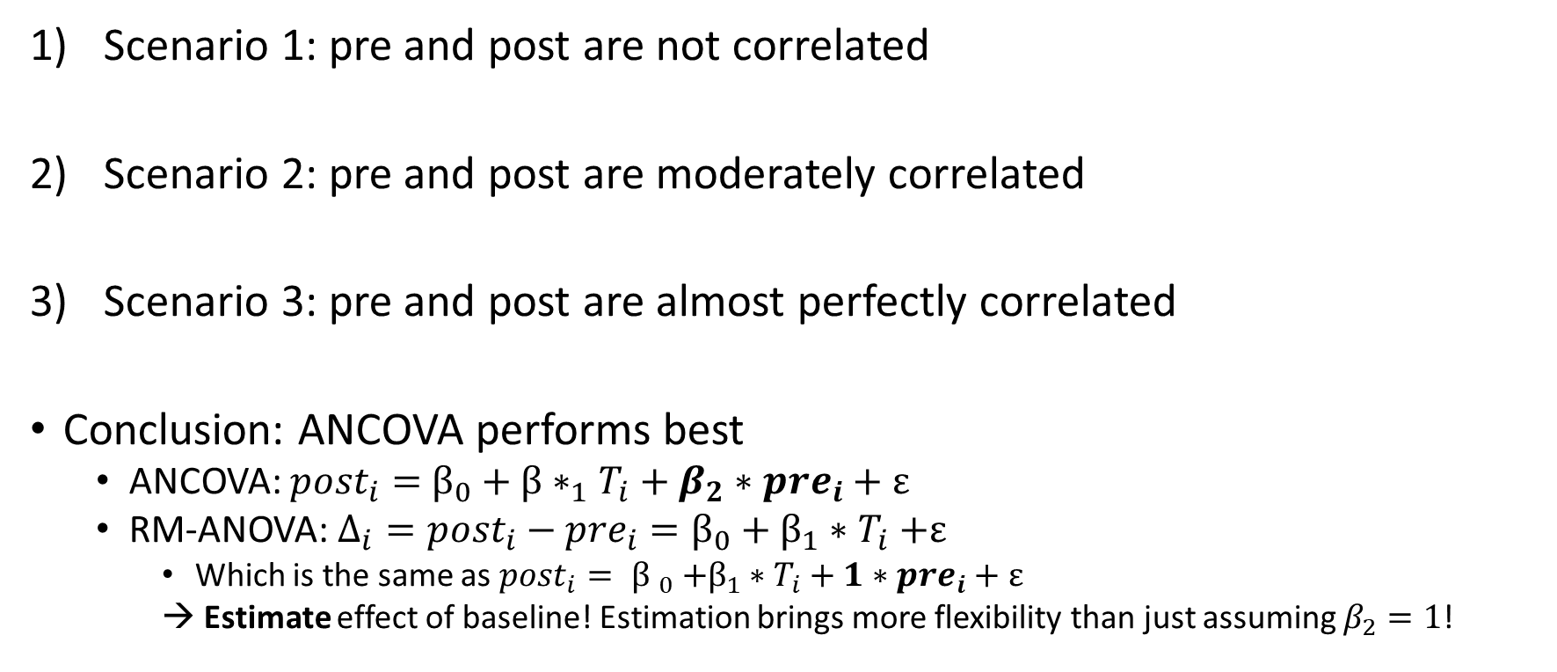
Scenario outcomes
Scenario 1: pre and post are not correlated
Scenario 2: pre and post are moderately correlated
Scenario 3: pre and post are almost perfectly correlated
Conclusion: ANCOVA performs best
ANCOVA: ${post}_{i}=$ $β_{0}+{β∗}_{1}T_{i}+β_{2}∗{pre}_{i}+ε$
RM-ANOVA: $Δ_{i}={post}_{i}−{pre}_{i}=β_{0}+β_{1}{∗T}_{i}+ε$
Which is the same as${ {post}_{i}= β }_{0} +β_{1}∗T_{i}+1∗{pre}_{i}+ε$
→ Estimate effect of baseline! Estimation brings more flexibility than just assuming $β_{2}=1$!
Example by Keith Goldfeld, https://www.rdatagen.net/post/thinking-about-the-run-of-the-mill-pre-post-analysis/

Slide 6
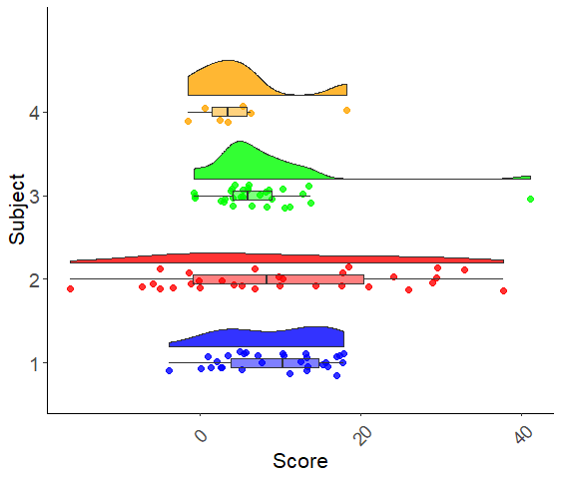
Measurement models and assumptions – 1
RM-ANOVA approach to analyze trials: Aggregate, i.e. take the mean of each cell for each subject
Assume that the mean is an accurate representation of all trials (i.e. normal distribution)
→Assume equal reliability of all trials (assign weight of 1 to each trial)
Ignore lower-level processes, e.g. learning over time
Sample effect
Effect Subject 1
Effect Subject 2
…
1
1
1
1
1
1
1
Trial 1
Trial 2
Trial 3
…
Trial 1
Trial 2
…

Slide 7
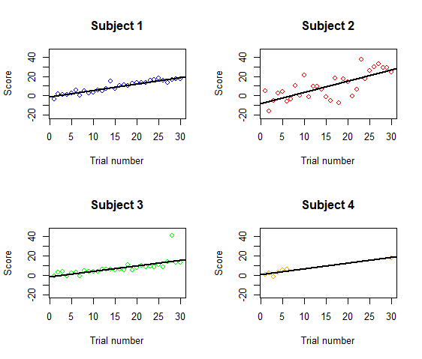
Measurement models and assumptions – 2
Two-step least-squares approach: Separate regression per subject, extract coefficient, do t-test on coefficient of all subjects
Allows to add lower-level regressor, e.g. adjust for effect of time
Many regressions on potentially few data points → noisy estimates
Each subject equally weighted?
Sample effect
1
1
1
Effect Subject 1
Effect Subject 2
…
1
1
1
1
1
1
1
Trial 1
Trial 2
Trial 3
…
Trial 1
Trial 2
…

Slide 8
Measurement models and assumptions – 3
Wouldn’t it be nice to estimate the contribution of each trial/ subject, e.g. based on its data quality?
Number of trials
Variance within subject
Outliers
→ Do not set weights to 1, but estimate them!
Sample effect
1
1
1
Effect Subject 1
Effect Subject 2
…
1
1
1
1
1
1
1
Trial 1
Trial 2
Trial 3
…
Trial 1
Trial 2
…

Slide 9
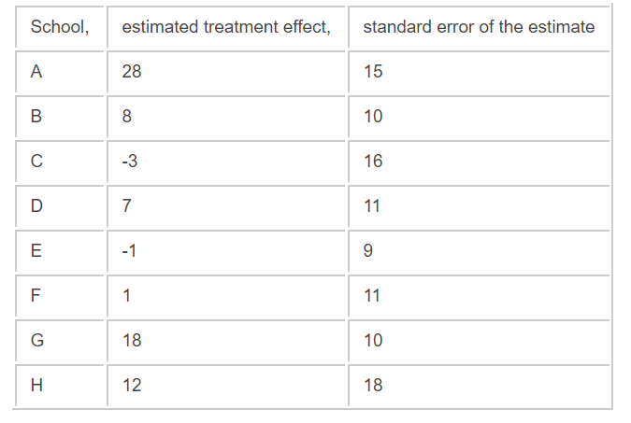
Rubin’s 8-schools model
True effect size in school A:
28 (effect in that particular school)?
Or 8 (mean effect across schools)?
Somewhere in the middle?
Phil Price: Everything I need to know about Bayesian statistics, I learned in eight schools:
https://statmodeling.stat.columbia.edu/2014/01/21/everything-need-know-bayesian-statistics-learned-eight-schools/

Slide 10
Partial pooling
Each subject has its own effect – but it might be hard to measure reliably
No pooling
Problem of few trials, large variance,…
Each subject should show the same effect as they all get the same treatment – any variation in the effect is just noise, no meaningful individual differences
Complete pooling
Problem of outliers
Find a compromise between each subjects peculiarity & the knowledge that all subjects originate from the same sample (undergoing the same treatment)
Partial pooling (“shrinkage”, “borrowing strength”, “regularization”)
Inform the estimated effect for subject A by the estimated effects of all other subjects
Phil Price: Everything I need to know about Bayesian statistics, I learned in eight schools:
https://statmodeling.stat.columbia.edu/2014/01/21/everything-need-know-bayesian-statistics-learned-eight-schools/

Slide 11
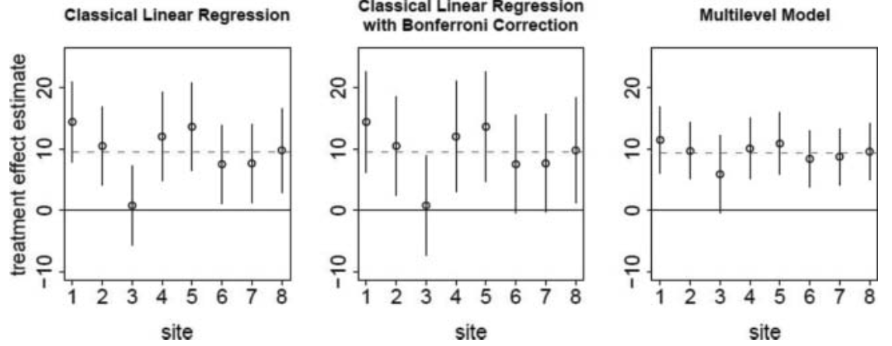
Solution to multiple-comparisons problem…?
Having multiple outcomes (e.g. questionnaire scores, treatment sites,…)
Traditional way: Bonferroni correction (affects confidence intervals)
Alternative: Inform one outcome by the others (affects estimates)
Gelman, A., Hill, J., & Yajima, M. (2012). Why we (usually) don't have to worry about multiple comparisons.
Journal of Research on Educational Effectiveness, 5(2), 189-211.

Slide 12
Summary motivation mixed models
Model lower-level processes
Estimate contribution of each lower-level effect to higher-level effect
Use other available data (e.g. “trials/ subjects originate from same source”) to improve estimation of lower-level effects

Slide 13
Linear mixed-effects models
Linear mixed-effects models (LMMs; also called multilevel analysis, hierarchical linear modeling, …)
For nested/grouped/clustered data: data points from the same source are more similar to each than data from different sources → “correlated errors”, “non-independence”
Data points (“trials”) nested in subjects
Subjects nested in groups (e.g. school classes, hospitals)
Groups nested in larger groups (e.g. classes nested in schools)
Data points (“trials”) nested in items

Slide 14
Advantages of mixed-effects models over RM-ANOVAs
More flexibility in modelled distribution of dependent variable
Not only normal, but also logistic/binomial, Poisson, log-normal,…
Model lower-level effects (e.g. effect of time on task, order effects,…)
Use continuous (not only categorical) predictors
Don’t throw out “errors”, but model them!
Relaxed assumptions:
Robust to unequal cell sizes/ trial numbers (by design or due to missingness)
Robust to unequal variances within groups (heteroscedasticity)
Estimate effect of lower-level effects on higher level effects
Use other available data to inform your estimates (partial pooling)
→ Increase power!

Slide 15
Bayesian vs. Frequentist philosophy of statistics

Slide 16
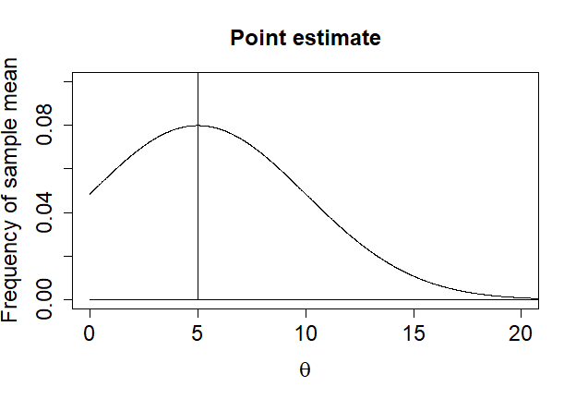
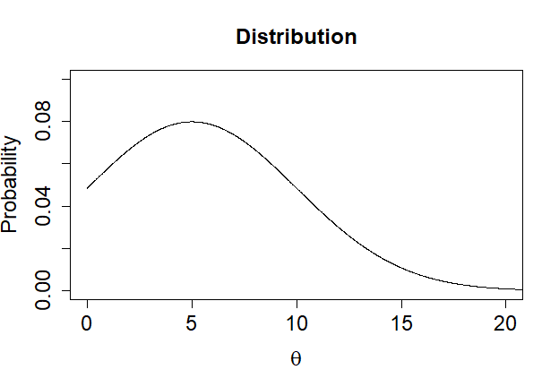
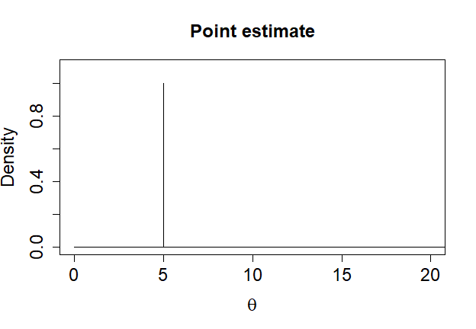
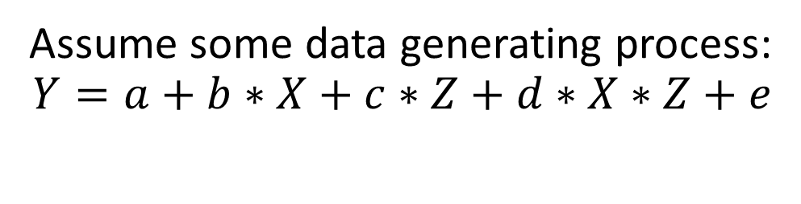
Frequentist vs. Bayesian perspective on parameters
Assume some data generating process:
$$Y=a+b∗X+c∗Z+d∗X∗Z+e$$
Variability due to finite sampling
True (ir-) reducible uncertainty
Frequentist perspective | Bayesian perspective
What is the true parameter value? How much are my data compatible with a certain hypothesized parameter value (e.g. H₀: Θ = 0)? | What degree of credibility/ belief/ probability should I assign to different possible parameter values?

Slide 17
Hypothesis testing vs. parameter estimation
Assume some data generating process:
$$Y=a+b∗X+c∗Z+d∗X∗Z+e$$
Hypothesis testing | Parameter estimation
How (in)compatible are my data with some (null) hypothesis H₀: Θ = θ? | Which parameter estimates should I use to predict Y?

Slide 18
Different interest in distributions
Assume some data generating process:
$$Y=a+b∗X+c∗Z+d∗X∗Z+e$$
Variability due to finite sampling
True (ir-) reducible uncertainty
Frequentist perspective | Bayesian perspective
Need sampling distribution of my test statistic to evaluate how compatible my data are with my null hypothesis | Interested in entire distribution to evaluate credibility/ belief to-be-assigned to different possible parameter values

Slide 19
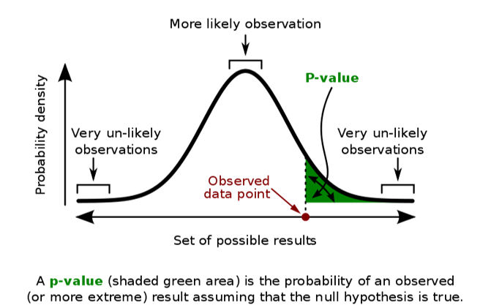
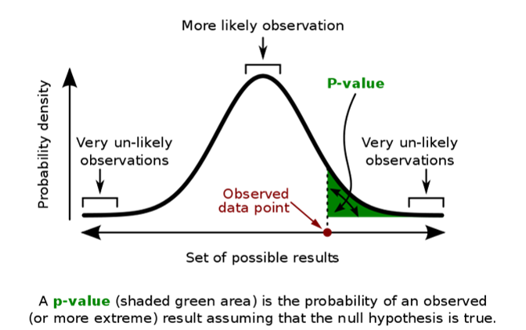


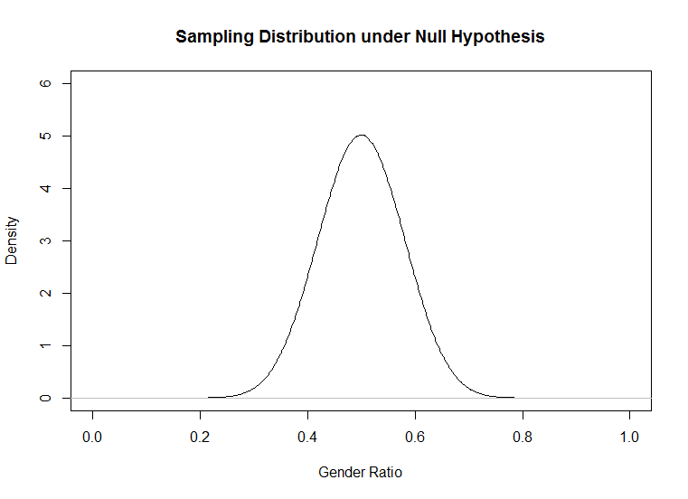

Frequentist scenario
Statistical world
Example
Postulate a population with “true” parameter θ, hypothesize e.g. H₀: θ = .50
Draw empirical sample from population, measure summary statistic (mean)
Draw infinitely many imaginary samples given H₀: θ = .50 is true, take summary statistic of each sample
Compute frequency of how often certain summary statistic (or more extreme one) is observed
Draw inferences about population
Assume population of humans in NL has $≤$50% women
Obtain sample of 100 people, measure that 60 are women
Model distribution of sample means with H₀: θ = .50 as t-distribution with mean θ and SD based on sample SD (i.e. SE)
Compute t-statistic for 60% under H₀, compute p-value for observed t-statistic or more extreme one
Conclude women > men

Slide 20
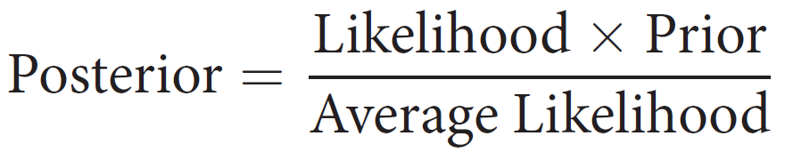
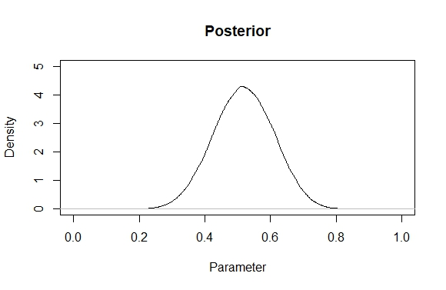
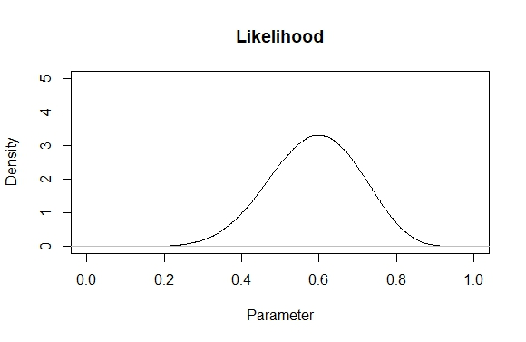
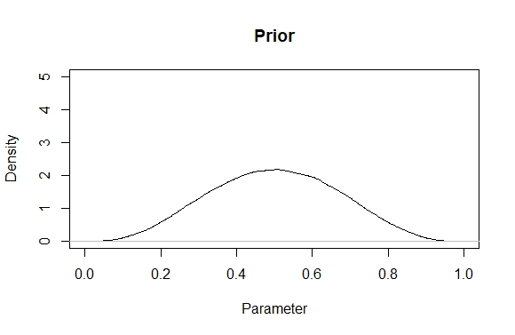
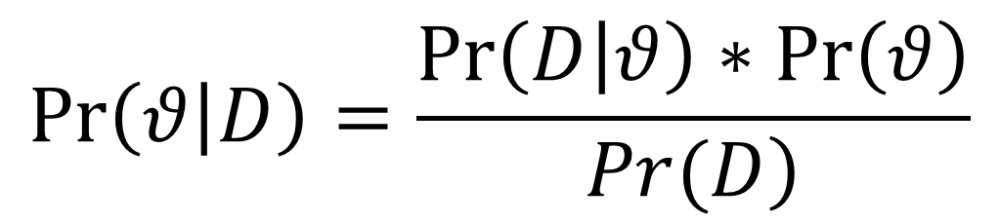
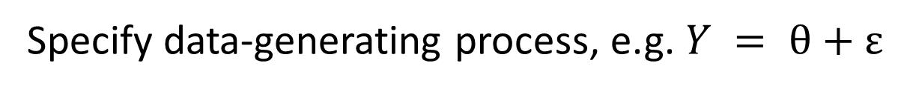
Bayes Theorem
$$\operatorname{Pr}\left(θ | D\right)=\frac{\operatorname{Pr}\left(D | θ\right)∗\operatorname{Pr}\left(θ\right)}{\left.Pr(D\right)}$$
Specify data-generating process, e.g. $Y = θ+ε$
Data: W,W,W,W,W,W,M,M,M,M

Slide 21
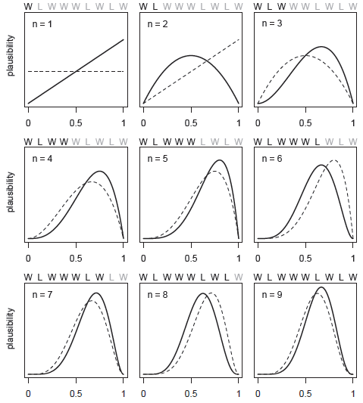
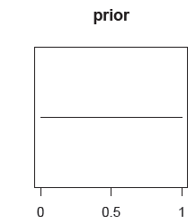
McElreath, R. (2018). Statistical rethinking: A Bayesian course with examples in R and Stan. Chapman and Hall/CRC.

Slide 22
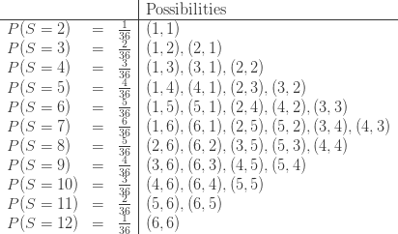

Bayesian scenario
Data: W,W,W,W,W,W,M,M,M,M
Statistical world
Example
Start with distribution of parameter θ (prior)
Obtain some data
Compute for each parameter value in how many ways data could have occurred (likelihood)
Compute distribution of θ conditional on data (posterior)
Start with density distribution on possible gender ratio values in NL
Ask 10 people for their gender
Update distribution on the fly, stop at some point when all data points have been accounted for
Compute final distribution on possible gender ratio values in NL
Population, sample, frequency, p-value,...

Slide 23
Interim summary
Frequentist
Bayesian
Interested in the true population parameter values
Test whether data are compatible with certain (null) hypotheses about parameter values
Interest in the distribution of credibility/plausibility/certainty/ probability over possible parameter values
Update distribution based on data using Bayes Theorem

Slide 24
Markov Chain Monte Carlo (MCMC) algorithms

Slide 25
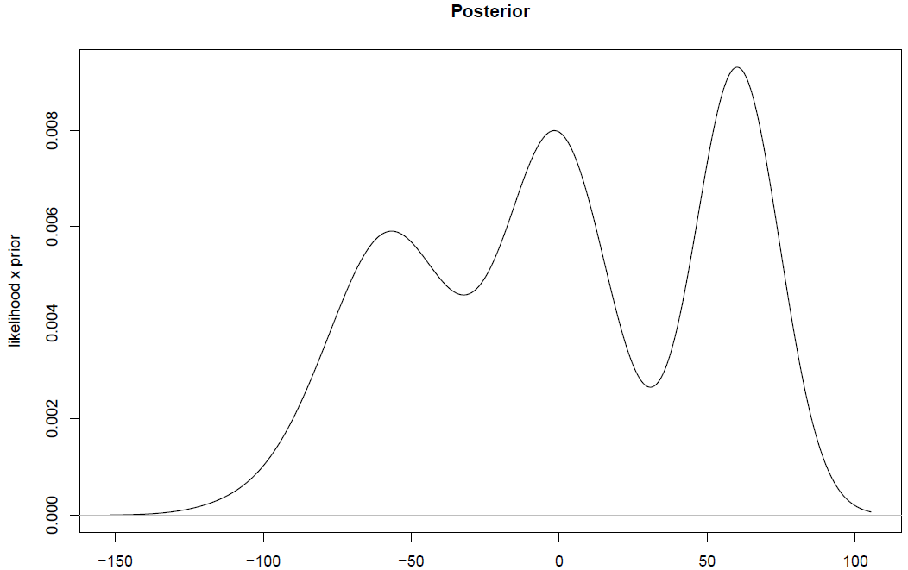
Problem of local minima

Slide 26
Metropolis algorithm – 1
Move to new location with
80% probability!
Ratio 0.80

Slide 27
Metropolis algorithm – 2
Move to new location with
100% probability!
Ratio 1.20

Slide 28
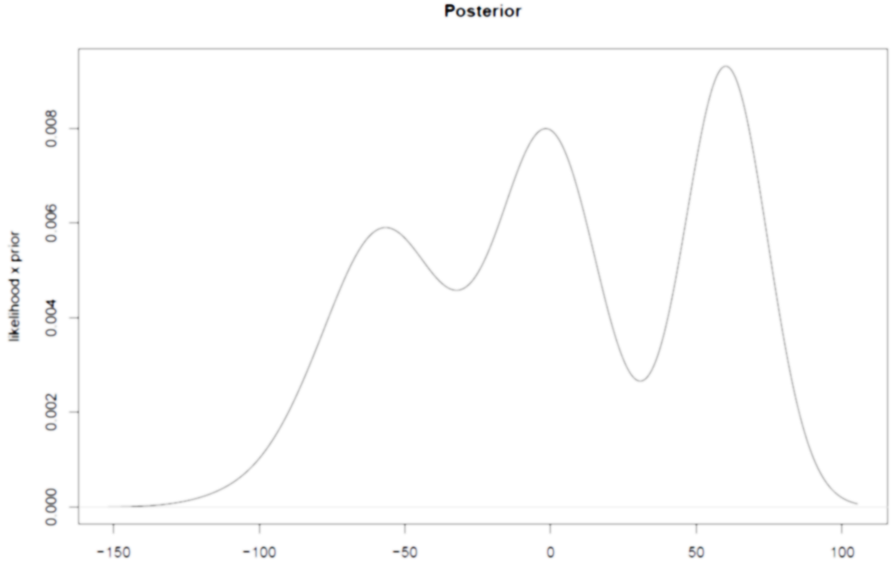
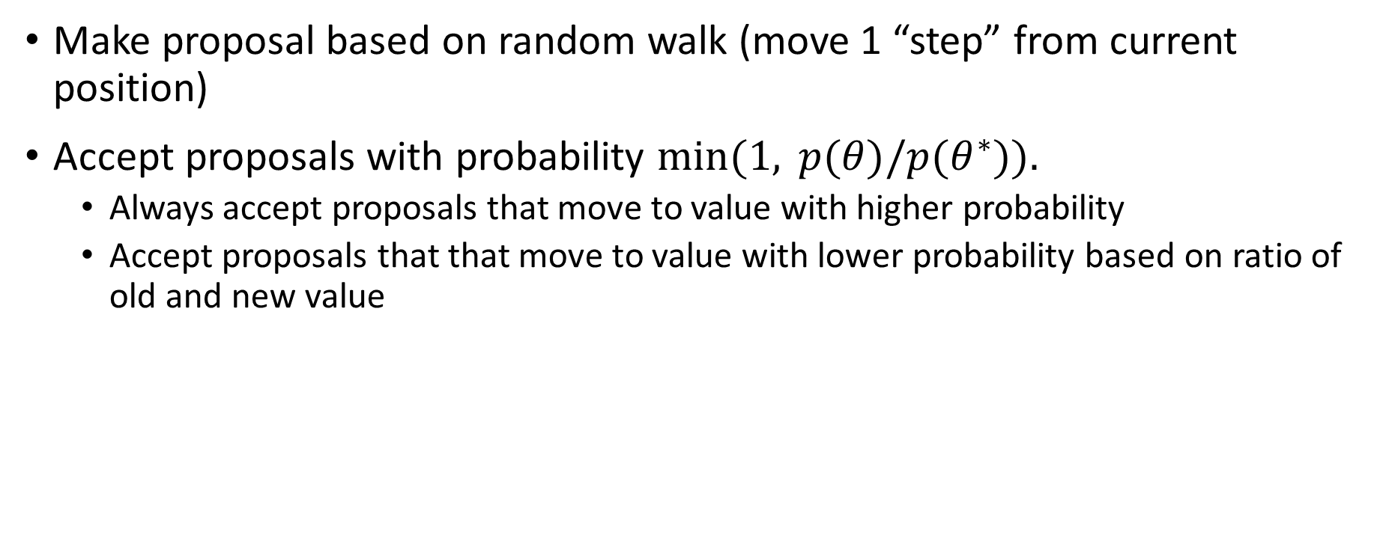
Summary Metropolis algorithm
Make proposal based on random walk (move 1 “step” from current position)
Accept proposals with probability $min⁡(1, p(θ)/p(θ^{∗})).$
Always accept proposals that move to value with higher probability
Accept proposals that that move to value with lower probability based on ratio of old and new value

Slide 29
Problems with Metropolis algorithm
Very slow (proposals based on random walk)
High autocorrelation (due to random walk) → many redundant samples
Problems with finding complex patterns in high-dimensional distributions (e.g. hierarchical models)
Solution: Hamiltonian Monte-Carlo (HMC) as implemented in STAN

Slide 30
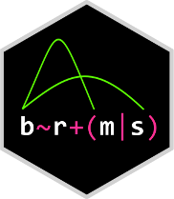
STAN
https://mc-stan.org/
Probabilistic programming language written in C++
Developed by Andrew Gelman and Bob Carpenter (and many others) at Columbia University
Can be interfaced from many other languages (e.g. CmdStan, Rstan, PyStan, MatlabStan, Stan.jl, StataStan)
Implements Hamiltonian Monte-Carlo with No-U-Turn sampler (NUTS)
Write lme4-like models that get translated into Stan code: brms (“Bayesian Regression Models using 'Stan’”) package by Paul Bürkner

Slide 31
brms Practical: bayesian regression models in stan

Slide 32
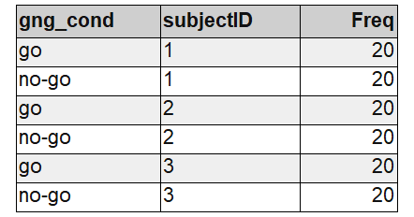
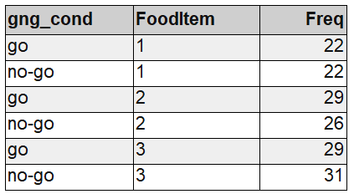
Example 1: Go/No-Go training data
Example data:
80 people rate 40 food items before and after an experimental (within-subject) manipulation (go/no-go training)
DV: difference score between ratings (post-pre)
IV: training condition of item (go / no-go)

Slide 33
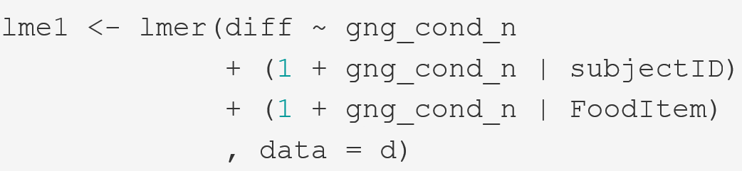
Quick recap on lme4 syntax
We follow the maximal model approach here (Barr, Levy, Scheepers, & Tily, 2013):
All fixed effects (i.e. population-level effects) that are important
A intercept adjustment (variance parameter) for each grouping level
An adjustment of the fixed-effect for each grouping level
The correlations between these adjustments

Slide 34
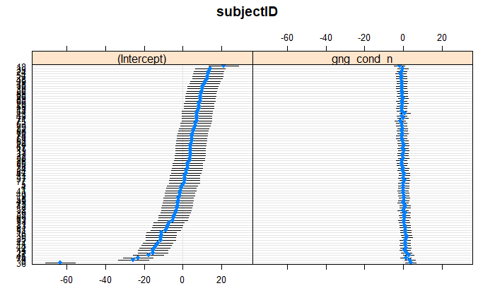

Slide 35
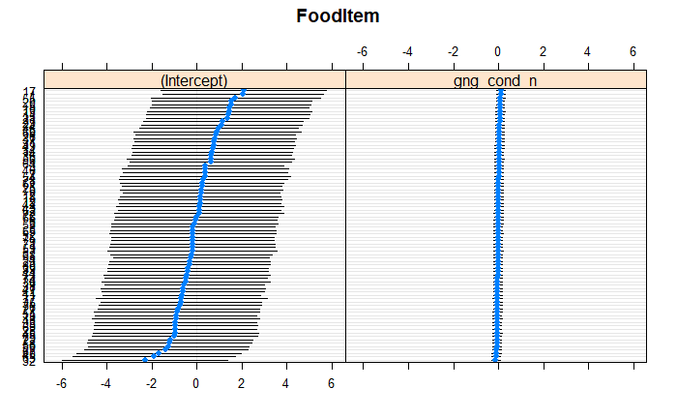

Slide 36
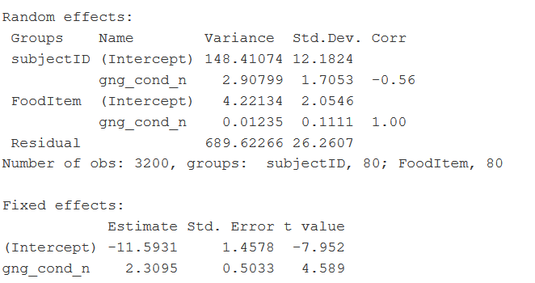

Slide 37
lme4 vs. brms: few words on practical differences
Why brms:
- If you prefer a Bayesian philosophy over the frequentist one
- If you have domain-knowledge about the research-question and what you might expect, you can directly put it into the model via the priors
- The HMC sampler can handle increasingly complex models with thousands of parameters that would (probably) be very difficult to fit in maximum likelihood (lme4) → no need for simplifying a maximal model*
- brms is very flexible and can already handle various non-normal models, (negative; zero - inflated) binomial, cumulative, exponential, lognormal, multinomial, drift- diffusion/wiener and many more and it’s even possible to define custom model families in STAN!
Why not brms:
- the fitting time might be order of magnitudes slower than lme4 (not to mention MixedModels in Julia) as the model needs to be compiled first and the MCMC sampling itself takes more time than optimization in lme4 though for simple models estimates are often very similar numerically
- Even though the change is easy if you know lme4, model diagnostics and output interpretation differ quite a lot
*technically this is the case but do not take this too serious (we’ll see later)

Slide 38
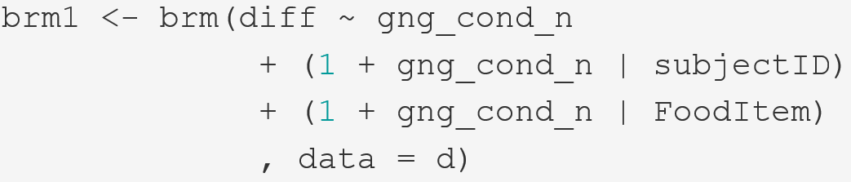

Making the switch: lme4 → brms
A few things are implicit here as they have a default setting that brm will fall back to if things are not specified:
What is the distribution of the response variable aka. model-family
- What are our priors?
How many MCMC samples do we want to collect?

Slide 39
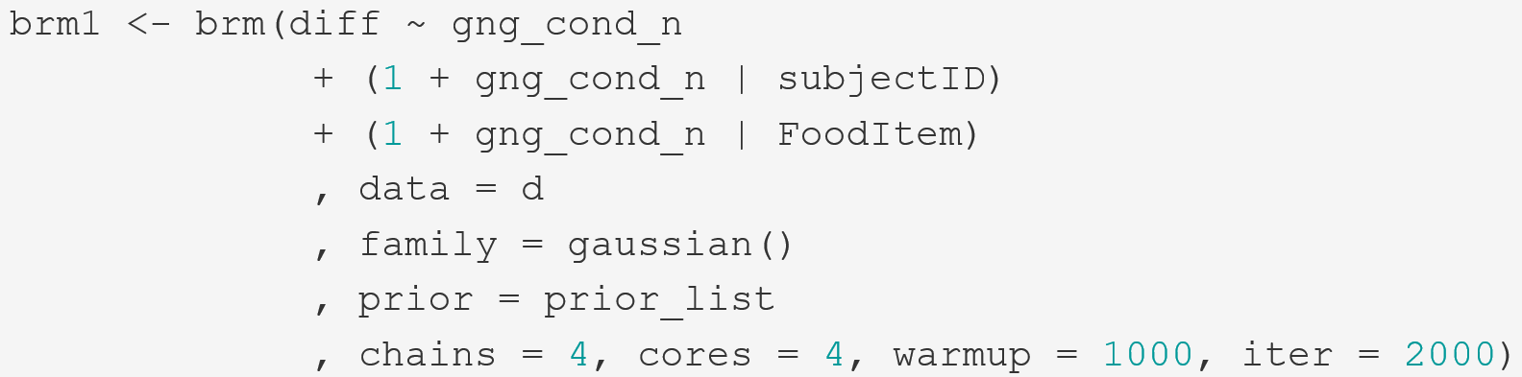
Making the switch: lme4 → brms
Fitting
Diagnostics
Evaluation

Slide 40
Priors

Slide 41
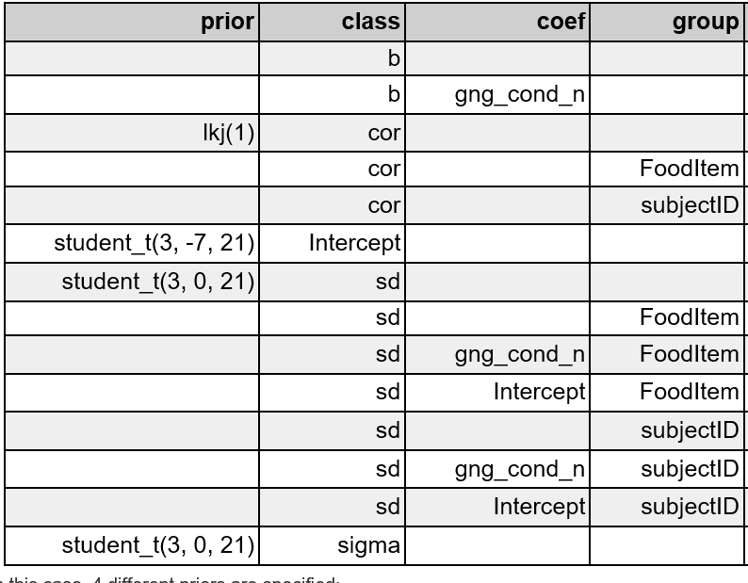
Fitting: priors
The defaults (get_prior(brm1))
Fixed effects
Random Effects
Random Correlations
Residual standard deviation
The term ‘default’ is a bit confusing here as the priors actually depend on your data and the default is only conceptually the same each time but will not numerically be the same for different data-sets / models.
What default means here:
Priors are obligatory for Bayesian inference and if you don’t dare to make at least some prior predictions about the data, then someone else has to do it!

Slide 42

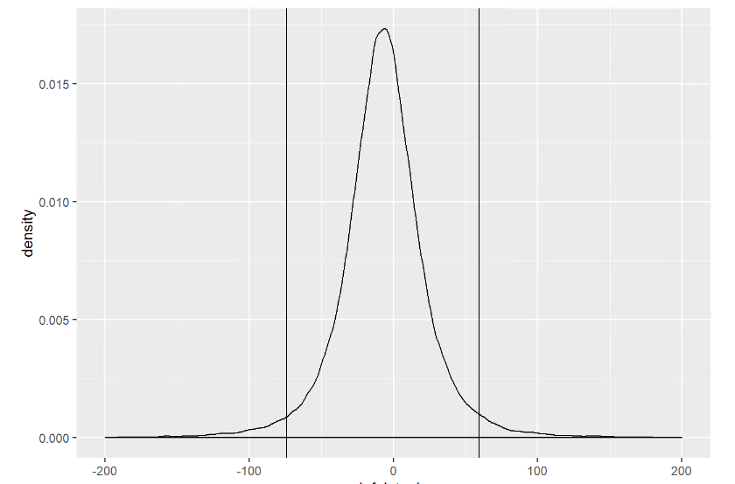
Fitting: weakly regularizing default priors
What do these priors (e.g. student-t distribution(df = 3, mean = -7, sd = 21) ‘mean’?
“before” seeing the data:
- most probable intercept value (i.e mean difference score) is -7 (i.e. the peak)
Most likely it is between ca. -75 and 60 (95% HDI)
However could also be -1000 or +1000 (not shown in graph)!
REALLY vague; We can do better than this in most cases!
E.g. we know that difference scores can only be between -200 and 200

Slide 43
Fitting: priors
Let’s do better: What do we know?
Intercept: most likely close to 0 as differences between pre- and post rating are mostly small. Can be -200 or 200 at max.
Fixed effect: go/no-go training does normally not have huge effect sizes on evaluation.
Random effects: there might be quite some individual variation between participants, probably less so for items. However, much more difficult to predict, so lets use a weakly regularizing prior (just as the default but not that weak).
Actually, we have ran quite some GNG studies in the lab, I could me much more specific than this without making very bold claims (but lets use only the above for now)…
How to specify this:
Intercept: set_prior('normal(0, 50)', class = 'Intercept’)
Fixed effect: set_prior('normal(0, 10)', class = 'b’)
Random effects: set_prior('cauchy(0, 5)', class = 'sd')

Slide 44
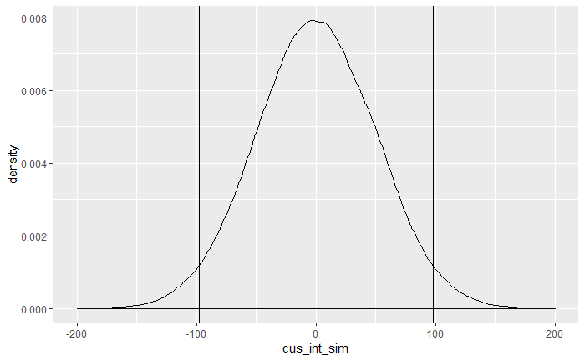
Fitting: priors
New intercept

Slide 45
Fitting
prior_list <- c(set_prior('normal(0, 50)', class = 'Intercept'),
set_prior('normal(0, 10)', class = 'b'),
set_prior('cauchy(0, 5)', class = 'sd')

Slide 46
Diagnostics

Slide 47
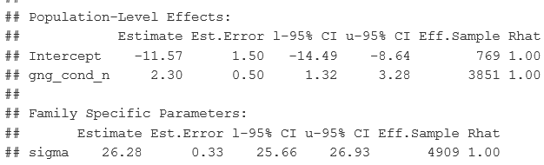
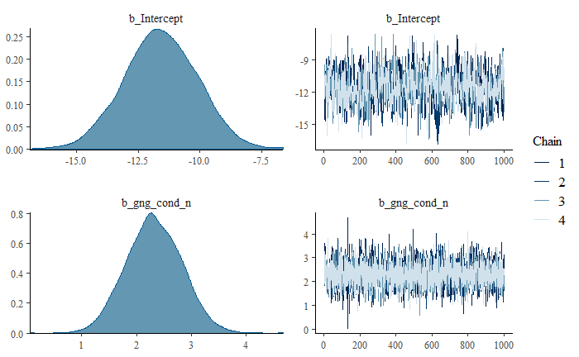
Diagnostics: Convergence
1. Did the chains mix well, i.e. did the MCMC sampling converge somewhere?
plot(brm1) summary(brm1)
Fat, hairy caterpillars
Rhat < 1.1 (or better <1.02)
Eff.Sample size is “big enough”
No divergent transitions warnings
→ If all are a “yes” you should be good

Slide 48
Diagnostics: Convergence - What if it goes wrong?
Can mostly be resolved by 2 simple changes:
Increase chain-length
Increases the „resolution“ of the HMC-sampler as some features of the target distribution might be too small to detect for the default resolution of the sampler
- control = list(adapt_delta = .99)
You can find more information on https://mc-stan.org/misc/warnings.html#divergent-transitions-after-warmup

Slide 49
Evaluation 1 - Adequacy

Slide 50
Checking adequacy
Posterior predictive check: how good does the posterior (our prior after updating it with the likelihood) represent the data?
Check for influential observations: Are there any observations that influence the posterior predictions heavily?

Slide 51
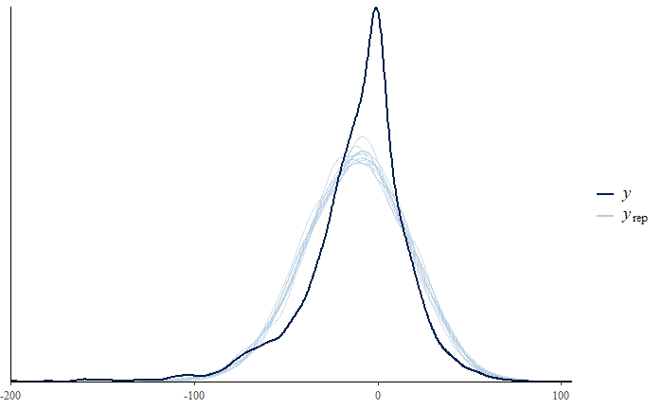
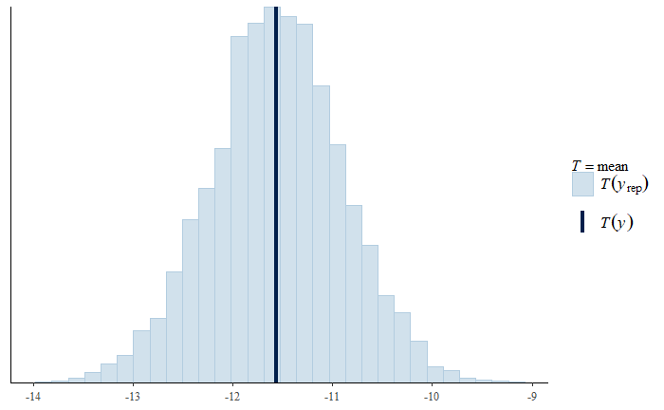
Evaluation: Adequacy – posterior predictive check
pp_check(brm1)
pp_check(brm1, type = “stat”)
Looks ok. The estimate of the mean is very close to the observed mean, and the spread of the distribution is close to the observed distribution.
However, the peak in the middle is not so well-covered in this case.

Slide 52
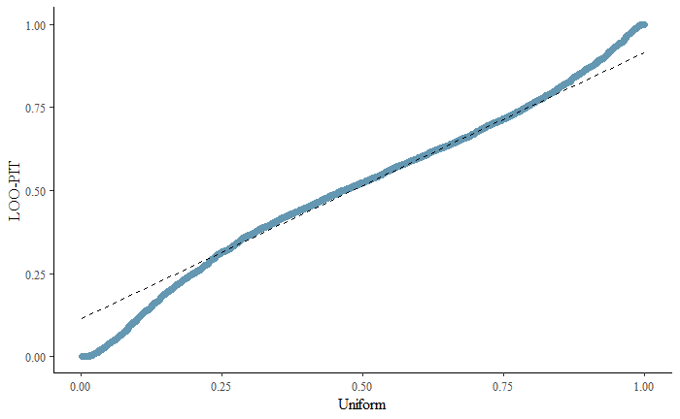
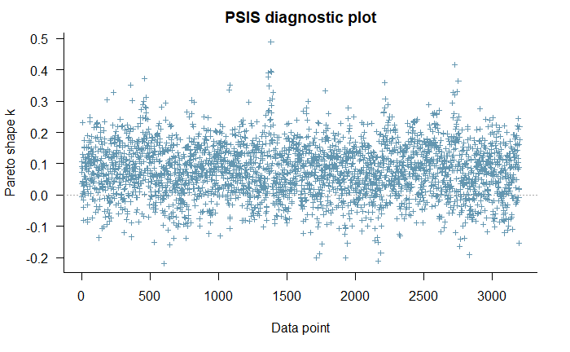
Evaluation: Adequacy
There is more we can do
- Check influential observations with loo and loo-pit qq-plot (see talk-notes)
No pareto-k samples above 0.7 and qq-plot looks quite ok.

Slide 53
Evaluation 2 - Estimation

Slide 54
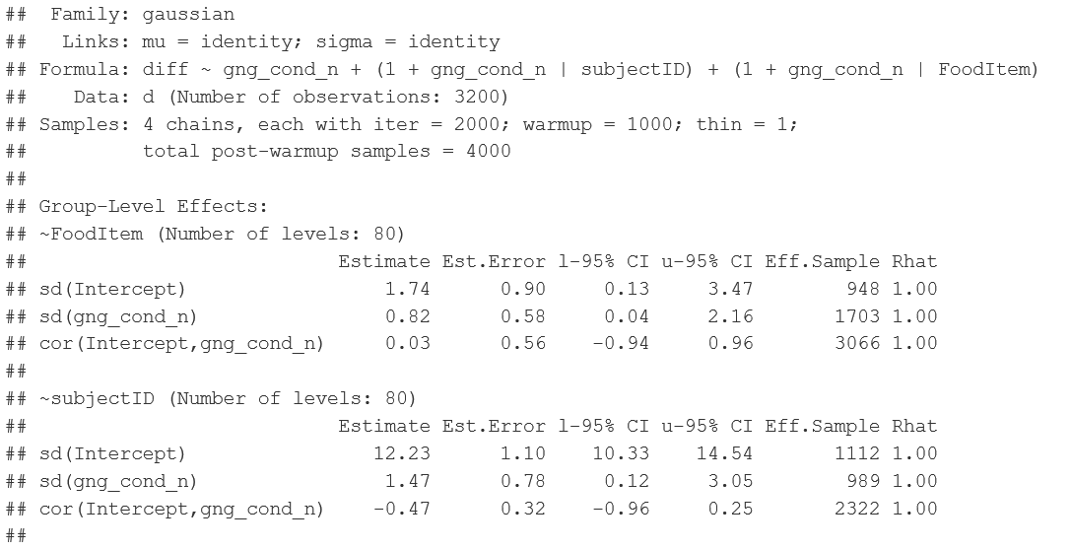
Evaluation: Estimates
Summary(brm1) #1 of 2

Slide 55
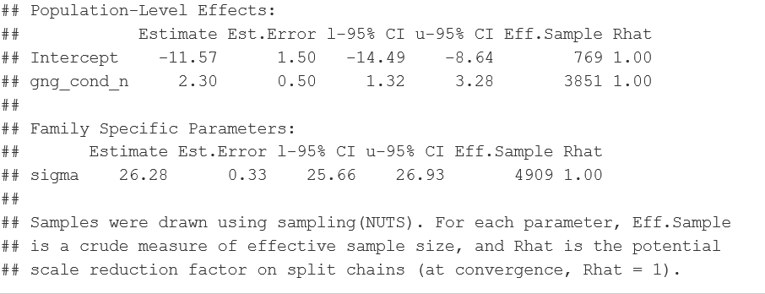
Evaluation: Estimates
Summary(brm1) #2 of 2

Slide 56
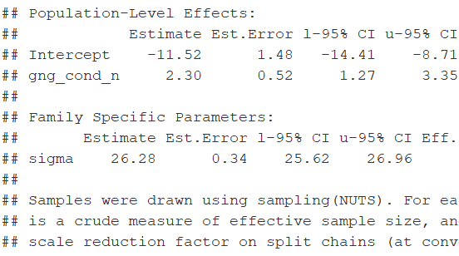
Back to priors quickly
Custom priors default priors
Almost identical!

Slide 57
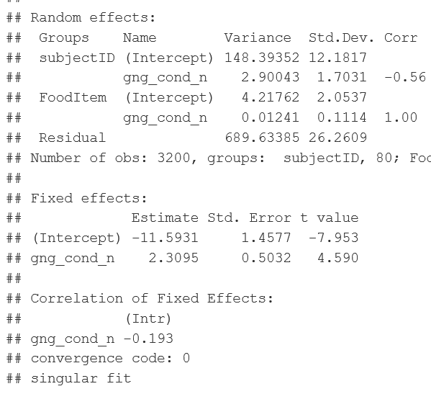
And what about lme4?
Custom priors lmer
Almost identical again… except for the correlations.

Slide 58

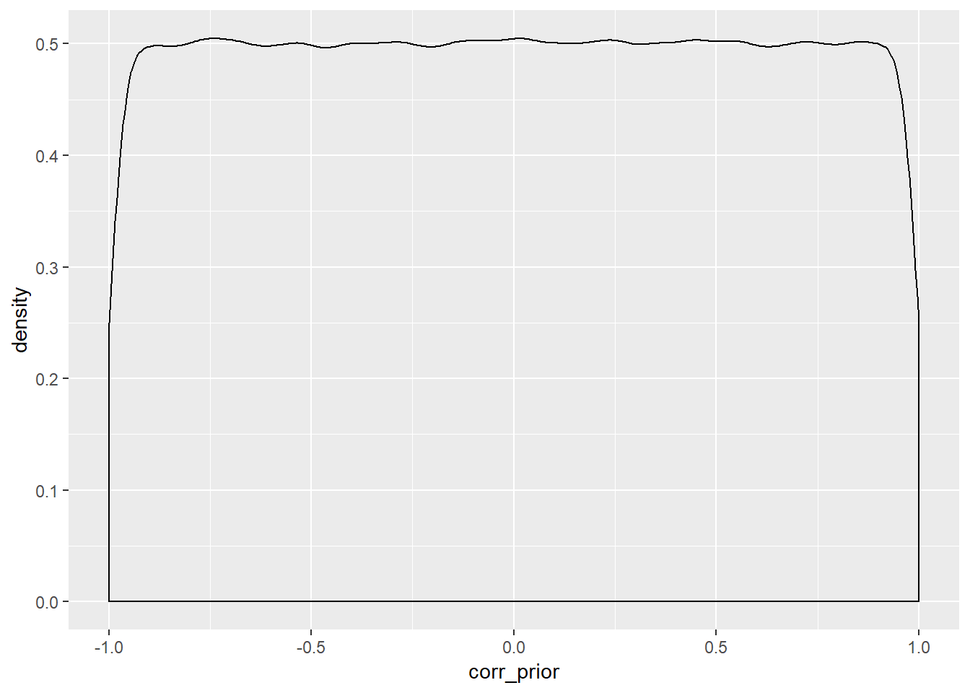
Correlations: an example of prior in – prior out
Remember that lkj(1)prior for the correlations?
This is what it looks like. And this is also what we get in the model summary:
We just do not have enough data to estimate a reliable correlation so we just get back our prior
This is also why our lme4 fit is singular.

Slide 59


Evaluation: plot the effects
marginal_effects(brm1) marginal_effects(brm1, method=“predict”)

Slide 60
Evaluation 3 - Testing

Slide 61
Evaluation: Is there an effect of condition?
What are our options here? We do not get p-values (they don’t exist/make sense in the Bayesian framework)
We can get posterior probabilities sometimes called “Bayesian p-values” that describe the proportion of the posterior that are above/below a certain value (e.g. 0).
Advantages: easy to compute, easily interpretable
Disadvantages: not trivial to do with factors that have more than 2 levels or their interactions.
We can do model comparisons based on information-criteria / quantifying predictive performance (e.g. AIC / WAIC / LOOIC / cross-validation)
Advantages: very flexible in terms of comparison (not only nested models)
Disadvantages: answering a slightly different question than what we normally want to know with significance tests (namely predictive performance)
We can calculate the Bayes-Factor (i.e. ratio of prior odds to posterior odds aka. the evidence ratio between two hypotheses)
Advantages: gives us overall “evidential value” statistic for an effect (as compared posterior probabilities)
Disadvantages: Take a lot of time and effort to compute (only stable if we increase iterations to > 10000), very dependent on prior with no clear standards of reporting yet.

Slide 62
Model Families

Slide 63

Beyond that: Model families
As said, we are not restricted to normal models, and can also e.g. fit a student-t distribution on the response data:

Slide 64

Beyond that: Model families
In this case, estimates do only change slightly but model-fit and predictive performance increase drastically (see notes).

Slide 65
Reading List
BRMS:
The standard intro to brms by Paul Bürkner: https://cran.r-project.org/web/packages/brms/vignettes/brms_overview.pdf
Another intro to brms by Paul Bürkner: https://cran.r-project.org/web/packages/brms/vignettes/brms_multilevel.pdf
Intro by Rens van der Schoot: https://www.rensvandeschoot.com/tutorials/brms/
STAN more generally:
Bayesian Workflow: Toward a principled Bayesian workflow in cognitive science (Shad, Betancourt, & Vasishth, 2019) https://osf.io/xs4zg/
Model-families: https://cran.r-project.org/web/packages/brms/vignettes/brms_families.html#beta-models and https://rdrr.io/cran/brms/man/brmsfamily.html
Bayesian stats in general (great book!): http://xcelab.net/rmpubs/sr2/statisticalrethinking2.pdf
https://bookdown.org/ajkurz/Statistical_Rethinking_recoded/ provides the book code chunks and exercises recoded in tydiverse and brms
Q & A:
Stay tuned and ask questions: https://discourse.mc-stan.org/c/interfaces/brms
Andrew Gelman‘s blog: https://statmodeling.stat.columbia.edu/
MCMCs:
Explanation and visualization of MCMCs by Richard McElreath: http://elevanth.org/blog/2017/11/28/build-a-better-markov-chain/
Visualization of MCMCs by Chi Feng: https://chi-feng.github.io/mcmc-demo/

