Slide 1
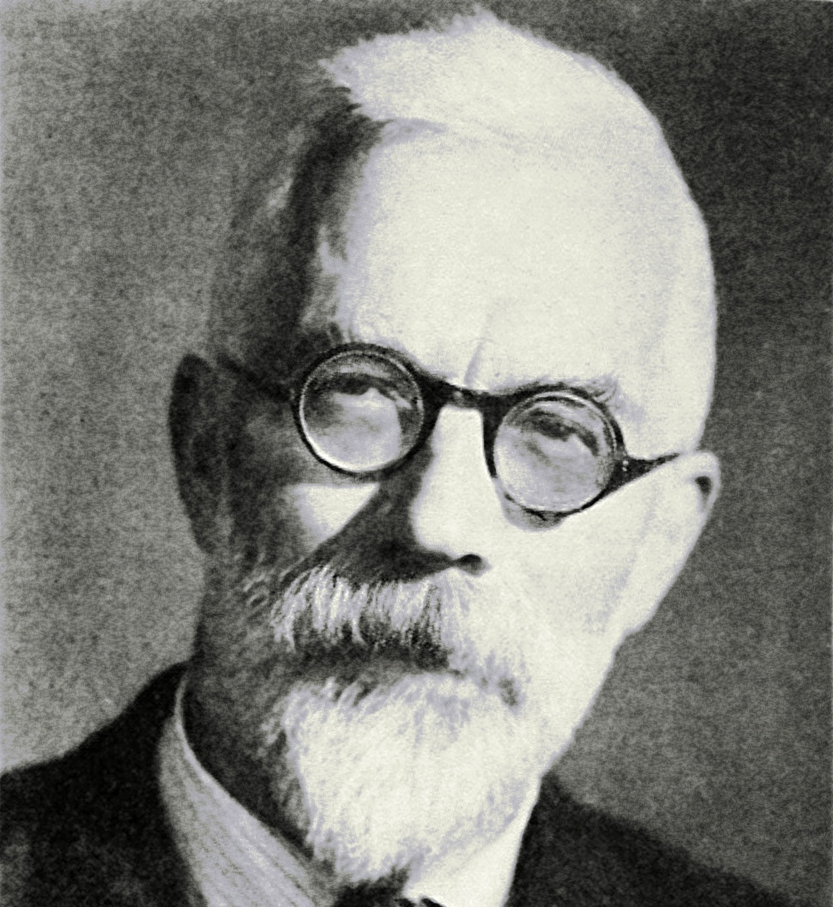

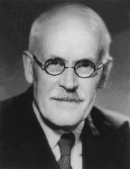
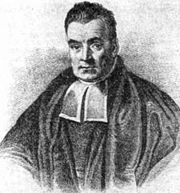
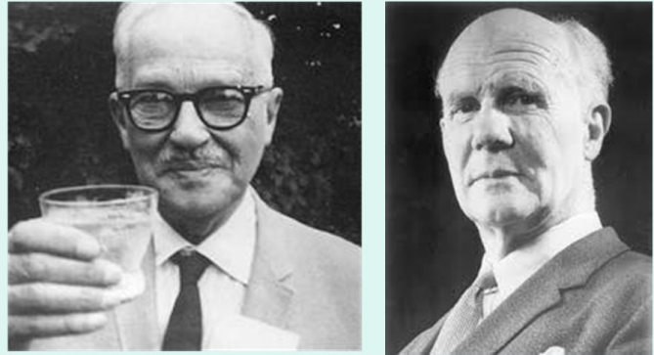
Extending the Statistical Toolbox: P-values, Bayes Factors and Beyond Julian Quandt

Slide 2

Extending the Statistical Toolbox: P-values, Bayes Factors and Beyond
Overview
Option 1
The Frequentist Method and NHST
The Bayesian Method and Bayes Factors
Beyond Bayes Factors and p-values
Why Bayesian is better
Option 2
How to go Bayesian with mixed-effects models in brms

Slide 3
Quick Reminder: Null-Hypothesis Significance Testing (NHST)
The Frequentist method in a nutshell
Question: What is the sex ratio in the Netherlands?
We define a null-hypothesis (e.g. the percentage of women in NL is 50%)
Assuming H0 is true, we test whether our sample is extreme considering the entire population of possible samples that we could have observed (i.e. the sampling distribution)
We conclude that we cannot assume H0 is true if the probability of getting such a sample is sufficiently small (e.g. p < .05) or we conclude that the data are not too unlikely if H0 is true.

Slide 4
Some of the problems with NHST
The selective conclusion problem: We cannot find evidence for the null-hypothesis with p-values, people who want to draw conclusions are nudged towards p-hacking.
We need a method that that allows us to directly compare H0 and H1!
The sequential sampling problem: We want to be able to monitor the evidence during data-collection until we are satisfied with the conclusion. P-values do not allow us to do this, as they will always support H1 eventually.
Stopping Data-Collection should be based on sufficient evidence, not a-priori assumptions about effect-size and power.

Slide 5
Bayesian Statistics

Slide 6
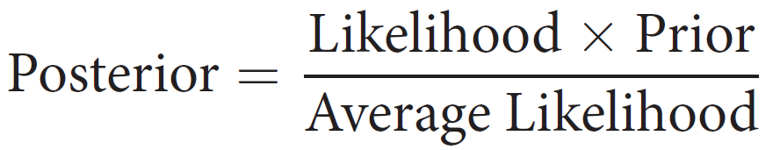
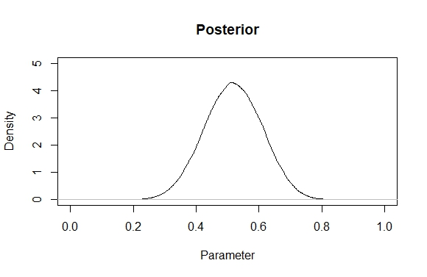
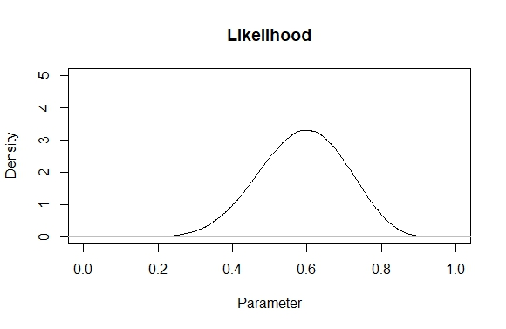
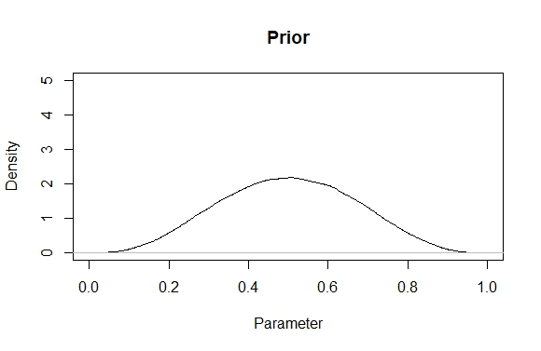
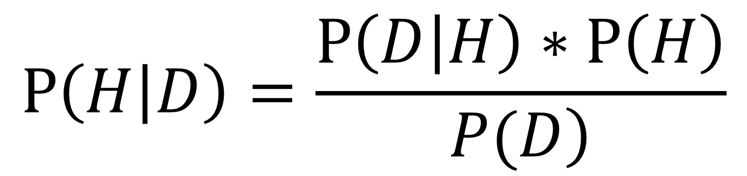
Bayes Theorem
$$P\left(H | D\right)=\frac{P\left(D | H\right)∗P\left(H\right)}{\left.P(D\right)}$$
Assume a data-generating process, e.g. $Sex =gender ratio in NL+ε$
Data: W,W,W,W,W,W,M,M,M,M

Slide 7
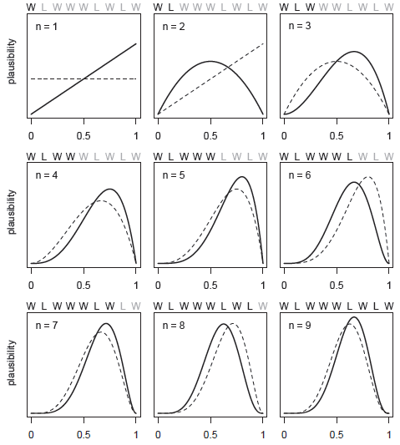
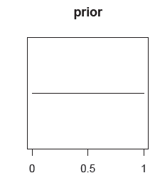
McElreath, R. (2018). Statistical rethinking: A Bayesian course with examples in R and Stan. Chapman and Hall/CRC.

Slide 8
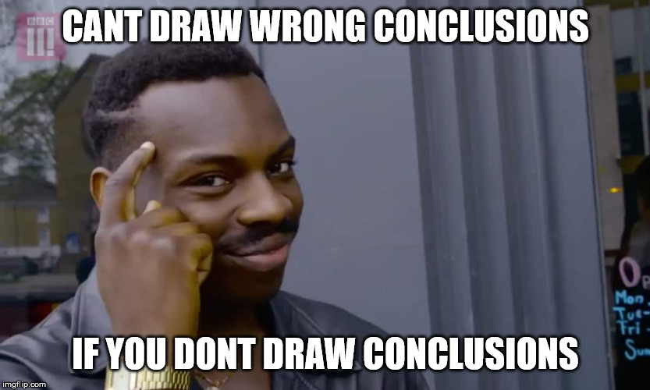
Bayesian Statistics in a nutshell
Come up with a prior that reflects your hypothesis
What we are interested in is expressing our belief about the world in posterior distributions.
Data are what they, just show the posterior.

Slide 9
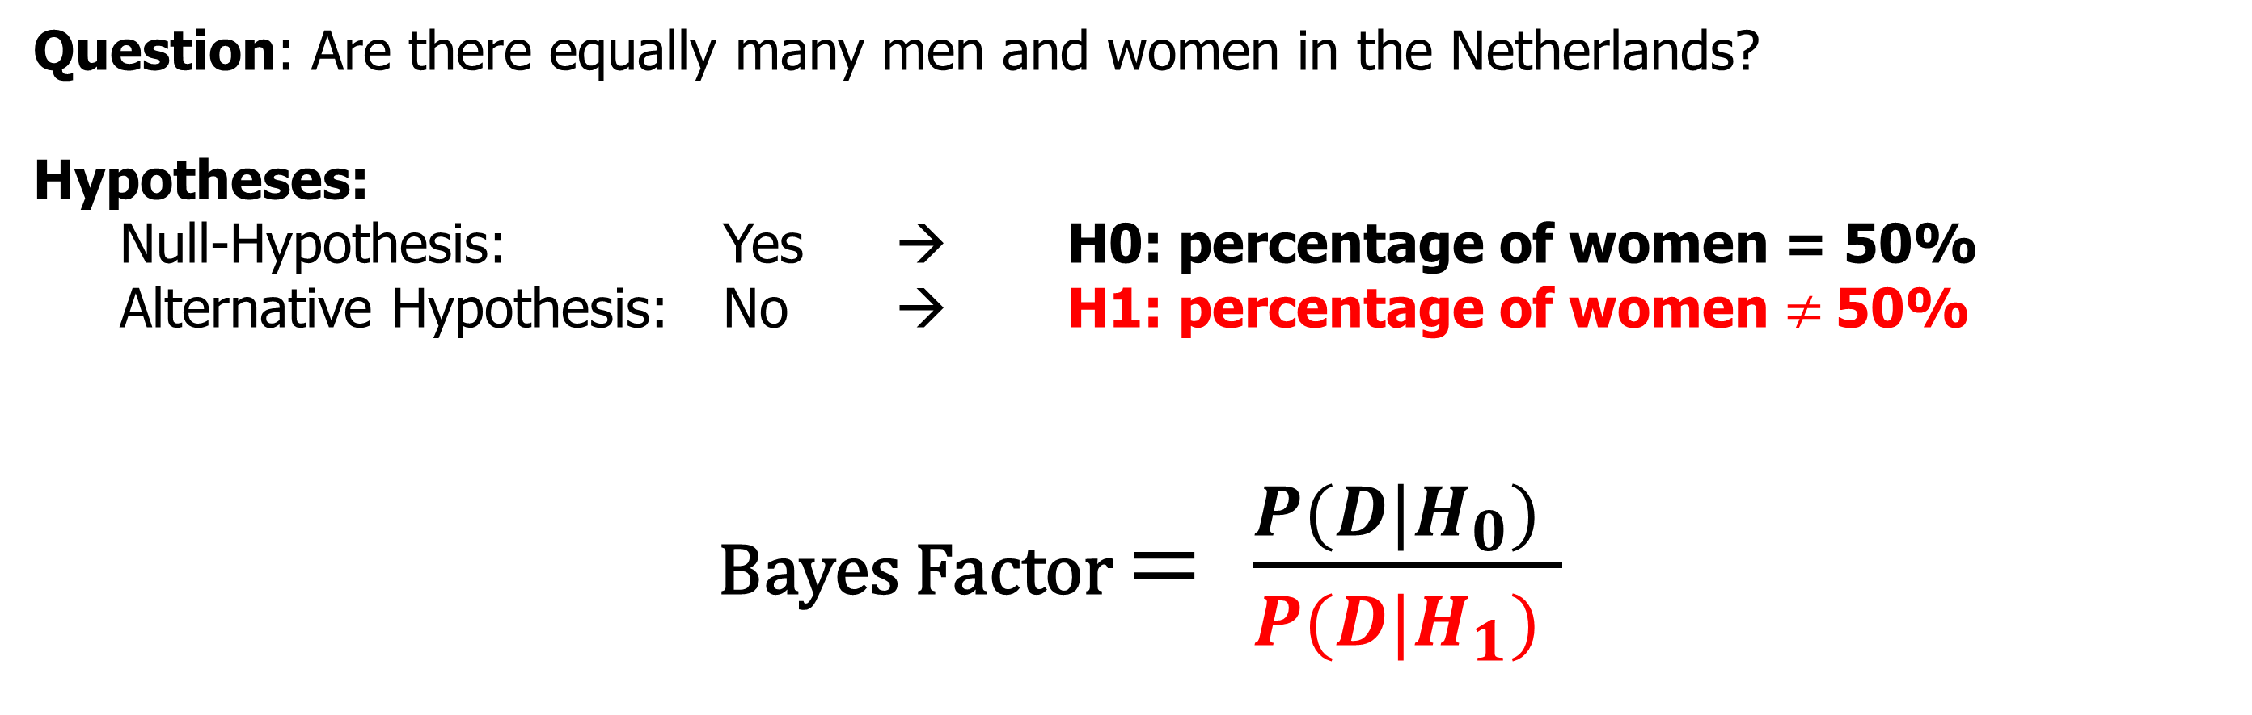
The Bayes Factor: How a Bayesian might evaluate Hypotheses
Question: Are there equally many men and women in the Netherlands?
Hypotheses:
Null-Hypothesis: Yes → H0: percentage of women = 50%
Alternative Hypothesis: No → H1: percentage of women $≠$50%
Bayes Factor $= \frac{P(D|H_{0}) }{P(D|H_{1}) }$

Slide 10
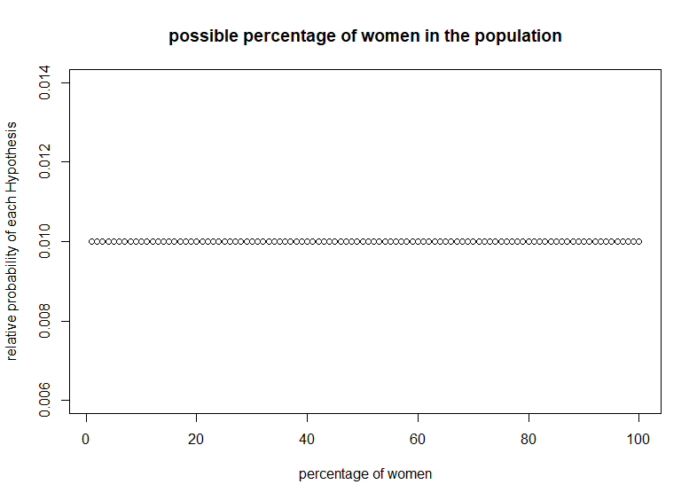
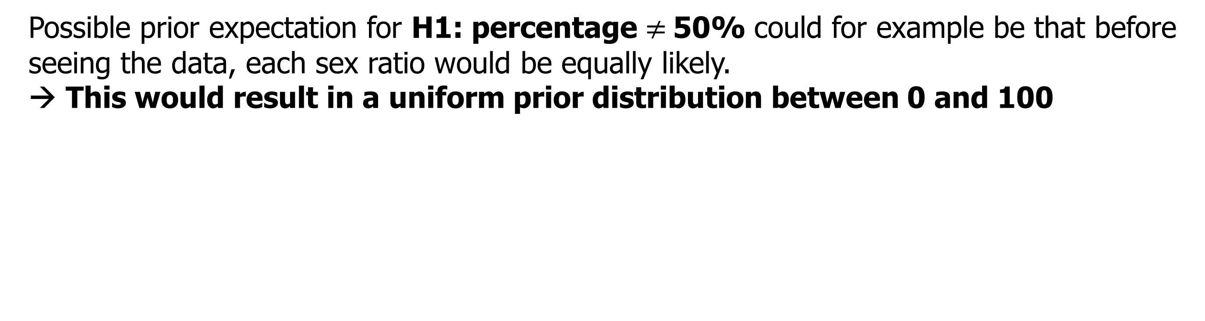
Priors
Possible prior expectation for H1: percentage $≠$50% could for example be that before seeing the data, each sex ratio would be equally likely.
→ This would result in a uniform prior distribution between 0 and 100
$\frac{P(D|H_{0}) }{P(D|H_{1}) }$ = $\frac{P(60 women|Sex Ratio=50\%) }{P(60 women|Sex Ratio=Uniform\left[0,100\right]) }$= $\frac{0.011}{0.010}$ = 1.1

Slide 11
The Bayesians critique of NHST
The selective conclusion problem: We cannot find evidence for the null-hypothesis with p-values, people who want to draw conclusions are nudged towards p-hacking.
We need a method that that allows us to directly compare H0 and H1!
We can express evidence in either direction:
or
$\frac{P(D|H_{0}) }{P(D|H_{1}) }$ = $\frac{P(60 women|Sex Ratio=50\%) }{P(60 women|Sex Ratio=Uniform\left[0,100\right]) }$= $\frac{0.011}{0.010}$ = 1.1
$\frac{P(D|H_{1}) }{P(D|H_{0}) }$ = $\frac{P(60 women|Sex Ratio=Uniform\left[0,100\right]) }{P(60 women|Sex Ratio=50\%) }$= $\frac{0.010}{0.011}$ = 0.91

Slide 12
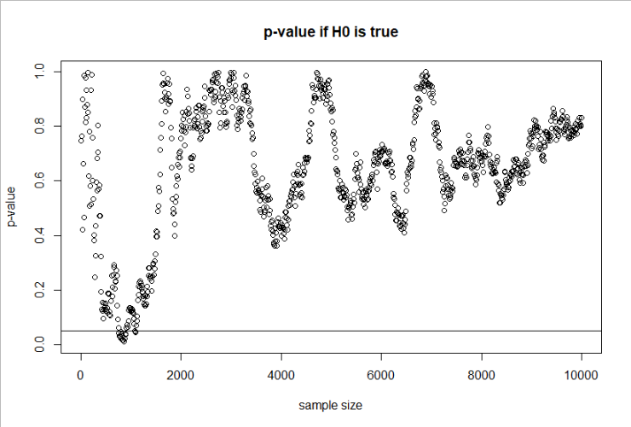
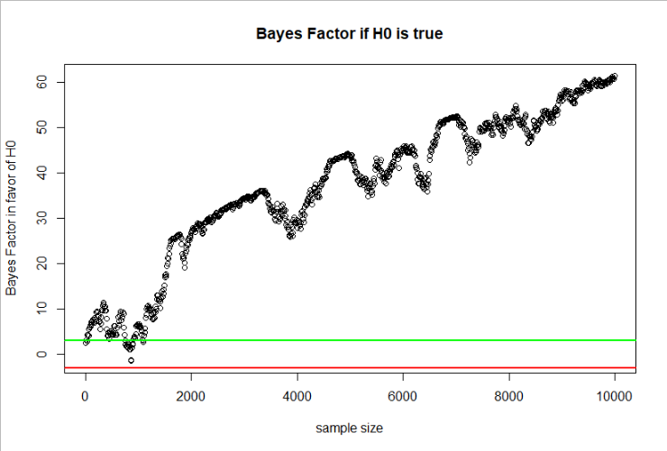
How does the Bayes Factor solve problems? - Example
The sequential sampling problem: We want to be able to monitor the evidence during data-collection until we are satisfied with the conclusion. P-values do not allow us to do this, as they will always support H1 eventually.
Stopping Data-Collection should be based on sufficient evidence, not a-priori assumptions about effect-size and power.
→ The BF allows us to draw the right conclusion here

Slide 13
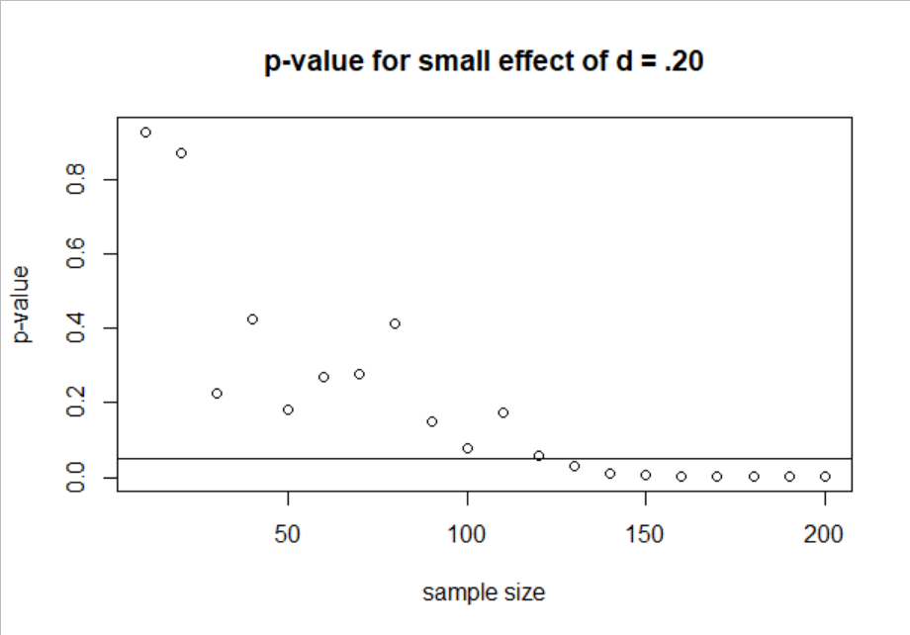
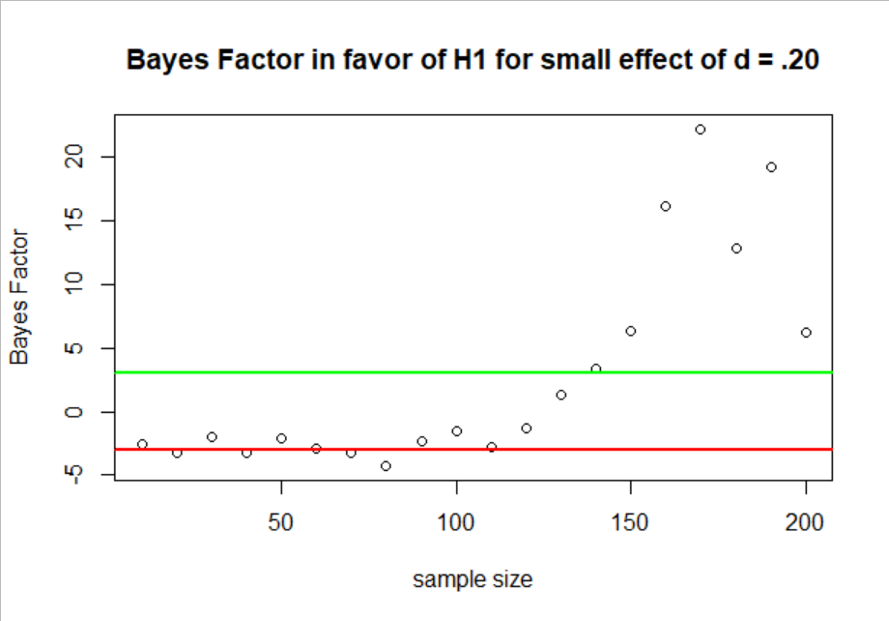
Are Bayes Factors objectively better then?
Bayes Factors might seem superior at this point but they also come with their own problems
Which priors should be used? Good defaults have been suggested but they are often quite conservative.
We can even draw another kind of wrong conclusion, i.e. accepting the null if H1 is true!
They do not solve the problem of decision thresholds – there is no free lunch!.
Optional Stopping based on BF will systematically bias parameter estimates!
For everything beyond t-tests and one-way ANOVA they get very difficult to compute and are not readily implemented in software packages (Specifying a prior on the log-scale of the raw effect when analyzing reaction-times is not very straightforward).
The good news is however, if you don’t want Bayes Factors, priors often do not matter so much!

Slide 14
Beyond p-values and Bayes Factors
Why should we want arbitrary decision thresholds to claim ground truth?
1. We know that research always involves a lot of degrees of freedom.
Multiverse Analysis
2. We should embrace the uncertainty about our inferences instead of forcing them to be binary (i.e. accept / reject).
Confidence intervals, Credible Intervals, Hypotheses Charts
3. The end-goal of psychological research should be to develop theories that will be able to make predictions about effect-sizes than claiming only presence or absence of an effect.
Parameter Estimation instead of Hypothesis Testing

Slide 15
Why Bayesian Statistics is better
It naturally embraces uncertainty as it is all about uncertainty!
Because it has priors!
Often the point is not putting previous effect sizes into the model but just common sense.
If my outcome is measured on a 7-point Likert Scale, the effect of a manipulation cannot be 8 points on the outcome. → prior distribution between 0 and 7
If my outcome is reaction times on an AAT, they will probably be only very few with more than 10 seconds.
We know a lot more about our data than we tend to think! Share your knowledge with your statistical model!
For complex models, such as mixed-effect models, this often makes the difference between not getting an answer (convergence problems) in Frequentist mixed-models and not the slightest problem in Bayesian mixed-models.

Slide 16
Why Bayesian Statistics is better
2. Almost no restrictions in what we want to do! The brms package in R allows you do to almost everything you’d ever need!
Multivariate Mixed-Effect Models
Mediation in Mixed-Effect Models
Simple Structural Equation Models
Dozens of different outcome distributions/model families are possible!
Think about how your outcome might look like! (normal, lognormal, poisson, binomial, beta, gamma…)
You can even use mixtures of these outcome distributions
Outliers can often be kept in the model instead of having to be deleted – this gives us more stable inferences!
Fit cognitive models such as drift diffusion models

Slide 17
brms : bayesian regression models in stan as an alternative to mixed-models in lme4

Slide 18
lme4 vs. brms: few words on practical differences
Why brms:
If you prefer a Bayesian philosophy over the frequentist one
If you have domain-knowledge about the research-question and what you might expect, you can directly put it into the model via the priors
Can handle complex models with thousands of parameters that would (probably) be very difficult to fit in maximum likelihood (lme4) → no need for simplifying a maximal model
brms is very flexible and can already handle various non-normal models, (negative; zero inflated) binomial, cumulative, exponential, lognormal, multinomial, drift- diffusion/wiener and many more and it’s even possible to define custom model families in STAN!

Slide 19
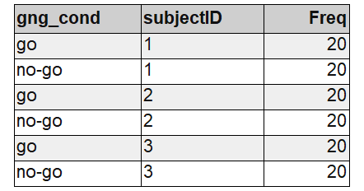
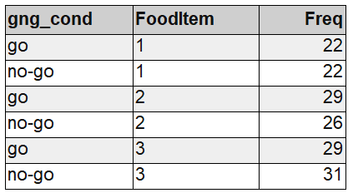
Example: Go/No-Go training data
Example data:
80 people rate 40 food items before and after an experimental (within-subject) manipulation (go/no-go training)
DV: difference score between ratings (post-pre)
IV: training condition of item (go / no-go)

Slide 20
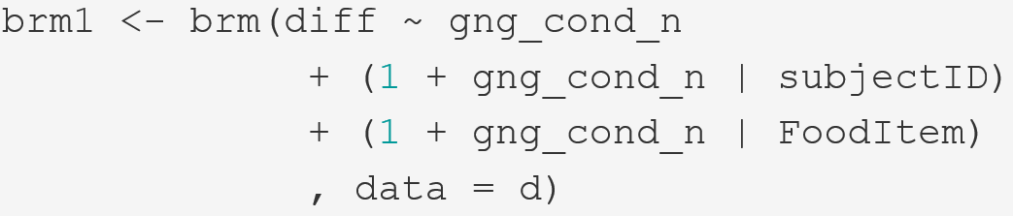
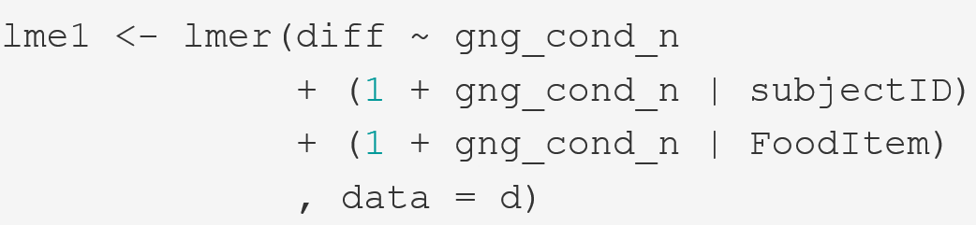

Making the switch: lme4 → brms
A few things are implicit here as they have a default setting that brm will fall back to if things are not specified:
What is the distribution of the response variable aka. model-family
- What are our priors?
How many MCMC samples do we want to collect?

Slide 21
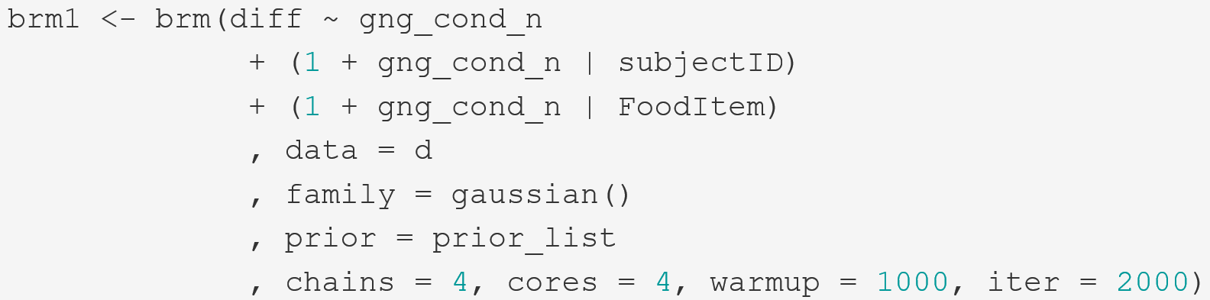
Making the switch: lme4 → brms

Slide 22
Priors

Slide 23
Priors
Priors are one of the most important parts of Bayesian statistics.
They allow us to add information such as domain expertise to the model
They allow us to regularize our inference (more on this later)
They are also the most criticized part of Bayesian statistics.
They make statistical inference dependent on subjective opinions!
What if I do not agree with your prior?

Slide 24
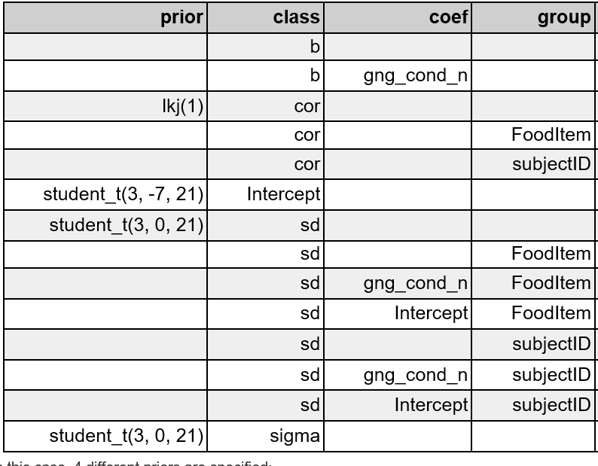
The default priors
Fixed effects
Random Effects
Random Correlations
Residual standard deviation
Priors are obligatory for Bayesian inference and if you don’t dare to make at least some prior brms will use one that is not optimal but at least not too daring.

Slide 25

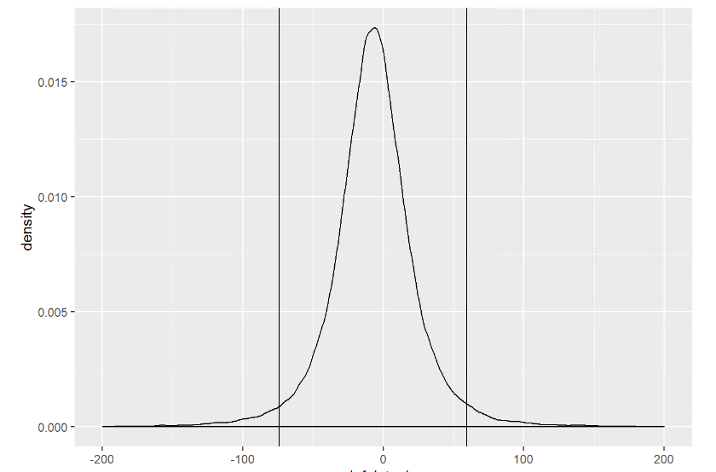
weakly regularizing default priors
- most probable intercept value (i.e mean difference score) is -7 (i.e. the peak based on the data)
Most likely it is between ca. -75 and 60 (95% HDI)
However could also be -1000 or +1000 (not shown in graph)!
REALLY vague; We can do better than this in most cases!
E.g. we know that difference scores can only be between -200 and 200

Slide 26
Fitting: priors
Let’s do better: What do we know?
Intercept: most likely close to 0 as differences between pre- and post rating are mostly small. Can be -200 or 200 at max.
Fixed effect: go/no-go training does normally not have huge effect sizes on evaluation.
Random effects: Here it might be difficult to know in advance so we will just use something that does not make any strong predictions.
How to specify this:
Intercept: Normal distribution µ = 0, σ = 50
Fixed effect: Normal distribution µ = 0, σ = 10
Random effects: Normal distribution, µ = 0, σ = 50

Slide 27
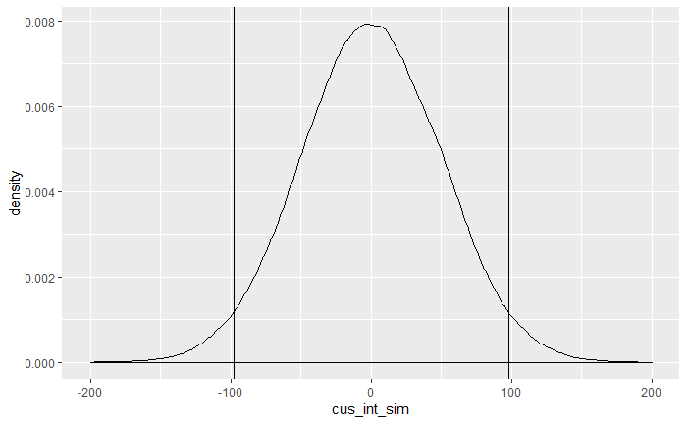
Fitting: priors
How does this new intercept prior look like?

Slide 28
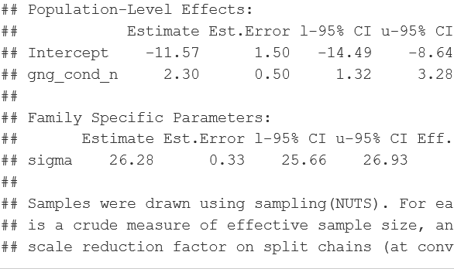
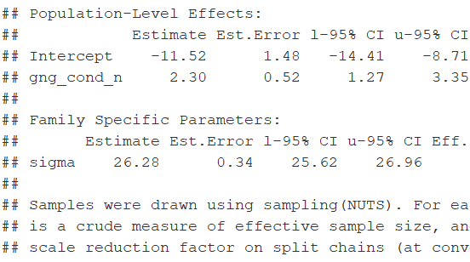
The influence of priors
Custom priors default priors
Take home message: Priors do not matter in most parameter-estimation cases with enough data. However, they can still be very useful to make the fitting easier and more efficient and you should not just ignore them.
If you want to calculate Bayes Factors, they are really, really important!

Slide 29
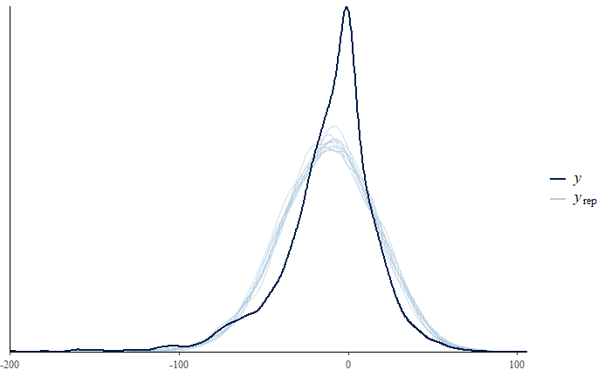
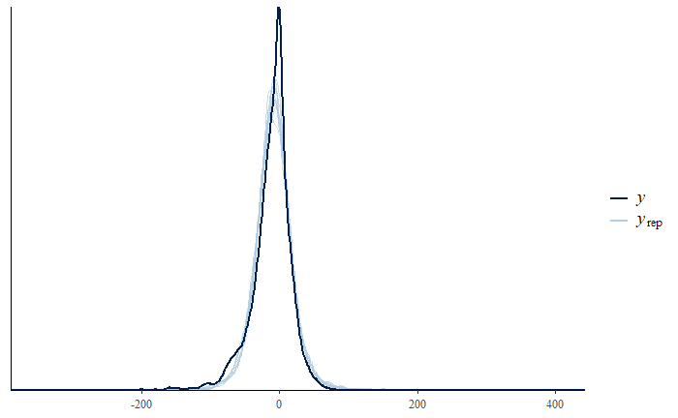
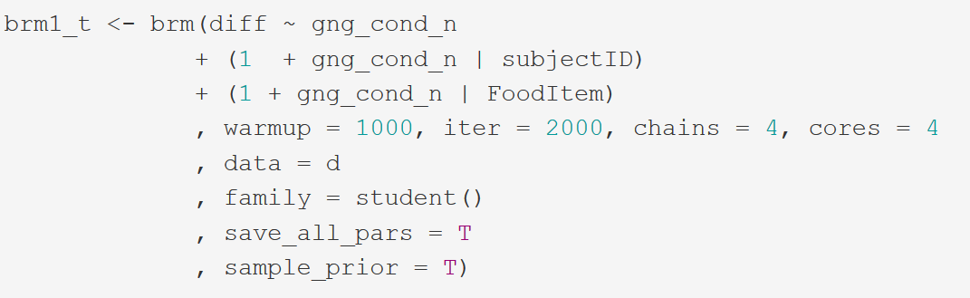
Do we have the right model family? – Posterior Predictive Checks
Looks ok. However, the peak in the middle is not so well-covered in this case.
… but can be better: For example what if we model the difference scores as a student-t distribution?

Slide 30
Why is brms better than lme4?
Almost no restrictions in what we want to do! The brms package in R allows you do to almost everything you’d ever need!
Multivariate Mixed models
Mediation in Mixed-Effect Models
Simple Structural Equation Models
Dozens of different outcome distributions/model families are possible!
Think about how your outcome might look like! (normal, lognormal, poisson, binomial, beta, gamma…)
You can even use mixtures of these outcome distributions
Outliers can often be kept in the model instead of having to be deleted – this gives us more stable inferences!
Fit cognitive models such as drift diffusion models
No annoying convergence problems, and model diagnostic if something goes wrong is much more straightforward.

Slide 31
How do we test our hypothesis?

Slide 32
Evaluation: Is there an effect of condition?
What are our options here? We do not get p-values (they don’t exist/make sense in the Bayesian framework)
We can get posterior probabilities sometimes called “Bayesian p-values” that describe the proportion of the posterior that are above/below a certain value (e.g. 0).
Advantages: easy to compute, easily interpretable
Disadvantages: no overall p-value for factors that have more than 2 levels or their interactions.
We can do model comparisons based on information-criteria / quantifying predictive performance (e.g. AIC / WAIC / LOOIC / cross-validation)
Advantages: very flexible in terms of comparison (not only nested models)
Disadvantages: answering a slightly different question than what we normally want to know with significance tests (namely predictive performance)
We can calculate the Bayes-Factor (i.e. ratio of prior odds to posterior odds aka. the evidence ratio between two hypotheses)
Advantages: gives us overall “evidential value” statistic for an effect (as compared posterior probabilities)
Disadvantages: Take a lot of time and effort to compute (only stable if we increase iterations to > 10000), very dependent on prior with no clear standards of reporting yet.

