Slide 1

Thank you for participating in a study that uses eye-tracking technology! This brief manual has been designed to guide you through the preparation for an eye-tracking session.
To ensure everything runs smoothly, please read the instructions carefully before starting.
This manual explains...
1) ...what is eye tracking?
2) ...what is important to consider before and during eye tracking?
3) ...how to calibrate the eye-tracking device?
You can go back and forth through the instructions by using the keyboard. Press the right arrow key to go to the next screen, and the left arrow key to go back to a previous screen to read it again.

Slide 2
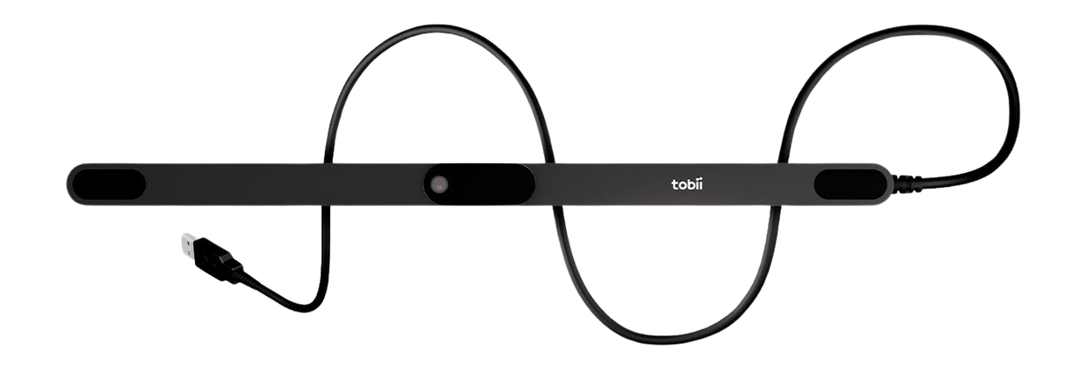
1) WHAT IS EYE TRACKING?
The eye-tracker is a small black bar placed at the bottom of your screen.
It measures where you are looking on the computer screen throughout the study.

Slide 3
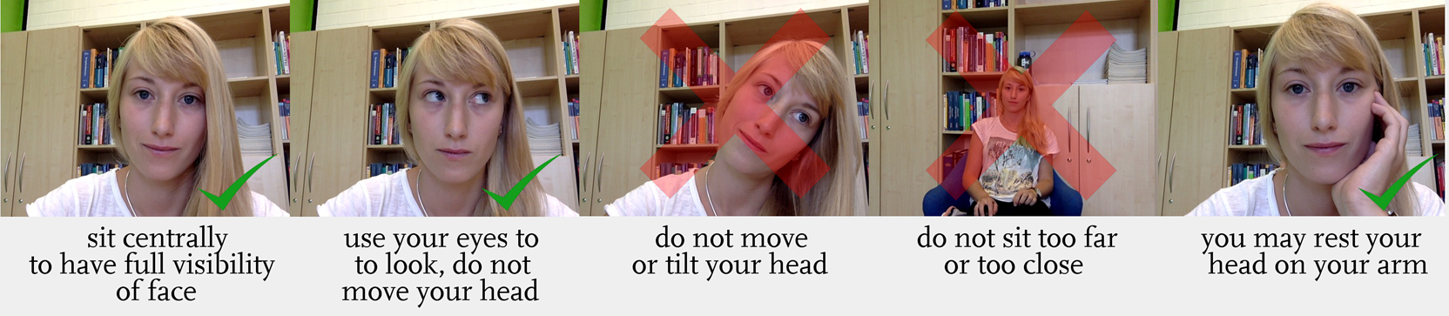
2) WHAT IS IMPORTANT TO CONSIDER BEFORE AND DURING EYE TRACKING?
Before we begin, take a moment to find a relaxed position that will allow you to stay still and focused throughout the whole study. Ensure that you are seated comfortably with your back supported and your feet flat on the floor.

Slide 4



3) HOW TO CALIBRATE THE EYE-TRACKING DEVICE?
Before the study starts, the eye-tracker has to be calibrated to your eyes through a three-step procedure.
STEP 1: HEAD POSITION CALIBRATION
In the first step, it is crucial that your head is positioned correctly. You will see two face masks: the black face mask will be fixed at the ideal position for eye tracking and your task will be to align the blue face mask with it as closely as possible. Once the masks are aligned, the background turns green.
too close
too far
perfect distance
DISTANCE FROM THE SCREEN

Slide 5
too far left
too far right
perfect position
HORIZONTAL HEAD POSITION
too high
too low
perfect position
VERTICAL HEAD POSITION
Once the background of the screen turns green, keep your head in this position. You may press the SPACE bar to continue to the second step. Make sure to move your head as little as possible for the rest of the study.

Slide 6




STEP 2: EYE MOVEMENT CALIBRATION
In the second step, the eye tracker will calibrate itself to your eye movements.
You will see a grey dot on the screen that will move to different positions. Keep your eyes fixed at the dot at all times.
1
1
1
3
2
2

Slide 7

STEP 3: EYE MOVEMENT VALIDATION
In the last step, the eye tracker will validate that it can track your eyes correctly.
For this, another green dot will appear, that you follow with your eyes, just like in the previous step.
1
1
1
2
2
3
In the end, you will be told whether the calibration has succeeded or not.
In case the procedure has not succeeded for some reason, you will be asked to repeat the calibration. Should the calibration fail again, you will be told to raise your hand to request assistance.

Slide 8
If these instructions are clear, you can start the calibration by pressing the C key.
If you have any unresolved questions, please raise your hand to request assistance.

