Slide 1
Identifying TM Helices in Tertiary Structures
Marco Klein & Julian Späth & Julius Vetter

Slide 2
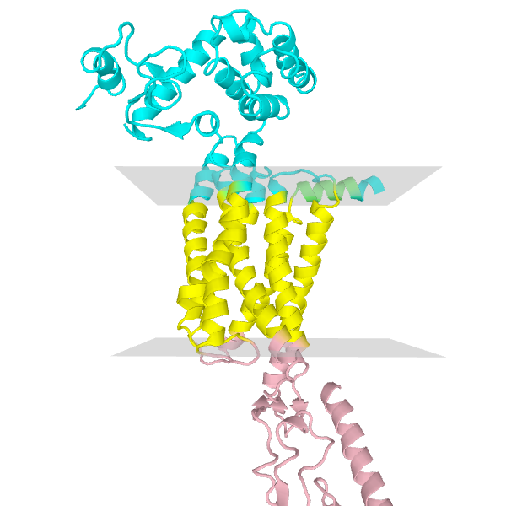
Transmembrane Proteins
Perform important physiological tasks
Molecule transport
Cell signaling
Contained substructures
Helix bundle
Beta barrel

Slide 3
Motivation
Only few determined
Not annotated in PDB
Missing membrane topology information

Slide 4
Goal
Implement classifier for transmembrane helices
Use TM helices to calculate membrane orientation
(grafik?)

Slide 5
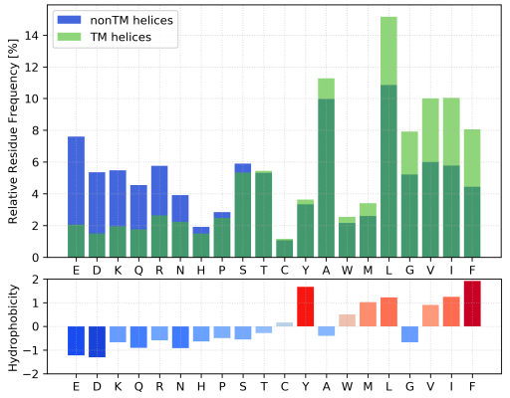
Data Preprocessing
PDBTM
Annotates transmembrane regions in TM proteins
Find overlap between annotated TM regions and helices from PDB files (70%) → positive samples
0% overlap + Helices of globular proteins → negative samples

Slide 6
Transmembrane Classification
70% Training Data vs. 30% Test Data
SVM
Features: amino acid frequencies
Linear + RBF kernel
5 fold CV

Slide 7
Classification Performance
Confusion Matrix (TP...)
Accuracy, MCC, f1-Score, Sensitivität, Spezifität

Slide 8
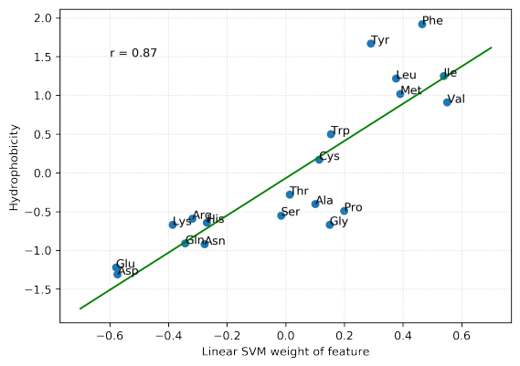
Linear SVM weights

Slide 9
Membrane geometry calculation
Calculate preliminary geometry
Filter potential FP helices using angles and distances
Normal vector of membrane = first PCA loading vector of remaining helices
Optimization
Objective function: Q-value
Hydrophobic and structural factors of protein slices
Sample test vectors in 15° cone around normal vector
Take vector with highest Q-value

Slide 10
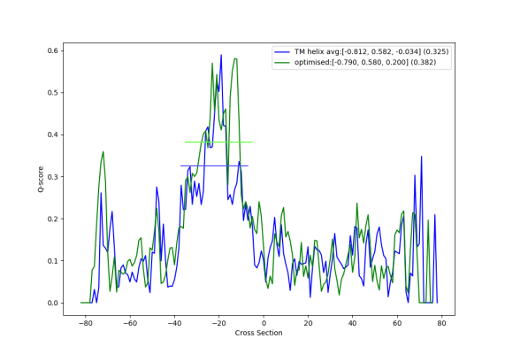
Membrane geometry calculation
Notes:
1be3

Slide 11
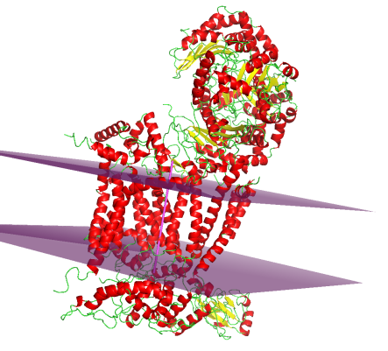
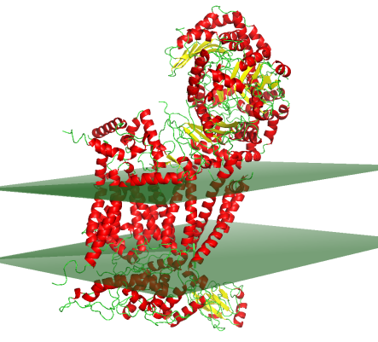
Membrane geometry calculation
Before
After
Notes:
1be3

Slide 12
Outlook
...

