Slide 1
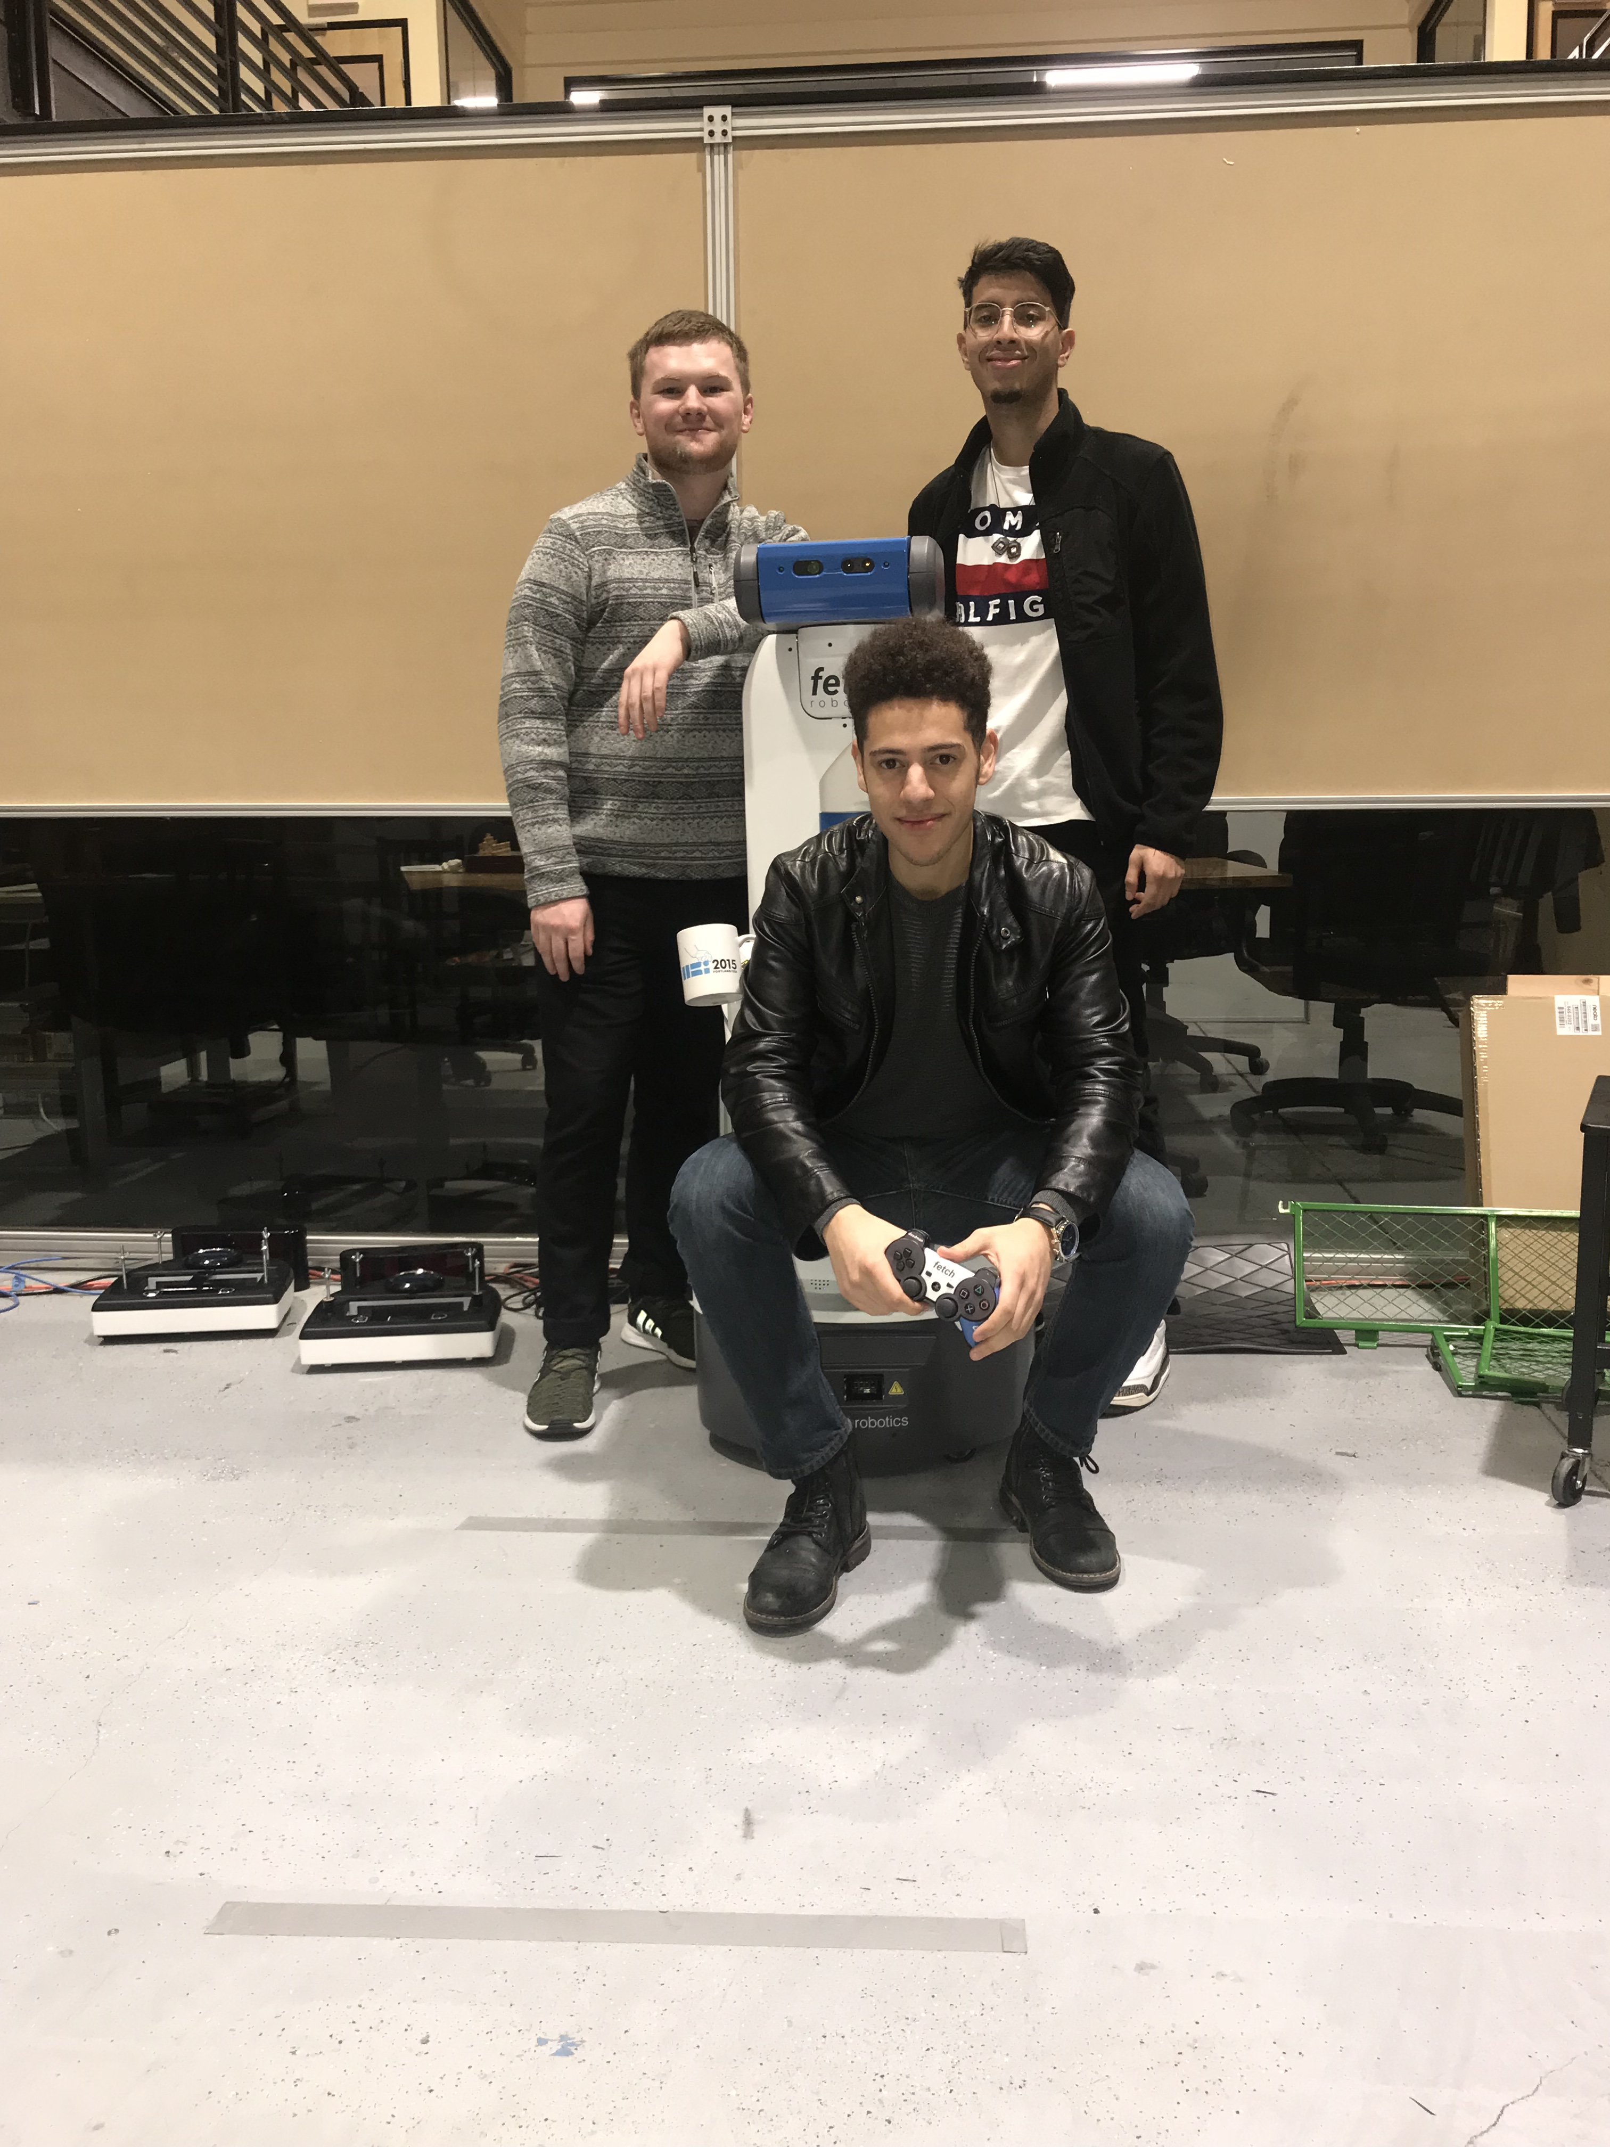
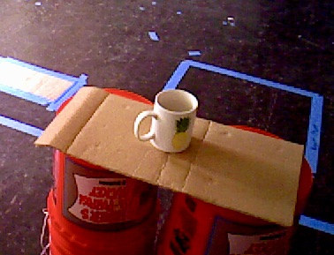

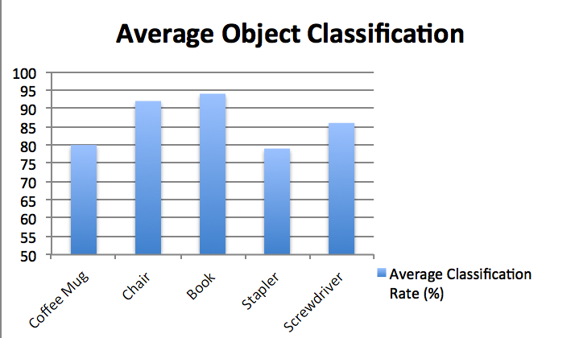
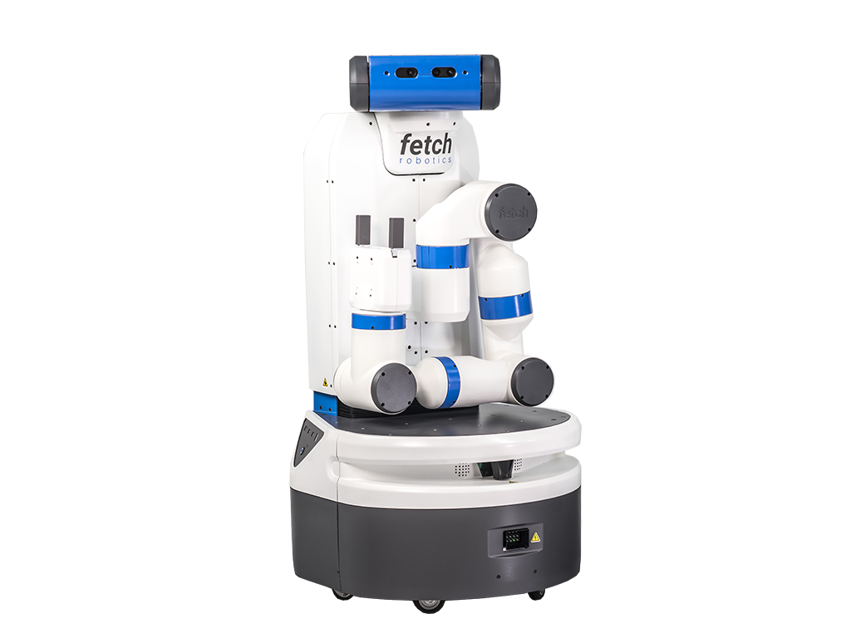
CS 67
Introduction
Online Deep Learning
For Object Recognition
on a Mobile Robot
Our project investigates the struggle to train machines to retain old information while learning new data, despite modern advancements in Neural Networks.
We are using Bandit, a Fetch mobile robot, to gather images of objects to classify. Our goal is to train Bandit to predict the class of new objects with an accuracy of 80% or higher.
Watch as our robot, Bandit, recognizes objects in the room completely on its own! Train it, show it a new object, and Bandit will correctly identify it!
Program Description
Our team implemented a software pipeline to manage interacting programs in our project. After Bandit gathers images, a collection of scripts perform data preparation, convolutional neural network (CNN) training, and object class prediction. The network is updated sequentially with new input from Bandit over time to achieve online learning.
Our classification system is initialized with general object classes to keep its predictions broad. With online learning, over time the network overfits itself to the objects it is exposed to and learns their individual features, such as logos, shapes, colors, and orientations.
With this in mind, our data set contains a variety of objects with different key features and dimensions. Individual objects have distinguishing traits Bandit can recognize, and consist of staplers, mugs, chairs, screwdrivers, and books to mimic realistic use cases.
Team From Left to Right
Miles McCall mccallm@oregonstate.edu
Julian Weisbord weisborj@oregonstate.edu
Michael Rodriguez rodrigmi@oregonstate.edu
Client
Dr. Bill Smart smartw@oregonstate.edu
Organization
Oregon State University Personal Robotics Lab
Acknowledgements
Special thanks to Chris Eriksen for helping to guide the project and assist throughout.
Background
We hypothesized that if we adjust the network model to value weights compatible with old and new data, our network will have increased efficiency adding data to its current collection.
This is based on the concept of Elastic Weight Consolidation (EWC), an important part of online learning.
Our intelligent agent is dynamically learning about its environment, making our system applicable in a range of human-assistance cases: labs, factories, offices, kitchens, etc.
Results
Conclusion
As we predicted, our model is able to classify objects with an 80+% success rate.
It is capable of identifying an object’s overarching class as well as differentiating between old and new objects.
Through online learning, the model is also able to learn new traits about previously seen objects over time.
This technology was the fundamental concept that allowed our model to efficiently and dynamically add image data to the networks current knowledge.
We demonstrated a template use case in which placeholder objects were introduced and learned over time, and are now interested in expanding these concepts to real environments.
Bandit
87%:
The average classification success rate of our finished model trained on the 5 object classes, 7% higher than our starting goal!
6 hours:
The average training time of our model with 500 images on an Nvidia GeForce GTX 970 GPU.
Who am I?
Mobile Robot
Intelligent Agent
Good Boy

