Slide 1
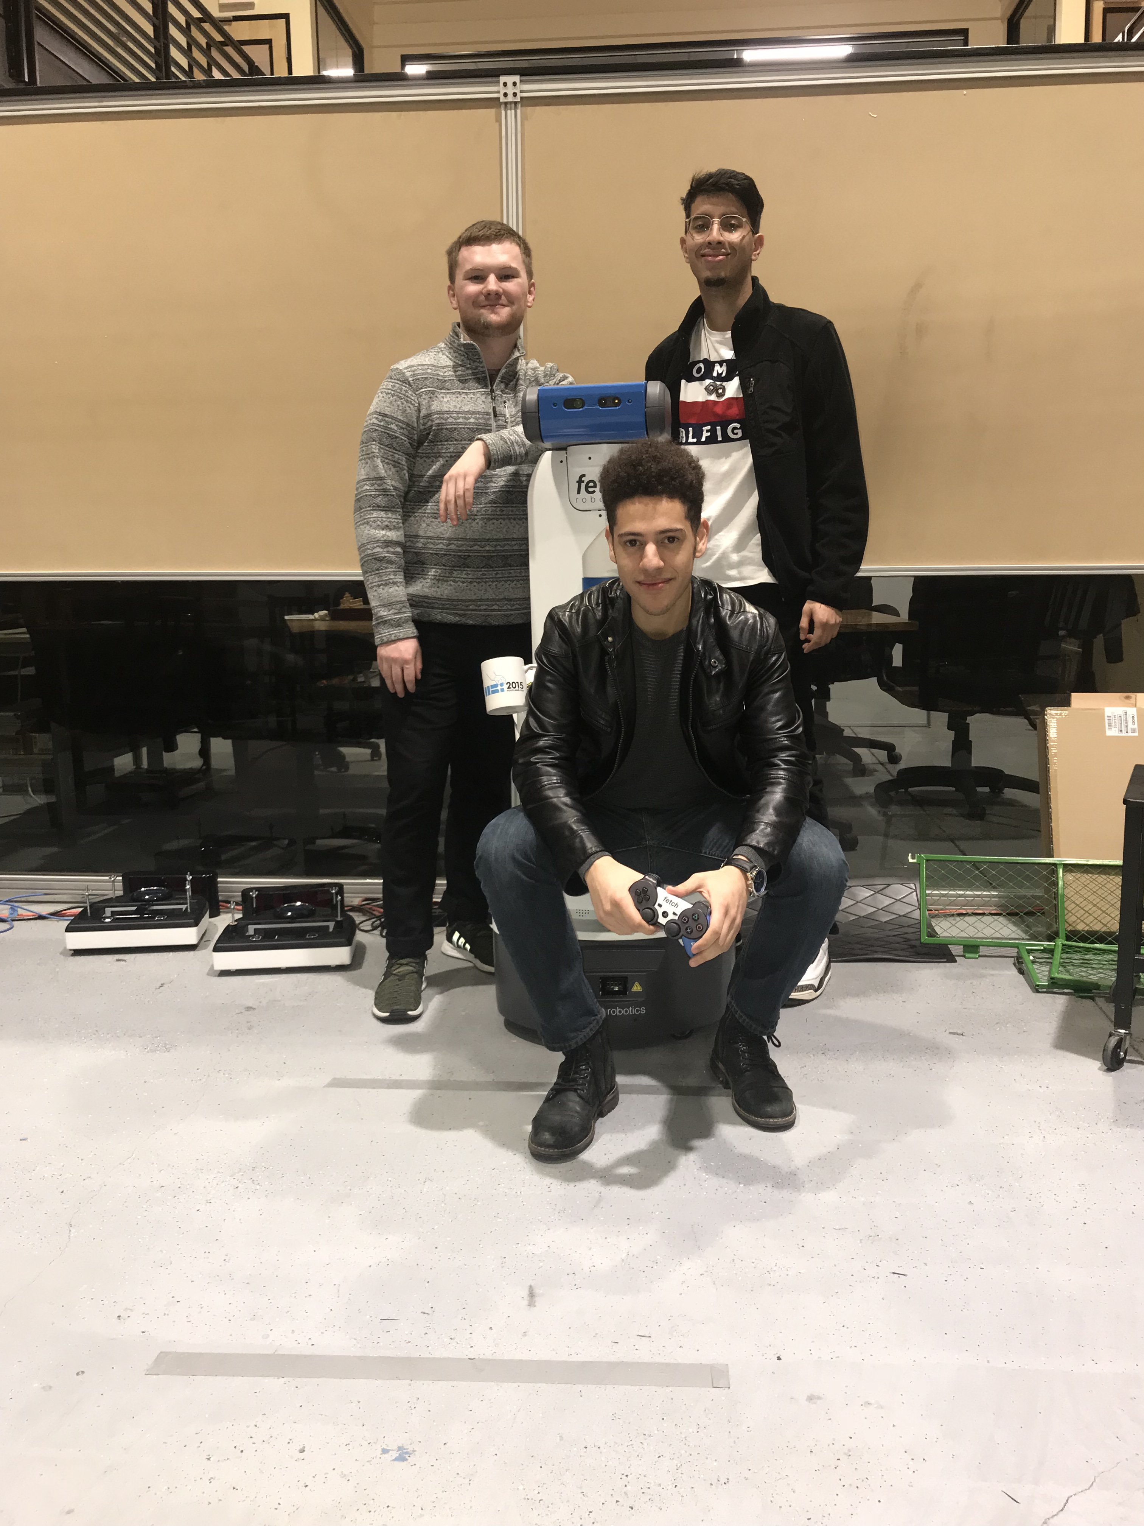
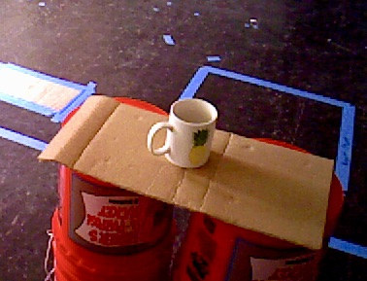

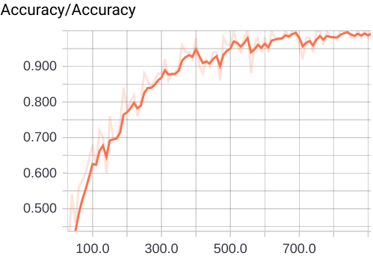
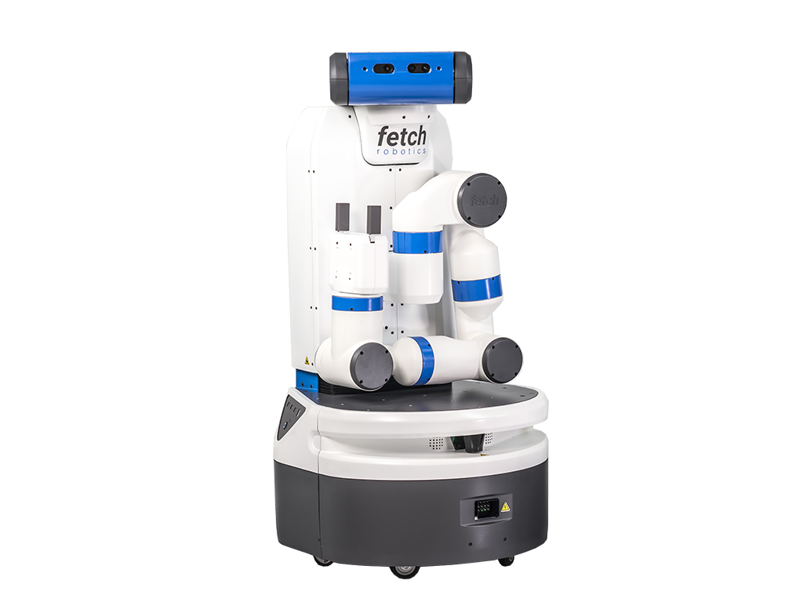
CS 67
Introduction
Online Deep Learning
For Object Recognition
on a Mobile Robot
Our project investigates the struggle to train machines to retain old task knowledge while learning new data. This issue is known as catastrophic forgetting and by using Sequential Deep Neural Networks we are able to eliminate a majority of the problem, allowing our robot to recognize objects with high certainty.
We are using Bandit, a Fetch mobile robot, to gather images of objects to classify. Our goal is to train Bandit to predict the class of new objects with an accuracy of 80% or higher.
Watch as our robot, Bandit, recognizes objects in the room completely on his own! Train him, show him a new object, and Bandit will correctly identify it!
Program Description
Our team implemented a software pipeline to manage interacting programs in our project. After Bandit gathers images of objects in a room, a collection of scripts perform data preparation, sequential convolutional neural network (CNN) training, and object class prediction. Online/Sequential Learning makes it easy to repeat this process over and over again, ensuring that Bandit learns the most from his environment
Our classification system is initialized with general object classes to keep predictions relatively broad. With online learning, as time goes on, the network overfits itself to the objects it is exposed to and learns their individual features, such as logos, shapes, colors, and orientations.
With this in mind, our data set contains a variety of commonplace objects with different key features and dimensions. Individual objects have distinguishing traits Bandit can recognize, and consist of staplers, mugs, chairs, screwdrivers, and books.
Team From Left to Right
Miles McCall mccallm@oregonstate.edu
Julian Weisbord weisborj@oregonstate.edu
Michael Rodriguez rodrigmi@oregonstate.edu
Client
Dr. Bill Smart smartw@oregonstate.edu
Organization
Oregon State University Personal Robotics Lab
Acknowledgements
Special thanks to Chris Eriksen for helping to guide the project and assist throughout.
Background
We hypothesized that by adjusting the network model to value knowledge compatible with old and new data, our network's efficiency will increase dramatically. This allows our intelligent robot to learn to recognize new objects much quicker than with common techniques like batch learning.
This technology is based on Deep Mind's Elastic Weight Consolidation (EWC), a state of the art online learning algorithm.
Our intelligent agent is dynamically learning about its environment, making our model applicable in a range of environment where humans need assistance. This system will shine in settings such as: labs, factories, offices, kitchens, and more!
Results
Conclusion
As we predicted, our model is able to correctly classify objects a vast majority of the time. It is capable of identifying an object’s overarching class and is able to differentiate between old and new objects.
Through online learning, the model is also able to learn new traits about previously seen objects over time. This technology was the fundamental concept that allowed our model to efficiently and dynamically add image data to the network's current knowledgebase.
We demonstrated a template use case in which placeholder objects were introduced and learned over time, and are now interested in expanding these concepts to larger, more fast-paced environments.
Bandit
97% Accuracy
The average classification success rate of our model trained on the 5 object classes using Inception ResNet for transfer learning, 21% higher than our starting goal!
2 hours
The average training time of our model with 500 images on an Nvidia GeForce GTX 970 GPU.
Who am I?
Mobile Robot
Intelligent Agent
Good Boy

