Slide 1

Final Project Predicting Recessions Using Gold Prices and Macroeconomic Indicators
Wiley, Julian
CSCI E-89 Deep Learning, Fall 2022
Harvard University Extension School
Prof. Zoran B. Djordjević

Slide 2
Introduction
Predicting economic recessions is one of the most important applications of machine learning for economics.
Recessions are major events that have significant implications for all manner of economic policies and business decisions. Currently, making predictions about future economic conditions is done by economists using traditional statistical models.
This project aims to use machine learning models to predict future economic conditions quickly so that policymakers and corporate actors can begin making plans to mitigate the consequences of these shifts as early as possible.

Slide 3




Description of software/tools

Slide 4
Description of Data
S&P500 for baseline performance
Consumer Price Index
Personal Consumption Expenditures
Unemployment Rate
GDP
Inflation
M2 Money Stock
Federal Funds Rate
Market Yield on U.S. Treasury Securities at 10-Year Constant Maturity, Quoted on an Investment Basis
Market Yield on U.S. Treasury Securities at 5-Year Constant Maturity, Quoted on an Investment Basis
Smoothed US Recession Probabilities
NBER Recession
Total nonfarm employment

Slide 5
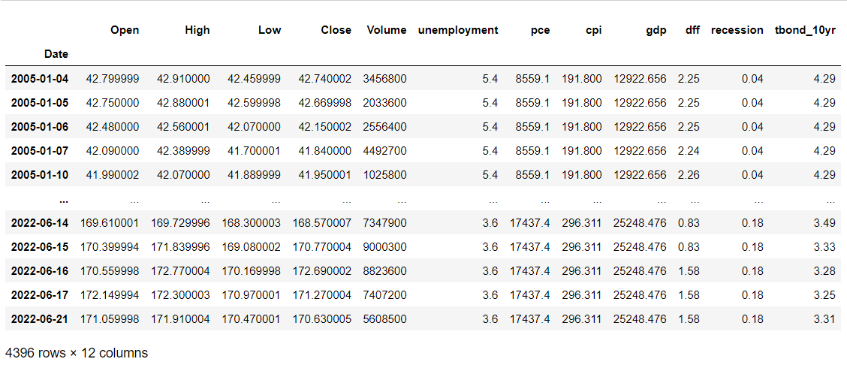
Combined Dataframe

Slide 6
Overview of Install/config/set up
Use Anaconda and Python 3.8 virtual environment
Set kernel to new virtual environment
Activate virtual environment
Create conda virtual env (https://janakiev.com/blog/jupyter-virtual-envs/
Install Tensorflow using standard pip installation
Install fredapi and yfinance through pypi wheels
Ensure pandas and numpy are installed
Fetch API key for FRED by signing up for an account and going to this link:
https://fred.stlouisfed.org/docs/api/api_key.html

Slide 7
Code highlights
# Fetch Gold Prices
yGld = yf.download('GLD', START_DATE, END_DATE, auto_adjust=True)
# Fetch S&P500 for baseline performance
snp = fred.get_series('SP500', observation_start=START_DATE, observation_end=END_DATE)
# Fetch Consumer Price Index
cpi = fred.get_series('CPIAUCNS', observation_start=START_DATE, observation_end=END_DATE)
# Fetch Personal Consumption Expenditures
pce = fred.get_series('PCE', observation_start=START_DATE, observation_end=END_DATE)
# Fetch Unemployment Rate
une = fred.get_series('UNRATE', observation_start=START_DATE, observation_end=END_DATE)
# Fetch GDP
gdp = fred.get_series('GDP', observation_start=START_DATE, observation_end=END_DATE)
# Fetch Inflation
inflation = fred.get_series('FPCPITOTLZGUSA', observation_start = START_DATE, observation_end=END_DATE)
# Fetch M2 Money Stock
m2 = fred.get_series('WM2NS', observation_start=START_DATE, observation_end=END_DATE)
# Federal Funds Rate
dff = fred.get_series('DFF', observation_start=START_DATE, observation_end=END_DATE)
# Market Yield on U.S. Treasury Securities at 10-Year Constant Maturity, Quoted on an Investment Basis
tbond_10yr = fred.get_series('DGS10', observation_start = START_DATE, observation_end=END_DATE)
# Market Yield on U.S. Treasury Securities at 5-Year Constant Maturity, Quoted on an Investment Basis
tbond_5yr = fred.get_series('DGS5', observation_start = START_DATE, observation_end=END_DATE)
# Market Yield on U.S. Treasury Securities at 3-Month Constant Maturity, Quoted on an Investment Basis
dgs3mo = fred.get_series('DGS3MO', observation_start = START_DATE, observation_end=END_DATE)
# Market Yield on U.S. Treasury Securities at 1-Month Constant Maturity, Quoted on an Investment Basis
dgs1mo = fred.get_series('DGS1MO', observation_start = START_DATE, observation_end=END_DATE)
# Smoothed US Recession Probabilities
recession = fred.get_series('RECPROUSM156N', observation_start=START_DATE, observation_end=END_DATE)
# NBER Recession
nber = fred.get_series('USREC', observation_start = START_DATE, observation_end=END_DATE)
# Total nonfarm employment
payems = fred.get_series('PAYEMS', observation_start = START_DATE, observation_end=END_DATE)

Slide 8
Code Highlights Cont.
# Univariate LSTM
lstm_model = Sequential()
lstm_model.add(LSTM(units=50, return_sequences=True, input_shape=(features_set.shape[1], 1),unroll=False))
lstm_model.add(Dropout(0.2))
lstm_model.add(LSTM(units=50, return_sequences=True))
lstm_model.add(Dropout(0.2))
lstm_model.add(LSTM(units=50, return_sequences=True))
lstm_model.add(Dropout(0.2))
lstm_model.add(LSTM(units=50))
lstm_model.add(Dropout(0.2))
lstm_model.add(Dense(units = 1))
lstm_model.summary()
# Multivariate LSTM
multi_gru_model = Sequential()
multi_gru_model.add(layers.GRU(units=50, return_sequences=True, input_shape=(multi_features_set.shape[1], multi_features_set.shape[2]),unroll=False))
multi_gru_model.add(Dropout(0.2))
multi_gru_model.add(layers.GRU(units=50, return_sequences=True))
multi_gru_model.add(Dropout(0.2))
multi_gru_model.add(layers.GRU(units=50, return_sequences=True))
multi_gru_model.add(Dropout(0.2))
multi_gru_model.add(layers.GRU(units=50))
multi_gru_model.add(Dropout(0.2))
multi_gru_model.add(Dense(units = 1))
multi_gru_model.summary()

Slide 9
Demonstration (results and visualizations)

Slide 10
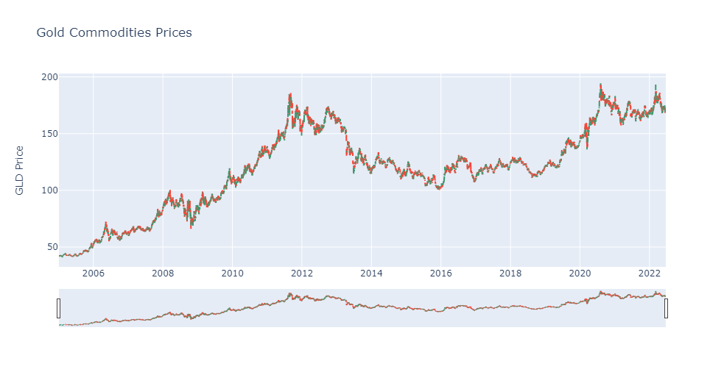
Gold Commodities Prices

Slide 11
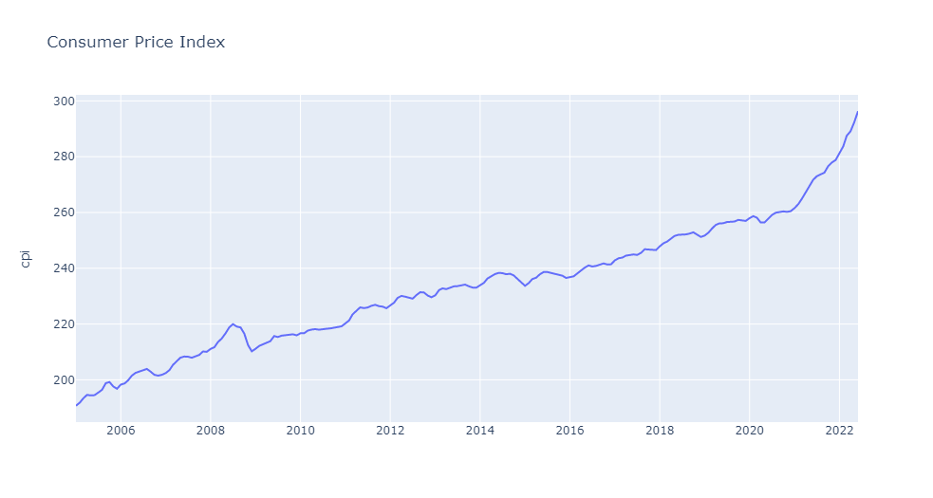
Consumer Price Index

Slide 12
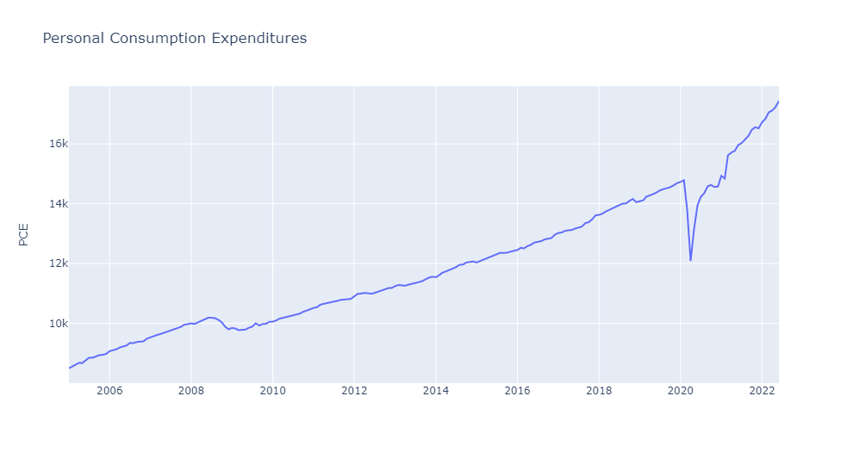
Personal Consumption Expenditures

Slide 13
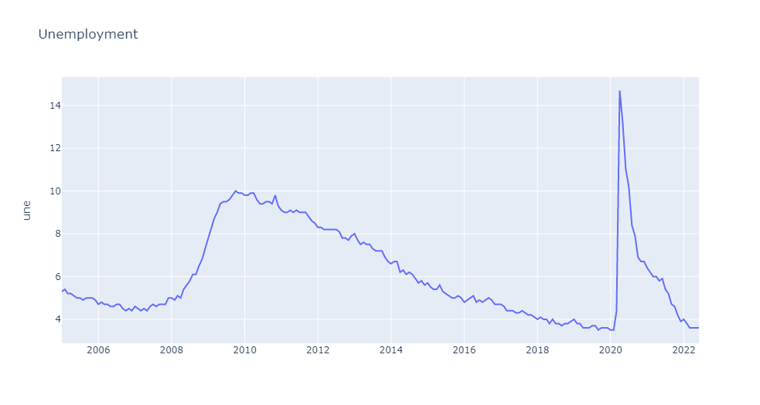
Unemployment

Slide 14
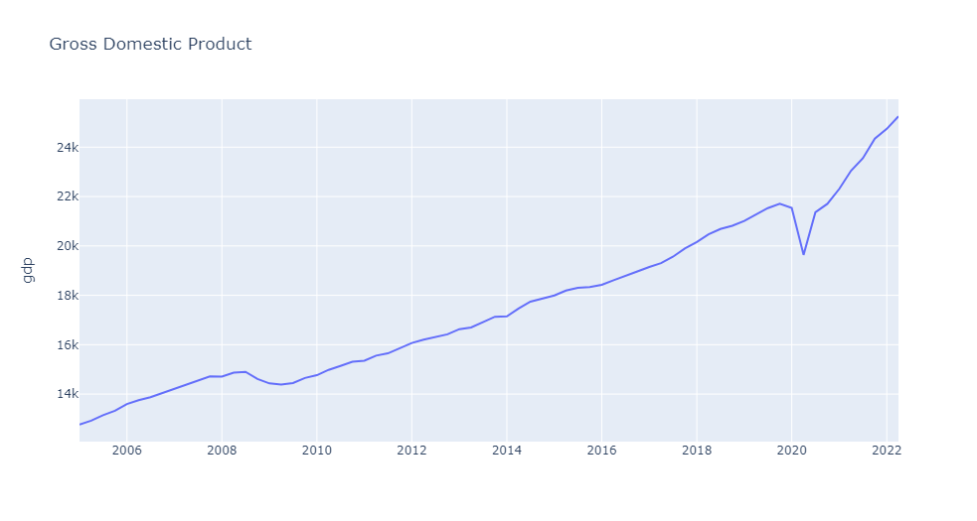
Gross Domestic Product

Slide 15
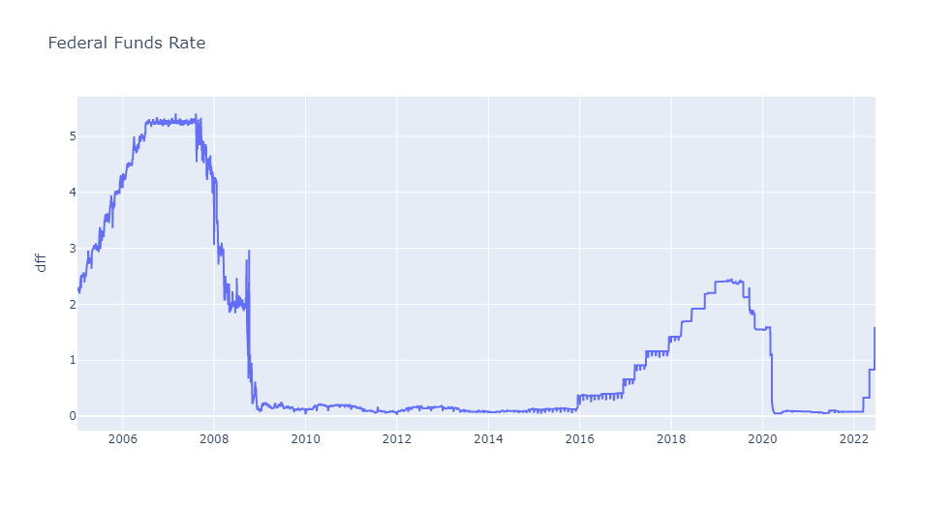
Federal Funds Rate

Slide 16
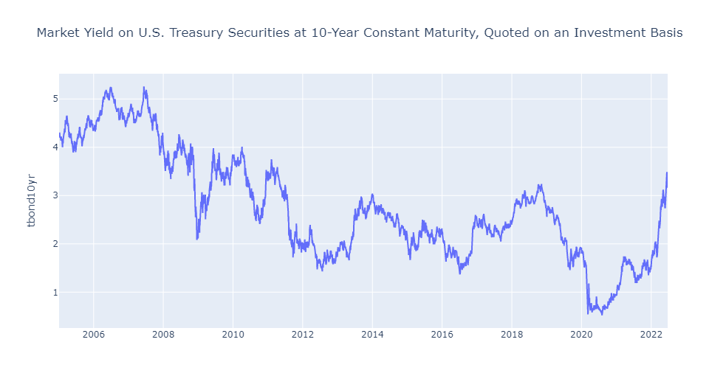
Market Yield- 10 yr T. Bond

Slide 17
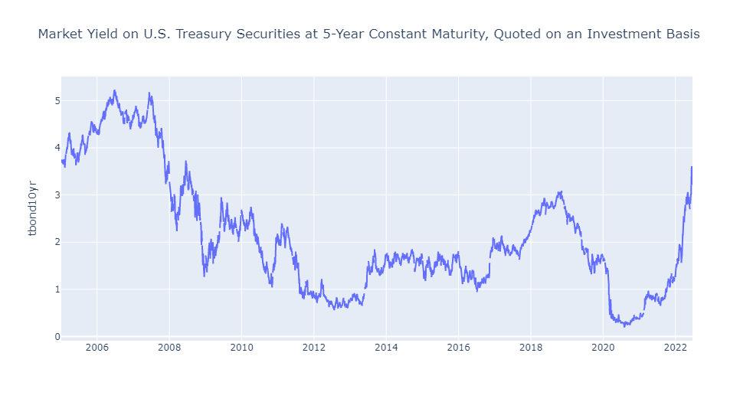
Market Yield- 5 yr T. Bond

Slide 18
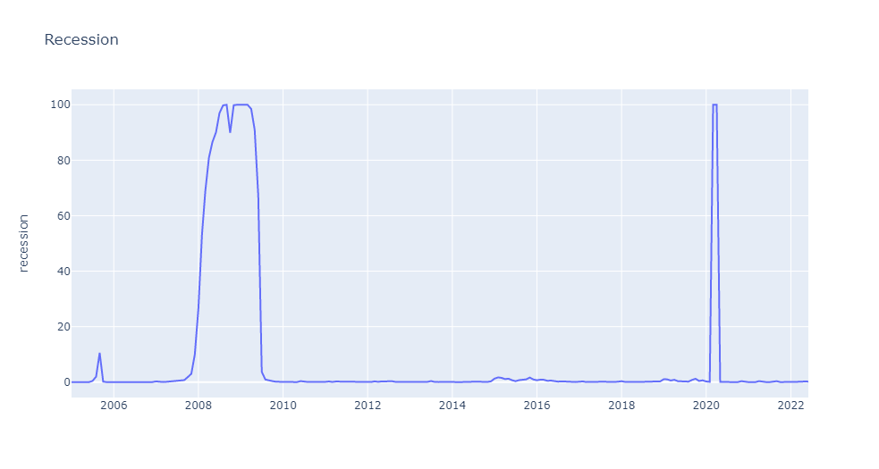
Recession

Slide 19
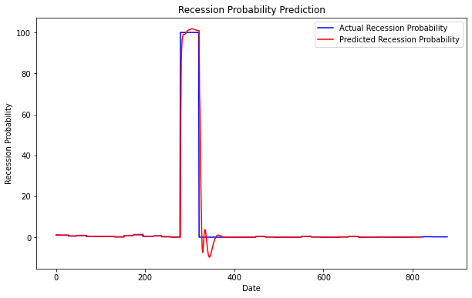
Univariate LSTM Predictions

Slide 20
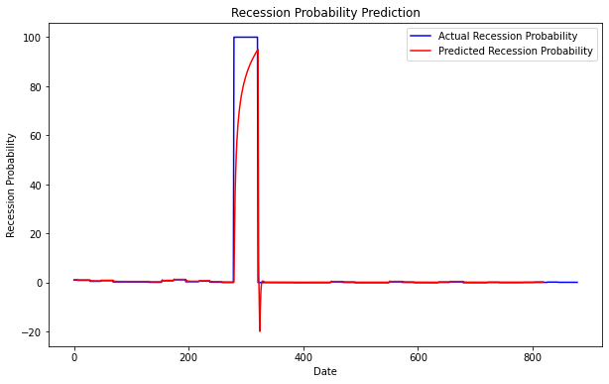
Univariate GRU Predictions

Slide 21
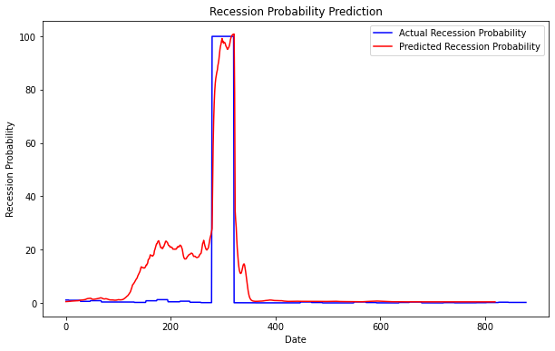
Multivariate LSTM Predictions

Slide 22
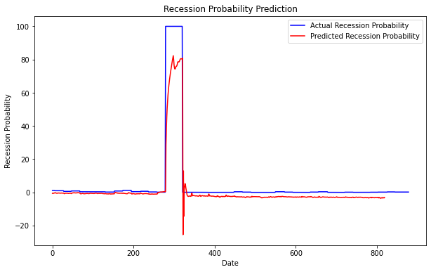
Multivariate GRU Predictions

Slide 23
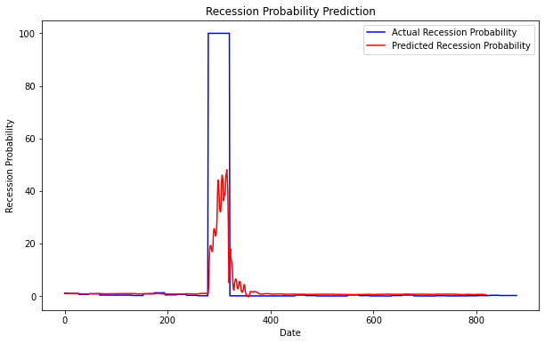
Multivariate CNN Predictions

Slide 24
Summarize: Lessons Learned & Pros/Cons
The best models were univariate
Losses (MSE) were not conclusive
Performance based on MSE was not correlated to performance on the test set
LSTM performed best
CNNs did not accurately detect the recessions
VAEs might have performed better but weren’t able to be compared to the rest easily
Models were good but different architectures should be tried
Overall, our approach appeared to produce fairly accurate regressors
In the future, treating this as a classification problem might yield better results

Slide 25
YouTube URLs, Last Page
Two minute (short): https://youtu.be/50ws4F889gU
15 minutes (long): https://youtu.be/-9HwrHZVedg

