Slide 1
Clinical Findings Extraction from Lumbar Imaging Reports
Julia (Reich) Lynch, DPT

Slide 2
Low Back Pain Background
Leading cost of disability worldwide (Martin et al, 2008)
Upwards of $100 billion in costs to the US each year (Martin et al, 2008)
Poor understanding of etiology (Deyo, 2014)
Radiological findings do not always match clinical findings and symptoms (Brinjiki et al, 2015)
Evidence supports that some findings are more prevalent in symptomatic patients (Czaplewski et al, 2023)

Slide 3
Importance of Automation
Identify patterns between radiological findings and pain requires data to be extracted.
Costly and inefficient to perform the data extraction manually

Slide 4
Image Processing vs NLP
95.6% accurate on lumbar disc detection (Jamaludin et al, 2017)
No evidence so far of valid classification
Utilize unstructured data in radiology report to extract clinical findings
Demonstrated to be valid across multiple diagnosis

Slide 5
Rules Based NLP
Pros:
low set up costs
Cons:
rigid
not scalable

Slide 6
Machine Learning NLP
Pros:
scalable,
flexible
Cons:
requires large, heterogeneous data set for training,
higher costs for development
Machine Learned NLP solution is the most feasible and applicable option.

Slide 7
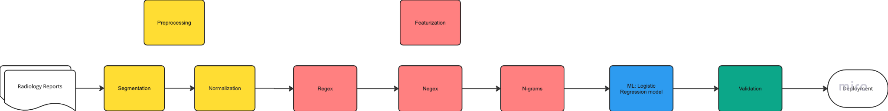
Sample NLP pipeline
Adapted from Tan et al, 2018

Slide 8
Example Use Case
Client seeking to analyze a clinic’s referral patterns, prescription patterns, and patient outcomes on patients with nerve root compression to determine quality of care using established best practices.

Slide 9
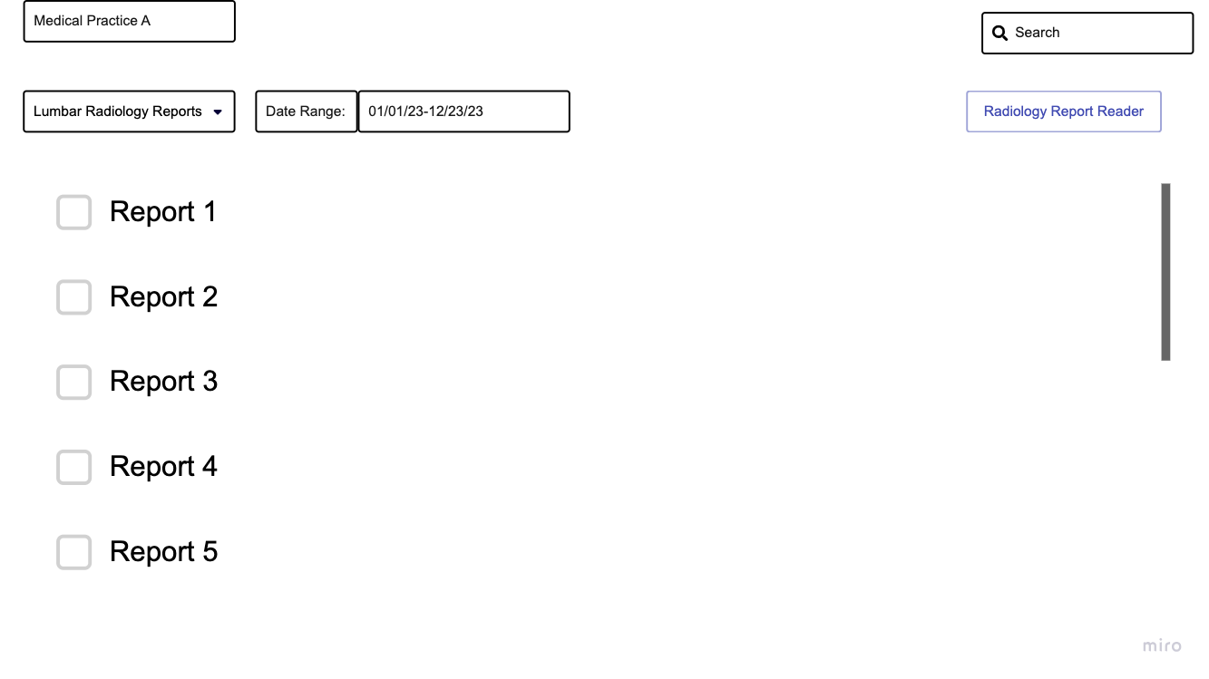

Slide 10
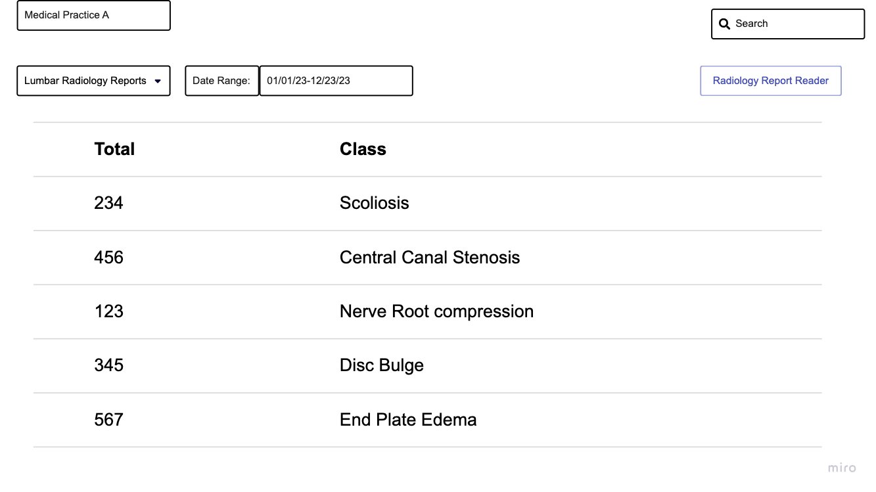

Slide 11
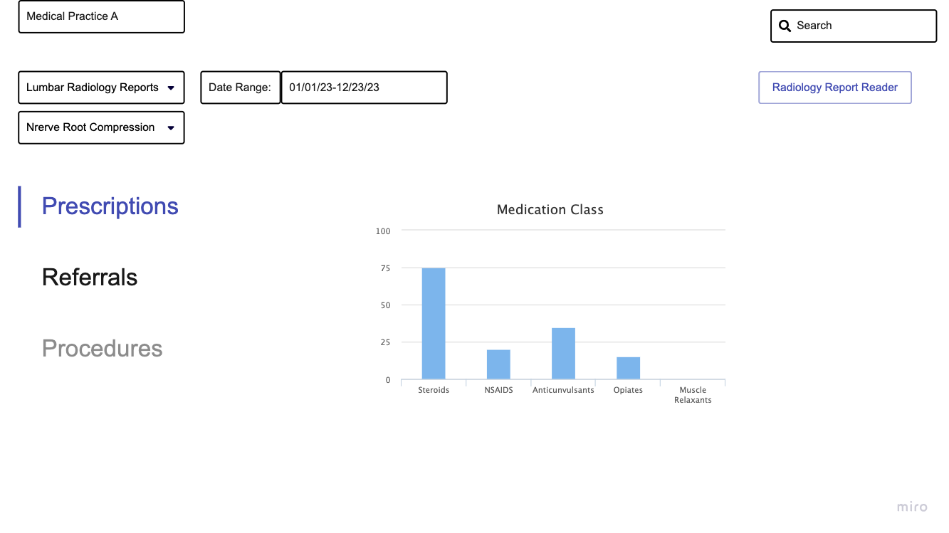

Slide 12
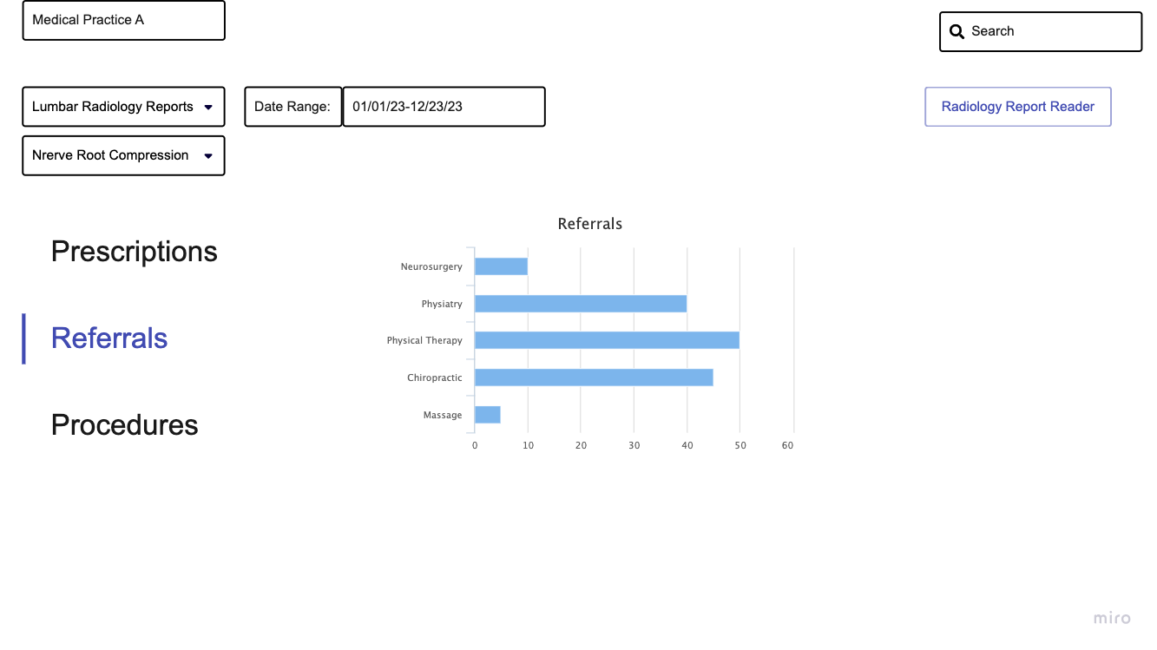

Slide 13
Business Opportunities
Decreased costs for payers
Greater ease and speed for claims authorizations
Improved patient outcomes
Research opportunities

Slide 14
References
Brinjikji W., Luetmer P.H., Comstock B., et. al.: Systematic literature review of imaging features of spinal degeneration in asymptomatic populations. AJNR Am J Neuroradiol 2015; 36: pp. 811-816. https://doi.org/10.3174/ajnr.A4173
Cui, Y., Zhu, J., Duan, Z., Liao, Z., Wang, S., & Liu, W. (2022). Artificial Intelligence in Spinal Imaging: Current Status and Future Directions. International journal of environmental research and public health, 19(18), 11708. https://doi.org/10.3390/ijerph191811708
Czaplewski, L.G., Rimmer, O., McHale, D. et al. Modic changes as seen on MRI are associated with nonspecific chronic lower back pain and disability. J Orthop Surg Res 18, 351 (2023). https://doi.org/10.1186/s13018-023-03839-w
4. Deyo R.A., Dworkin S.F., Amtmann D., et. al.: Report of the NIH Task Force on research standards for chronic low back pain. Eur Spine J 2014; 23: pp. 2028-2045. https://doi.org/10.1007/s00586-014-3540-3
Jamaludin, A., Lootus, M., Kadir, T. et al. ISSLS PRIZE IN BIOENGINEERING SCIENCE 2017: Automation of reading of radiological features from magnetic resonance images (MRIs) of the lumbar spine without human intervention is comparable with an expert radiologist. Eur Spine J 26, 1374–1383 (2017). https://doi.org/10.1007/s00586-017-4956-3
Martin BI, et al. Expenditures and health status among adults with back and neck problems. JAMA. 2008;299:656–664. [PubMed] [Google Scholar]
Tagliaferri, S. D., Angelova, M., Zhao, X., Owen, P. J., Miller, C. T., Wilkin, T., & Belavy, D. L. (2020). Artificial intelligence to improve back pain outcomes and lessons learnt from clinical classification approaches: three systematic reviews. NPJ digital medicine, 3, 93. https://doi.org/10.1038/s41746-020-0303-x
Tan WK, Hassanpour S, Heagerty PJ, et al. Comparison of Natural Language Processing Rules-based and machine-learning systems to identify lumbar spine imaging findings related to low back pain. Academic radiology. November 2018. Accessed August 16, 2024. https://www.ncbi.nlm.nih.gov/pmc/articles/PMC6162177/.
Zech J., Pain M., Titano J., et. al.: Reports, natural language–based machine learning models for the annotation of Clinical Radiology. Radiology 2018; pp. 171093. https://doi.org/10.1148/radiol.2018171093

