Slide 1

CSE 414
Machine Learning and Deep Learning Lab
Submitted By:
Submitted To:
Name | Registration ID
Arnica Sarker | 22201015
Julias Uddin Khan | 22201034
Faria Zarin Subah
Assistant Professor
Department of Computer Science & Engineering
University of Asia Pacific

Slide 2
Explainable Early Sepsis Prediction Using Temporal Deep Learning and XAI on ICU Time-Series Data

Slide 3
Project Objective
Problem Statement
Sepsis is a life-threatening medical emergency. Delayed diagnosis can significantly increase mortality risk. An early prediction system can help clinicians intervene faster and improve patient outcomes.
Main Objective
To develop an explainable early-warning sepsis prediction system using ICU temporal patient data and advanced deep learning techniques.

Slide 4
Project Objective (Cont.)
Project Goals
Predict sepsis 3 hours and 6 hours before onset
Handle irregular and missing ICU clinical data
Compare traditional ML and deep learning models
Improve prediction interpretability using Explainable AI (XAI)

Slide 5
Motivation and Social Impact
Why This Project Matters
Sepsis causes millions of deaths globally every year
ICU clinicians need reliable early-warning systems
Early intervention can reduce mortality and treatment cost
AI-assisted monitoring can improve critical care decisions
Who Benefits
ICU doctors and nurses
Hospitals and healthcare systems
Critical care patients
Medical researchers
Uniqueness of Our Work
Early prediction at both 3h and 6h horizons
Temporal deep learning approaches
Integration of Explainable AI
Clinically interpretable outputs

Slide 6
Dataset Description
Dataset Used
PhysioNet 2019 Sepsis Challenge Dataset
Dataset Characteristics
Public ICU clinical dataset
Multivariate patient time-series data
Contains hourly ICU patient measurements
Dataset Structure
Training Set A → Used for training
Training Set B → Used for external-style testing
Important Clinical Features
Heart Rate
Respiratory Rate
Temperature
FiO2
Blood Pressure
Oxygen Saturation
Lactate
Calcium
Phosphate
Platelets
Preprocessing Steps
Missing value handling
Forward filling
Median imputation
Mask matrix generation
Delta time matrix generation
Feature normalization
Sliding window creation

Slide 7
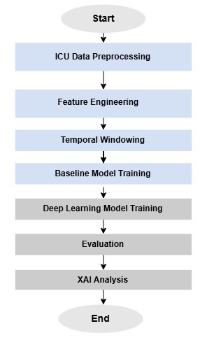
Methodology / Model Architecture
Baseline Machine Learning Models
Logistic Regression
Random Forest
XGBoost
Deep Learning Models
GRU-D
1D CNN Temporal Model
Why GRU-D?
Handles missing ICU data naturally
Uses mask and time-decay mechanisms
Designed specifically for irregular medical time-series
Why Explainable AI?
Improves model transparency
Builds clinician trust
Identifies influential clinical features
Makes predictions clinically interpretable
Fig: Flow chart of Methodology.

Slide 8
Implementation
Tools and Frameworks
Python
Kaggle
Google Colab
PyTorch
Scikit-learn
SHAP
NumPy
Pandas
Matplotlib
Data Processing
Filled matrices
Mask matrices
Delta matrices
Temporal windows
Prediction Horizons
3-hour prediction
6-hour prediction
Training Strategy
Set A → Training
Set B → Testing
Explainability Techniques
SHAP Analysis
Feature Importance
Counterfactual Explanations
PDP (Partial Dependence Plot)
ICE (Individual Conditional Expectation)

Slide 9
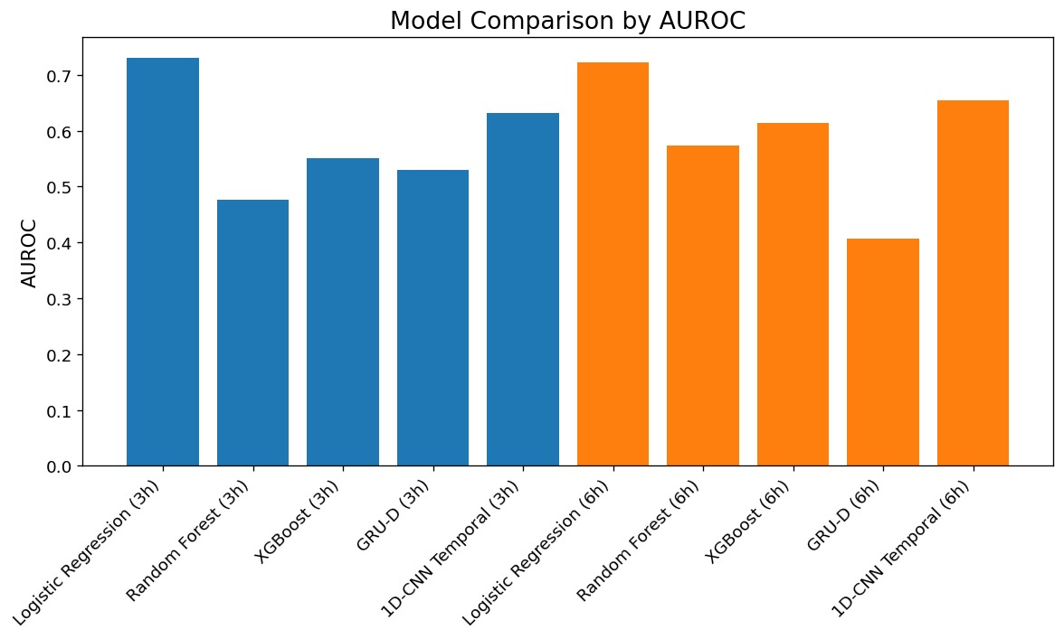
Results and Analysis
Best Performing Models
1D CNN
Logistic Regression (Base line model)
Key Findings
Temporal deep learning models outperformed traditional ML models
3h prediction achieved better performance than 6h prediction
Deep learning captured ICU temporal dynamics effectively
Important Clinical Features
FiO2
Phosphate
Calcium
Temperature
Respiratory Rate
Fig: Model Comparison by AUROC

Slide 10
Results and Analysis (Cont.)
XAI Findings
Higher FiO2 increased predicted sepsis risk
Abnormal phosphate levels increased risk
Respiratory instability affected prediction confidence
Clinical Interpretation
The model learned clinically meaningful
relationships related to:
Respiratory compromise
Inflammation
Metabolic imbalance
Systemic deterioration
Fig: Model Comparison by AUROC

Slide 11
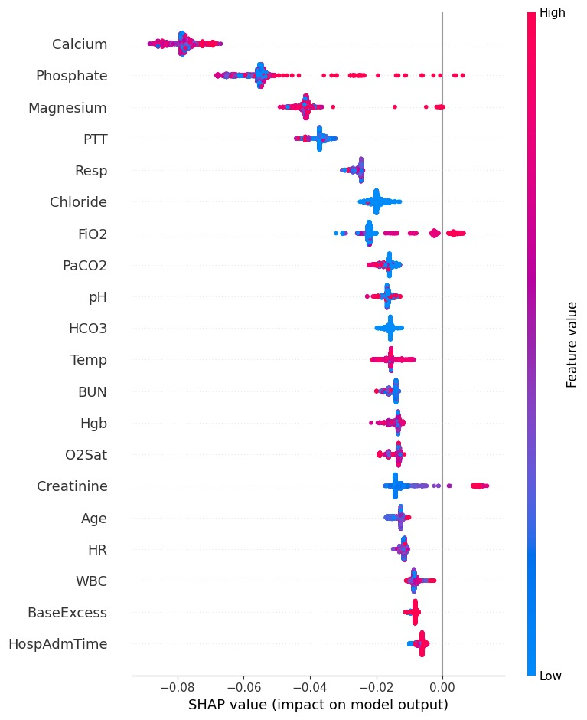
Results and Analysis (Cont.)
Overall Model Comparison
Model | Horizon | AUROC | AUPRC | Recall | F1 Score
Logistic Regression | 3h | 0.731 | 0.0167 | 0.654 | 0.0245
Logistic Regression | 6h | 0.723 | 0.0317 | 0.675 | 0.0426
Random Forest | 3h | 0.477 | 0.0063 | 0.000 | 0.000
Random Forest | 6h | 0.574 | 0.0156 | 0.000 | 0.000
XGBoost | 3h | 0.551 | 0.0071 | 0.000 | 0.000
XGBoost | 6h | 0.614 | 0.0158 | 0.000 | 0.000
GRU-D | 3h | 0.529 | 0.0058 | 0.451 | 0.0158
GRU-D | 6h | 0.407 | 0.0084 | 0.118 | 0.0077
1D-CNN | 3h | 0.632 | 0.0115 | 0.010 | 0.0133
1D-CNN | 6h | 0.654 | 0.0222 | 0.000 | 0.000
Fig: SHAP Value (Impact on model output)

Slide 12
Detect obstacle ↓
Team Member Contribution
Team Member | Contribution
Arnica Sarker | Dataset preprocessing, Baseline model, GRU-D development, 1D-CNN development, XAI analysis, Report writing
Julias Uddin Khan | Literature review, Methodology design , Model evaluation, Visualization, Documentation, Presentation

Slide 13
Conclusion
What We Achieved
Developed an explainable ICU sepsis prediction system
Compared ML and deep learning approaches
Applied temporal learning for early prediction
Integrated XAI for transparency and interpretability
Main Findings
Logistic Regression (Base line model) and CNN performed best
Temporal learning improved prediction quality
XAI improved model interpretability
Limitations
Limited computational resources
Limited hyperparameter tuning
Future Work
Use larger ICU datasets
Deploy a real-time clinical dashboard
Add transformer-based temporal models
Perform clinical validation

Slide 14
CEP Mapping
Knowledge Profile Mapping — K
Attribute | How K is Addressed in Our Project | Evidence
K3: Engineering Fundamentals | The project applies programming, data preprocessing, machine learning fundamentals, and model evaluation concepts. | Python notebooks, preprocessing code, evaluation metrics
K4: Specialist Knowledge | Advanced temporal deep learning models such as GRU-D and 1D CNN are used for ICU time-series prediction. | GRU-D/CNN model implementation
K5: Engineering Design | A complete prediction pipeline is designed from ICU data preprocessing to model training, evaluation, and XAI interpretation. | Methodology flowchart, system pipeline
K6: Engineering Practice | Modern tools such as Python, Kaggle, Google Colab, PyTorch, Scikit-learn, Pandas, NumPy, SHAP, and Matplotlib are used. | Code files, Kaggle notebooks, generated output files
K7: Comprehension of Engineering in Society | The project addresses an important healthcare problem where early sepsis prediction can support ICU decision-making and patient safety. | Problem statement, societal impact section
K8: Research Literature | Existing research on sepsis prediction, GRU-D, XGBoost, SHAP, and Explainable AI is reviewed and applied. | References section, related work discussion

Slide 15
CEP Mapping (Cont.)
Complex Engineering Problem Mapping — P
Attribute | How P is Addressed in Our Project | Evidence
P1: Depth of Knowledge Required | The project requires knowledge of machine learning, deep learning, time-series modeling, missing data handling, and XAI. | Technical methodology, model notebooks
P2: Range of Conflicting Requirements | The project balances prediction accuracy, early warning time, computational cost, and clinical interpretability. | Comparison of 3h vs 6h prediction, ML vs DL results
P3: Depth of Analysis Required | Sepsis prediction has no simple solution because ICU data are irregular, missing, and highly variable across patients. | Preprocessing pipeline, mask/delta matrix generation
P4: Familiarity of Issues | The project works on a complex medical prediction problem using ICU patient data, which is less familiar than ordinary classification tasks. | PhysioNet ICU dataset description
P5: Extent of Applicable Codes | The system must consider ethical AI, transparency, and responsible clinical decision-support limitations because it is related to healthcare. | Ethical discussion, XAI interpretation
P6: Stakeholder Involvement | The project is designed for ICU clinicians, hospitals, patients, and healthcare systems as potential stakeholders. | Beneficiary and societal impact section
P7: Interdependence | The project includes many connected components: data preprocessing, temporal windowing, model training, evaluation, XAI, and clinical interpretation. | Full methodology pipeline

Slide 16
CEP Mapping (Cont.)
Complex Engineering Activities Mapping — A
Attribute | How A is Addressed in Our Project | Evidence
A1: Range of Resources | The project uses diverse resources including ICU data, Python libraries, Kaggle/Colab computing platforms, and research papers. | Dataset, notebooks, tools, references
A2: Level of Interaction | The project requires interaction between clinical knowledge, data preprocessing, model development, evaluation, and explainability. | Integrated ML/DL/XAI workflow
A3: Innovation | The project combines early sepsis prediction at multiple horizons with temporal deep learning and Explainable AI. | 3h/6h prediction, GRU-D/CNN, SHAP/PDP/ICE
A4: Consequences for Society and Environment | Early sepsis prediction can improve ICU care, reduce delayed diagnosis, support clinicians, and improve patient outcomes. | Societal impact section
A5: Familiarity | The project extends beyond basic ML classification by applying temporal modeling, missingness-aware learning, and clinical interpretability. | GRU-D with mask/delta matrices, XAI analysis

Slide 17
Thank You!
Any Questions?

Slide 18
Reference
[1] A. Reyna et al., “Early Prediction of Sepsis From Clinical Data: The PhysioNet/Computing in Cardiology Challenge 2019,” Crit. Care Med., vol. 48, no. 2, pp. 210–217, 2020.
[2] Z. Che, S. Purushotham, K. Cho, D. Sontag, and Y. Liu, “Recurrent Neural Networks for Multivariate Time Series With Missing Values,” Sci. Rep., vol. 8, no. 1, pp. 1–12, 2018.
[3] T. Chen and C. Guestrin, “XGBoost: A Scalable Tree Boosting System,” in Proc. ACM SIGKDD Int. Conf. Knowl. Discovery Data Mining, 2016, pp. 785–794.
[4] S. M. Lundberg and S.-I. Lee, “A Unified Approach to Interpreting Model Predictions,” in Proc. Adv. Neural Inf. Process. Syst. (NeurIPS), 2017, pp. 4765–4774.
[5] D. Shillan, J. Sterne, J. Champneys, and B. Gibbison, “Use of Machine Learning to Analyse Routinely Collected Intensive Care Unit Data: A Systematic Review,” Crit. Care, vol. 23, no. 1, pp. 1–11, 2019.
[6] H. Moor et al., “Early Prediction of Sepsis in the ICU Using Machine Learning: A Systematic Review,” Front. Med., vol. 8, pp. 1–14, 2021.
[7] Y. Song et al., “Deep Learning Enables Accurate Diagnosis of Novel Coronavirus (COVID-19) With CT Images,” IEEE/ACM Trans. Comput. Biol. Bioinf., vol. 18, no. 6, pp. 2775–2780, 2021.
[8] G. D. Clifford et al., “PhysioNet Challenge 2019,” PhysioNet, 2019. [Online].
Available: https://physionet.org/content/challenge-2019/

