Slide 1
The analysis of the Netflix movie descriptions
Julia Sitdikova BASB 212

Slide 2

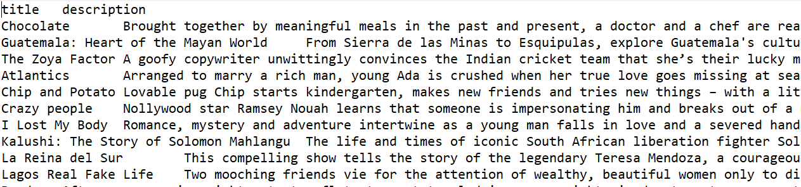
DATASET DESCRIPTION
Used data contains of the 10 Netflix films description datasets in 10 genres: dramas, comedies, documentaries, action movies, anime, stand-ups, children movies, horrors, classic movies, crime movies which were combined in one dataset «netflix»
Example:

Slide 3
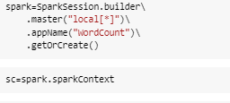
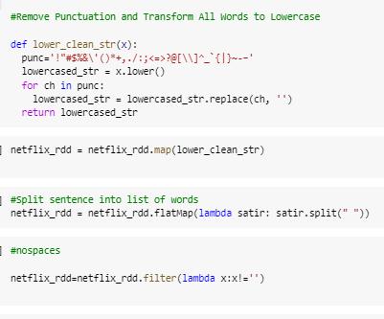
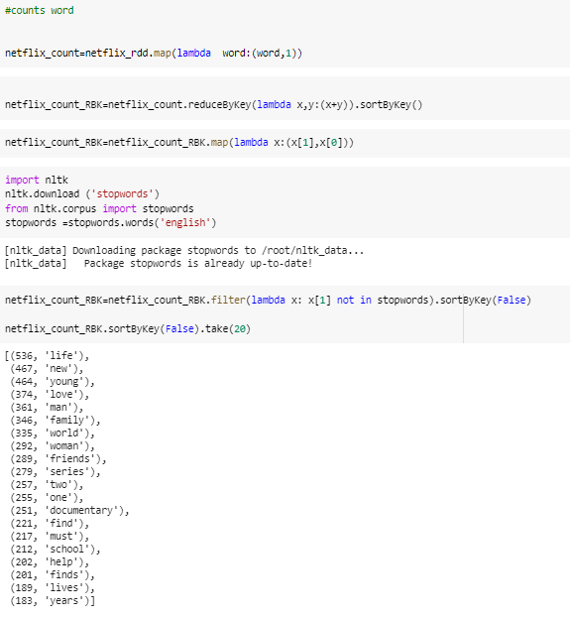
THE CODE EXECUTION
Import of the libraries and Pyspark installation
Data cleaning (deleting of the punctuation, whitespaces,making of the lowercase)
The word count

Slide 4

Wordcount result
The most common words in the data are «life», «new», «young», «love»

Slide 5
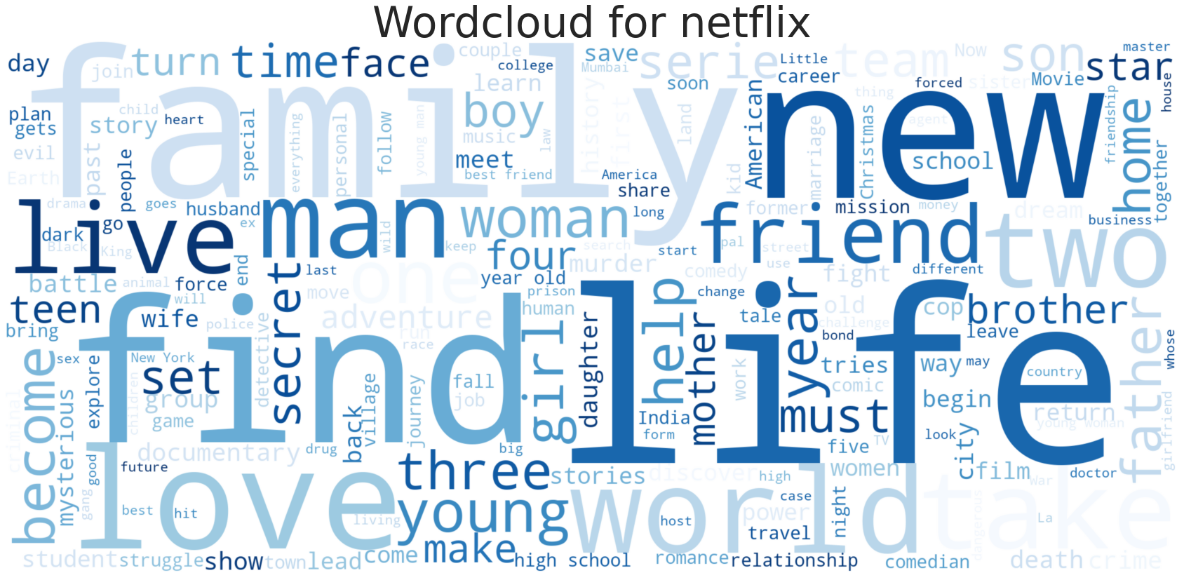
DATA VISUALIZATION

Slide 6
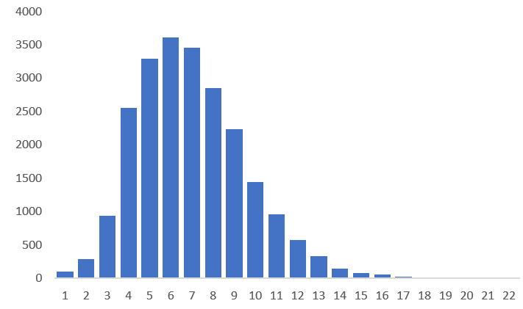
STATISCTIC
THE DISRTIBUTION OF LETTERS NUMBER IN WORDS
23743
THE TOTAL NUMBER OF UNIQUE WORDS
MOST COMMON WORDS ARE WITH 6-7 LETTERS

Slide 7
CONCLUSIONS
The presented results might give us the brief overview on what are the most popular topics that film producers like to focus on and sponsor. We see that authors of the movies like to transmit trough their art «life», «love», the stories of the «young» people, relationships («family», «friends») and discoveries of the «new».
The results might be used in studies of the film industry, analysis of the films demand and how the advertisement and attraction of the audience though movie description work.

