Slide 1
Predicting third down conversion success rate
By John goodale, Julia Smith, Julia Sweet,
Kyle Younghans, and matt Garcia
Presented in partial fulfilment of the
University of Minnesota data visualization and analytics
Boot camp
Notes:
JULIA SMITH

Slide 2
Goal
The goal was to determine whether we could accurately predict the success potential of a third down play based on current game situation. Specifically, whether teams should run or pass in certain conditions.
We focused on third down because failing to convert a third down usually means the drive has stalled and the team must punt or attempt a field goal. In turn, time of possession is something that teams seek to control in each game. While each down is important, this “make or Break” situation doesn’t exist on the 1st and 2nd down.
Notes:
JULIA SMITH

Slide 3
Tools and data
We used several python libraries in our analyses: pandas, numpy, sci-kit learn.
We used the seaborn and matplotlib libraries and tableau to create our visualizations.
Our data came from the nfl api.
Notes:
JULIA SMITH

Slide 4
Regression Models
Linear Regression
Logistic Regression
Classification Model
Confusion Matrix
Random Forest
Grid Search
Sequential - Keras Model
K-nearest neighbors algorithm
Notes:
JULIA SMITH

Slide 5

Data and cleaning:
Our Data came from nflscrapR which is a library in R that pulls play by play data from the NFL API. This data contains every play from 2009-2018. Using Pandas, we combined each year to create one large data frame. From there we kept rows that had an EPA that was not null and had a play type of either no play, pass, or run. Then we dropped all plays that were classified as a replay, challenge, or timeout. We also removed any plays that involved a kneel or a spike. Then, since the scope of our project was related to 3rd down, we dropped every play that wasn’t on 3rd down. Lastly, we selected the columns we wanted to use as attributes and created our final data frame which was then exported to a CSV for use within our machine learning models.
Notes:
KYLE

Slide 6
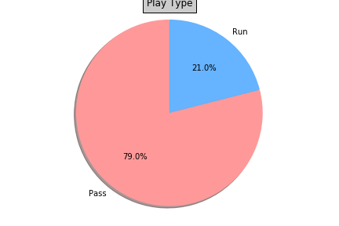
CHALLENGE 1: Imbalanced data
Many more pass plays than run plays.
Some features were limited to one type of play.
Notes:
JULIA SWEET

Slide 7
https://public.tableau.com/profile/john.goodale#!/vizhome/ThirdDownSuccess/ThirdDownRunAvgEP?publish=yes
Notes:
JOHN

Slide 8
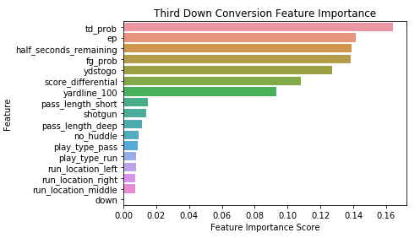
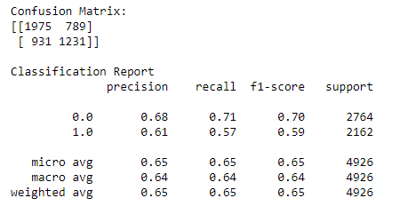
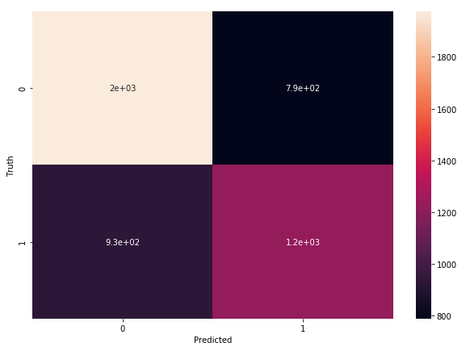
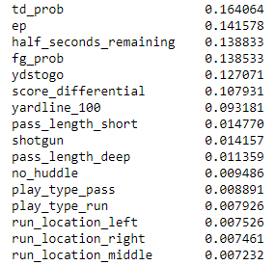
3rd Down Conversion Random Forest Model (n=19704)
Notes:
MATT

Slide 9
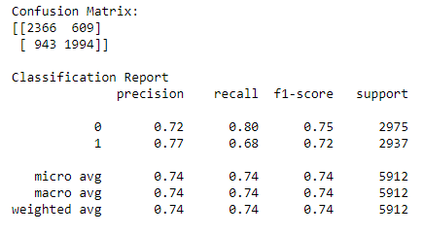
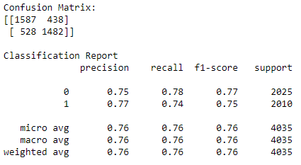
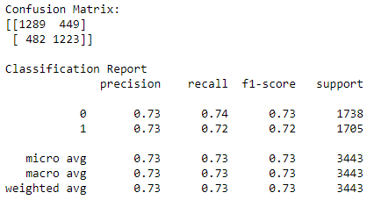
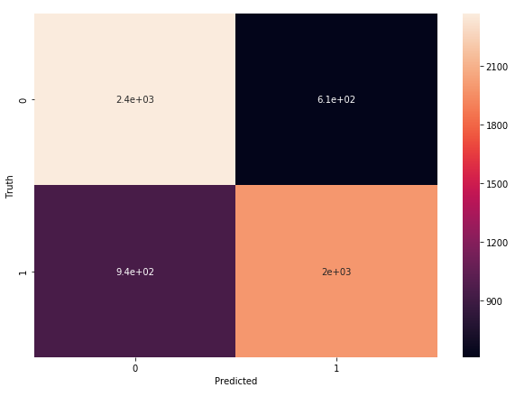
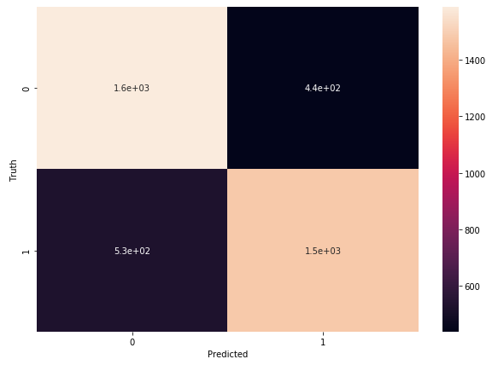
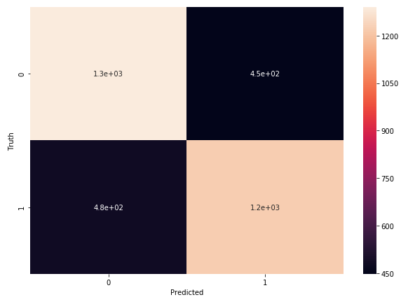
3rd Down Run/Pass Random Forest Confusion Matrix (pass=0, run=1)
3rd Down Run/Pass No YTG Constraints
3rd Down Run/Pass <=5 YTG
3rd Down Run/Pass <=3 YTG
n = 19704
n = 13450
n = 11474
Notes:
MATT

Slide 10
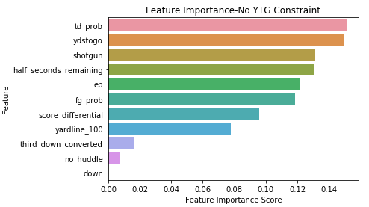
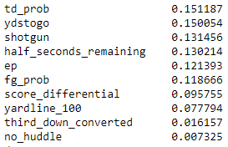
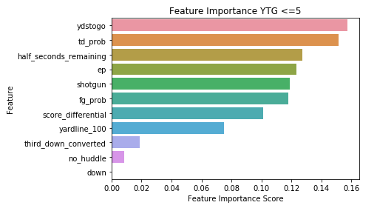
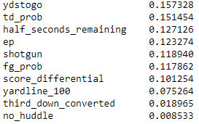
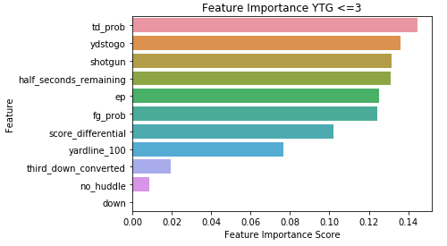
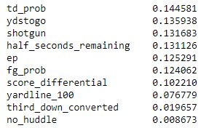
3rd Down Run/Pass Random Forest Feature Weights
3rd Down Run/Pass No YTG Constraints
3rd Down Run/Pass <=5 YTG
3rd Down Run/Pass <=3 YTG
Notes:
MATT

Slide 11
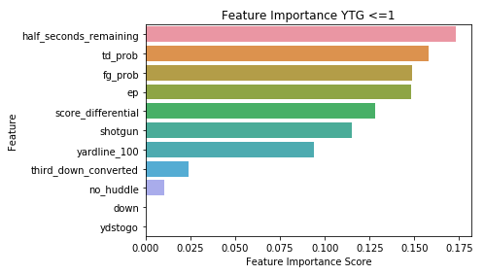
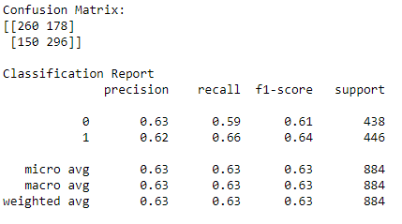
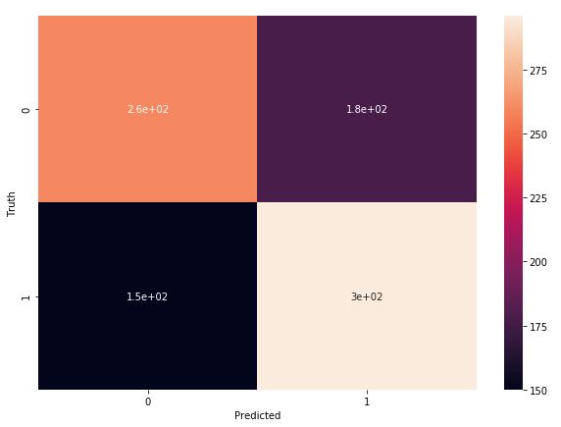
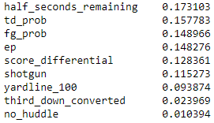
3rd Down Run/Pass <=1 Yards to go (n=2946)
Notes:
MATT

Slide 12
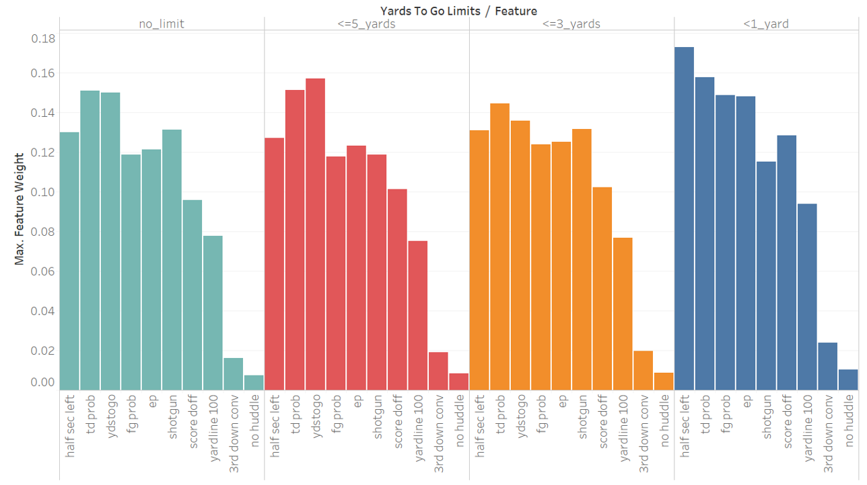
Notes:
MATT

Slide 13
Challenge Two: Low accuracy
We used linear regression, logistic regression, and two classification models in the hopes of finding one that could accurately predict the likelihood of success of the plays.
Unfortunately, we were unable to find any with an accuracy of above 70 ~4%, even when we used deep learning.
Notes:
JULIA SWEET

Slide 14
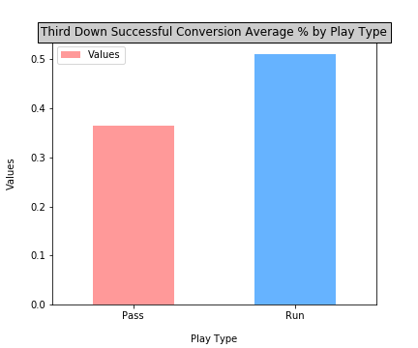
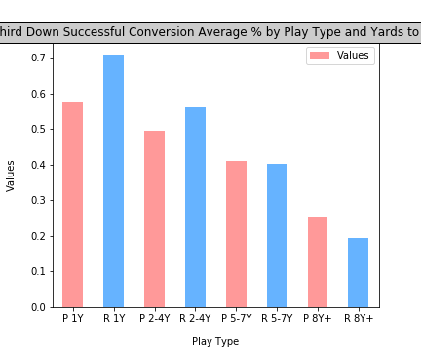
Notes:
RICARDO

Slide 15
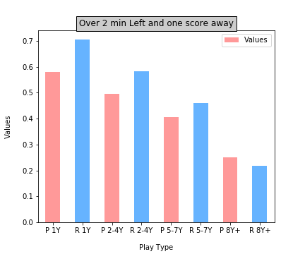
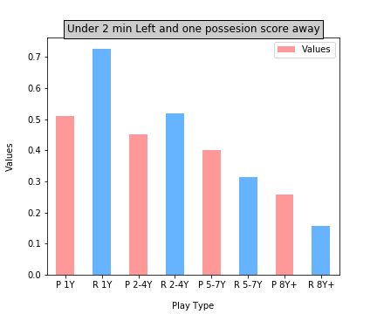
Notes:
RICARDO

Slide 16
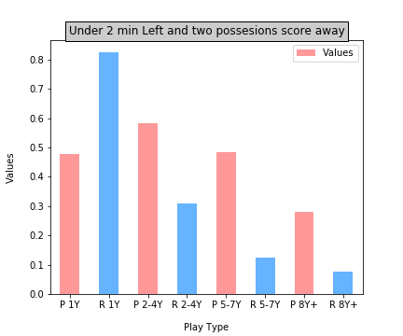
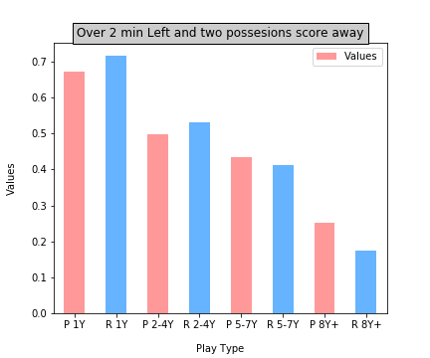
Notes:
RICARDO

Slide 17
fin

