Slide 1

Data Analysis with Power BI
Anastasia Nikonorova
Microsoft Student Partner
City life, Business analyst
a.nikonorova@clcorp.ru
cl.World
Julia Valentinova
Microsoft Student Partner
julia.vav@gmail.com

Slide 2
Versions
Power BI Desktop
Hundreds of data sources
Data processing
Custom visualizations
Direct connection with DB
Relationships between tables
Dax and PowerQuery scripts
Power BI Pro
Dashboards that deliver a 360-degree, real-time view of the business
Keep data up-to-date automatically
Collaborate on shared data with your team
Control data access
Power BI Premium
Gain dedicated capacity you allocate, scale, and control
Publish reports on-premises with Power BI Report Server
Unlock more capacity and higher limits for your Pro users
*Also there is a mobile and web versions for accessing data at any time.

Slide 3
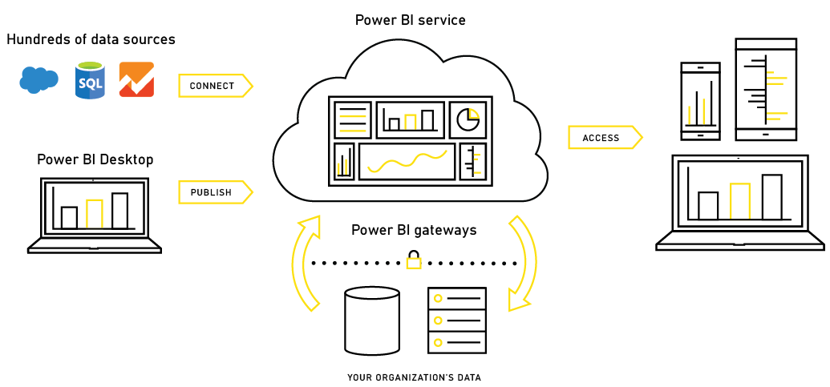
Structure of connections

Slide 4
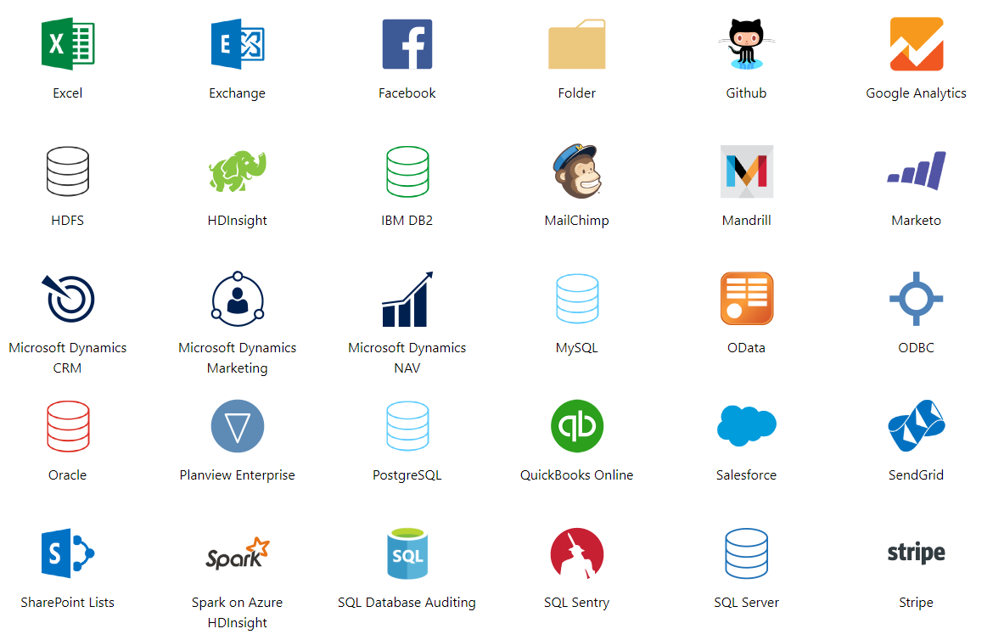
Sources

Slide 5



Connecting to the database
Import using SQL
DirectQuery
Power BI Gateway

Slide 6

Thank you for your
attention!

