Slide 1
Noxious Data Analysis

Slide 2
Setup and Questions
Dataset consists of population neuronal response (153 neurons) across various stimulus conditions and trials.
4 conditions: Cold Noxious, Hot Noxious, Aversive, Tail Shock
~ 15 trials per condition
After stimulus onset alignment, each trial is 25 seconds with a 10 Hz frame rate.
Goals
Can cells be clustered based on their response to the different stimuli?
Does the population activity encode the different stimuli
Visualizing pop activity in PCA space
Decoding stimulus condition
How many neurons needed to decode stimulus condition?

Slide 3
Preliminary results
06.04.25

Slide 4
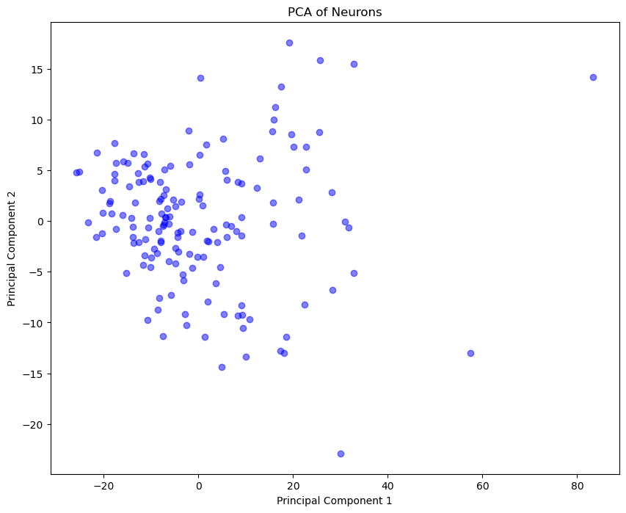
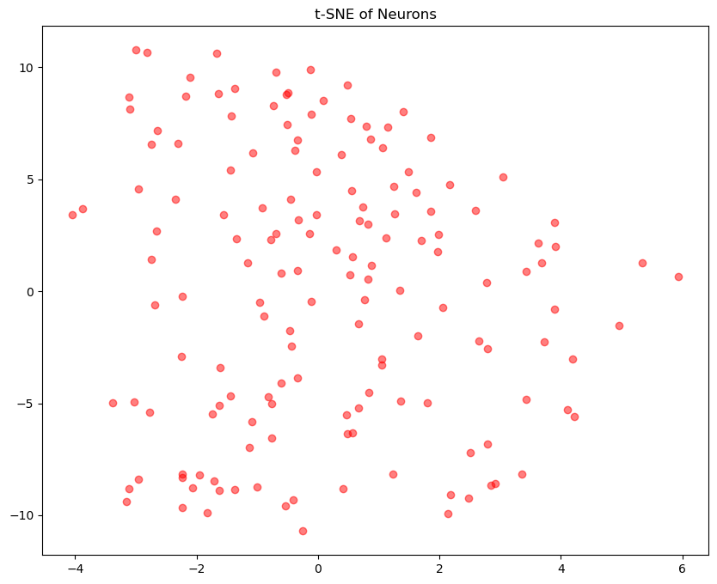
Cell Clustering
After reshaping the data to (cell, stimxtrialxtime), we can project into low dimensional space with PCA or tSNE
Each point represents 1 cell
Seems there is not distinct clusters. If there were, could use clustering methods to label clusters.

Slide 5
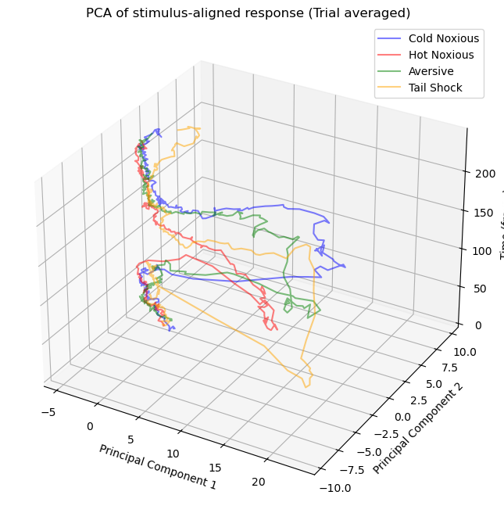
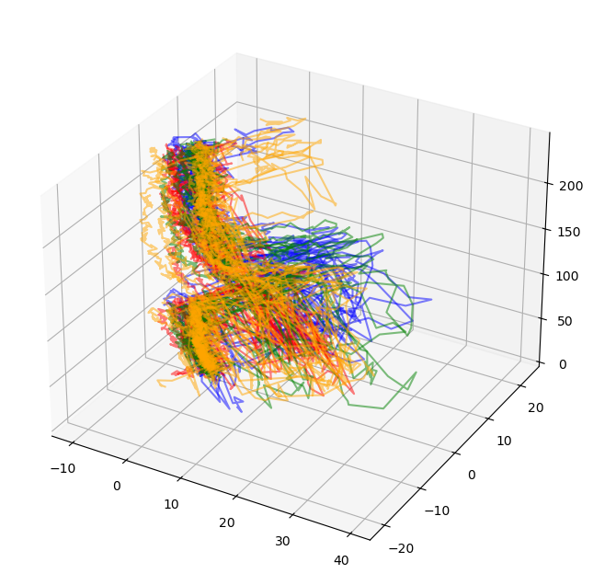
PCA population activity trajectories
Now we can look at the trajectory of each trial in PCA space of population activity
Time(s)
When averaging across stimulus conditions, we see distinct trajectories per stimulus condition.
However looking at each trial we do see a lot of noise within each stimulus condition.
It is nice that the baseline and end for each condition/trial is the same.

Slide 6
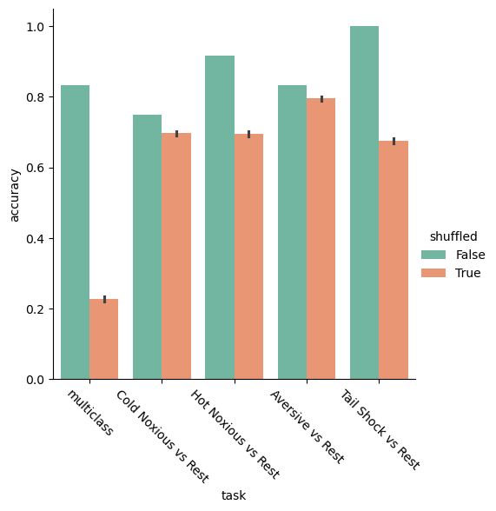
SVM decoding of stimulus condition
Per previous work, we try to classify each trial into its stimulus condition based on population activity over time.
We can either do multiclass classification or do any stimulus condition vs. rest (binary classification). We compare against shuffled baseline.
The population activity clearly is able to distinguish between different stimuli in comparison to baseline, but some are easier to distinguish than others.
Things to do more:
Look at confusion matrix which shows which conditions are hardest to distinguish from each other
Look at weights to understand which cells/time points are most important for distinguishing

Slide 7
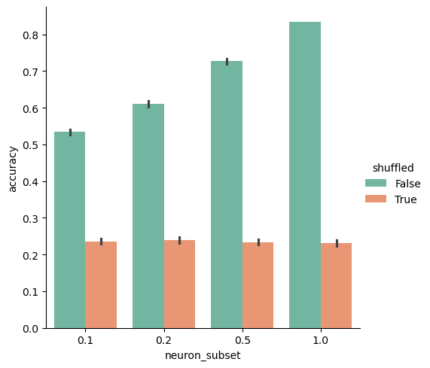
How many neurons needed to classify?
For the multiclass classification, we can ask how many neurons are needed to successfully classify the stimulus condition? We randomly subset the neuron population based on a percentage (0.1, 0.2, 0.5, 1.0) and perform the multiclass classification with SVM.

