Slide 1
Quantifying Sky Signals: Simulating Visibility Correlations in Radio Interferometry
Julia Zimmerman
Institute for Computing in Research
August 1st, 2025

Slide 2
What is Radio Interferometry?

Slide 3
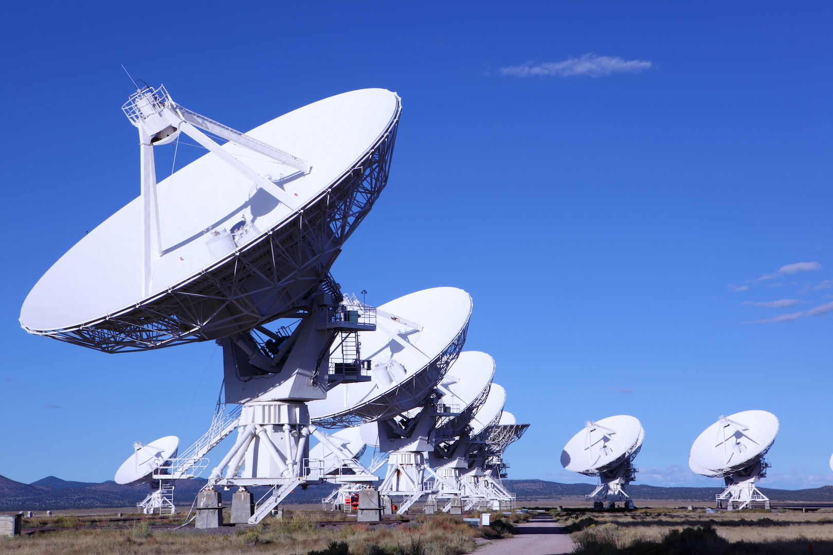
What is Radio Interferometry?

Slide 4
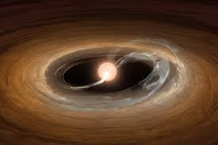
What is Radio Interferometry?

Slide 5
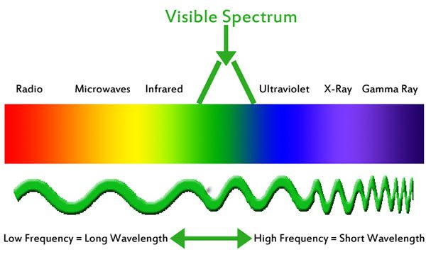
What is Radio Interferometry?

Slide 6
Why Radio Interferometry?

Slide 7
Why Radio Interferometry?

Slide 8
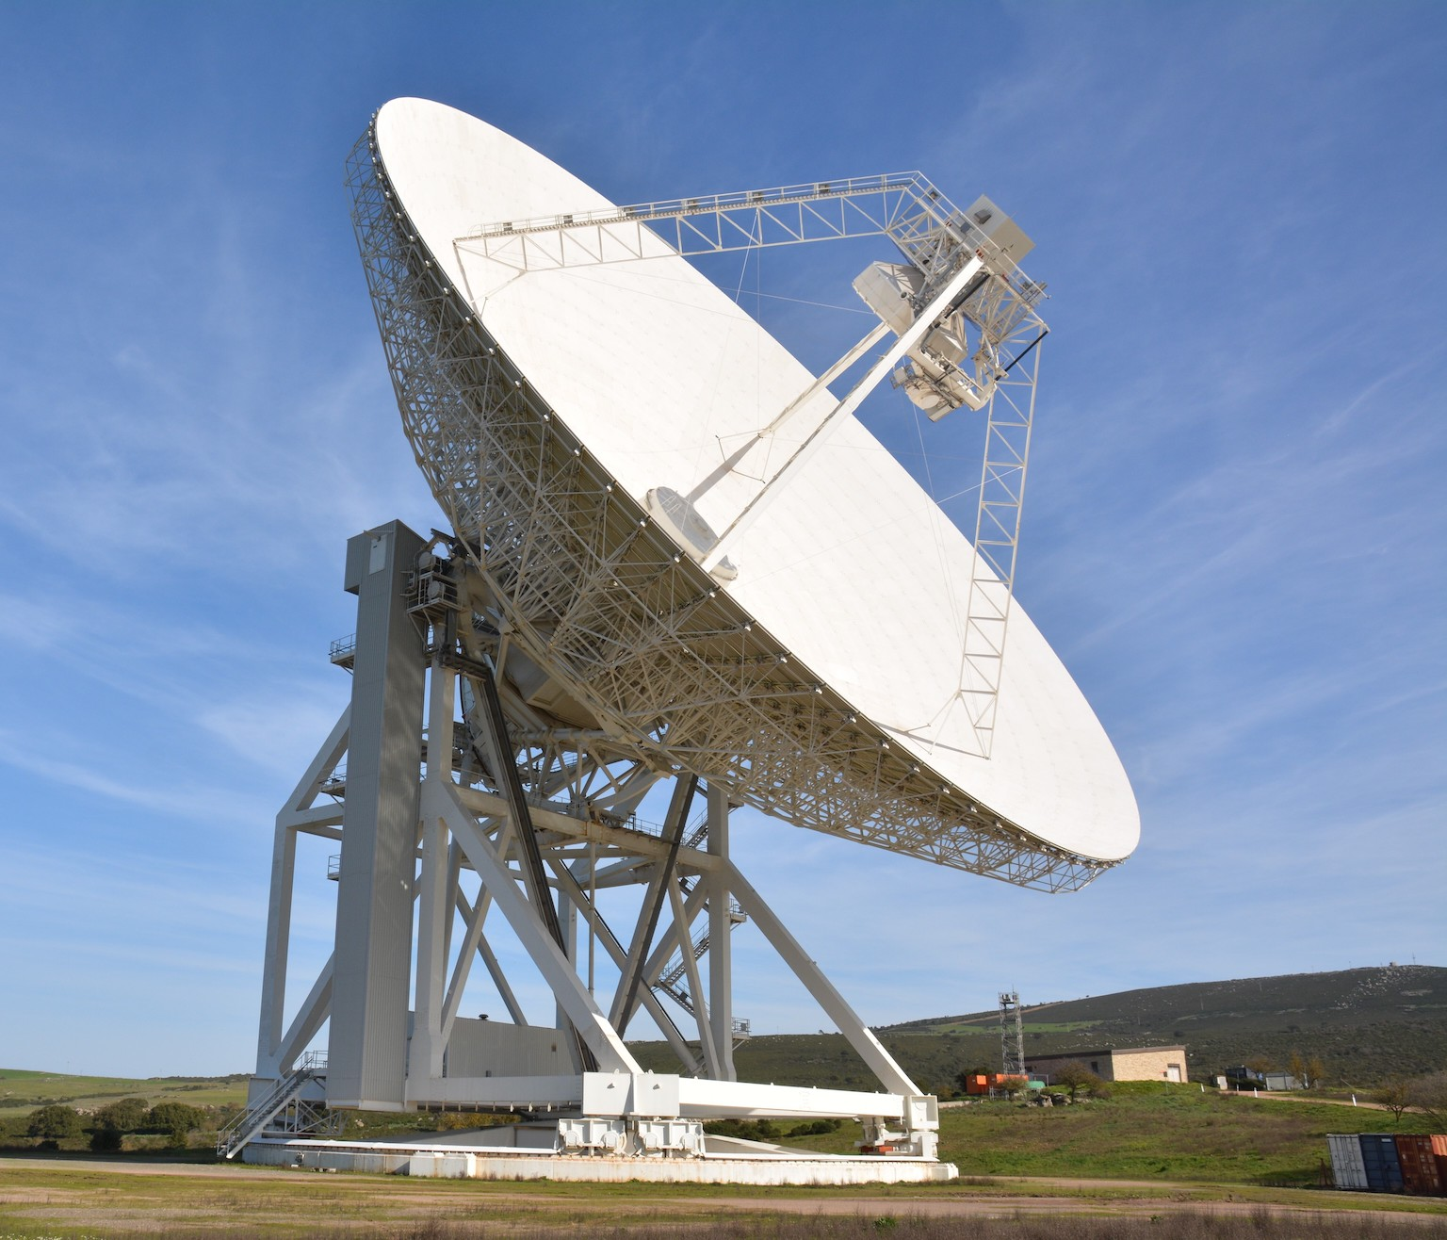
How Does it Work?

Slide 9
How Does it Work?

Slide 10
How Does it Work?
ŝ
ŝ

Slide 11
How Does it Work?
ŝ
ŝ
𝑏⃗

Slide 12
How Does it Work?
ŝ
ŝ
𝑏⃗
d

Slide 13
How Does it Work?
ŝ
ŝ
𝑏⃗
d

Slide 14
How Do You Calculate Visibility?

Slide 15
How Do You Calculate Visibility?

Slide 16
How Do You Calculate Visibility?

Slide 17
How Do You Calculate Visibility?

Slide 18
How Do You Calculate Visibility?

Slide 19
How Do You Calculate Visibility?

Slide 20
How Do You Calculate Visibility?

Slide 21
How Do You Calculate Visibility?

Slide 22
How Do You Calculate Visibility?

Slide 23
How Do You Calculate Visibility?

Slide 24
Calculating the Unit Vector
ICRS Coordinate

Slide 25
Calculating the Unit Vector
ICRS Coordinate
Altitude Azimuth
Coordinate

Slide 26
Calculating the Unit Vector
ICRS Coordinate
Altitude Azimuth
Coordinate
Cartesian
Coordinate

Slide 27
Calculating the Unit Vector
ICRS Coordinate
Altitude Azimuth
Coordinate
Cartesian
Coordinate
NEU Coordinates?

Slide 28
Calculating the Unit Vector
ICRS Coordinate
Altitude Azimuth
Coordinate
Cartesian
Coordinate
NEU Coordinates?

Slide 29
How Does the Simulation Work?
* Using Astropy, Numpy

Slide 30
How Does the Simulation Work?
* Using Astropy, Numpy
Starting time, duration, total time
points

Slide 31
How Does the Simulation Work?
* Using Astropy, Numpy
Starting time, duration, total time
points
Time Array

Slide 32
How Does the Simulation Work?
* Using Astropy, Numpy
Starting time, duration, total time
points
Time Array
Offsets of antenna array location
in East, North, Up
Coordinates

Slide 33
How Does the Simulation Work?
* Using Astropy, Numpy
Starting time, duration, total time
points
Time Array
Offsets of antenna array location
in East, North, Up
Coordinates
Baseline,Antenna
Array

Slide 34
How Does the Simulation Work?
* Using Astropy, Numpy
Starting time, duration, total time
points
Time Array
Offsets of antenna array location
in East, North, Up
Coordinates
Baseline,Antenna
Array
List of Right Ascension,
Declination
coordinates

Slide 35
How Does the Simulation Work?
* Using Astropy, Numpy
Starting time, duration, total time
points
Time Array
Offsets of antenna array location
in East, North, Up
Coordinates
Baseline,Antenna
Array
List of Right Ascension,
Declination
coordinates
Source Array

Slide 36
How Does the Simulation Work?
* Using Astropy, Numpy
Starting time, duration, total time
points
Time Array
Offsets of antenna array location
in East, North, Up
Coordinates
Baseline,Antenna
Array
List of Right Ascension,
Declination
coordinates
Source Array
Unit vector, baseline vector
dot product-ed, divided by
speed of light

Slide 37
How Does the Simulation Work?
* Using Astropy, Numpy
Starting time, duration, total time
points
Time Array
Offsets of antenna array location
in East, North, Up
Coordinates
Baseline,Antenna
Array
List of Right Ascension,
Declination
coordinates
Source Array
Unit vector, baseline vector
dot product-ed, divided by
speed of light
Geometric Time
Delay

Slide 38
How Does the Simulation Work?
* Using Astropy, Numpy
Starting time, duration, total time
points
Time Array
Offsets of antenna array location
in East, North, Up
Coordinates
Baseline,Antenna
Array
List of Right Ascension,
Declination
coordinates
Source Array
Unit vector, baseline vector
dot product-ed, divided by
speed of light
Geometric Time
Delay
Amplitude, frequency information

Slide 39
How Does the Simulation Work?
* Using Astropy, Numpy
Starting time, duration, total time
points
Time Array
Offsets of antenna array location
in East, North, Up
Coordinates
Baseline,Antenna
Array
List of Right Ascension,
Declination
coordinates
Source Array
Unit vector, baseline vector
dot product-ed, divided by
speed of light
Geometric Time
Delay
Amplitude, frequency information

Slide 40
How Does the Simulation Work?
* Using Astropy, Numpy
Starting time, duration, total time
points
Time Array
Offsets of antenna array location
in East, North, Up
Coordinates
Baseline,Antenna
Array
Visibility
List of Right Ascension,
Declination
coordinates
Source Array
Unit vector, baseline vector
dot product-ed, divided by
speed of light
Geometric Time
Delay
Amplitude, frequency information

Slide 41
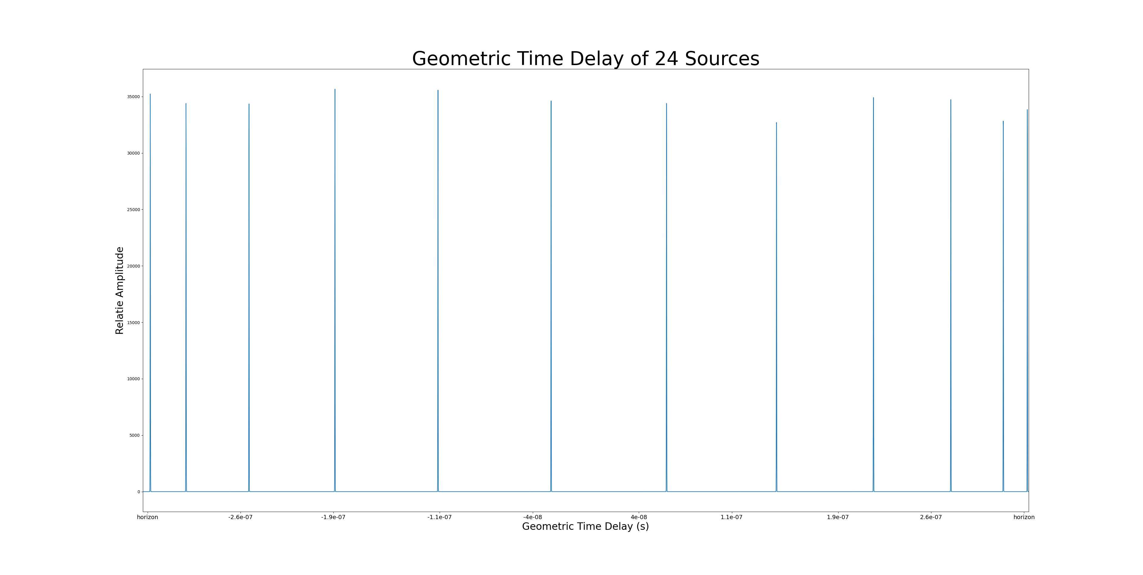
Results

Slide 42
Limitations

Slide 43
Limitations
Simplification

Slide 44
Limitations
Simplification
Amplitudes

Slide 45
Future Improvements

Slide 46
Future Improvements
More Amplitudes

Slide 47
Future Improvements
More Amplitudes
Parallelization

Slide 48
Future Improvements
More Amplitudes
Parallelization
User Input

Slide 49
Closing
Radio waves / Radio interferometry lets us observe the sky in more detail
Simulation inputs amplitude, time, frequency,antenna positions, source locations, array location. Computes visibility
Use visibility for analysis, like geometric time delay analysis

Slide 50
Thank you!
Questions?

Slide 51
Image References
https://www.space.com/very-large-array.html
https://www.kent.ac.uk/news/science/20641/kent-researcher-helps-identify-young-star-caught-in-a-fit-of-growth
https://www.shineretrofits.com/lighting-center/faq/electromagnetic-spectrum/?srsltid=AfmBOormiM_ZT1GqbmNNV5AmbMJZt4AyKo8LixdQTIG_hjR1Ttf5ahW7 https://www.satellitetoday.com/government-military/2024/10/04/telespazio-wins-italian-deep-space-antenna-contract/

