Slide 1
Differential Equations and the Simple and Damped Harmonic Oscillator
Julia Zimmerman
Institute for Computing in Research

Slide 2
What is a differential equation?

Slide 3
Differential Equation Example:

Slide 4
Differential Equation Example:

Slide 5
Differential Equation Example:

Slide 6
Differential Equation Example:

Slide 7
Differential Equation Example:

Slide 8
Differential Equation Example:

Slide 9
How are they used in Physics?
Why are they useful?

Slide 10
How are they used in Physics?
How are they used in Physics?

Slide 11
How are they used in Physics?
Solving the Simple Harmonic Oscillator

Slide 12
How are they used in Physics?

Slide 13
How are they used in Physics?

Slide 14
How are they used in Physics?

Slide 15
How are they used in Physics?

Slide 16
How are they used in Physics?

Slide 17
How are they used in Physics?

Slide 18
How are they used in Physics?

Slide 19
How are they used in Physics?

Slide 20
How are they used in Physics?

Slide 21
How are they used in Physics?

Slide 22
How are they used in Physics?

Slide 23
How are they used in Physics?

Slide 24
How are they used in Physics?

Slide 25
How are they used in Physics?
Solving the Damped Harmonic Oscillator

Slide 37
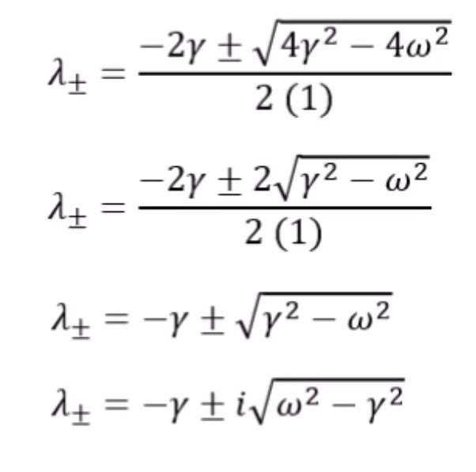

Slide 38
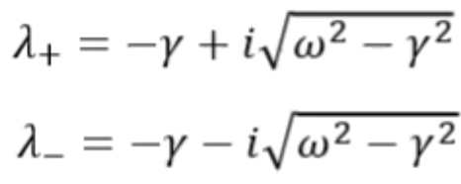

Slide 39
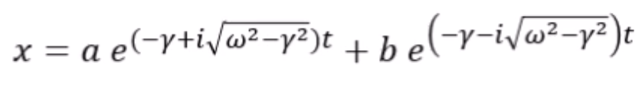

Slide 40
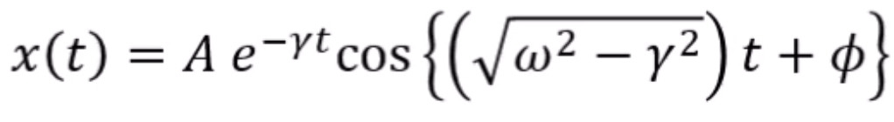

Slide 41


Slide 42
Thank you! Any questions?

