Slide 1
Category review: Chips
June 2020
Retail Analytics
Brand note: If client logo is not required, use alternate title page layout right click slide thumbnail > Layout > Title

Slide 2
Notes:
To view Privacy video explaining how important data privacy is to Quantium, please click here: https://www.youtube.com/watch?v=Zq1QDAkoRzU
or here Q:\Company Reference\Brand & Design\Brand videos\Q Privacy.mp4
At Quantium, we believe that data is the behavioural footprint of humanity and that it has to be treated with the utmost care and responsibility.
Histories, attitudes, indeed lives are stored within it in ways that aren’t always apparent – and that’s what makes its potential so powerful.
To work with it responsibly, sensitively, we set ourselves the highest data privacy protection and governance standards.
We have spent 17 years perfecting privacy-by-design and secure-by-design principles. Central to this is not holding any personally identifiable information about people –
we neither receive it, and put the necessary protections in place to be unable to decipher it.
Every aspect of handling data is safeguarded: from its de-identification, to its encryption – data security is paramount and of the highest grade.
We pride ourselves on gaining the trust of iconic organisations around the world through years of securely working with their data,
and in turn the trust that builds with their stakeholders.

Slide 3
Executive summary
Key Insights
Recommendations
01
Customer Analytics
Category sales have mainly been from Budget – older families, Mainstream – young single/couples, and Mainstream – retirees shoppers.
The high spend in chips for mainstream young singles/couples and retirees is due to there being more of them than other buyers.
Mainstream, midage and young singles and couples are also more likely to pay more per packet of chips. This is indicative of impulse buying behaviour.
Mainstream – young single/couples segment is the most potential pool to target.
We can relocate some Tyrrells and smaller packs of chips in discretionary space near segments where this segment frequent visits to increase visibilty and impulse behaviour.
02
Trial Store Performance Analysis
The results for trial stores 77 and 88 during the trial period show a significant difference in at least two of the three trial months.
But the new trial layout just improved the number of customers in Store 86 while total sales were not significantly higher.
Further investigation should be conducted if the implementation of the trial was different in trial store 86, such as any special offers which can reduce the product price.

Slide 4
Executive summary
Key Insights
Recommendations
01
Customer Analytics
Category sales have mainly been from Budget – older families, Mainstream – young single/couples, and Mainstream – retirees shoppers.
The high spend in chips for mainstream young singles/couples and retirees is due to there being more of them than other buyers.
Mainstream, midage and young singles and couples are also more likely to pay more per packet of chips. This is indicative of impulse buying behaviour.
Mainstream – young single/couples segment is the most potential pool to target.
We can relocate some Tyrrells and smaller packs of chips in discretionary space near segments where this segment frequent visits to increase visibilty and impulse behaviour.
02
Trial Store Performance Analysis
The results for trial stores 77 and 88 during the trial period show a significant difference in at least two of the three trial months.
But the new trial layout just improved the number of customers in Store 86 while total sales were not significantly higher.
Further investigation should be conducted if the implementation of the trial was different in trial store 86, such as any special offers which can reduce the product price.

Slide 5
01
Customer Analytics

Slide 6
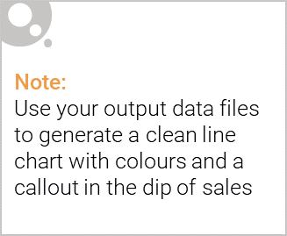
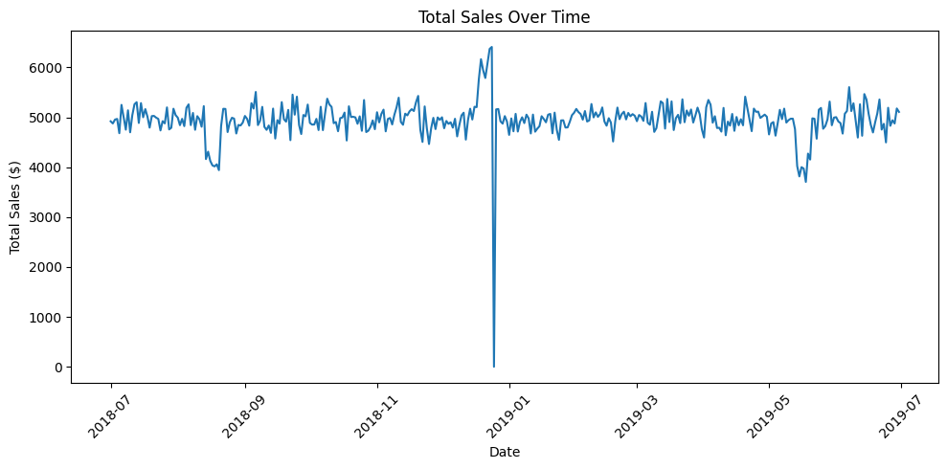
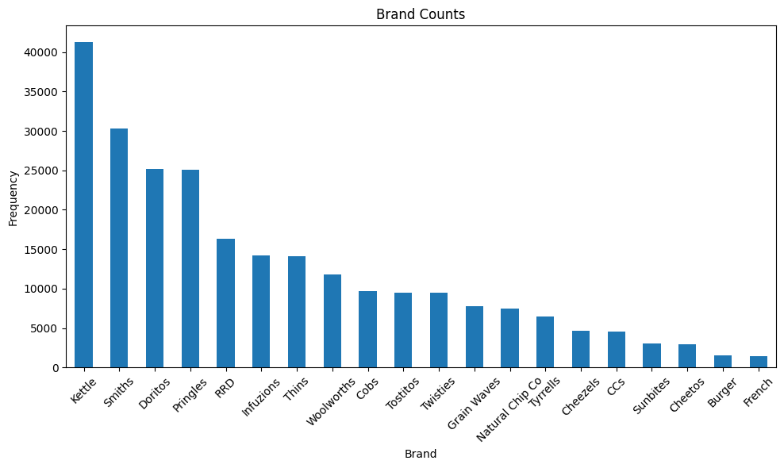
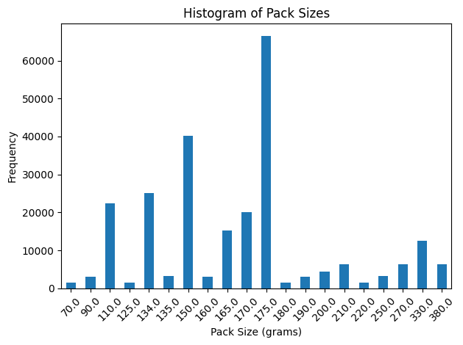
Overview: The chips category is fairy stable with Kettle leading the market
The lead-up to Christmas
Total sales remain fairly stable over time, fluctuating around a consistent level ($4.5K - $5.5K/day).
There is a sharp spike in Christmas season, followed by a dip as shops closed on Christmas Day.
In general, Kettle is the most popular brand, followed by Smiths, Doritos, and Pringles.
175g is the most frequently sold pack size.
Shops closed on Christmas Day
This analysis will focus on customer segment analysis and uplift testing for the new trial layout.

Slide 7
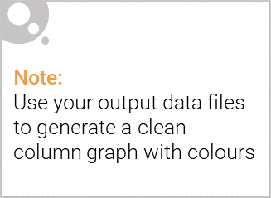
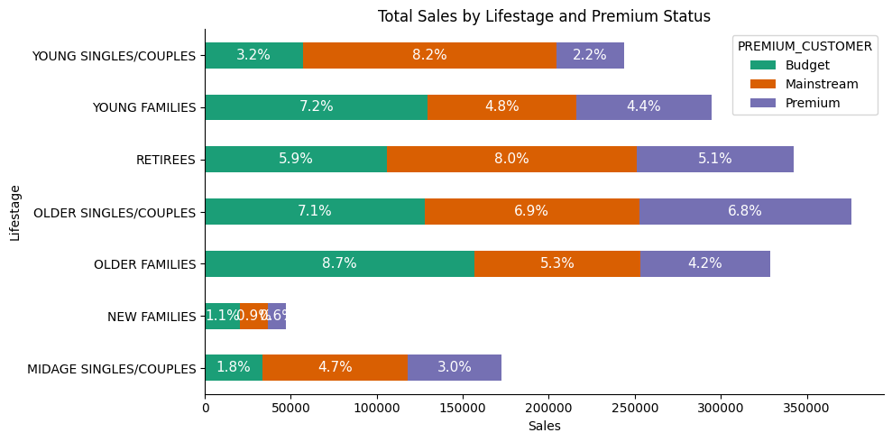
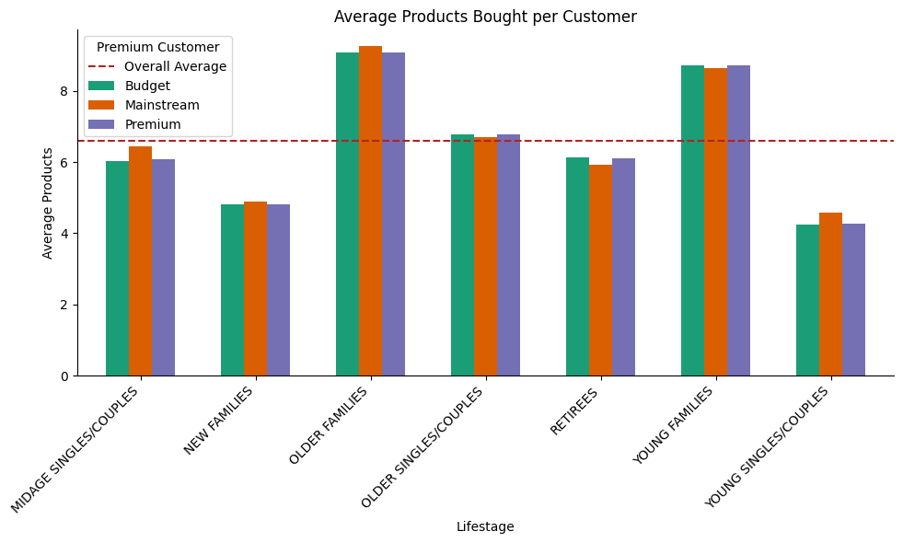
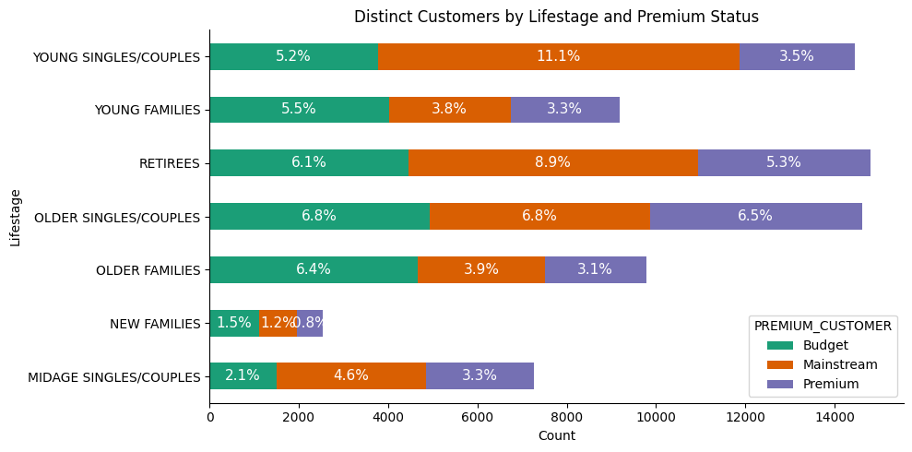
Mainstream - young singles/couples is a potential segment with the highest number of customers and the second highest sales
[1]
Sales are coming mainly from Budget - older families [3], Mainstream - young singles/couples [1], and Mainstream – retirees [2].
While there are more Mainstream - young singles/couples [1] and Mainstream – retirees [2] who buy chips leading to the higher sales, this is not the case for Budget - older families [3].
Older and Young families in general buy more chips per customer.
[2]
[3]
[1]
[3]
[2]
[3]

Slide 8
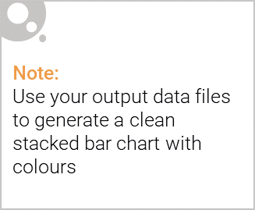
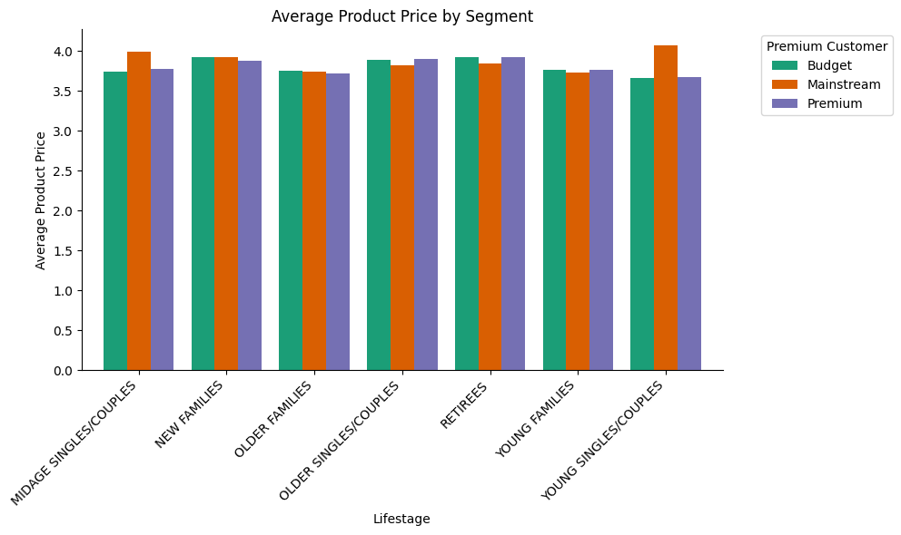
Editable (delete this)
Mainstream - young singles/couples is also more willing to pay more per packet of chips compared to its budget and premium counterparts.
statistically different
Mainstream midage and young singles and couples are more willing to pay more per packet of chips compared to their budget and premium counterparts.
This may be due to premium shoppers being more likely to buy healthy snacks and when they buy chips, this is mainly for entertainment purposes rather than their own consumption. This is also supported by there being fewer premium midage and young singles and couples buying chips compared to their mainstream counterparts.

Slide 9
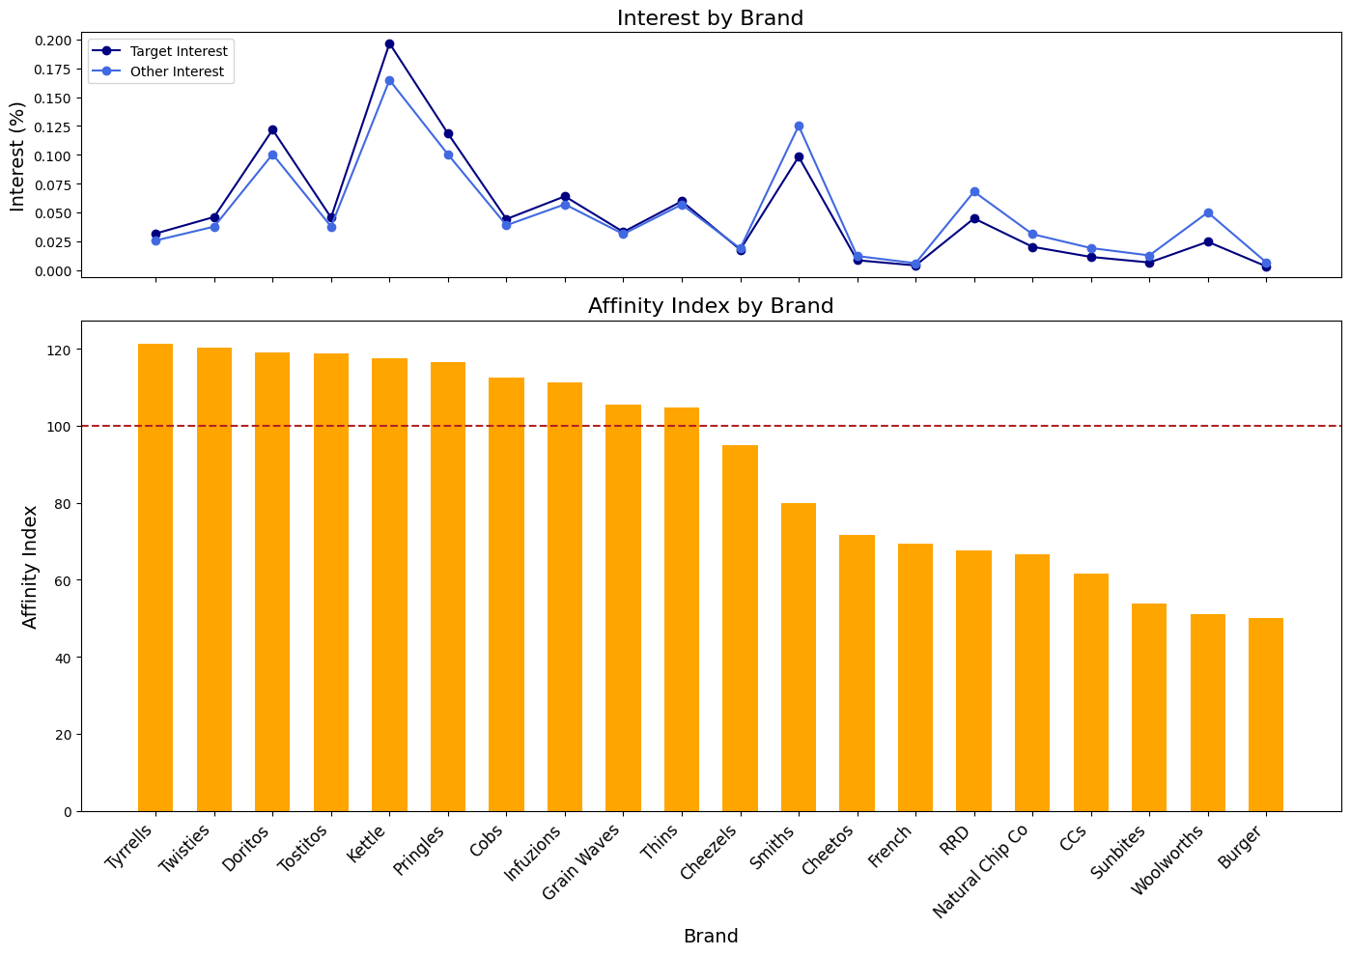
Editable (delete this)
Tyrrells chips should be prioritized to target Mainstream - young singles/ couples segment
Tyrells, though not being widely popular, has the highest affinity index. This brand should be prioritized in marketing campaigns targeting this specific group, such as off-locating in discretionary space near segments where young singles and couples frequent more often to increase visibilty and impulse behaviour.
Kettle has the highest "Target Interest" among all brands, indicating that it is still the most popular brand among the target audience. This brand also has a high affinity index for our target group with 18% more likely to buy than other groups.
Smiths, RRD, and Woolworths have high "Other Interest" and low affinity index, suggesting that while they are popular among the general audience, they may not be as strongly preferred by the target group. Those brands might not be suitable for attracting this group.
Affinity index: A metric used to measure how closely a target audience is related to a brand, product, or service. It compares the percentage of a target group that interacts with a brand to the percentage of the general population that interacts with the same brand. Values above 100 indicate a higher affinity and values below 100 indicate a lower affinity.

Slide 10
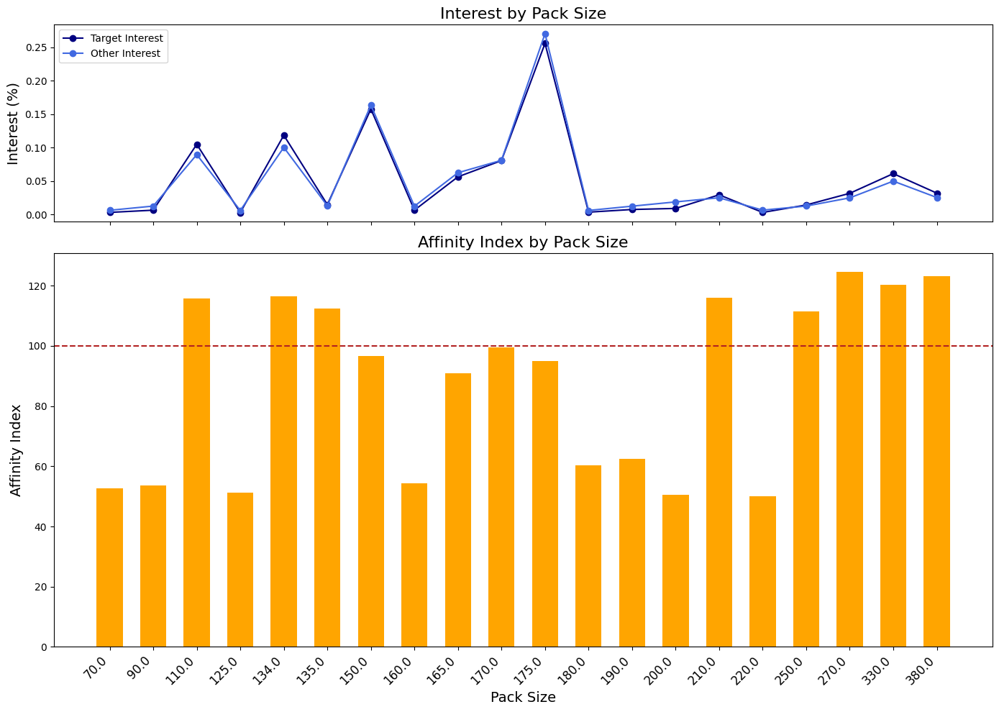
Editable (delete this)
Chips in small sizes are more attractive to Mainstream - young singles/ couples segment
150g and 175g seem have the highest interest for both target and other groups, but a slightly low affinity index, indicating that even though these two pack sizes are widely popular, it might be more suitable for mass promotions and campaigns.
Instead, some smaller sizes including 110g and 134g are 16% more attractive to our targeted group compared to others. These sizes might work well for targeted marketing campaigns.
Moreover, some bigger sizes (270g, 330g, and 380g) show lower interest but have relatively high affinity of above 20%, indicating that they may be preferred by a more specific segment, such as couples.
Affinity index: A metric used to measure how closely a target audience is related to a brand, product, or service. It compares the percentage of a target group that interacts with a brand to the percentage of the general population that interacts with the same brand. Values above 100 indicate a higher affinity and values below 100 indicate a lower affinity.

Slide 11
02
Trial Store Performance Analysis

Slide 12
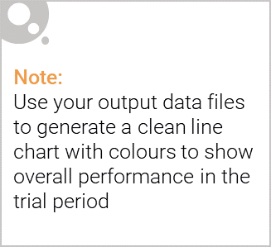
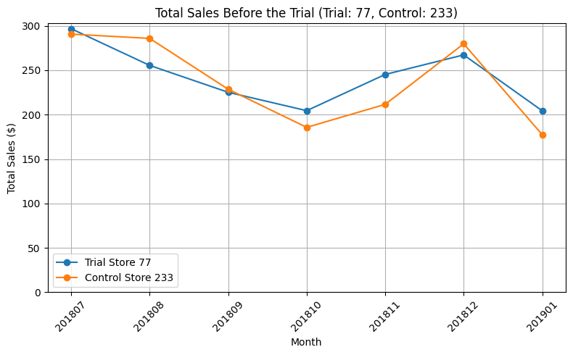
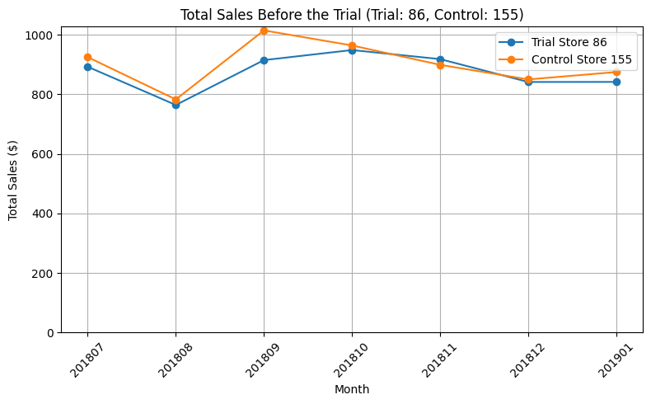
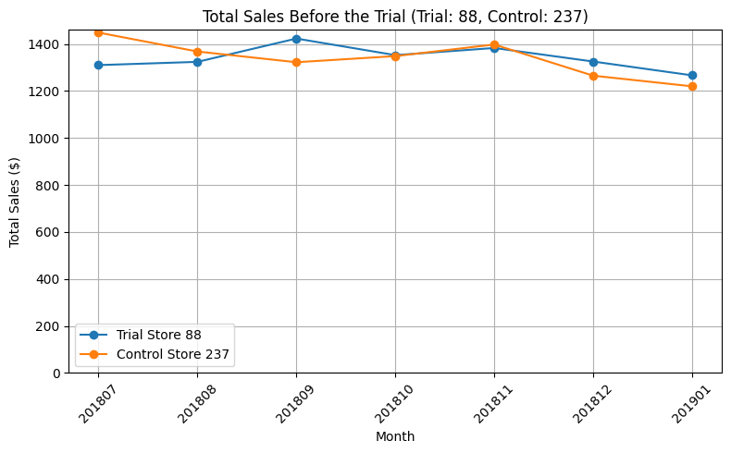
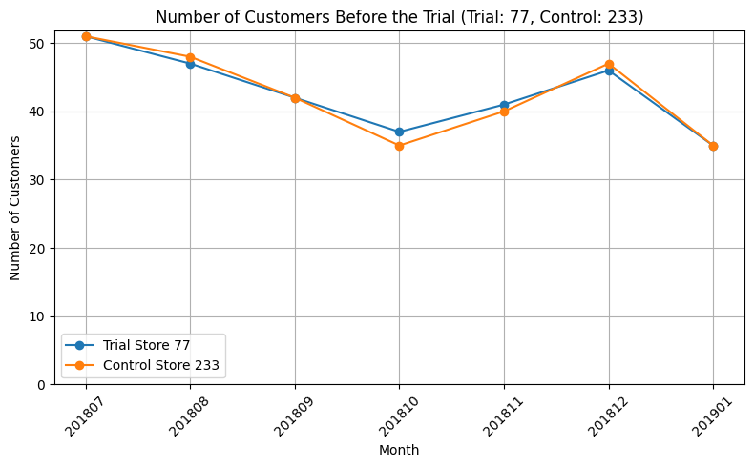
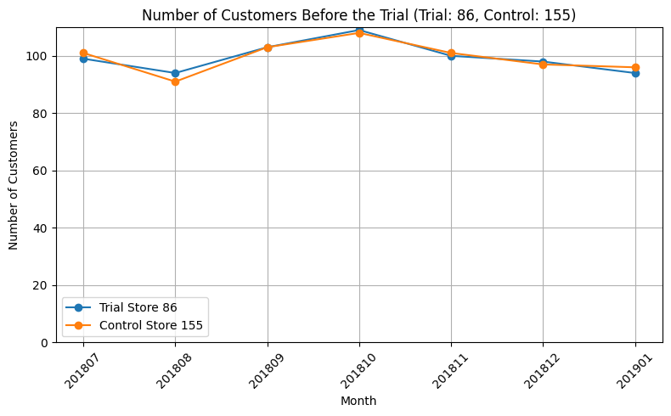
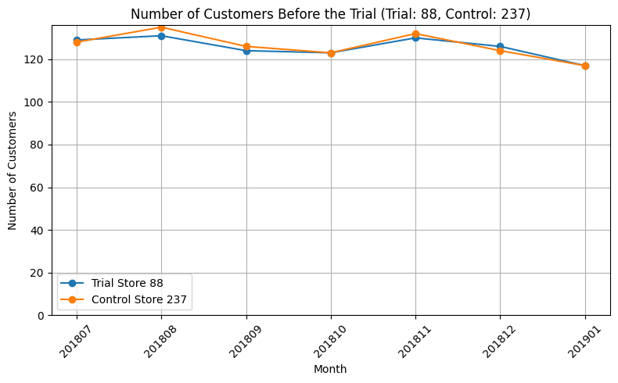
Control stores are selected based on the correlation and magnitude distance with the Trial stores for relevant evaluation
A new trial layouts were introduced in Store 77, Store 86, and Store 88 (Trial stores).
Control stores which had the same performance with Trial stores before the trial period are identified as a baseline to compare performance. The selected control stores has the highest similarity score with one of the trial stores, which is calculated based on correlation (50%) and magnitude distance (min-max distance) (50%) of total sales and number of customers between each pair of trial and control stores.
Final selection: (Trial 77 – Control 233), (Trial 86 – Control 155), (Trial 88 – Control 237)

Slide 13
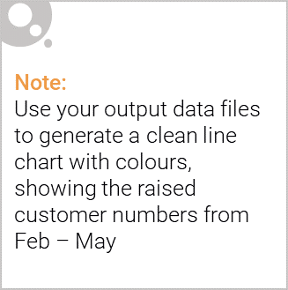
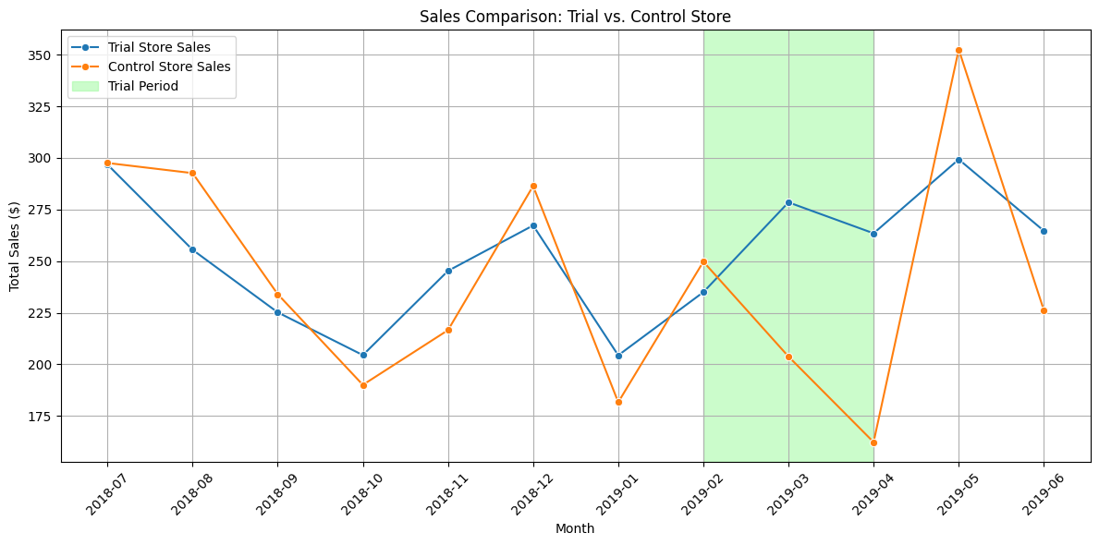
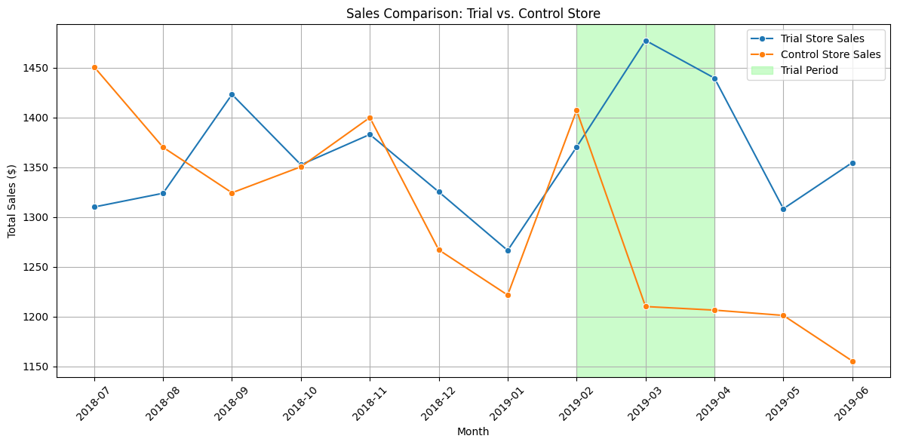
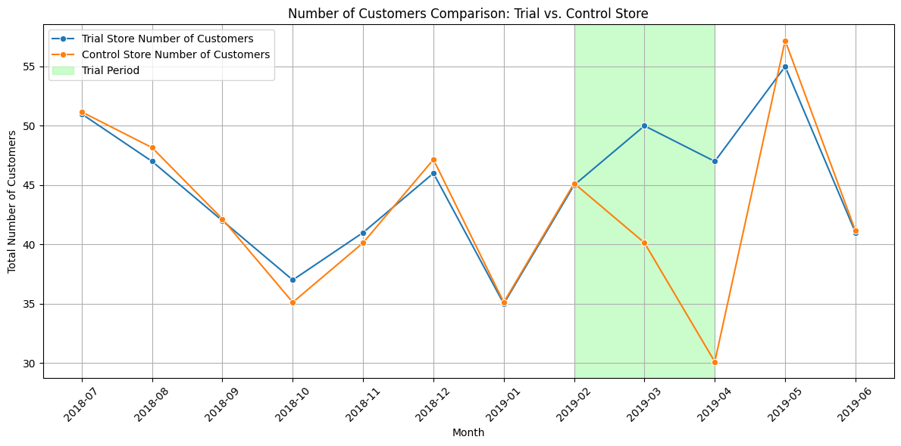
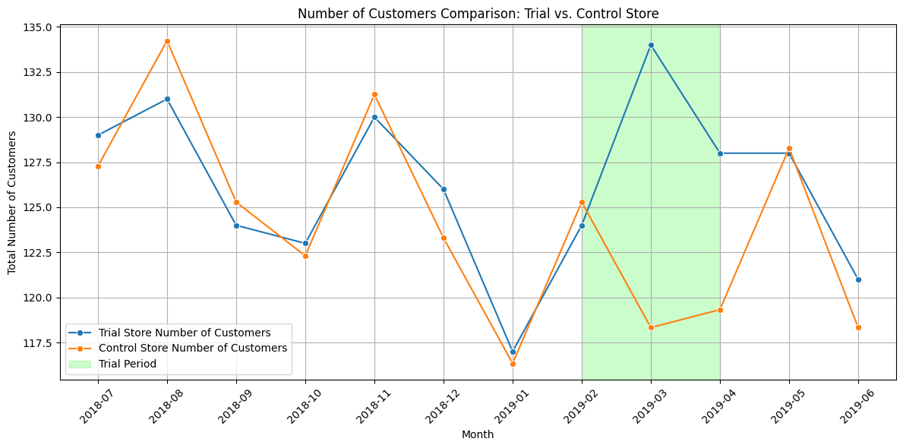
Store 77 and Store 88 was successfully implemented the new trial layout with 2 of 3 months outperforming in both sales and number of customers
Trial 77 vs. Control 233
Trial 88 vs. Control 237
statistically different

Slide 14
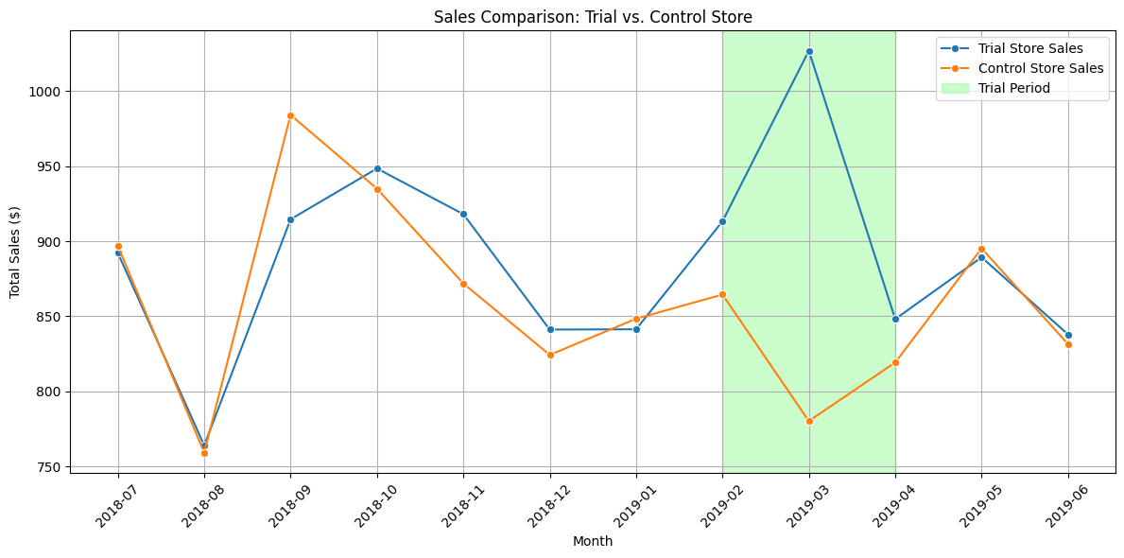
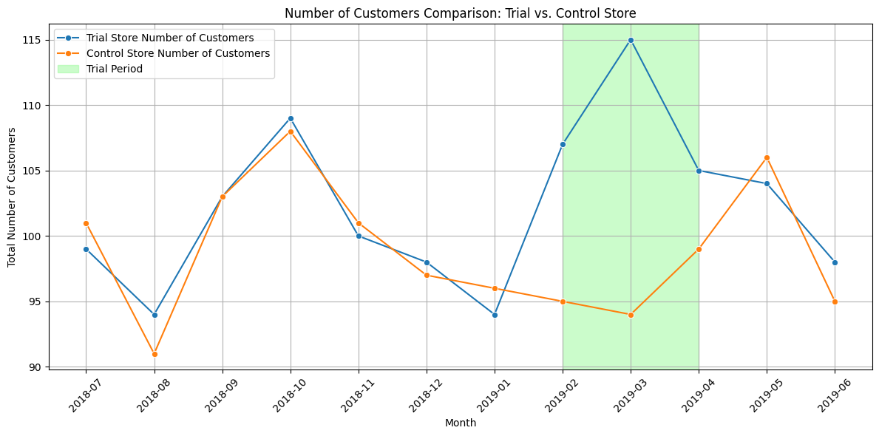
The new trial layout just improved the number of customers in Store 86 while total sales were not significantly higher
Trial 86 vs. Control 155
Total sales in Trial store 86 was statistically higher than its control store only in March.
While the number of customers outperformed in all 3 trial months.
This result suggests that there might be special deals in the trial store that may have resulted in lower prices.
statistically different

