Slide 1
ACI Script Demo for APO-ACI Class
Julie Rudolph
CDW

Slide 2
Goals of the Script
For each tenant that has the contract <contract-name> configured as an object, add a new Filter to that contract.
As of this writing, the login session info, contract name and filter information is hardcoded in the script.
Script uses the acitoolkit.
Name of script is “AddFiltertoContract.py”

Slide 3
Goals of the Script
In this example, we’ll be adding an ACL Entry that allows tcp/5060 to the existing contracts named “WebCt”

Slide 4
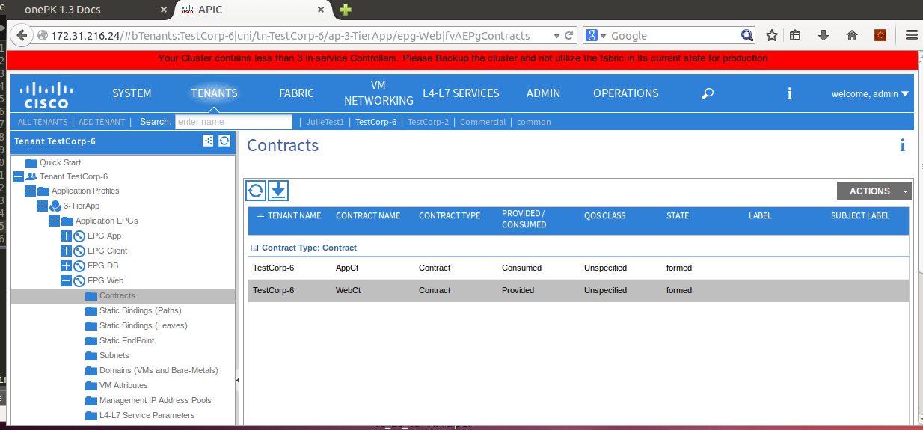
Tenant “TestCorp-6” is using a contract named “WebCt”

Slide 5
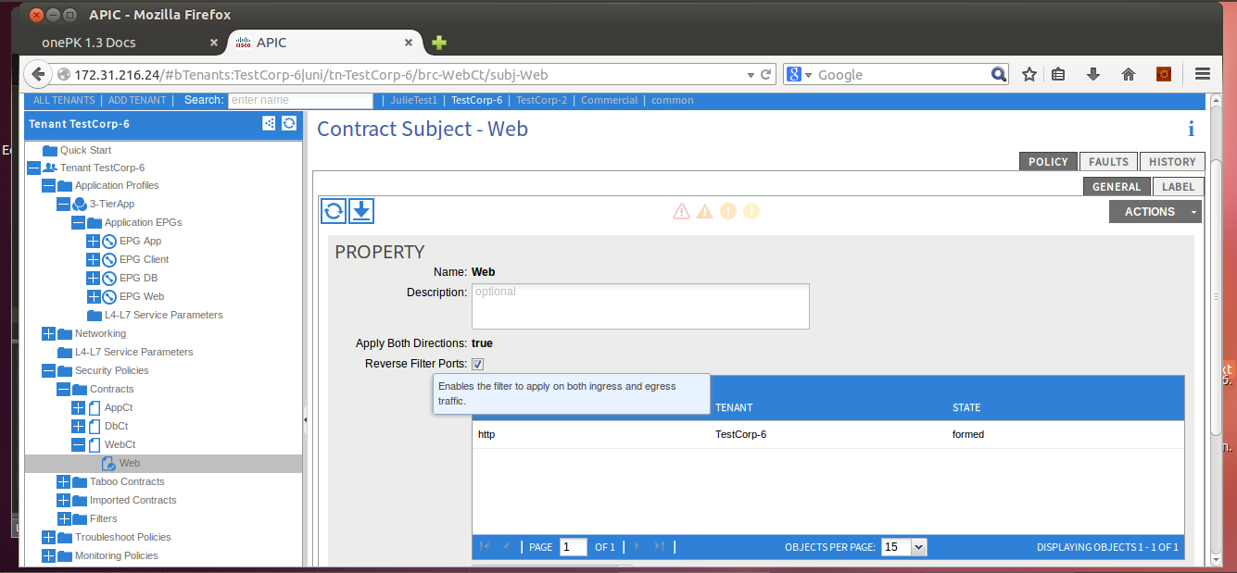
But, only one entry Currently in the TestCorp-6 WebCt contract

Slide 6
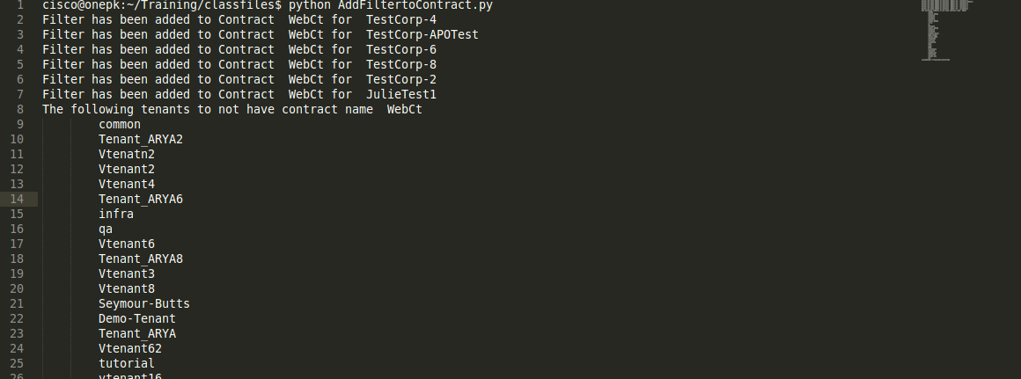
Run the Script

Slide 7
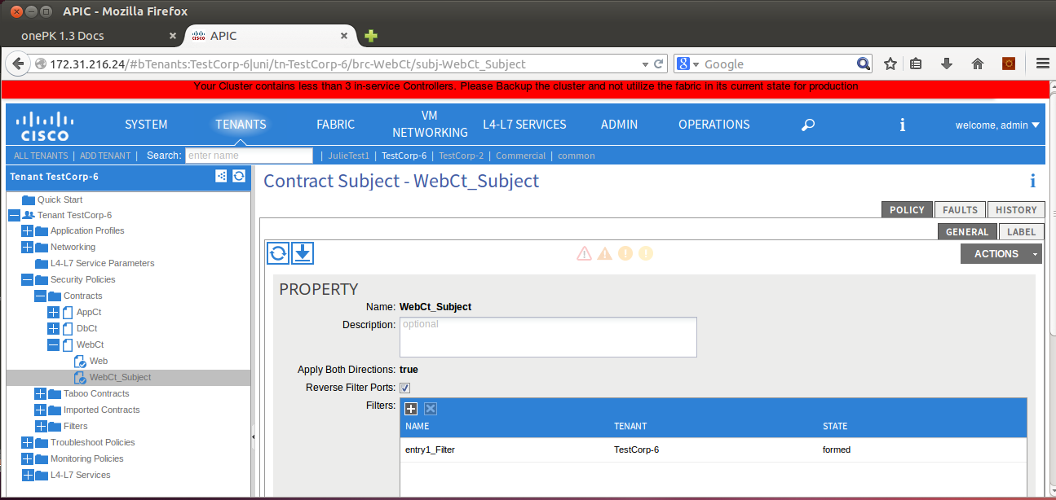
New Filter Entry is Now Added to Contract

Slide 8
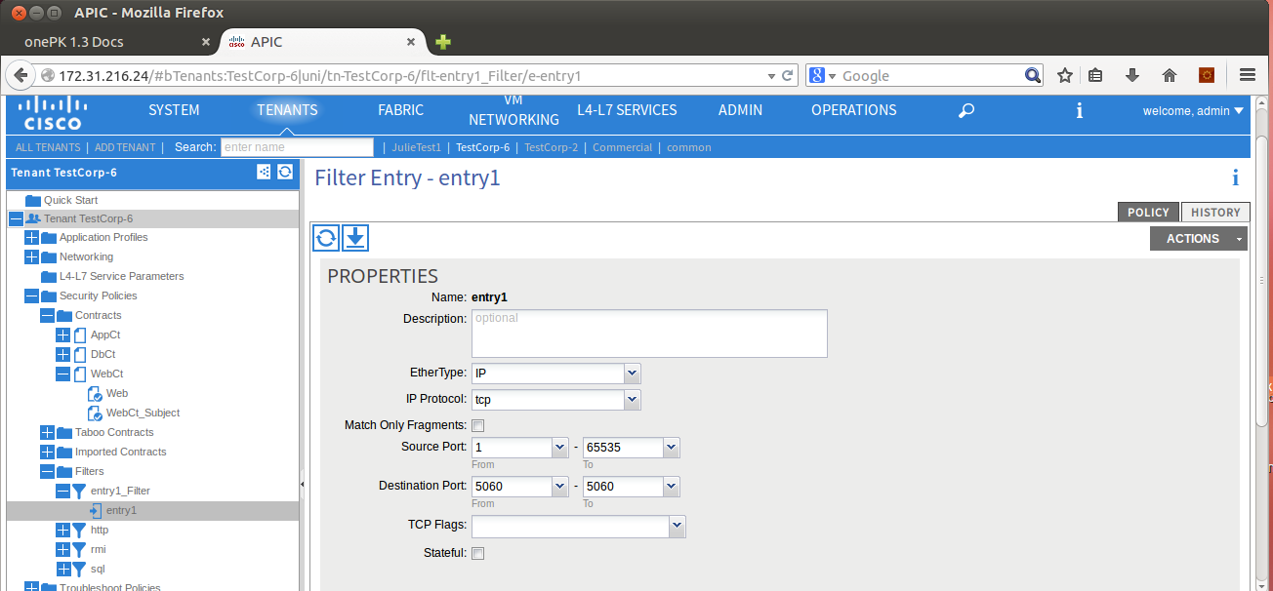
The Filter Allows tcp/5060, as configured in the script.

