Slide 1
OFDMA Transmission
OFDMA = Orthogonal Frequency-Division Multiple-Access
  Both modulation method (OFDM) and multiple-access method useful for broadband wireless communications which exhibit time-dispersion (multipath)
  Provides efficient (low-cost) transceiver structures based on FFT front-end processing when combined with a cyclic prefix
  Relatively simple high-performance channel estimation
  Optimal matched filtering due to orthogonalization of dispersive channel
Downside
  High peak-to-average power ratio
EURECOM LTE-Tutorial, Mobile Communications Department 2009

Slide 2





Blockwise Transmission with a Cyclic Prefix
OFDM symbol
samples
Information-bearing component -
samples
Cyclic-prefix :
samples
Cyclic-prefix chosen such that beginning and end of symbol are the same
i.e.
EURECOM LTE-Tutorial, Mobile Communications Department 2009

Slide 3
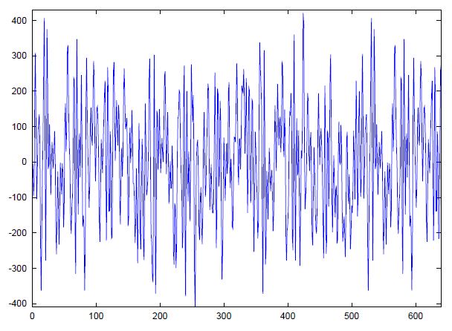
Blockwise Transmission with a Cyclic Prefix
PREFIX
(128)
INFORMATION
(512)
EURECOM LTE-Tutorial, Mobile Communications Department 2009

Slide 4
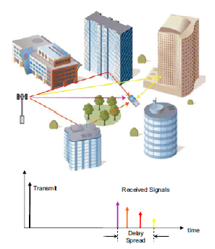
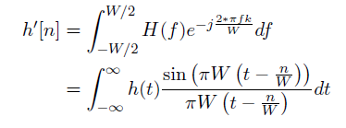
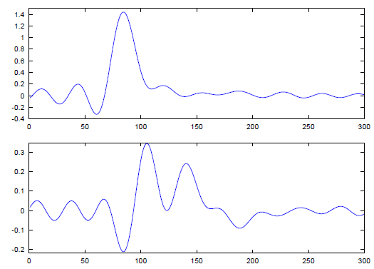

Multipath Propagation
Discrete-time channel seen by RX
EURECOM LTE-Tutorial, Mobile Communications Department 2009

Slide 5
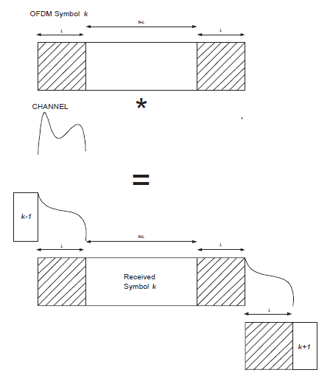
Multipath propagation
Cyclic prefix allows for block orthogonality if delay-spread of channel is shorter than L samples
Signal energy in prefix is neglected by receiver
Useful portion for RX,
energy from symbol k
only
EURECOM LTE-Tutorial, Mobile Communications Department 2009

Slide 6




Frequency-Domain Representation
In the frequency-domain, channel is completely orthogonalized due to cyclic prefix, for strictly time-limited channel (approximately true)
RX signal
noise
Circulant Convolution
EURECOM LTE-Tutorial, Mobile Communications Department 2009

Slide 7















Frequency-Domain Representation
EURECOM LTE-Tutorial, Mobile Communications Department 2009

Slide 8
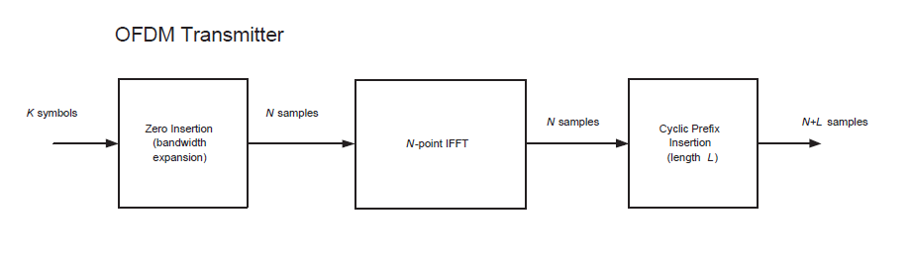


OFDM
Spectral
shaping
-ve freq
Is taken from a QAM alphabet
Null carriers
+ve freq
DC
EURECOM LTE-Tutorial, Mobile Communications Department 2009

Slide 9
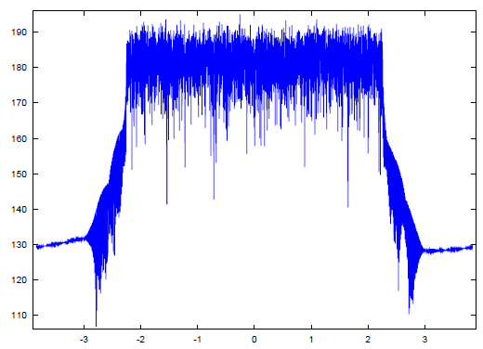
Typical OFDM Spectrum
(LTE 5MHz, with additional low-pass filter)
DC Null
4.515 MHz = (301/512)*7.68MHz
EURECOM LTE-Tutorial, Mobile Communications Department 2009

Slide 10
SC-FDMA
SC-FDMA is a single-carrier technique similar to OFDM. A key distinguishing point with 802.16e/m for PHY-layer.
A form of “DFT-precoded” OFDM
  Signals are conceived in the time-domain and then converted to frequency domain, frequency-translated and converted back.
Main advantage, less peaky => more efficient power-amplifier in UE TX chain
Main disadvantage, less flexible (for advanced techniques) RX structure in eNb.
  Note: implementation losses due to SC-FDMA in eNb, may reduce power savings in UE (time will tell …)
EURECOM LTE-Tutorial, Mobile Communications Department 2009

Slide 11

SC-FDMA
K-point
FFT
Spectral
Shaping +
Frequency
translation
-ve freq
Null carriers
+ve freq
Is taken from a QAM alphabet
DC
EURECOM LTE-Tutorial, Mobile Communications Department 2009

Slide 12
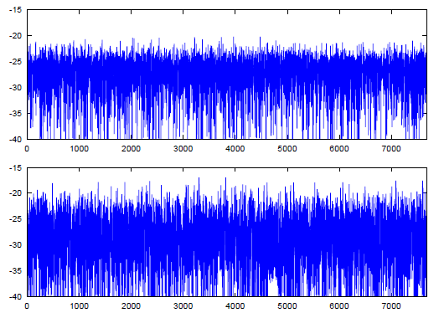
Peak-to-Average-Power Ratio Comparison
- 300 QPSK carriers (REs), 512 point IFFT
Squared Signal amplitude (dB)
6.2 dB (SC-FDMA,
LTE)
9.49 dB (OFDMA,
WiMAX)
EURECOM LTE-Tutorial, Mobile Communications Department 2009

Slide 13
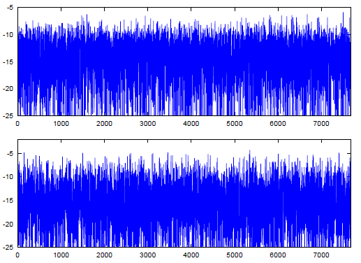
Peak-to-Average-Power Ratio Comparison
- 300 64QAM carriers (REs), 512 point IFFT
8.1 dB
10.7 dB
Smaller difference with 64QAM -> implementation loss due to sub-optimal eNb receiver will hurt more
EURECOM LTE-Tutorial, Mobile Communications Department 2009

Slide 14
OFDM (single-antenna) Inner Receiver (UE)
I[n]
Prefix
Extraction
FFT
I[k]
Channel
Compen-
sation
I[k]
LLR
Unit
Digital
Baseband
Inputs
Q[n]
Q[k]
Q[k]
BroadbandChannel
Estimates
Pilot
extraction
To timing (DAQ) and frequency correction units, and I/Q imbalance
Channel
Estimation
EURECOM LTE-Tutorial, Mobile Communications Department 2009

Slide 15



Channel Compensation
  Receiver sees
  Gets channel estimate
Estimation error
  Under perfect estimate, sufficient statistics for decoding would be
Scaled Signal
Component
Signal dependent
Noise term
  Along with
EURECOM LTE-Tutorial, Mobile Communications Department 2009

Slide 16
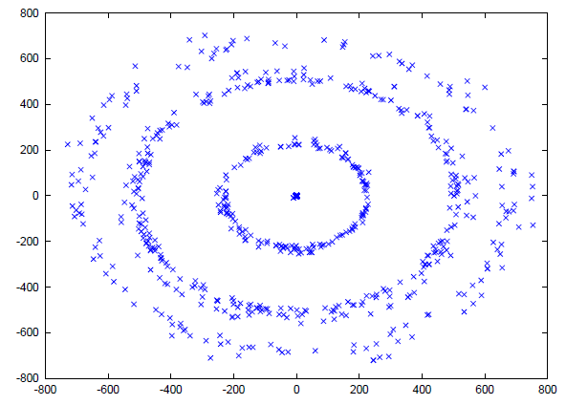
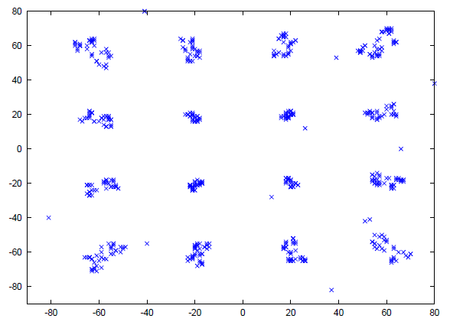
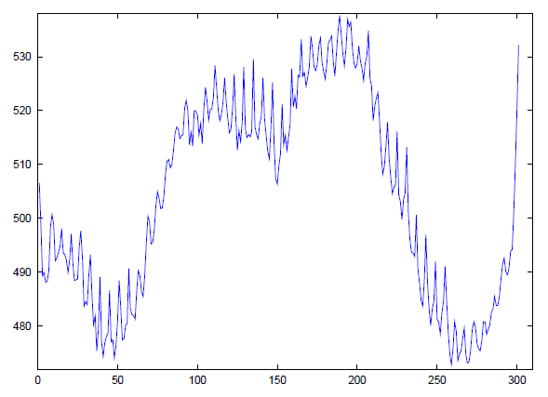
Channel Compensation (16QAM, 300 carriers)
At FFT output
After Channel compensation
Fairly “flat” channel (linear phase) after
channel estimation
EURECOM LTE-Tutorial, Mobile Communications Department 2009

Slide 17
Lab Session 2
Objective
  Perform full OFDM demodulation of SSS (Secondary Synchronization Signal)
    Cyclic prefix extraction and frequency-domain translation
    Channel Estimation using PSS
    Data detection (Maximum-Likelihood)
Introduction to LTE Framing first …
EURECOM LTE-Tutorial, Mobile Communications Department 2009

Slide 18
Framing
LTE is specified for any bandwidth between 1.08 MHz and 19.8 MHz which is a multiple of 180 kHz
The “common” sizes will be
  1.08 MHz transmission bandwidth with 1.25 MHz spacing
  2.7 MHz transmission bandwidth with 3 MHz spacing
  4.5 MHz transmission bandwidth with 5 MHz spacing
  9 MHz transmission bandwidth 10 MHz spacing
  13.5 MHz transmission bandwidth with 15 MHz spacing
  18 MHz transmission bandwidth with 20 MHz channel spacing
Support for FDD and TDD
LTE-Tutorial and OpenAir1 implementation

Slide 19
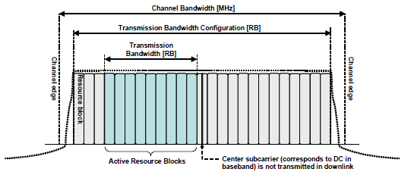
Resource blocks
LTE defines the notion of a resource block which represents the minimal scheduling resource for both uplink and downlink transmissions
A physical resource block(PRB) corresponds to 180 kHz of spectrum
LTE-Tutorial and OpenAir1 implementation

Slide 20
Common PRB Formats
Channel Bandwidth (MHz) | N_{RB}^{DL}/N_{RB}^{UL} | Typical IDFT size | Number of Non-Zero Sub-carriers (REs)
1.25 | 6 | 128 | 72
5 | 25 | 512 | 300
10 | 50 | 1024 | 600
15 | 75 | 1024 or 2048 | 900
20 | 100 | 2048 | 1200
PRBs are mapped onto contiguous OFDMA/SC-FDMA symbols in the time-domain (6 or 7)
Each PRB is chosen to be equivalent to 12 (15 kHz spacing) sub-carriers of an OFDMA symbol in the frequency-domain
  A 7.5kHz spacing version exists with 24 carriers per sub
Because of a common PRB size over different channel bandwidths, the system scales naturally over different bandwidths
LTE-Tutorial and OpenAir1 implementation

Slide 21
OFDMA/SC-FDMA Mapping
OFDMA/SC-FDMA Sub-carriers are termed “Resource Elements” (RE)
DC carrier and high-frequencies are nulled
  Spectral shaping and DC rejection for Zero-IF receivers
  Half the bandwidth loss w.r.t. WCDMA (22%)
Channel Bandwidth (MHz) | N_{RB}^{DL}/N_{RB}^{UL} | Bandwidth Expansion
1.25 | 6 | 8%
5 | 25 | 11%
10 | 50 | 11%
15 | 75 | 11%
20 | 100 | 11%
LTE-Tutorial and OpenAir1 implementation

Slide 22
Example: 600 REs, 50 RBs (10 MHz channel)
PRB48-49
“Normal” Cyclic Prefix Mode
(7 symbols)
PRB46-47
PRB44-45
PRB42-43
PRB40-41
PRB38-39
PRB25
PRB36-37
PRB34-35
“Extended” Cyclic Prefix Mode
(6 symbols)
PRB32-33
PRB30-31
PRB28-29
PRB26-27
PRB24-25
N_{RB}^{DL}/N_{RB}^{UL}
PRB22-23
PRB20-21
PRB18-19
PRB16-17
PRB14-15
PRB12-13
N_{SC}^{RB}=12
PRB24
PRB10-11
PRB8-9
PRB6-7
PRB4-5
PRB2-3
PRB0-1
l=0
l=6
N_{UL}^{symb} /N_{UL}^{symb}
LTE-Tutorial and OpenAir1 implementation

Slide 23
Sub-frame and Frame
One frame = T_{f} =307200T_{s} = 10ms
T_{slot}= 15360T_{s}=500μs
0
1
2
3
18
19
One subframe
71.9μs
71.3μs
Normal Prefix
5.2μs
4.69μs
Frequency
Domain
View
83μs
Extended Prefix
13.9μs
Time-domain
View
LTE-Tutorial and OpenAir1 implementation

Slide 24
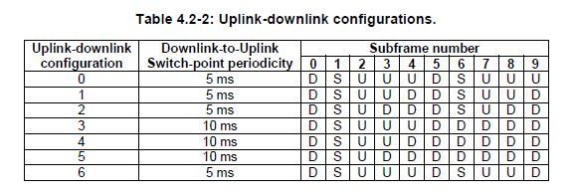
TDD Framing (just for information)
One frame = T_{f} =307200T_{s} = 10ms
T_{slot}= 15360T_{s}=500μs
0
1
DwPTS
GP
UpPTS
10
11
DwPTS
GP
UpPTS
18
19
One subframe
S-subframe
S-subframe
Size of GP depends on cell radius, typically DwPTS is larger than UpPTS
LTE-Tutorial and OpenAir1 implementation

Slide 25
Downlink Physical Channels (Lab3)
Physical Downlink Shared Channel (PDSCH)
  Carries user and control plane traffic. It is dynamically scheduled every sub-frame by the eNb
Physical Broadcast Channel (PBCH)
  Carries a minimal amount of cell-specific control plane traffic (1 kbit/s)
Physical Multicast Channel (PMCH)
  Carries cell-specific user-plane broadcast/multicast traffic (e-MBMS)
Physical Control Format Indicator Channel (PCFICH)
  Carries cell-specific control format information. This channel indicates to the UE the control format (number of symbols comprising PDCCH, PHICH) of the current subframe.
Physical Downlink Control Channel (PDCCH)
  Carries user and cell-specific control information (scheduling, resource assignments, etc). This collection of channels provides the UE with the DLSCH assignments in the sub-frame
Physical Hybrid ARQ Indicator Channel (PHICH)
  Carries user-specific control information for HARQ (ACK/NACK)
LTE-Tutorial and OpenAir1 implementation

Slide 26
Physical Signals (Lab 1+2)
Reference Signals
  Cell-specific reference signals : Used for channel estimation and frequency-offset estimation in UE
  User-specific reference signals: Used for channel estimation for a specific user receiving a tailored signal
  Positioning reference signals (Rel 9/10)
  CSI reference signals (Rel 10, not really required …)
Synchronization Signals
  Primary synchronization signal (PSS): Used for timing acquisition at UE
  Secondary synchronization signal (SSS): Used for basic framing acquisition at UE allowing demodulation of physical channels
LTE-Tutorial and OpenAir1 implementation

Slide 27
Antenna Ports (for Lab 3)
LTE Rel-8 supports up to 4 physical antennas
  Single-antenna configuration, (p={0})
  Dual-antenna configuration , (p={0,1})
  Quad-antenna configuration , (p={0,1,2,3})
A fifth “virtual” antenna, (p={4}) is included to indicate MBSFN (MBMS) reference and physical channels
A sixth “virtual” antenna, (p={5}), is included to indicate user-specific antenna processing (e.g. beamforming) with an unspecified number of physical antennas
Release 9/10 defines new antenna ports
  Positioning reference (localization) signals (p={6})
  UE specific antenna processing signals (p={7,8,9,10}) => 2-user MU-MIMO with 2,4 physical antennas
  UE specific antenna processing signals ((p={11,12,…,18}) => “super”-MIMO with 2,4,8 antennas, single or multiuser
LTE-Tutorial and OpenAir1 implementation

Slide 28
Antenna Ports (Lab 3)
p={0}
p={0,1}
p={0,1,2,3}
p={5}
LTE-Tutorial and OpenAir1 implementation

Slide 29
The start of the connection (Cell Search)
Cover the basic procedures for identifying the eNB and most basic cell parameters
  Primary Synchronization (Cell ID group) (Lab 1)
  Secondary Synchronization ( Complete Cell ID + Frame format) (Lab 2)
  Physical Broadcast Channel (Master Information Block, MIB) (Lab 3)
The keys to allow establishment of a protocol context
LTE-Tutorial and OpenAir1 implementation

Slide 30
LTE UE Synchronization Procedures
Cell Search comprises
  Timing and frequency synchronization with the cell using the primary synchronization reference signal. This also gives the Cell ID group N_{ID}⁽²⁾ (0,1,2)
  Cell ID N_{ID}⁽¹⁾ (0,…,166) and Frame type (FDD/TDD, Normal/Extended Prefix) determination from secondary synchronization reference signals
  Demodulation of PBCH (using N_{ID}^{Cell}= 3N_{ID}⁽¹⁾ + N_{ID}⁽²⁾) to receive basic system information during steady-state reception
    N_{RB}^{DL} (cell bandwidth)
    PHICH-config (to allow PDCCH demodulation, for system information)
    Frame number (8 bits from payload, 2 bits from redundancy version)
    Antenna configuration (1,2,4 from CRC mask)
LTE-Tutorial and OpenAir1 implementation

Slide 31
Initial Timing/Frequency Acquisition
(Synchronization Signals, FDD Normal CP)
10 ms
Subframe 0
Subframe 1
Subframe 4
Subframe 5
Subframe 9
Frequency
(PRBs)
Time
(symbols)
Primary(Y) and Secondary(B)
Synchronization Signals
(2nd half)
Primary (Y) and Secondary B)
Synchronization Signals
(first half)
PBCH
LTE-Tutorial and OpenAir1 implementation

Slide 32
Initial Timing/Frequency Acquisition
(Synchronization Signals, TDD Normal CP) (For your Information only)
10 ms
Subframe 0
Subframe 1
Subframe 4
Subframe 5
Subframe 9
Frequency
(PRBs)
Time
(symbols)
Primary(Y) and Secondary(B)
Synchronization Signals
(2nd half)
Primary (Y) and Secondary B)
Synchronization Signals
(first half)
PBCH
LTE-Tutorial and OpenAir1 implementation

Slide 33

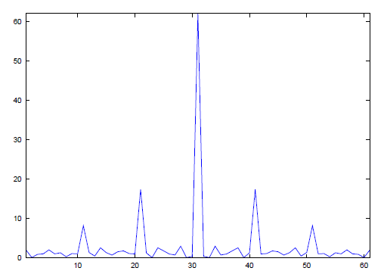
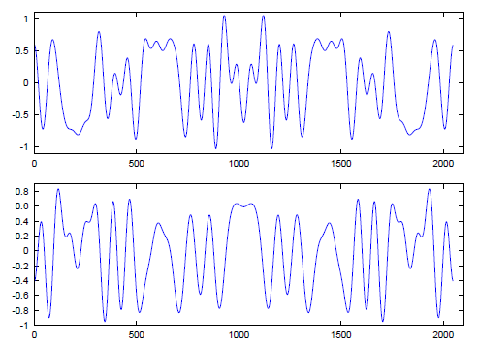
Primary Synchronization (Lab 1)
Zadoff-Chu root-of-unity sequence has excellent auto-correlation properties and is very tolerant to frequency-offsets
Autocorrelation sequence
Real component
(time-domain
u=25)
Imag component
(time-domain,
u=25)
LTE-Tutorial and OpenAir1 implementation

Slide 34
Primary Synchronization RX
Correlation of 3 primary sequences (d*_{u}(-n)) with received signal. Each eNB (or sector) has different sequence => Reuse pattern of 3 for different eNB or sectors (N_{ID}⁽²⁾)
Threshold
d*_{u}(-n)
↓M
()²
r(n)
Received
Frame
Decimating correlator + non-coherent thresholding
Primary Purpose: Determine start of frame
Alternate purposes: Channel estimation for SSS/PBCH and frequency offset estimation
Implemented as Zadoff-Chu sequence of length 62 REs around DC (i.e. same resource block as PBCH, but only 62 out of 72 REs)
LTE-Tutorial and OpenAir1 implementation

Slide 35
Secondary Synchronization
Purpose: determine frame type and cell ID N_{ID}⁽¹⁾
Implemented as BPSK-modulated interleaved sequence of two length-31 binary m-sequences (m=31) with cyclic shifts m₀ and m₁. and scrambled by the two different scrambling sequences
  Results in 167 possible BPSK sequences for each of subframe 0 and 5
The receiver must perform correlations with all 167 sequences and find the most likely transmitted sequence. It can use the output of the primary sequence correlation as a rough channel estimate to improve detection probability
Position relative to PSS allows for frame type determination
LTE-Tutorial and OpenAir1 implementation

Slide 36
Secondary Synchronization RX
Hypothesis : one of 4 frame types TDD/FDD, normal/extended prefix => gives position in samples of SSS with respect to PSS detected in primary synchronization
Use channel estimate (partially coherent) from PSS and quantized uniform phase offset to compensate residual frequency offset (PSS/SSS not in same symbol) and amplitudes in SSS symbol
Correlate with 167 out of 167 * 3 sequences (167 per PSS N_{ID}⁽²⁾) of length 62 in each of slots 0 and 10
Choose sequence which has highest coherent correlation
This has to be done with 2 different assumptions (subframe 0 or subframe 5 is first in RX buffer), or we just wait until we receive an RX frame in the correct order (i.e. when subframe 0 falls in the first 5 ms of the RX buffer)
LTE-Tutorial and OpenAir1 implementation

Slide 37
SSS RX preliminaries (sss.c : rx_sss)
Based on estimated PSS positions and N_{ID}⁽²⁾ , for each hypothesized Frame configuration (normal/ext prefix, FDD/TDD) compute
  DFT of size used initially in UE (min 128, max 2048) in two SSS symbols corresponding to that hypothesis (to be refined after PBCH detection giving cell bandwdith). The size depends on the sampling rate and downsampling factor used in the receiver.
  Use PSS symbol for rough channel estimate (componentwise complex product) in SSS REs
  Correlate with all 167 possible SSS BPSK sequences over both symbols (with flip between symbols in case start of frame is in 2nd half of RX frame buffer)
  Complex Multiply with phase correction factor to compensate phase offset between PSS and SSS symbols (due to residual frequency error)
LTE-Tutorial and OpenAir1 implementation

Slide 38
Channel Estimation for SSS
Use the PSS, under hypothesis of received sequence being correct!
EURECOM LTE-Tutorial, Mobile Communications Department 2009

Slide 39
Secondary Synchronization RX
H*₀ (k)
D*_{sss,0,n}(k)
Σ
e^{2πjΔ/N}
Δ=-3,…,3, N=8
R_{sss,0}(k), k=0,...,62
X
X
H*₅ (k)
D*_{sss,5,n}(k)
Re
X
R_{sss,5}(k), k=0,...,62
X
X
Compute over all n (167 sequences),
Δ, subframe 0/5 flip and choose max
H*₀ (k)=D_{pss,0,u}(k) R_{pss,0}*(k), k=0,...,62
H*₅ (k)=D_{pss,5,n}(k) R_{pss,5}*(k), k=0,...,62
PSS-based channel estimates
LTE-Tutorial and OpenAir1 implementation

Slide 40
Basics of Channel Coding
Example of LTE PBCH
Coding
  Convolutional codes + BPSK/QPSK
A bit on convolutional code performance and link with 1st part of course
  Minimum distance error events
Decoding via Viterbi Algorithm
How it’s done for general QAM (bit-interleaving)
  Generalization to Turbo Codes
  The need for a new decoding algorithm (turbo-decoding)
EURECOM LTE-Tutorial, Mobile Communications Department 2009

Slide 41
PBCH
The PBCH carries the MIB (24 bits + 16-bit CRC)
  CRC is masked with 3 patterns identifying the number of transmit antennas used by eNB (1,2,4)
It uses
  4 symbols over 6 PRBs (1.08 MHz) for all bandwidth configurations (i.e. it is always the same like PSS/SSS)
  1920 information bits with QPSK modulation with normal CP
  1720 information bits with QPSK modulation with extended CP
It is coded using
  a rate 1/3 tail-biting convolutional code (36.212)
  A rate-matching procedure providing 4 replicas (redundancy versions) which are spread across 4 radio-frames (40 ms)
LTE-Tutorial and OpenAir1 implementation

Slide 42
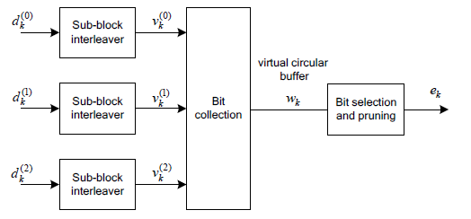
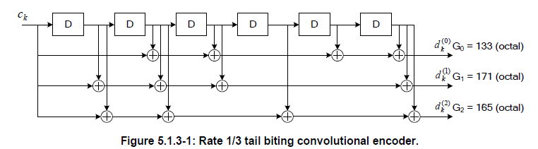
PBCH Channel Coding
Antenna mask (1,2,4) =>
(0x0000,0xFFFF,0x5555)
MIB
(24 bits)
CRC16
CCode
+
LTE-Tutorial and OpenAir1 implementation

Slide 43
PBCH Modulation
TX Diversity
Precoding
(1,2,4)
Mapping
To RE
OFDM
TX
e_{k,i}
_{i=0,1,2,3}
scrambling
QPSK
Modulation
Mapping
To RE
OFDM
TX
e_{k,0}
e_{k,1}
e_{k,2}
e_{k,3}
Frame n
Frame n+1
Frame n+2
Frame n+3
LTE-Tutorial and OpenAir1 implementation

Slide 44
PBCH Detection
Detection of the PBCH requires the following steps (per frame)
  Generation of the cell-specific reference signals based on the cell ID derived from SSS detection
  DFT of 4 PBCH symbols
  Performing channel estimation for the 4 symbols of the PBCH
  Extracting the PBCH resource elements (240)
  Applying the conjugated channel estimates to the received resource elements
  Antenna combining (TX diversity code combining)
  Channel decoding
  CRC Check for one of the 3 antenna masks
LTE-Tutorial and OpenAir1 implementation

Slide 45
A bit on Performance (on the board!)
Take some notes …
EURECOM LTE-Tutorial, Mobile Communications Department 2009

Slide 46
Cell-Specific Reference Signals (needed for PBCH detection)
p={0},p={0,1}
p={0,1,2,3}
p=0
p=0
p=2
p=1 (if active)
p=1
p=3 (if active)
LTE-Tutorial and OpenAir1 implementation

Slide 47
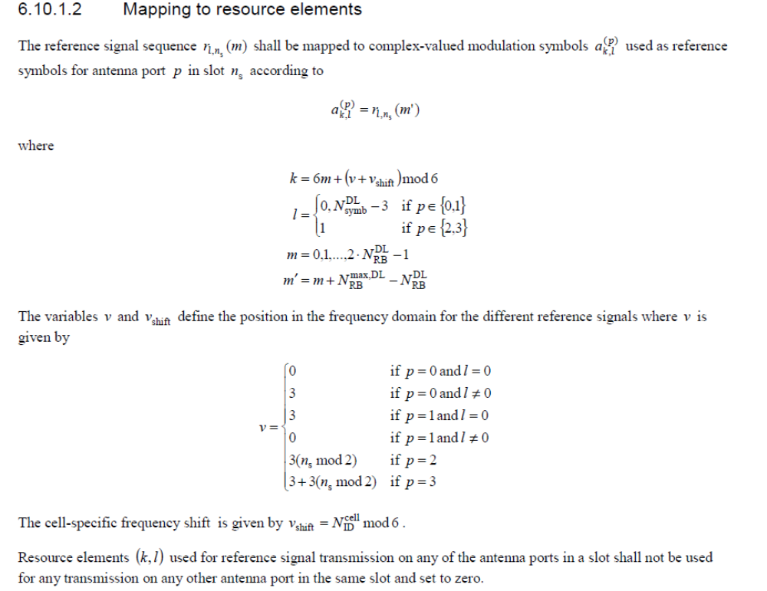
Cell Specific Reference Signals
EURECOM LTE-Tutorial, Mobile Communications Department 2009

Slide 48
Cell-Specific Reference Signals
Pseudo-random QPSK OFDM symbols
  Based on generic LTE Gold sequence
  Different sequence for different cell IDs
  Different in each symbol of sub-frame
  Different in each sub-frame, but periodic across frames (10ms)
Evenly spaced in subframe to allow for simple and efficient least-squares interpolation-based receivers
  Between REs in frequency-domain
  Across symbols in time-domain
LTE-Tutorial and OpenAir1 implementation

Slide 49
















Channel Estimation in LTE (simple)
  Recall that receiver sees
  Must get channel estimate for channel compensation
Estimation error
PRB1
PRB0
Interpolation
Extrapolation
Interpolation
Extrapolation
NO pilots here
LTE-Tutorial and OpenAir1 implementation

Slide 50





Channel Estimation in LTE (simple) – cont’d
The previous steps allow for determining the frequency response (MIMO) on symbols where the pilots are located
For the remaining symbols, we perform time-interleaving across adjacent symbols with pilots
LTE-Tutorial and OpenAir1 implementation

Slide 51
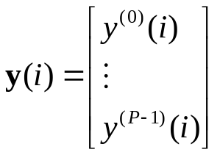
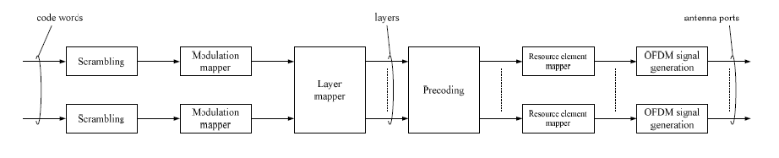




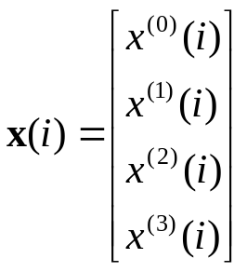
General PDSCH Transmission Chain
Bitwise
scrambling
b⁽⁰⁾(i)
b⁽¹⁾(i)
One or two
codewords
QPSK,16QAM
64 QAM (possibly
Different on each stream
LTE-Tutorial and OpenAir1 implementation

Slide 52
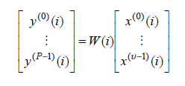
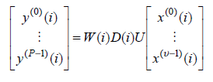
Precoding
Precoding serves two purposes
  TX diversity through either Space-Frequency Block Coding (Alamouti,Double Alamouti) or Single-stream Delay Diversity
  Rank increase for closed-loop techniques (dual-stream MIMO and MU-MIMO)
Spatial Multiplexing
Large Cyclic Delay-Diversity
LTE-Tutorial and OpenAir1 implementation

Slide 53
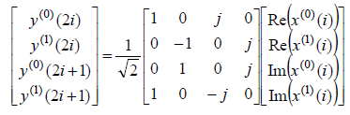
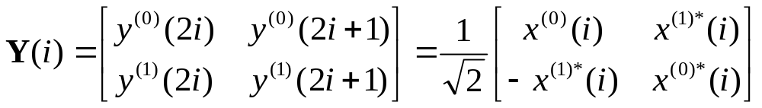
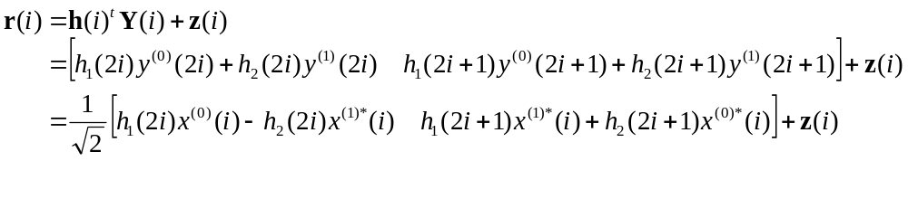
Transmit Diversity (2 Antennas)
LTE-Tutorial and OpenAir1 implementation

Slide 54
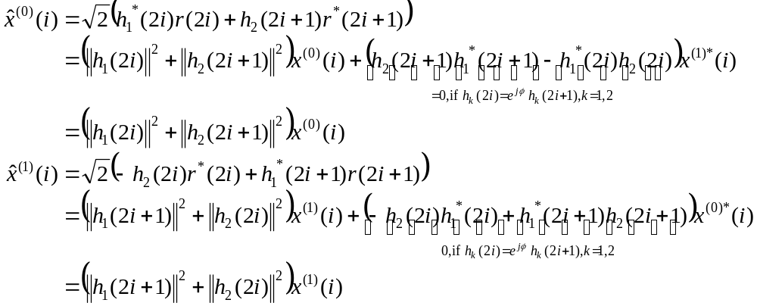
Alamouti Combining at RX
LTE-Tutorial and OpenAir1 implementation

Slide 55
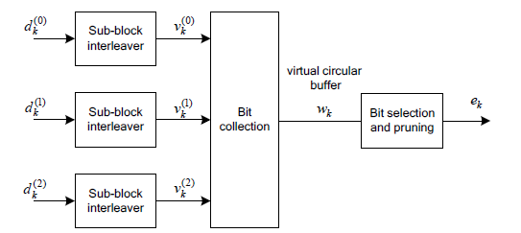
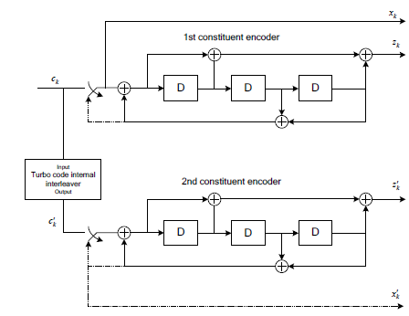
Generalization
Turbo
Code
Transport
Block
Segmentation
Turbo
Code
Interleaving and
Rate Matching
LTE-Tutorial and OpenAir1 implementation

Slide 56
General PDSCH Transmission Chain
Bitwise
scrambling
b⁽⁰⁾(i)
b⁽¹⁾(i)
One or two
codewords
QPSK,16QAM
64 QAM (possibly
Different on each stream
LTE-Tutorial and OpenAir1 implementation

