Slide 1
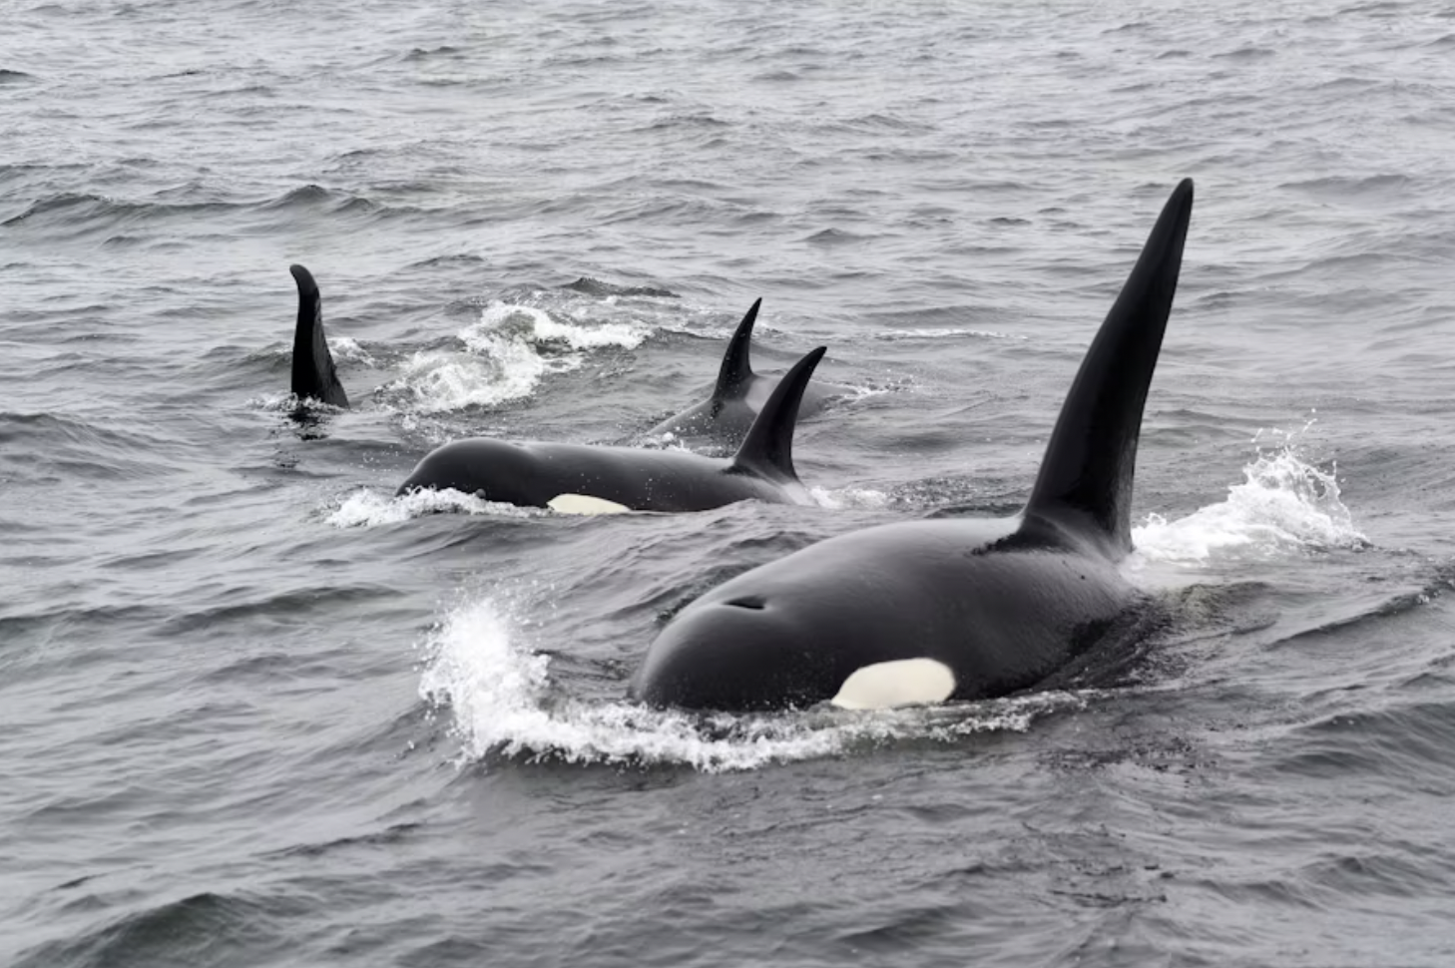
San Juan Islands Orca Sightings service: API docs
Technical writer: Julie Brodeur
Subject matter expert: Jeff Naemura

Slide 2
Project overview
About the San Juan Islands Orca Sightings API
A cloud-based RESTful API designed to track orca movements around the San Juan Islands.
Allows orca enthusiasts to report sightings.
Helps others spot whales from land.
Purpose of the docs
Teach users how to easily set up, understand, and interact with the API.
Provide comprehensive resources for developers.

Slide 3
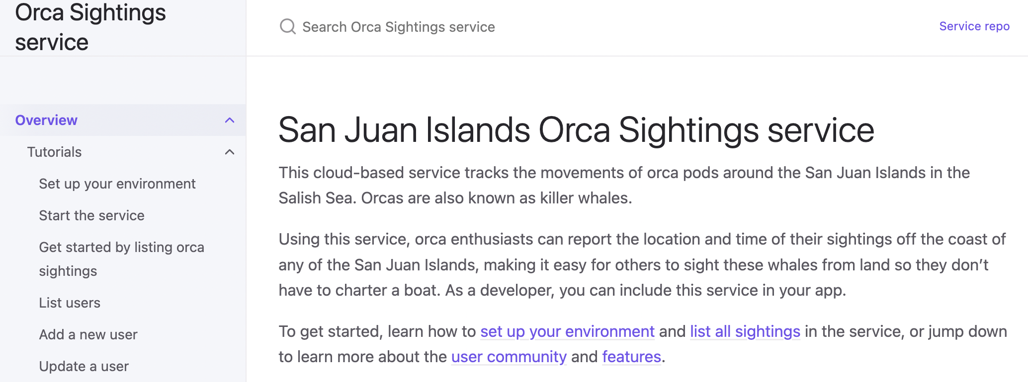
Doc structure: user onboarding
Overview & tutorials
Focus: Guiding new users from setup to first interaction.
Overview: Quick introduction to the service and key links.
Tutorials: Step-by-step guides for practical use. Ensures a smooth onboarding experience for all skill levels.

Slide 4
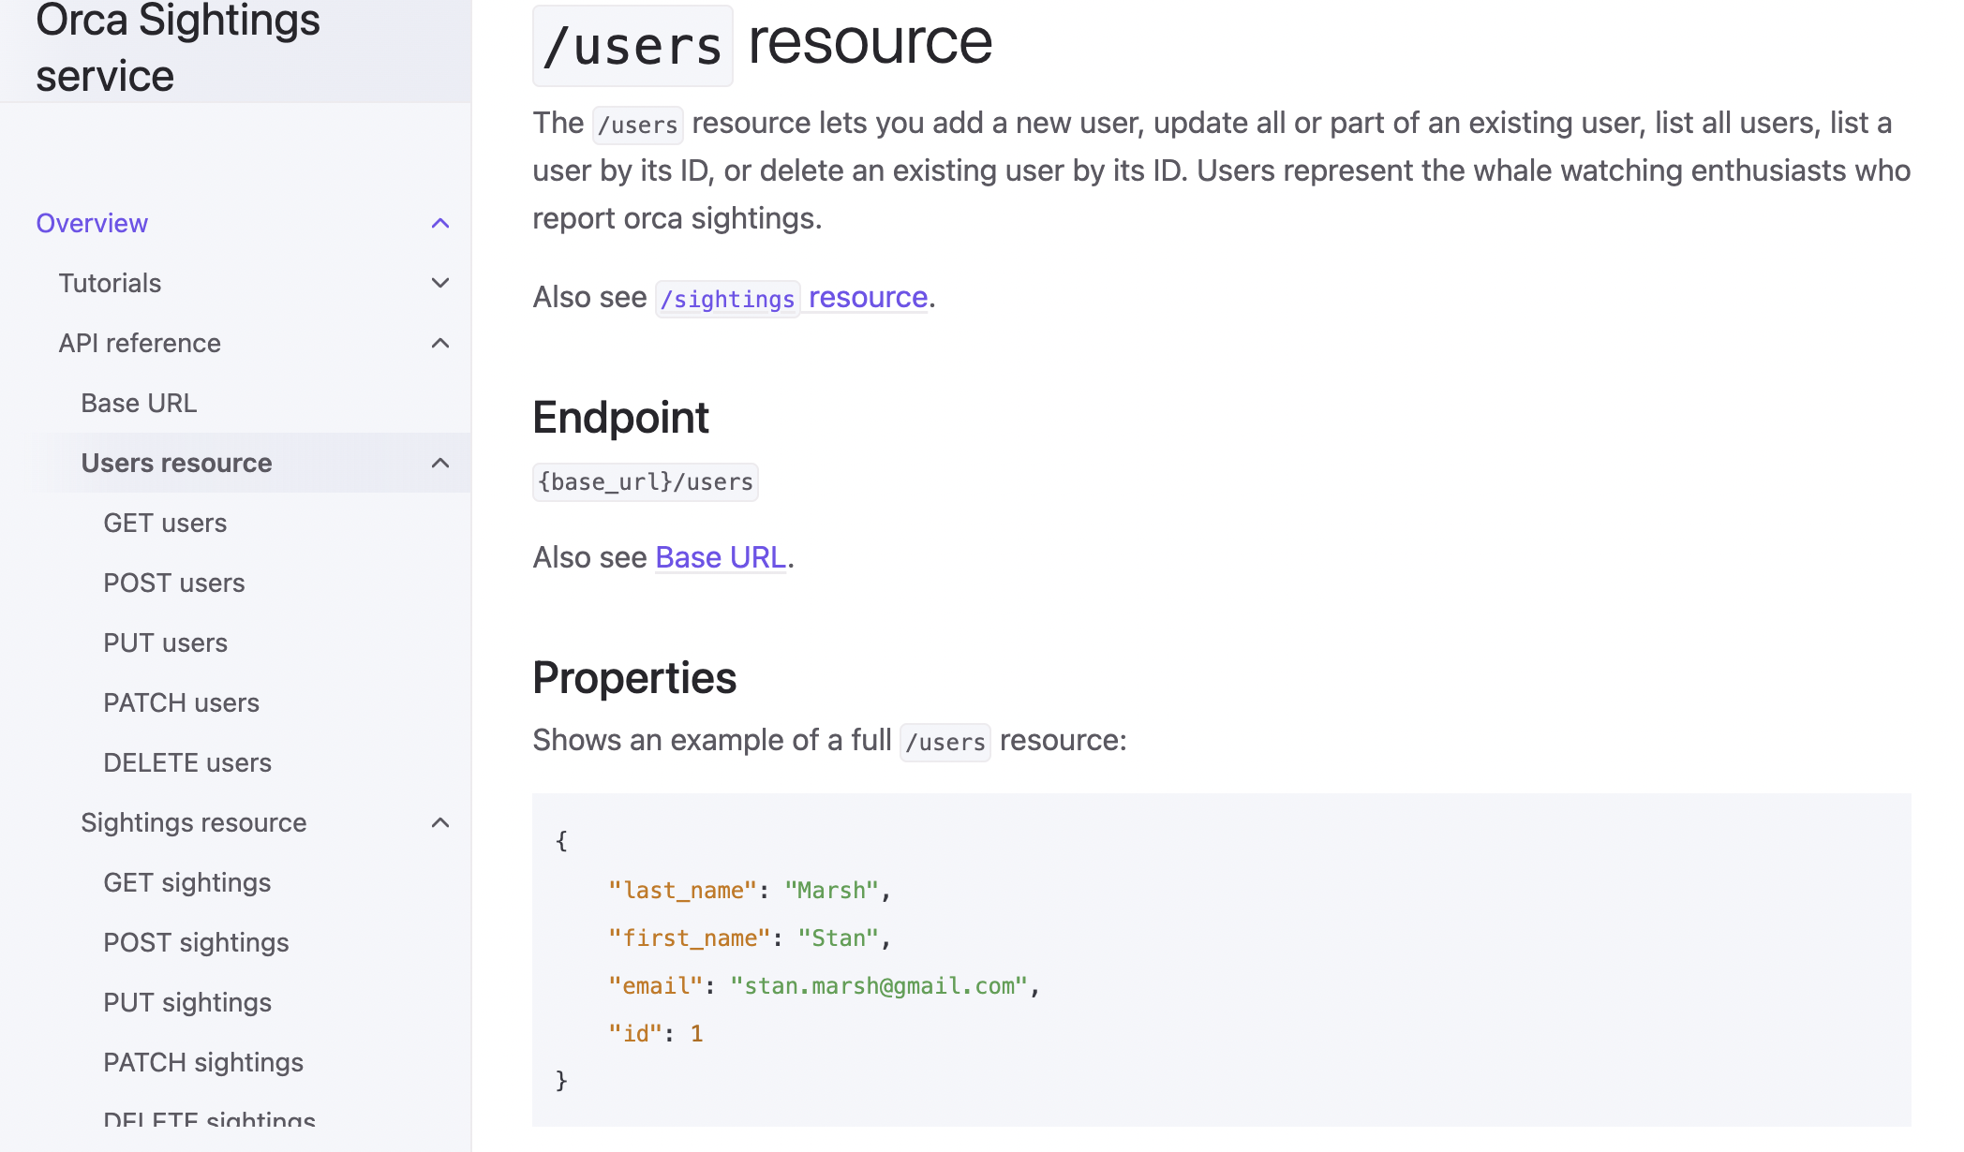
Doc structure: developer details
API reference
Focus: Provides details on API resources.
Resources: /users and /sightings.
Supported HTTP Methods: GET, POST, PUT, PATCH, DELETE clearly defined for each endpoint.
Benefit: Developers can integrate the API into their apps by quickly finding the information they need.

Slide 5
Key features
Well-structured, searchable, and navigable documentation.
Clear and concise explanations.
Comprehensive API reference and helpful tutorials.
Focus on user experience and ease of adoption.

Slide 6
Value
For developers:
Faster integration - Clear setup reduces time-to-first-success
Self-service support - Comprehensive examples reduce support tickets
Confidence building - Progressive tutorials ensure success
For business:
Reduced support costs - Documentation answers common questions
Improved adoption - Better developer experience drives usage
Professional credibility - Quality docs enhance product perception
Portfolio demonstrates technical accuracy + business understanding
I create documentation that serves both developer needs and business objectives.

Slide 7
Thank you!
Enjoy the San Juan Islands Orca Sightings service for educational use.
Link to API docs

