Slide 1
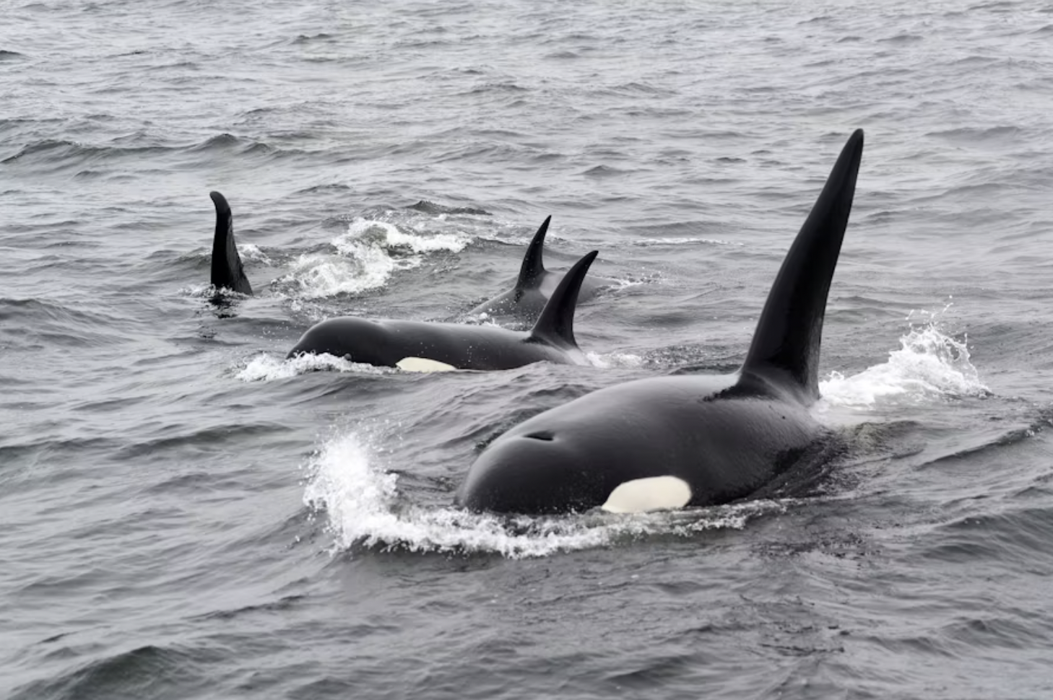
San Juan Islands Orca Sightings service: API docs
Technical writer: Julie Brodeur
Subject matter expert: Jeff Naemura

Slide 2
Project overview
About the San Juan Islands Orca Sightings API
A cloud-based RESTful API designed to track orca movements around the San Juan Islands.
Allows orca enthusiasts to report sightings.
Helps others spot whales from land.
Purpose of the docs
Teach users how to easily set up, understand, and interact with the API.
Provide comprehensive resources for developers.

Slide 3
Key features
Well-structured, searchable, and navigable documentation.
Clear and concise explanations.
Comprehensive API reference and helpful tutorials.
Focus on user experience and ease of adoption.

Slide 4
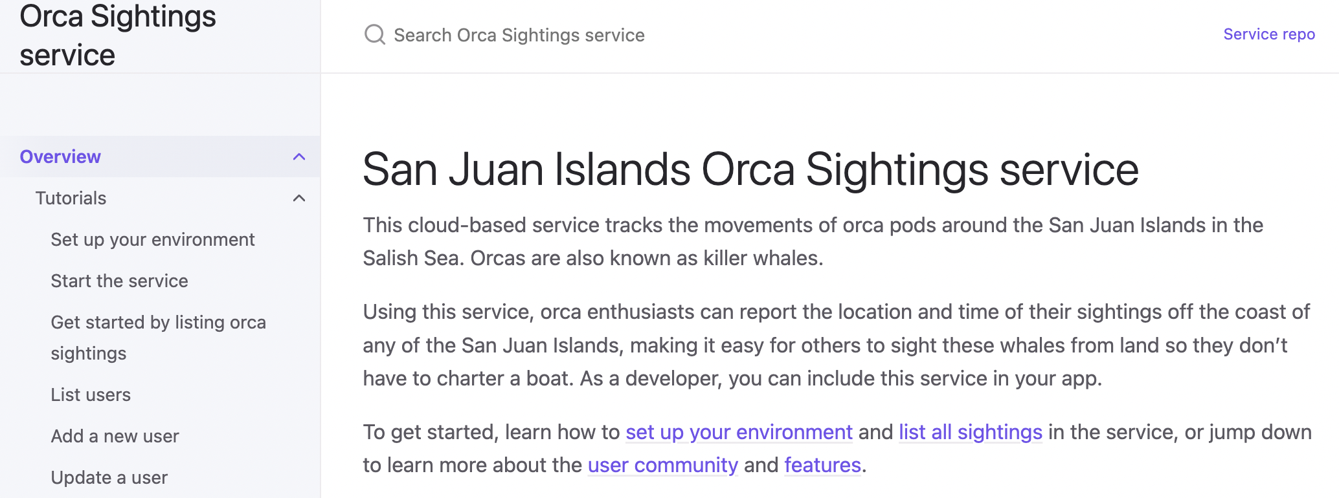
Doc structure: user onboarding
Overview & tutorials
Focus: Guiding new users from setup to first interaction.
Overview: Quick introduction to the service and key links.
Tutorials: Step-by-step guides for practical use. Ensures a smooth onboarding experience for all skill levels.

Slide 5
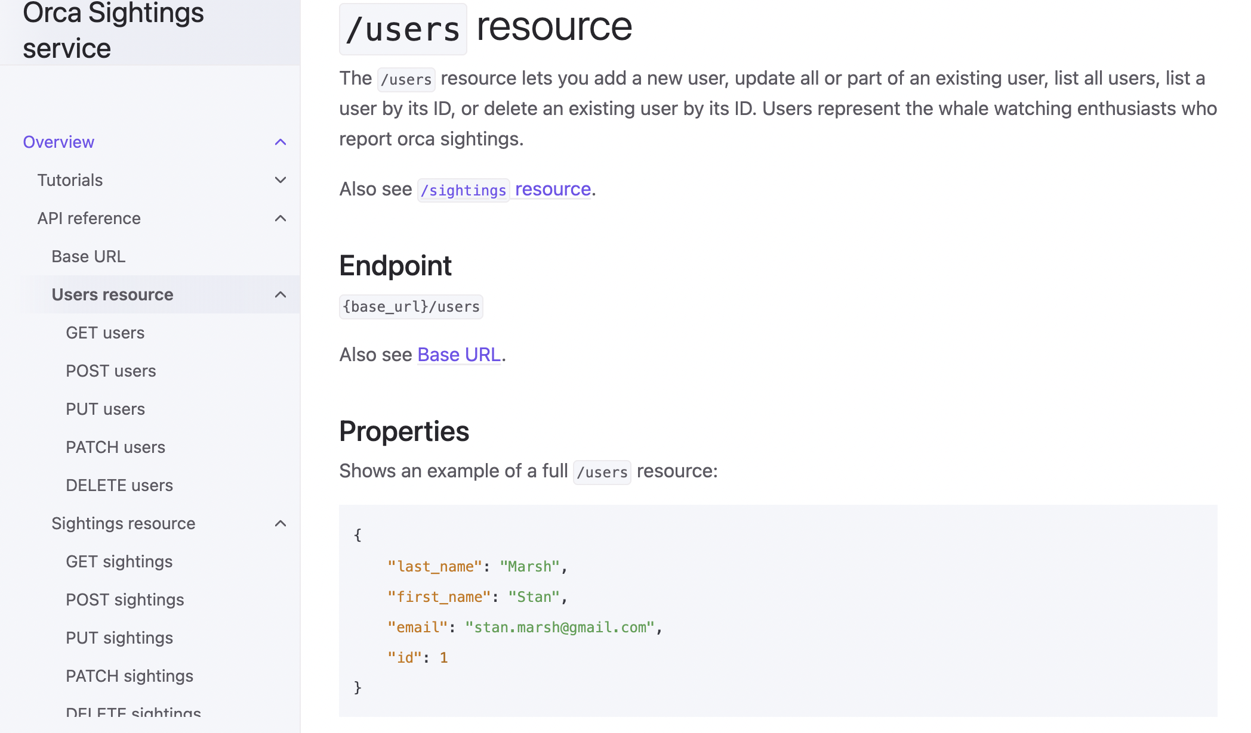
Doc structure: developer details
API reference
Focus: Provides details on API resources.
Resources: /users and /sightings.
Supported HTTP Methods: GET, POST, PUT, PATCH, DELETE clearly defined for each endpoint.
Benefit: Developers can integrate the API into their apps by quickly finding the information they need.

Slide 6
Project challenges & successes
Challenges
Git merge issues
Setup of Just the Docs theme
Terminology ambiguity: parameters vs properties
Lots of work required some late nights
Needed to edit several files at work directly in GitHub
AI responses sometimes sent me down a rabbit hole
Successes
Effective SME support
Content visualization & planning: Used Notion to help me visualize structure of docs and improve content navigation
Consistent additions to repository
AI-assisted content generation: Used Gemini 2.5 Flash for help in writing ISO 8601 format topic, generating data tables, cURL examples, and creating outlines for tutorials, significantly speeding up repetitive work
Successfully figured out how to edit the _config.yml file to add the Just the Docs theme
Learned new Markdown tricks, such as linking to headings, adding images, and emojis.
Usability testing went smoothly and suggestions improved the docs
Improved Git workflow

Slide 7
Value
For developers:
Faster integration - Clear setup reduces time-to-first-success
Self-service support - Comprehensive examples reduce support tickets
Confidence building - Progressive tutorials ensure success
For business:
Reduced support costs - Documentation answers common questions
Improved adoption - Better developer experience drives usage
Professional credibility - Quality docs enhance product perception
Portfolio demonstrates technical accuracy + business understanding
I create documentation that serves both developer needs and business objectives.

Slide 8
Thank you!
Enjoy the San Juan Islands Orca Sightings service for educational use.
Link to API docs

