Slide 1
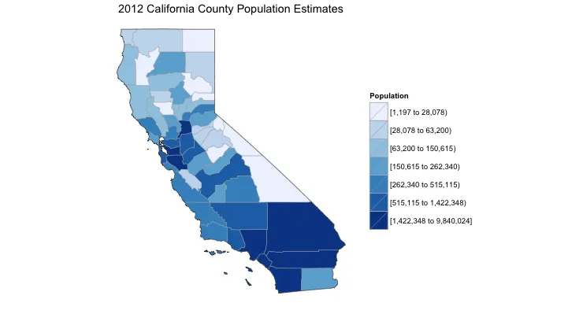
Choropleth of Population per County.
This will be root page?
The user can change the year at the top?
The user can click on a county and that will
Zoom in….

Slide 2
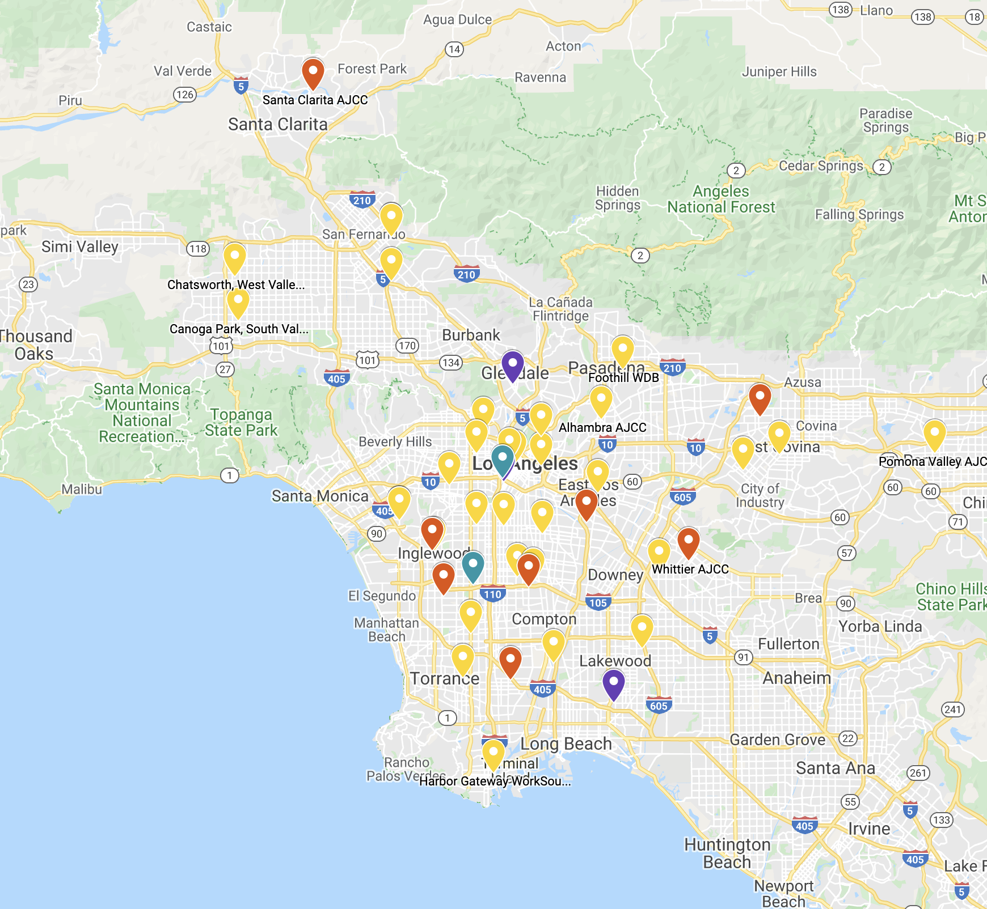




Current
Historical
pm 2.5
pm 10
Ozone
NO2
Once zoomed into the county,
a default of markers with pm 2.5 appears.
The user can click on the menu to the top right
To change parameters.
The user can click on markers and more data will
Appear in a popup box.

Slide 3
Current
Historical
pm 2.5
pm 10
Ozone
NO2
If the user is interested in historical AQ.
They can click on the top left menu.
This will change the map to a choropleth
of AQ, which they can play.
Date and Time

