Slide 1
Education factors in the United States
By: Solongo Tserenkhand, Whitney White, Julie Hong, Liz Eli

Slide 2

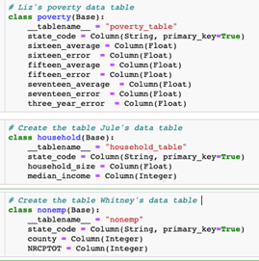
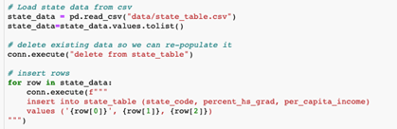
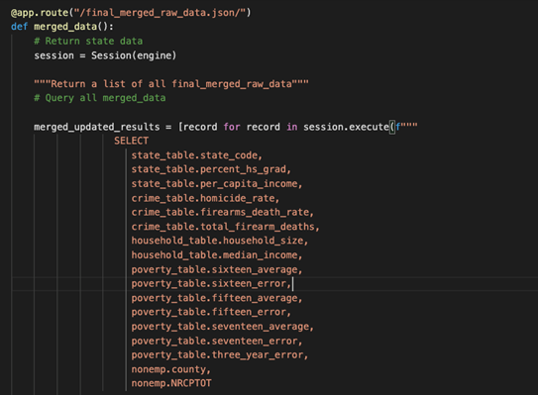

Prepare Data Ready
Solongo:
Web Scraping
Create DB
Create Tables & Insert Data
Flask
Deployed Flask https://solongobootcamp2020.herokuapp.com/

Slide 3
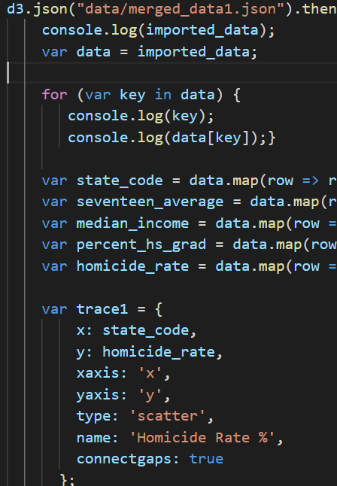
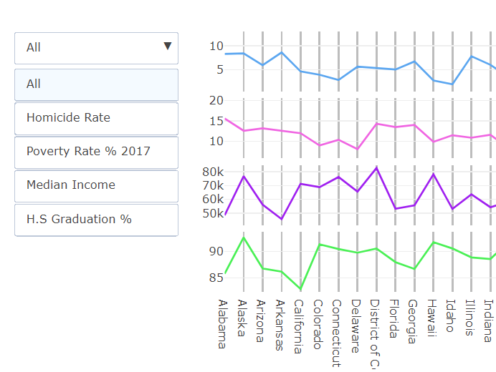
External High School Graduation Factors in US
Liz:
Plotly JS
Subplots
Findings
States with mild outliers all 4 subplots:
Louisiana, Massachusetts, New Hampshire, Washington
States close to medians in all subplots:
Georgia, South Carolina
Notes:
Key value pairs with plotly and javascript
Dropdown menu to see 1 chart at a time

Slide 4
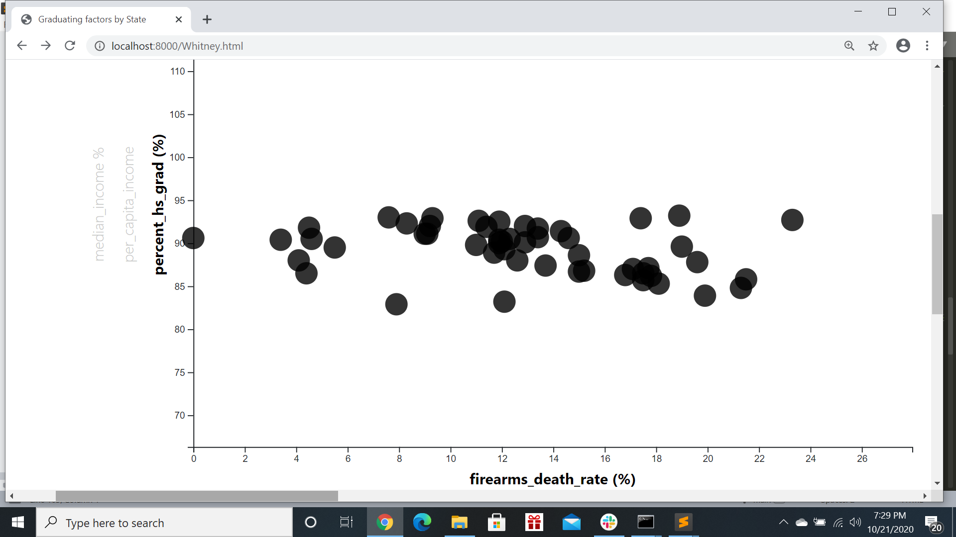
Graduating Factors by State
Whitney:
Data Collection
Interactive Scatter Plot
Creating HTML
Unemployment Data
http://api.census.gov/data/2018/nonemp?
Collaborate everyone’s html files

Slide 5

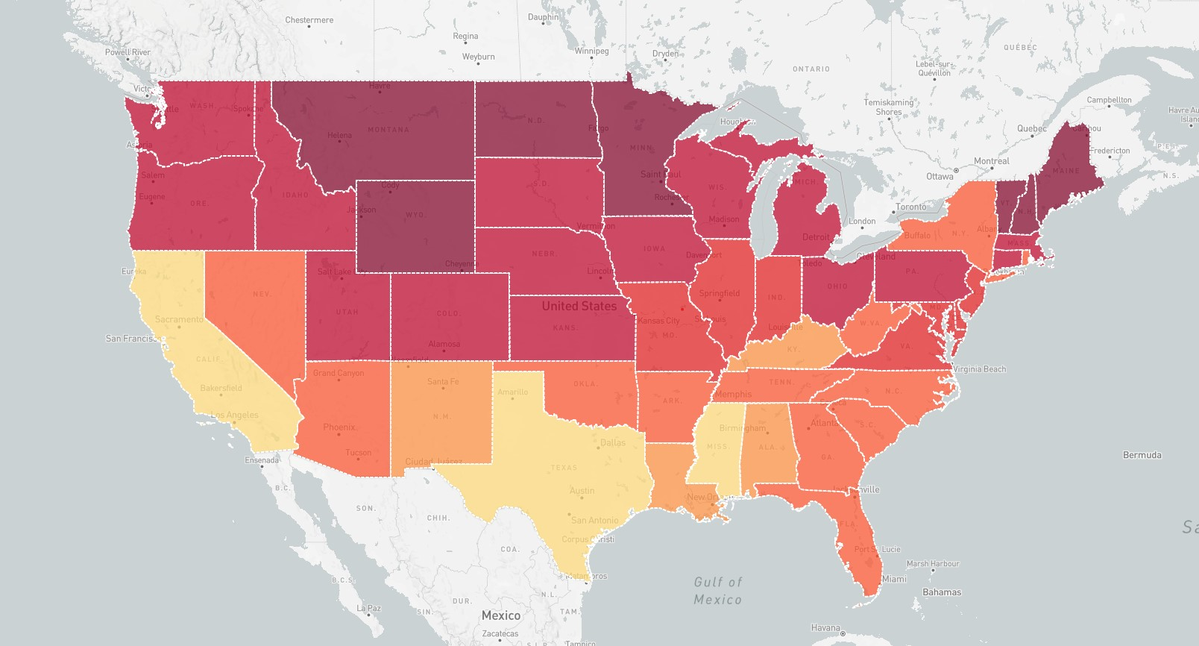
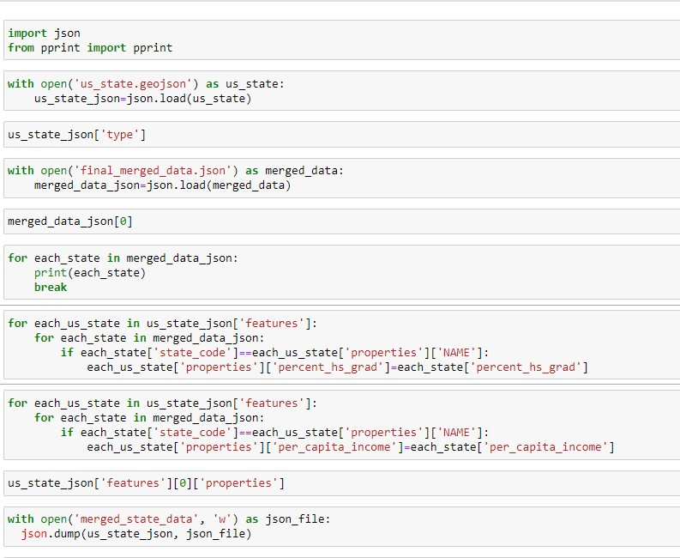
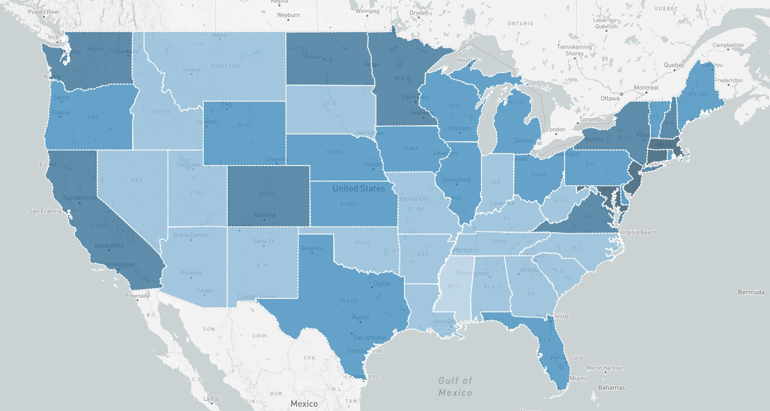
High School Grad Rate & Per Capita Income
Julie:
GeoJson & Json Data
Leaflet Mapping
Visualization & Analysis
State GeoJson https://eric.clst.org/tech/usgeojson/
Merged Data in Json from Flask App
Combined using Python
No direct trend in HS grad rate & Per Capita Income

Slide 6
Data Benefits
01
Relocation Opportunities
Provide demographic and educational data to people looking for relocation opportunities
02
Marketing Strategy
Targeted Marketing
Prospective market analysis
03
Political Campaigns
Public policies to meet the needs of population

