Slide 1
The Goldilocks Principle
in Environmental Design
Why the Brain Prefers the Middle
David Kirsh • Cognitive Science • UC San Diego • February 2026

Slide 2
The Core Claim
Across visual complexity, acoustic intensity, temperature, material coverage,
fractal geometry, spatial proportions, and light levels—the relationship between
environmental stimulus and human response follows an
inverted-U function.
This is not seven coincidences. It reflects something fundamental
about how the brain engages with environmental stimulation.
Too Little
Just Right
Too Much

Slide 3
e.g.
The Inverted-U in Everyday Spaces
The Bare Hospital Corridor
A Well-Designed Café
Times Square at Rush Hour
White walls, fluorescent light,
no variation, no views, low
complexity. Patients report
boredom, anxiety, disorientation.
PE ≈ 0: nothing to learn.
Wood surfaces (~40%), moderate
music (~65 dB), natural light,
varied seating nooks, plants.
People choose to work here.
PE is moderate: enough variety
to sustain engagement.
Extreme visual complexity,
80+ dB, flashing lights,
crowds, unpredictable motion.
Most people report stress
and a desire to leave.
PE overwhelms the model.
← Too little PE Just right PE Too much PE →

Slide 4
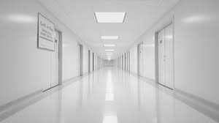
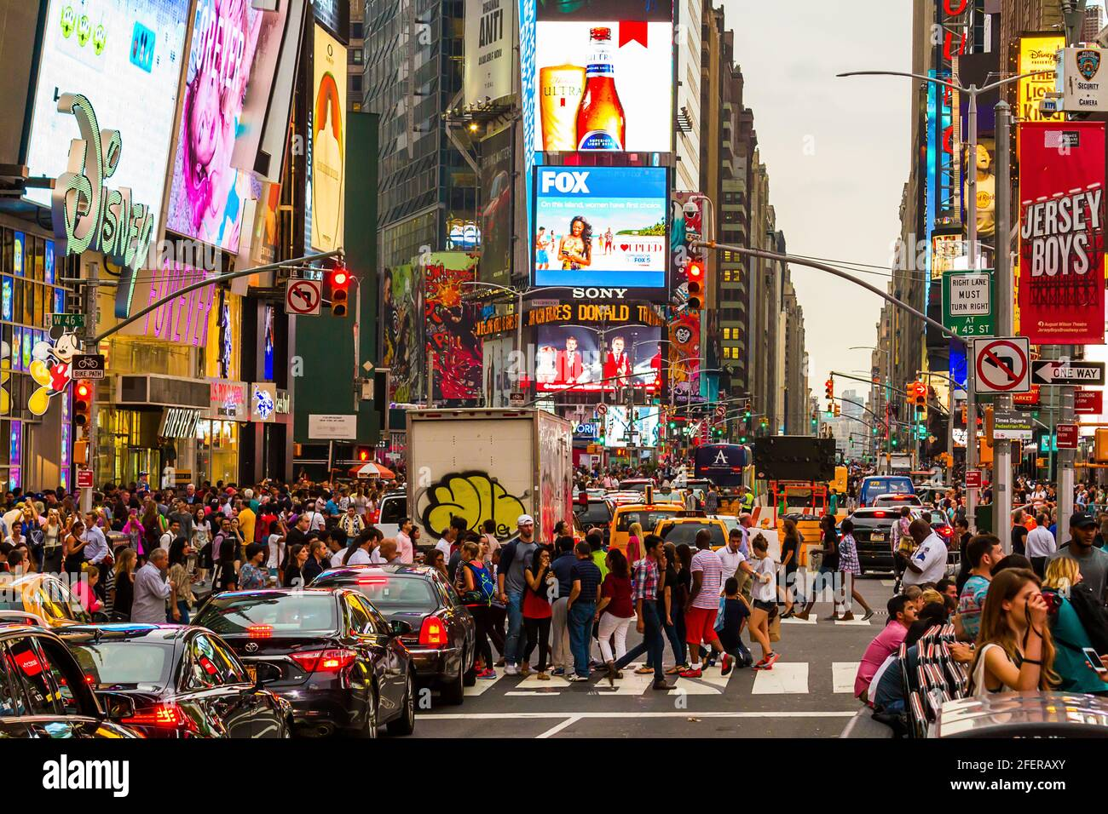


Slide 5
1
The Evidence:
Inverted-U Functions Everywhere

Slide 6
Visual Complexity: The Classic Inverted-U
Berlyne (1971)
Fechner (1876) first documented it Birkhoff (1933) formalized it Berlyne gave it a mechanism Güçlütürk et al. (2016) confirmed it computationally
Architecture: Stamps (2004): building facades
Salingaros (2003): ornamental density

Slide 7
e.g.
Visual Complexity: Three Building Facades
Minimalist Glass Box
Gothic Cathedral Facade
Unrestored Kowloon Walled City
A corporate glass tower:
repetitive grid, no ornament,
no material variation.
D ≈ 1.0–1.1.
Rated: “cold,” “sterile,”
“forgettable.” Berlyne:
insufficient collative properties
→ no exploratory engagement.
Chartres Cathedral: D ≈ 1.3–1.4.
Hierarchical ornament at multiple
scales. Rose window, archivolts,
columns, statuary, texture.
Rated: “fascinating,” “inspiring.”
Complexity is high but
organized—self-similar at
multiple scales = 1/f statistics.
D ≈ 1.7–1.9. Random accretion
of structures, no organizing
principle, clashing materials,
no visual hierarchy.
Rated: “overwhelming,”
“chaotic.” PE exceeds model
capacity at every level of
the visual hierarchy.

Slide 8
Seven Channels, One Pattern
Visual Complexity
Optimum: D ≈ 1.3
Acoustic Intensity
Optimum: ~70 dB
Temperature
Optimum: 22± 2°C
Wood Coverage
Optimum: ~45%
Fractal D
Optimum: D ≈ 1.3
Ceiling Height
Optimum: 3.0–3.5m
Light Level
Optimum: 500–1000 lux

Slide 9
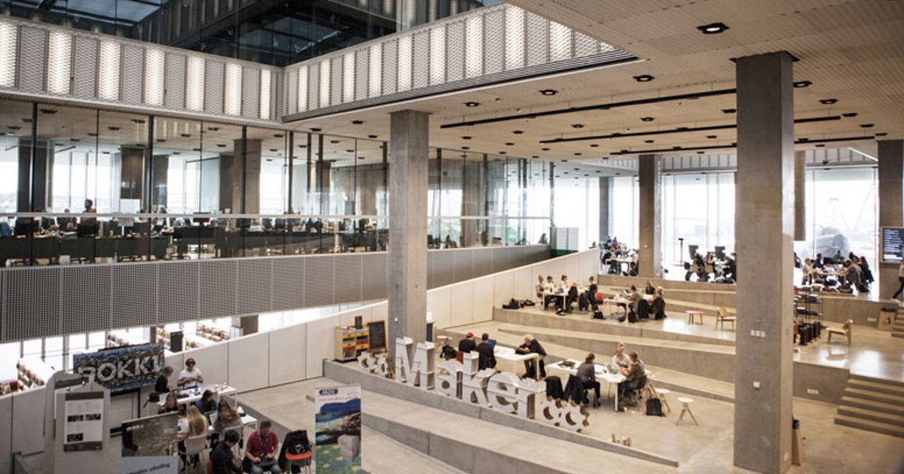
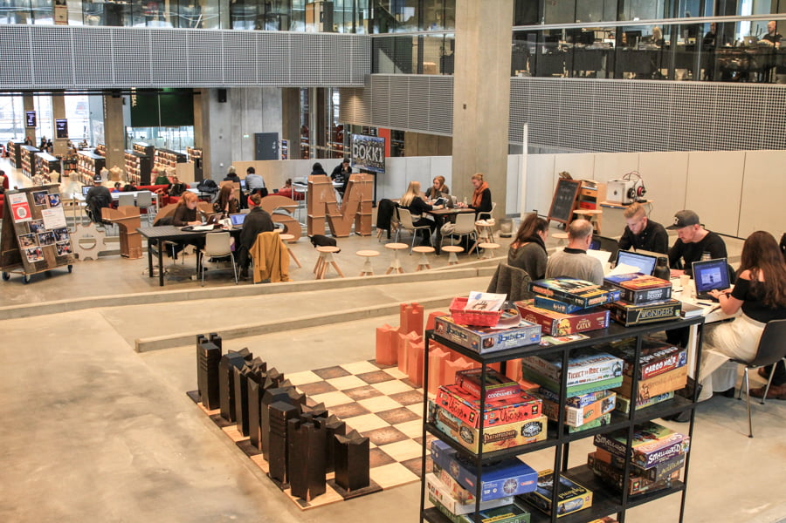
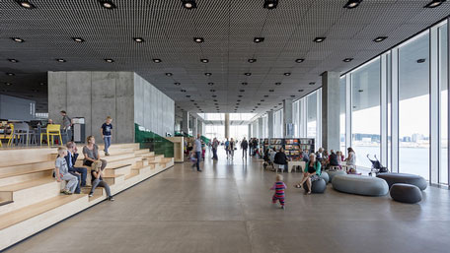
e.g.
Dokk1, Aarhus: One Building, Multiple Activity Spaces
Maker Space + Stepped Seating
Social Game Zone
Children’s / Family Zone
Activity: Collaborative learning, maker workshops, group projects
High visual complexity (D ≈ 1.4–1.6). Moderate acoustic (~55 dB ambient). 4m+ ceilings prime abstract/divergent thinking. Glass-enclosed quiet study visible above = prospect-refuge gradient.
OPTIMAL for collaborative creation
Activity: Board games, casual laptop work, social encounter
Moderate-high complexity (games, giant chess, varied seating). Higher acoustic (~60–65 dB conversation). Open sightlines. Visual richness from game materials sustains engagement without overwhelming.
OPTIMAL for social play
Activity: Free play, family browsing, sensory exploration
High visual variety (soft sculptures, wooden steps, color). Permissive acoustics (children’s noise tolerated). Floor-to-ceiling harbor views. Soft seating invites bodily exploration.
OPTIMAL for exploratory play
When the activity doesn’t match the room’s designed activity space: Each zone above is a cognitive niche tuned to specific activities (Kirsh, 2026). Try to do focused code review in the Game Zone and the acoustic PE that sustains social play now causes phasic LC interruptions every 30 seconds — your epistemic bubble cannot filter out task-irrelevant speech. Try to brainstorm in a quiet reading room designed for solitary study and the very silence that supports deep focus now starves the associative search of the moderate noise it needs.
The cost is measurable: reduced speed-accuracy (more errors at the same pace), longer interruption recovery, higher cognitive load, and lower satisfaction — precisely the behavioral signatures of reduced cognitive congeniality.

Slide 10
Acoustic Intensity: Creative Tasks Only
Mehta et al. (2012)
Moderate noise mildly defocuses attention → broader associative activation → enhanced creative insight
But NOT for focused tasks
Focused work shows monotonically negative effects of noise (Banbury & Berry, 2005)

Slide 11
e.g.
The Coffee Shop Effect: Why Writers Go to Cafés
The writer in the café
Ambient noise at ~65–70 dB: espresso machine, muffled conversation, music.
Neural mechanism: Unpredictable auditory input sends mild phasic LC-NE bursts that partially disrupt the default mode network’s tendency toward ruminative, narrow processing. This opens a wider associative search space without fully capturing attention.
The writer produces more novel ideas than in silence—but the same noise would devastate a coder debugging a complex function.
The surgeon in the OR
Operating rooms: random alarms, team chatter, equipment noise. Studies show surgeon error rates rise 30–66% with background music and speech (Miskovic et al., 2008).
Neural mechanism: Surgical tasks demand sustained focused attention (tonic LC mode). ANY phasic disruption causes micro-switches to the ventral attention network, costing 0.5–2 seconds of reorientation per burst.
Same acoustic intensity, opposite cognitive effect—because the task determines where on the inverted-U you need to be.

Slide 12
Wood Surfaces: Peak at ~45% Coverage
Three theories converge:
1. Biophilia
Evolved affiliation with natural materials
2. Fractal Fluency
V1/V2 processing efficiency for 1/f grain
3. Predictive Processing
Low prediction error for natural statistics
>90% wood = monotony + claustrophobia
(Nyrud & Bringslimark, 2010)

Slide 13
e.g.
Wood: Three Rooms at 15%, 45%, and 90%
15% Wood: Token Accent
45% Wood: The Sweet Spot
90% Wood: The Log Cabin Problem
A white-walled office with one
wooden shelf. The wood is
insufficient to register as a
coherent material signal.
Fractal grain visible on only 15%
of visual field → too few 1/f
samples for V1/V2 to establish
processing fluency.
d ≈ 0.10–0.15 (barely detectable).
Japanese hinoki room: wooden
floor, one accent wall, ceiling
beams. White plaster counterpoint
provides contrast and variety.
Fractal grain covers enough visual
field for processing fluency without
monotony. Multiple materials = PE
stays in the learnable range.
d ≈ 0.45–0.55 for ↓ cortisol.
Sakuragawa et al. (2005).
Floor, walls, ceiling, furniture all
wood. The room feels “closed in,”
“heavy,” “suffocating.”
No material variation → PE ≈ 0.
Pattern monotony triggers the
Berlyne boredom response.
Visual field becomes uniform →
no information gain at any scale.
d < 0.10 (Tsunetsugu et al., 2007).

Slide 14
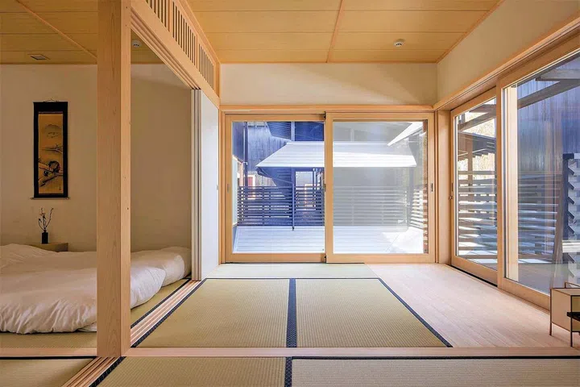
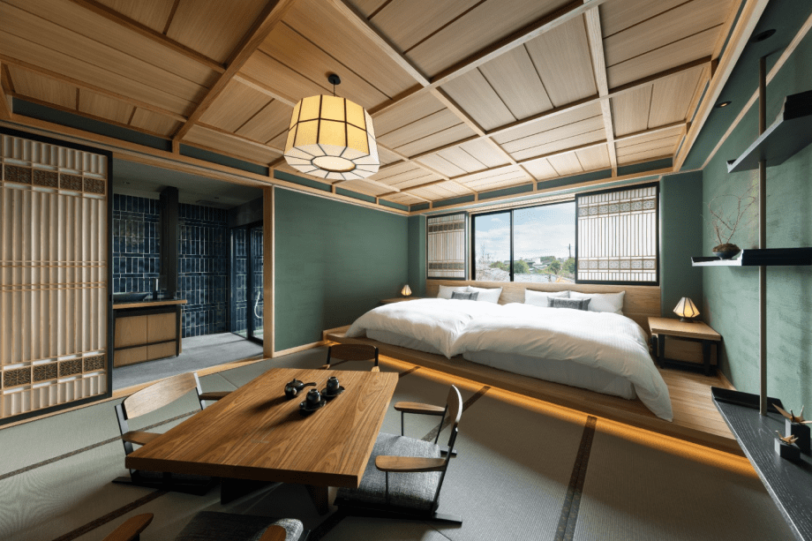
Japanese hinoki room

Slide 15
2
Beyond Boring vs. Stimulating:
Berlyne’s Full Framework

Slide 16
Berlyne’s Four Collative Variables
Complexity
Novelty
Incongruity
Surprisingness
Number & variety
of elements
Difference from
expectation
Elements conflict
with context
Violates specific
predictions
Each produces its own
inverted-U
Each produces its own
inverted-U
Each produces its own
inverted-U
Each produces its own
inverted-U

Slide 17
e.g.
Berlyne’s Four Variables in Architecture
Complexity
Gaudi’s Sagrada Familia vs. a Mies van der Rohe
pavilion. Sagrada: extreme ornamental complexity at
every scale—yet organized by biological logic, so it
feels rich rather than chaotic. Mies: elegant simplicity—
but walk through it for 30 minutes and boredom sets in.
The inverted-U explains both reactions.
Novelty
Your first day in a new city vs. your 100th day. Day 1:
everything is novel, attention is heightened, cortisol
elevated, exploration intense. Day 100: habituation has
reduced PE to near zero for familiar routes. Novel
architecture ages: a striking building becomes invisible
with familiarity. The inverted-U shifts along the x-axis.
Incongruity
Gehry’s Guggenheim Bilbao in a 19th-century Spanish
city: titanium curves amid stone facades. Moderate
incongruity → delight and engagement (tourists travel to
see it). Imagine the same building in a nature preserve:
excessive incongruity → offense and protest.
Surprisingness
Tadao Ando’s Church of the Light: a plain concrete
box—then a cruciform slit floods the altar with light.
The surprise violates your prediction of a dark interior.
Moderate surprisingness = awe. Extreme surprisingness
(a floor that gives way, a wall that moves) = anxiety.

Slide 18
Berlyne’s Two-System Model
Modern translation:
Reward = mesolimbic dopamine for learnable PE
Aversion = anterior insula + dACC for PE exceeding model (treat this as a neg number)
Net = the inverted-U: peak where dopamine > insula

Slide 19
e.g.
The Two Systems at Work: Walking Through a Museum
Imagine walking through the Louvre:
Room 1: Empty white hallway (transition corridor). Reward system barely activated—nothing to predict, nothing to learn. Aversion system mildly activated—something feels wrong about the emptiness. Net: slight negative. Prediction: You walk faster.
Room 2: Vermeer gallery (6 paintings, warm light, intimate scale). Reward system strongly activated—each painting provides learnable surprise, the light is warm, the scale is human. Aversion system barely activated—nothing threatening or overwhelming. Net: strong positive. Prediction: You linger.
Room 3: Grande Galerie (500m of paintings floor-to-ceiling, tourist crowds). Reward system activated—so much to see—but aversion system also strongly activated: too many PE sources competing for attention, social density, acoustic chaos. Net: mixed → “museum fatigue.” Prediction: You need (want) to sit down.
The museum walk is a journey along the inverted-U: under-stimulation → sweet spot → over-stimulation, all within the same building.

Slide 20
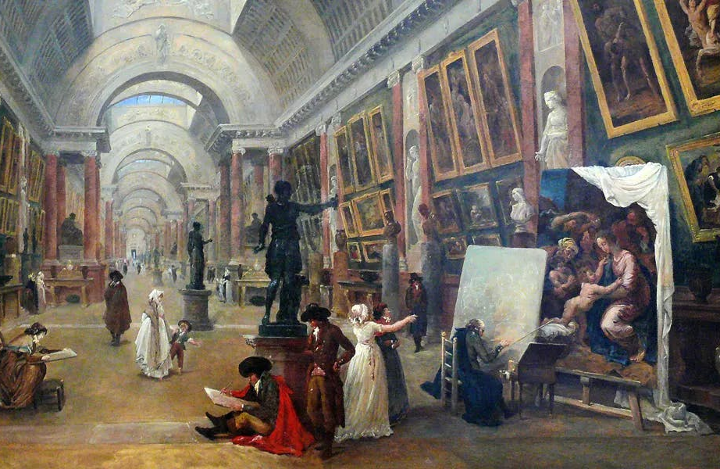
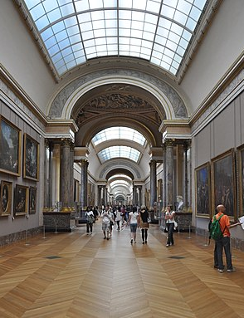
PAST
NOW
The Great Gallery of the Louvre

Slide 21
What Berlyne Missed
Multi-Channel Independence
The inverted-U operates independently in each sensory channel.
Channels interact through shared arousal pathways (LC-NE).
Task Dependence
Creative tasks prefer higher stimulation; focused tasks prefer lower.
The optimal level shifts with what you’re doing.
Cultural Variation
Goldilocks set-points shift across cultures. India fieldwork shows
correlated elevation across ALL modalities simultaneously.

Slide 22
e.g.
Task Dependence: Same Room, Two Tasks, Opposite Effects
Brainstorming session (10am)
Room: Open atrium, 4m ceiling, south windows, coffee-shop acoustics (~65 dB), wood and plants.
Effect: High ceiling primes abstract thinking (T007, d≈0.4). Moderate noise broadens associative search. Natural light and views sustain engagement without fatigue. Compound d ≈ 0.6.
This room is OPTIMAL for creative work.
Code review session (2pm)
Same room. Same team. Same environment.
Effect: High ceiling IMPAIRS detail focus (T007neg, d≈–0.3). Coffee-shop noise causes constant phasic LC interruption. Nature view captures involuntary attention away from screen. Compound d ≈ –0.15 to +0.10.
This room is ANTI-OPTIMAL for focused work.
Same environment. Different task. Opposite Goldilocks position.

Slide 23
3
Predictive Processing:
The Best Framework, But Not Enough

Slide 24
PP Explains WHY the Inverted-U Exists
Zero PE
Moderate PE
Excessive PE
No information gain
Neural habituation
Reduced dopamine
BOREDOM
Learnable surprise
Model updating
Dopamine reward
ENGAGEMENT
Model failure
Insula + dACC alarm
HPA cortisol
ANXIETY

Slide 25
e.g.
Three PE Zones in Your Morning Commute
Zero PE:
The Familiar Route
Moderate PE:
The New Side Street
Excessive PE:
Lost in a Foreign City
You’ve driven this road 2,000 times.
Every turn is predicted. The visual
model generates zero error. Your
mind wanders—you arrive and can’t
remember the drive. LC is in low
tonic mode. Attention is elsewhere.
Architectural parallel: a corridor
you’ve walked 10,000 times.
Invisible. No cognitive engagement.
You take a different route. New
buildings, unfamiliar intersections,
a park you didn’t know existed.
Each turn generates learnable PE.
You’re alert, curious, noticing.
Dopamine reward for successful
navigation.
Architectural parallel: a building
with just enough variation to
sustain interest on the 100th visit.
No street signs you can read. No
familiar landmarks. Traffic rules
you don’t understand. Every
intersection is a model failure.
Cortisol rises. Anxiety builds.
You want to find somewhere safe.
Architectural parallel: a building
with no wayfinding cues, random
layouts, disorienting geometry.

Slide 26
Six Limitations of PP for the Goldilocks Principle
1. Normative Gap
PP says minimize PE. Goldilocks says optimize it. The dark room problem. Andy’s solution next slide.
2. Task-Specific Optima
PP doesn’t predict creative tasks prefer higher PE than focused tasks.
3. Multi-Channel Structure
PP operates within modalities. Doesn’t predict cross-modal compensation.
4. Cultural Set-Points
PP predicts modality-specific prior shifts. India shows correlated shift.
5. Prospect-Refuge
PP predicts max prospect + max refuge. But intermediate is preferred.
6. Explicit Cognition
PP is subpersonal. Adults override implicit inverted-U via goals, aesthetics, activity frames (Kirsh, 2026).

Slide 27
e.g.
Where PP Fails: The Dark Room and the Prospect-Refuge Puzzle
The Dark Room Problem
PP says: minimize prediction error. The best way to minimize PE is to sit in a dark, silent, unchanging room where nothing ever surprises you. PE = 0. Free energy minimized. But nobody wants to live in a dark room. People voluntarily seek out novelty, variety, stimulation. Why?
PP’s answer: “active inference” and “expected free energy.” But these are additions to the framework, not predictions from it.
Goldilocks’ answer: the brain doesn’t minimize PE. It OPTIMIZES it. Zero PE is as bad as excessive PE. The target is moderate PE.
The Prospect-Refuge Puzzle
PP predicts: max prospect (open view = max prediction) + max refuge (enclosure = max safety) should be monotonically preferred. But Dosen & Ostwald (2016) found people prefer INTERMEDIATE enclosure:
• Fully enclosed (100%): claustrophobic • Fully open (0%): exposed, vulnerable • Alcove with partial view (40–60%): safe + engaged
Think: reading in a bay window. Your back is protected. You can see the street. Not too open, not too closed.
PP cannot derive this inverted-U. Goldilocks predicts it.

Slide 28
4
Beyond Implicit Processing:
Activity Space and the Explicit Channel

Slide 29
BEYOND IMPLICIT PROCESSING
The Kidd & Hayden Problem:
What the Curiosity Inverted-U Doesn't Show
Kidd & Hayden (2015) established an inverted-U for curiosity. But their evidence base has a critical limitation.
WHAT KIDD & HAYDEN ESTABLISH
WHAT IT CANNOT SHOW
Infants, monkeys, and rats show an inverted-U for looking time / information seeking: Too predictable → disengagement Moderate surprise → sustained attention Too unpredictable → look-away This is implicit PE-driven curiosity operating at the level of sensory prediction.
Adult humans have extensive explicit processing: A graduate student persists through high-PE mathematics BECAUSE she explicitly values the outcome. An architect DELIBERATELY chooses moderate visual complexity — not because her PE system demands it, but because she knows it works.
Adults override the implicit inverted-U
Explicit goals, values, and metacognitive awareness let adults persist through high PE (studying hard material) or seek it out (horror films, extreme sports, Varanasi). The infant inverted-U is a floor, not a ceiling.
Even 'implicit' processing is higher-level in adults
An adult's automatic processing operates over model selection and theory comparison — not just feature prediction. Your visual system implicitly evaluates whether a facade is 'right' at the level of architectural grammar, not just spatial frequencies.
The inverted-U WIDENS with expertise
An experienced architect can tolerate and enjoy higher visual complexity than a novice — because her predictive model is deeper. Expertise shifts the entire Goldilocks profile rightward. Kidd's infants have no expertise to shift.
Notes:
Kidd & Hayden (2015) is an important paper that establishes the inverted-U for curiosity and information-seeking. But their evidence comes from infants, monkeys, and rats — organisms whose processing is predominantly implicit. Adult humans have three features that fundamentally change the picture. First, they can OVERRIDE the implicit inverted-U through explicit goals and metacognitive awareness — a grad student persists through extremely high PE because she values the outcome. Second, even adult 'implicit' processing operates at higher levels of abstraction — model selection, theory comparison, architectural grammar — not just low-level feature prediction. Third, expertise WIDENS the inverted-U: an experienced architect enjoys and processes higher visual complexity because her predictive model is deeper. This means the Kidd & Hayden inverted-U is a floor — the minimum structure — not the full story of how adults engage with environments.

Slide 30
ACTIVITY SPACE FRAMEWORK
Activity Space: Why the Room Is Not the Unit of Analysis
Three levels of activity analysis reframe the Goldilocks optimum as activity-relative (Kirsh, 2026)
1
Logical Level
Goal–subgoal structure of the activity. Topological, not metric: the same cooking task admits indefinitely many kitchen layouts. Only framework operating at this level — it sets boundary conditions for all other Tier 1 theories (PP, Berlyne, ART, Biophilia, SRT).
2
Physical Level
Metric implementation: distances, tool placement, circulation, HVAC, acoustics, lighting. Topology-to-metric mapping. Mise-en-place changes cognitive congeniality without changing the formal task (Kirsh, 1995). Two identical kitchens can differ enormously in cognitive support.
3
Cognitive Level
The epistemic bubble: activity-driven attentional filtering determines which features are cognitively active. 70% of subjects miss a gorilla when counting passes (Simons & Chabris, 1999). The same room generates different PE profiles depending on activity. Cognitive congeniality is measurable: speed-accuracy, interruption recovery, error cost.
No other Tier 1 framework operates at the logical level. Activity Space uniquely moderates when and how all other frameworks apply.

Slide 31
THE EXPLICIT–IMPLICIT BRIDGE
How Activity Frames Gate Prediction Error
Explicit activity selection reconfigures the affordance ecology through which implicit PE operates
Step 1: EXPLICIT
Person deliberately selects an activity (read, converse, sketch, meditate). This is goal-directed, prefrontal, conscious.
Step 2: RECONFIGURATION
Activity frame reshapes the epistemic bubble: different features become salient, different affordances perceived. Task-positive network gates attention.
Step 3: IMPLICIT PE SHIFTS
Effective stimulus changes. Same physical room generates different prediction errors because the implicit system now processes a different affordance ecology.
Step 4: GOLDILOCKS SHIFTS
The inverted-U optimum for each channel is now defined relative to the activity, not the room. Multi-activity spaces face inherent Goldilocks conflicts.
The Bridge
Explicit processing (activity selection) gates implicit processing (PE-based inverted-U) by reconfiguring the affordance ecology. This is the mechanism the Kidd & Hayden inverted-U cannot capture: adults choose their activity frame, and that choice reshapes the landscape over which bottom-up PE optimization operates. The Goldilocks optimum is activity-relative. Dokk1 implements different profiles for different activity spaces in one building (Kirsh, 2026).
Inattentional blindness (Simons & Chabris 1999) • Task-positive network (Cole et al. 2014) • Cognitive congeniality (Kirsh 1996) • Activity space (Kirsh 2026)

Slide 32
THE EXPLICIT CHANNEL
Environments Affect Adults Through
Two Processing Channels
The Goldilocks inverted-U for adults integrates BOTH implicit PE and explicit evaluation
IMPLICIT CHANNEL (subpersonal)
EXPLICIT CHANNEL (personal-level)
What Kidd & PP capture: Autonomic responses Heart rate, skin conductance, cortisol Affective valence Amygdala, insula, ventral striatum activation Prediction error processing V1→IT hierarchy, auditory cortex, somatosensory Attentional capture LC-NE phasic bursts, ventral attention network This is where the infant inverted-U lives.
What Kidd & PP miss:
Aesthetic judgment "This building feels right" — reflective evaluation Semantic meaning A hospital that "doesn't feel institutional" — category-level Cultural aesthetic norms Transmitted preferences, not just altered priors Deliberate engagement Choosing to stay in high-PE environments for explicit reasons This is uniquely adult and uniquely human.
+
THE GOLDILOCKS ADVANTAGE
The full adult Goldilocks inverted-U integrates both channels. The cultural set-point shifts we see in India may be partly explicit — transmitted aesthetic norms and deliberate environmental choices, not just recalibrated sensory priors. A patient's response to a hospital room is BOTH implicit (autonomic stress from acoustic chaos) AND explicit ("this looks like a place where people die").
Notes:
This is the central theoretical move. Environments affect adults through TWO processing channels: the implicit channel (autonomic responses, affective valence, PE processing, attentional capture — what Kidd and PP capture) and the explicit channel (aesthetic judgment, semantic meaning, cultural norms, deliberate engagement — what they miss). The infant inverted-U captures ONLY the implicit channel. The full adult Goldilocks inverted-U integrates both. This has profound implications: the cultural Goldilocks set-point shifts we observe in India may be PARTLY explicit — transmitted aesthetic norms, deliberate environmental choices, not just recalibrated sensory priors. A patient's response to a hospital room is BOTH implicit (autonomic stress from acoustic chaos) AND explicit ('this looks like a place where people die'). Any framework that only captures the implicit channel — as PP, SRT, and Berlyne all do — is necessarily incomplete for adult environmental design.

Slide 33
THEORETICAL ADVANTAGE
Why Goldilocks Can Incorporate
Explicit Processing — and Others Can't
Predictive Processing
Cannot represent aesthetic judgment
Fundamentally subpersonal. PE operates below conscious awareness. Active inference adds agency but not reflective evaluation. The dark room problem emerges because PP cannot represent explicit goals overriding PE minimization.
Stress Recovery (SRT)
Excludes cognition by design
Ulrich's core claim is a 'pre-cognitive affective pathway' — stress recovery happens BEFORE and WITHOUT cognitive appraisal. If you let explicit processing in, SRT loses its theoretical distinctiveness.
Berlyne's Arousal Theory
Stimulus-centered, not agent-centered
Arousal potential is a stimulus property, not a cognitive evaluation. Collative variables (complexity, novelty) are measured at the stimulus, not at the person's reflective response. No room for 'I choose to find this interesting.'
Attention Restoration (ART)
Restoration requires effortless engagement
Kaplan's 'soft fascination' is involuntary attention capture by natural stimuli. It works BECAUSE it doesn't require deliberate effort. Adding explicit processing would undermine the restoration mechanism.
The Goldilocks Principle: Because it is normative (prescribing an optimum) rather than purely mechanistic, it can integrate both channels. The optimum includes what the person thinks about the environment, not just what their PE system computes.
Notes:
This slide makes the comparative argument explicit. PP is fundamentally subpersonal — the dark room problem emerges precisely because PP has no way to represent explicit goals overriding PE minimization. SRT is explicitly built to bypass cognitive appraisal — it's a pre-cognitive pathway by design. Berlyne measures stimulus properties (arousal potential), not the person's reflective response. ART depends on involuntary attention — restoration works BECAUSE it doesn't require effort. None of these frameworks can easily incorporate explicit processing without undermining their core theoretical commitments. The Goldilocks principle can because it is NORMATIVE — it prescribes an optimum that includes both what the PE system computes implicitly AND what the person evaluates explicitly. The normative move — saying there EXISTS an optimal level and design SHOULD target it — creates space for the full range of human environmental engagement. This is the theoretical advantage that matters most for this philosophical audience.

Slide 34
PHILOSOPHY OF MIND
Goldilocks as Cognitive Niche
Engineering: The Extended Mind Argument
If cognitive processes extend into the environment (Clark & Chalmers, 1998), design IS cognitive engineering
1
The Extended Mind Thesis
Cognitive processes are not brain-bound. The notebook, the sketch, the arranged workspace — these are components of the extended cognitive system. The environment is not stimulus to the organism; it is part of the computational architecture.
2
The Goldilocks Claim
The extended cognitive system has optimal operating parameters per channel of environment-brain coupling. There exists an optimum for visual PE, acoustic PE, thermal homeostatic deviation, olfactory congruence — and these optima are parameterized first by the activity the agent is engaged in, then by culture, individual difference, and circadian phase.
3
The Niche Engineering Conclusion
Architectural design is cognitive niche engineering: adjusting the parameters of the extended cognitive system to optimize its function for the activities occupants pursue (Kirsh, 2026). The optimal Goldilocks profile is not a property of the space alone but of the space-activity coupling. Different activities in the same space require different profiles; the niche must be tuned to the activity.
The feedback loop: Different cultures construct different cognitive niches with different Goldilocks profiles → those profiles shape the sensory and cognitive preferences of the people who develop within them → who then reconstruct the niche. Crucially, people always engage a space through an activity (Kirsh, 2026): the niche is optimized not for a space but for a space-activity system. Varanasi's elevated set-points are a cognitive niche in dynamic equilibrium, tuned to the activities its inhabitants pursue.
Notes:
This slide connects the Goldilocks principle to one of the most important ideas in philosophy of mind: the extended mind thesis. If Clark and Chalmers are right that cognitive processes extend into the environment, then architectural design is cognitive niche engineering. But a crucial point, developed in my Activity Space paper (Kirsh, 2026), is that the niche must be tuned to the activities occupants pursue. People never engage a space without having some task or activity in mind. Tasks shape how a person perceives and conceives of their environment through what I call an epistemic bubble or activity space. The Goldilocks set-point profile is therefore not a property of the space alone — it is a property of the space-activity coupling. The same physical space will have different optimal profiles for different activities. The feedback loop runs through activity: cultures construct niches tuned to their characteristic activities, those niches shape sensory and cognitive preferences, and people reconstruct the niche. Varanasi's elevated set-points are a cognitive niche in dynamic equilibrium, tuned to the activities — ritual, commerce, social congregation — that its inhabitants pursue. For this philosophical audience, this is arguably the most important contribution: environmental design is the optimization of extended cognitive systems for the activities they support.

Slide 35
5
India Fieldwork:
Cultural Goldilocks Set-Points

Slide 36
Multi-Modal Set-Point Elevation: Varanasi vs. Western Baselines
India
Western
All modalities shift in the same direction → single underlying parameter?

Slide 37
e.g.
Varanasi Ghat vs. Stockholm Apartment: Two Goldilocks Profiles
Dashashwamedh Ghat, Varanasi
Visual: D ≈ 1.6–1.8. Hundreds of colors, saris, temple carvings, boats, fires, flowers. Constant motion.
Acoustic: 70–80 dB. Bells, chanting, vendors, river sounds, all simultaneous.
Thermal: 35°C+ in summer. Tolerated.
Olfactory: Incense + marigold + cooking + river. Dense, layered, intense.
People sit here for hours. They are COMFORTABLE. This is their Goldilocks zone.
Apartment, Stockholm
Visual: D ≈ 1.1–1.2. White walls, blond wood, one plant, clean lines. Almost no ornament.
Acoustic: < 35 dB. Triple-glazed windows. Clock ticking is audible.
Thermal: 21°C. Precisely regulated.
Olfactory: Neutral. Perhaps faint coffee.
Residents find this COMFORTABLE. The Varanasi ghat would be overwhelming.
This is THEIR Goldilocks zone.
Same principle. Different parameters.

Slide 38
5
Applications:
Designing with the
Goldilocks Principle

Slide 39
Hospitals: The Multi-Channel Goldilocks Catastrophe
Visual
EXTREME complexity
(equipment, signage)
Acoustic
UNPREDICTABLE alarms
at random intervals
Thermal
INCONSISTENT
(cold corridors, warm rooms)
Olfactory
INCONGRUENT chemicals
in healing contexts
Spatial
NO REFUGE
(long exposed corridors)
Goldilocks Fix
COORDINATED multi-
channel intervention

Slide 40
e.g.
Hospital Before/After: The Khoo Teck Puat Hospital, Singapore
Typical Hospital Ward
Visual: fluorescent panels on dropped ceiling tiles. Equipment, cords, monitors everywhere. D ≈ 1.6–1.8 but disorganized—high complexity without hierarchy.
Acoustic: alarms fire every 45–90 seconds on a typical ward (Cvach, 2012). Each alarm = phasic LC burst = attention capture. Cumulative: hundreds of attention interruptions per hour.
Olfactory: cleaning chemicals (ammonia, bleach) in a context where the brain expects “healing.” Cross-modal incongruence PE.
Patient outcome: elevated cortisol, disrupted sleep, slower wound healing (Ulrich et al., 2008).
Khoo Teck Puat Hospital (Biophilic, multi-channel)
Visual: garden views from every bed. Organized complexity (D ≈ 1.3) from vegetation at multiple scales. Warm wood accents at ~35–40%.
Acoustic: smart alarm triage reduces false alarms by 70%. Water features provide constant broadband masking (~45 dB), suppressing phasic responses.
Olfactory: garden scents enter wards through operable windows. Congruent with “healing garden” context.
Outcome: 30% faster recovery, 50% less sedative use, significantly improved patient satisfaction (Tan, 2013).

Slide 41
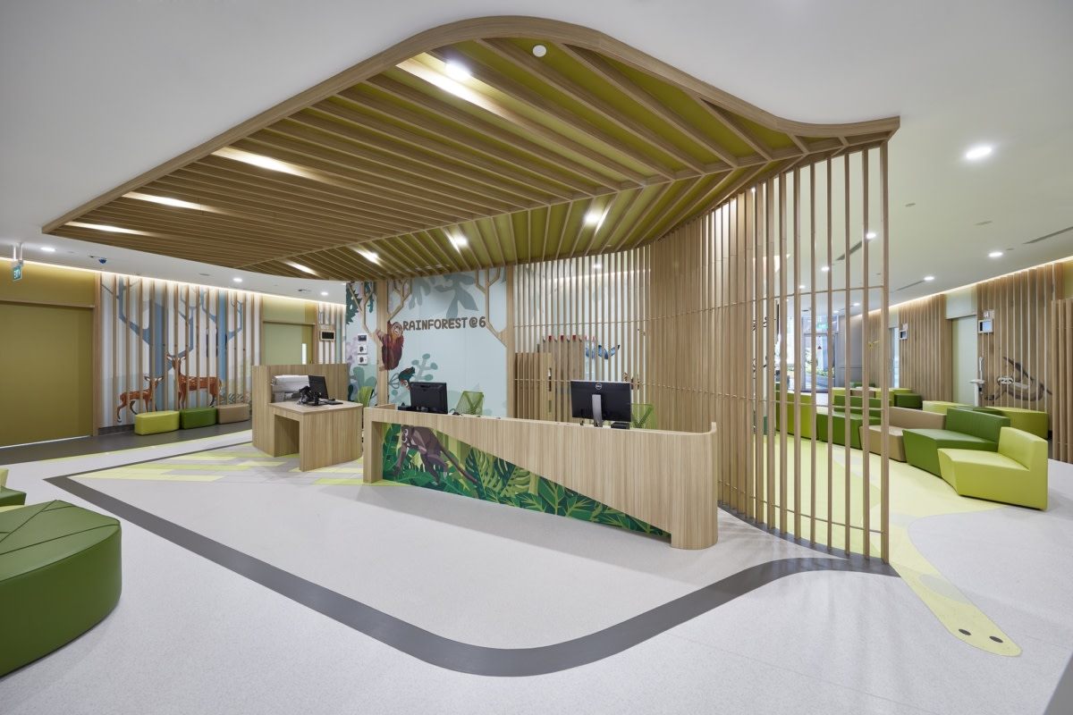
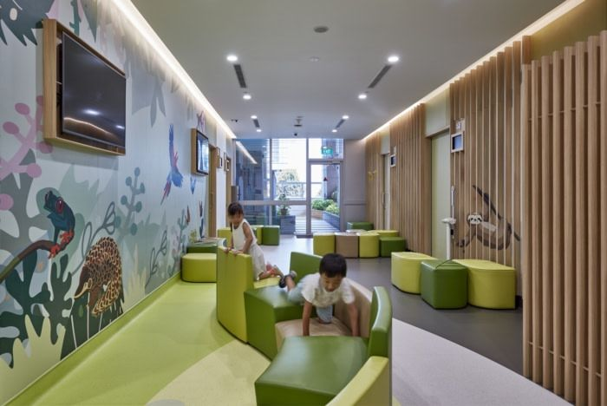
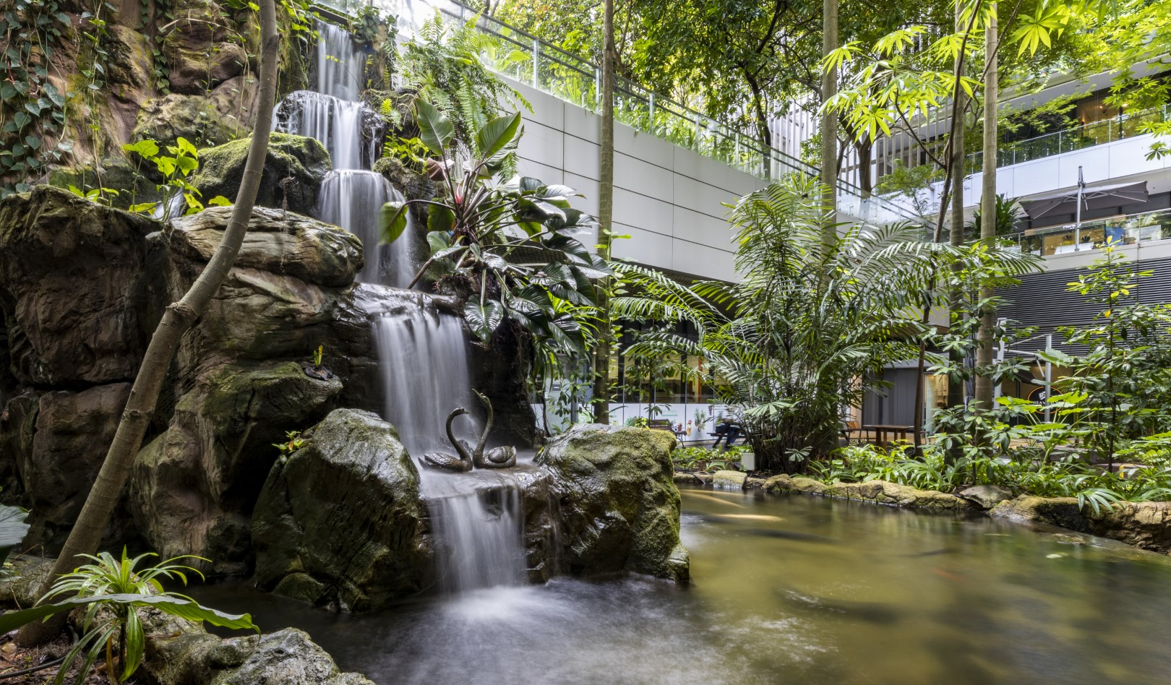

Slide 42
Open-Plan Offices: The LC-NE Disaster
Unpredictable Speech
→ Phasic LC bursts
Poor Interior Daylight
→ Weak tonic LC mode
No Refuge Zones
→ No escape from intrusion
Locus Coeruleus
Exploration Mode
Low tonic NE + frequent phasic bursts = the OPPOSITE of deep work mode
Fix: Bright blue-enriched light (tonic LC) + acoustic control (phasic suppression) + focus pods (refuge)

Slide 43
e.g.
Before/After: A Real Office Goldilocks Intervention
Before: Standard Open Plan
Light: Interior desks get 150–200 lux from overhead fluorescents. No blue-enrichment. Tonic LC = weak.
Sound: Avg 58 dB with speech peaks to 72 dB every 30–60 sec. Each peak = phasic LC burst. ~120 attention interruptions/hour.
Spatial: No enclosure option. Can’t escape visual or auditory intrusion. Prospect without refuge.
Result: Developers report 2–3 hours of uninterrupted focus per 8-hour day. Headphone use at 85%.
After: Goldilocks Intervention
Light: Circadian LED panels at 500+ lux, blue-enriched 6500K mornings, warm 3000K afternoons. Tonic LC = strong.
Sound: Acoustic felt panels + white noise masking (42 dB floor). Speech peaks drop to 48 dB. Phasic interruptions reduced 80%.
Spatial: 4 enclosed focus pods (2.5m ceiling, wood-lined, sound-isolated). Prospect-refuge: open desk = prospect, pod = refuge.
Result: Uninterrupted focus time doubles to 4–5 hours. Self-reported satisfaction +40%. Headphone use drops to 25%.

Slide 44
Cross-Modal Compensation: Channels Trade Off
Quiet + Low Visual Complexity
Total PE too low. Under-stimulation.
Fix: increase visual complexity.
Noisy + High Visual Complexity
Total PE too high. Overwhelm.
Fix: reduce visual complexity.
Channels compensate through shared LC-NE arousal pathway
Visual and acoustic design are NOT independent.
Jointly optimized against a total PE budget.

Slide 45
e.g.
Cross-Modal Compensation in Practice
The Japanese Tea House
The Indian Railway Station
Extremely quiet (< 30 dB). Minimal furniture. Neutral palette. By acoustic and visual measures alone: UNDER-stimulating.
But: tatami mat texture, tokonoma alcove with one scroll and one flower, shoji screen casting moving shadows, garden view framed by the window.
The visual channel provides just enough 1/f fractal complexity and gentle motion to compensate for acoustic and material minimalism. Total PE stays in the learnable range.
Extremely loud (> 80 dB). Extreme social density. Visual chaos. By Western standards: OVER-stimulating.
But: experienced Indian commuters show low cortisol. The acoustic PE is partially compensated by spatial familiarity (zero PE in navigation) and social warmth (interpersonal density = positive valence, not threat).
The familiar spatial channel compensates for the overloaded acoustic channel. Different cultures have different compensation strategies.

Slide 46
The Future: Dynamic Goldilocks Profiles
8am
Morning Focus
11am
Collaboration
2pm
Creative Session
4pm
Deep Work
Bright blue light,
quiet, neutral walls,
22°C
Moderate ambient,
nature views, warm
colors, 23°C
Higher complexity,
permissive acoustics,
coffee-shop vibe
Dim warm light,
very quiet pods,
low complexity
Activity × Circadian × Culture = Dynamic multi-channel optimization (Kirsh, 2026)

Slide 47
e.g.
A Smart Office Through the Day: Pixel HQ (Hypothetical)
8:30 AM — Arrival + Email Triage
Ceiling panels: 6500K blue-enriched at 600 lux (ipRGC → SCN entrainment → cortisol peak → alert). White noise floor: 42 dB. Thermal: 22°C. Open desk area. Task: email requires moderate focus. Goldilocks channel check: all green.
10:00 AM — Design Sprint
Team moves to “Studio” zone. 4m ceilings. Walls shift to warm oak panels with projected mood boards. Acoustic masking raises to 48 dB with “café hum.” Temperature up to 23°C. Goldilocks shift: higher visual complexity + moderate acoustic stimulation to support divergent thinking.
1:30 PM — Post-Lunch Code Review
Individuals retreat to focus pods: 2.5m ceiling, 4000K neutral light at 400 lux, wood-lined, acoustic isolation (<35 dB), 21°C. Goldilocks shift: minimize all non-task PE to maximize sustained attention bandwidth. The pod IS the Goldilocks intervention for the activity.
4:00 PM — Wind Down + Planning
Lights shift to 3000K warm at 350 lux (SCN reads “sunset,” begins melatonin pre-cursor). Lounge area: soft seating, nature view, garden sounds. Goldilocks profile matches circadian phase: lower optimal stimulation as the day winds down.

Slide 48
The Goldilocks Principle
1. The brain prefers intermediate environmental stimulation across all modalities
2. Berlyne’s framework is richer than “boring vs. stimulating” but misses multi-channel structure
3. PP provides the best mechanism but can’t explain the normative, task-specific, or cultural features
4. Goldilocks set-points are activity-dependent, culturally tunable parameters of the extended cognitive system
5. Design implication: optimize the Goldilocks profile for the activity space, not just the physical space
6. The system provides the tools: templates, mechanism chains, Bayesian composition
David Kirsh • kirsh@ucsd.edu • Cognitive Science, UCSD

