Slide 1
Evaluating ML models
April 2020

Slide 2
Challenge 1: Unreproducible patterns
Notes:
Applied Predictive Modeling states on page 61 that models can easily overemphasize patterns that are not reproducible.
This can happen for a multitude of reasons. I’m going to talk about 3. The first is:
- temporary localized patterns
- example: account from SC, shipping address in TX

Slide 3
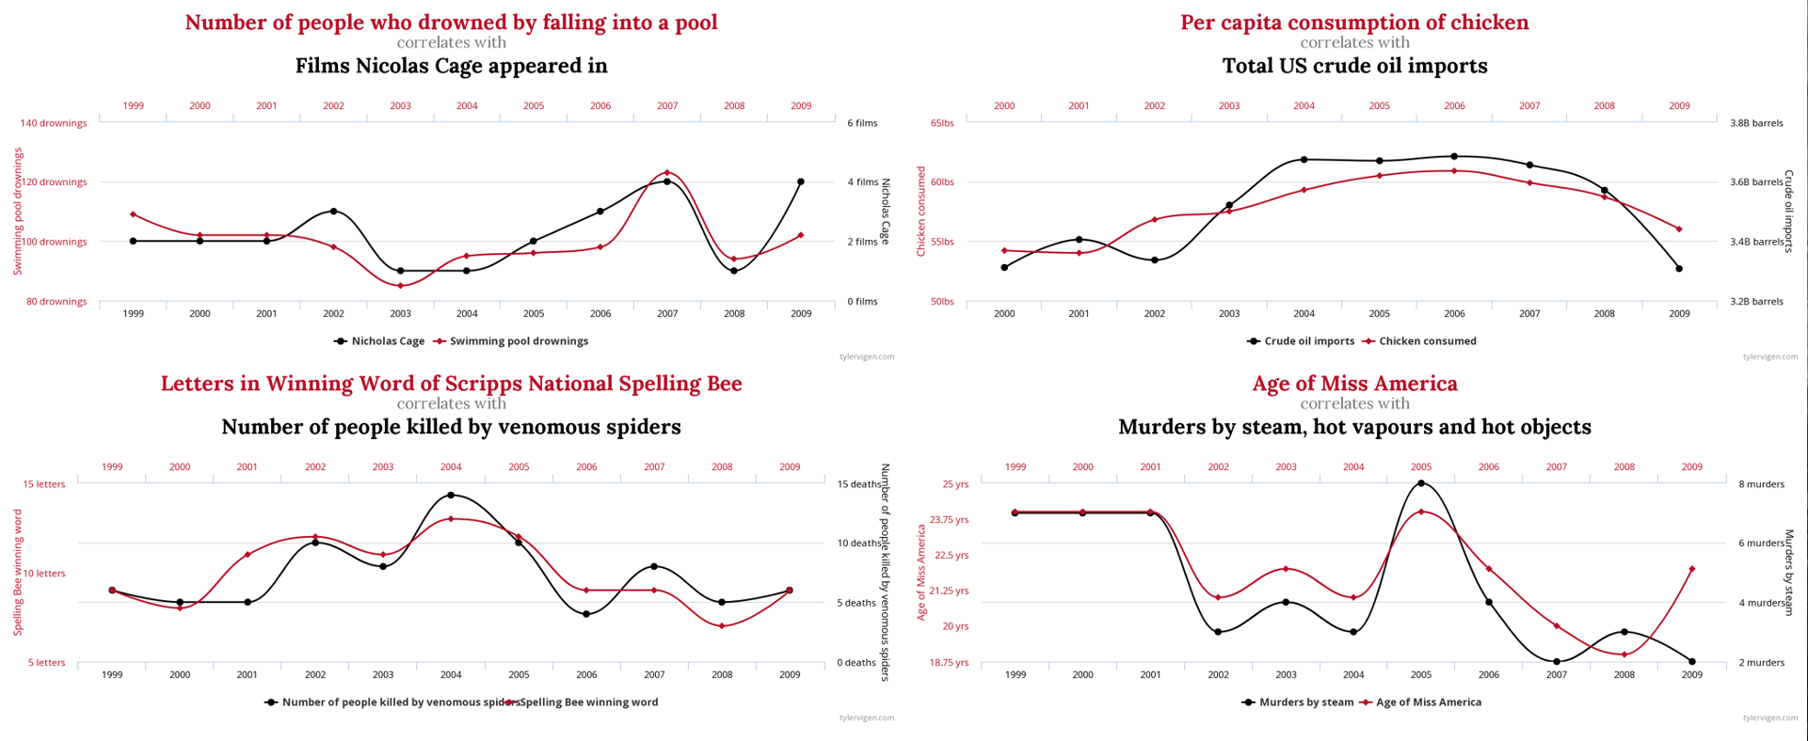
Spurious Correlations
Notes:
spurious correlations (examples from [tylervigen.com](https://www.tylervigen.com/spurious-correlations))

Slide 4
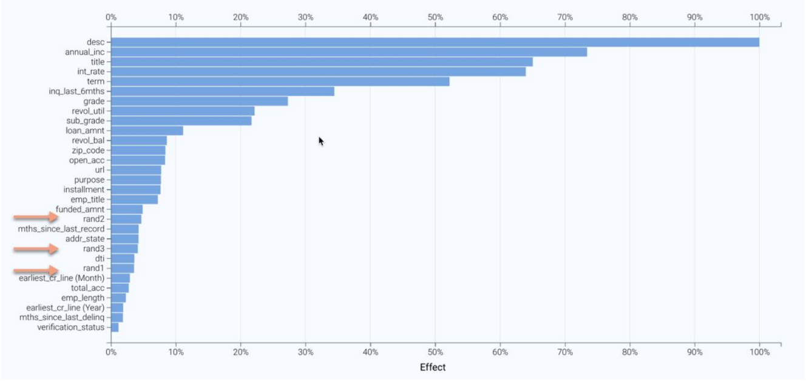
Flukes in the data
Notes:
flukes in the data (example from the ODSC [Interpretability workshop](https://github.com/rajshah4/inter_workshop/blob/master/InterpretabilityWorkshop.pdf) by Rajiv Shah from DataRobot)
Rajiv Shah regularly creates and includes random features, which helps him separate out the signal from the noise

Slide 5
Challenge 2: Unrealistic representation of uncertainty
Notes:
In addition, page 295 of *[Introduction to Machine Learning with Python](https://www.amazon.com/Introduction-Machine-Learning-Python-Scientists/dp/1449369413)* points out that not all models provide a realistic representation of uncertainty. For example, if overfit, a decision tree can be 100% certain of its predictions, even if it's almost never right.
We need a way to evaluate models to ensure quality, compare those models to determine which one is most appropriate, and at what threshold to set our final choice.

Slide 6
Confusion Matrix
 | Predicted Negative | Predicted Positive
Actual Negative | True Negative (TN) | False Positive (FP)
Actual Positive | False Negative (FN) | True Positive (TP)
Notes:
The rows comprise the true values and the columns comprise the predicted values. These actual and predicted values combine to create four categories (counter clockwise): True Negative, False Negative, True Positive, and False Positive.
From the diagram you can see that the second word indicates the prediction (positive or negative) and the first word states whether that prediction was correct or incorrect (true or false).

Slide 7
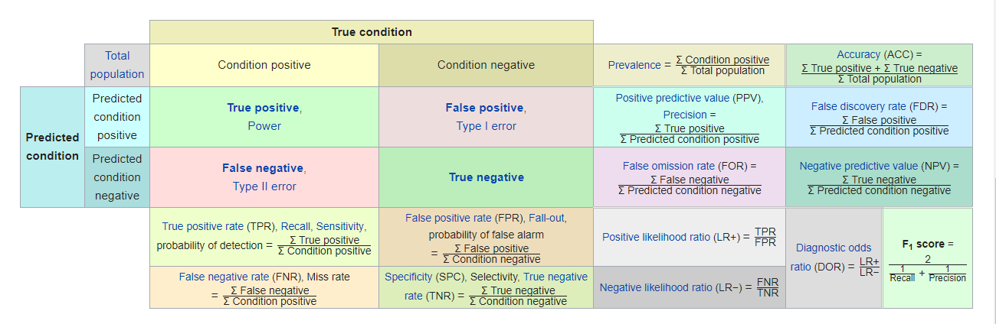
Confusion Matrix Metrics
Notes:
A selection of metrics that can be derived from these four categories can be seen in this chart
Due to the imbalanced nature of our data, the metrics we're most interested in are recall (aka sensitivity), precision, and false positive rate (aka 1 - specificity). Using these three metrics we can examine recall vs precision and sensitivity vs specificity.

Slide 8
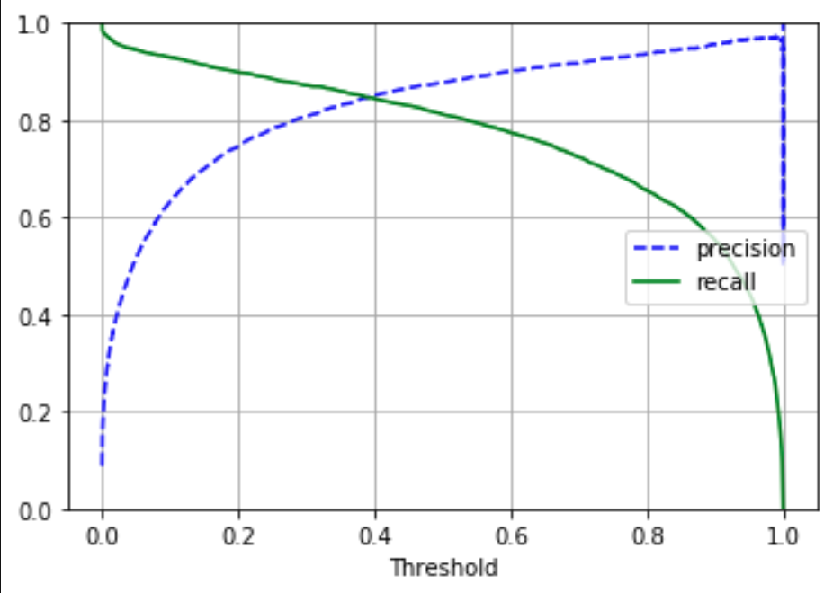
Precision and Recall vs Threshold
Notes:
On the far left recall is at 100%. This means that all positive observations were identified. While recall is perfect, it's easy to see that percision is at its lowest. This is because to grab all positive observations compromises had to be made which allowed more false positives through.
On the far right precision is at its highest. This means that the majority of positive predictions were in fact positive observations. However, recall is at an ultimate low. This is because in order to remove all false positivies limitations had to be set which moved many positive predictions into the false negative camp.
The precision and recall vs threshold chart won't always be so pretty.

Slide 9
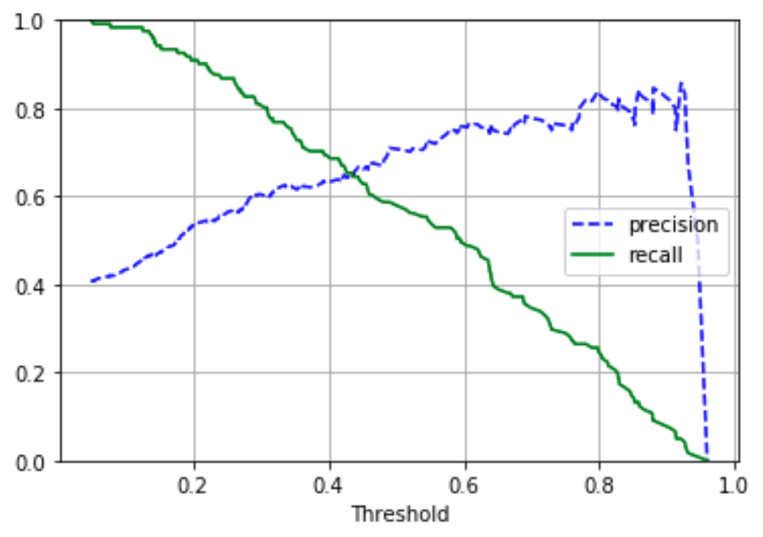
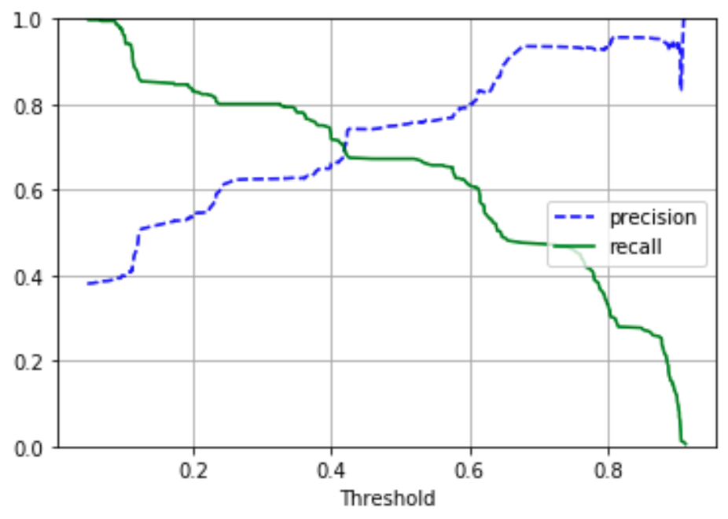
Precision and Recall vs Threshold cont.
Horse colic dataset
Titanic dataset
Notes:
On the far left recall is at 100%. This means that all positive observations were identified. While recall is perfect, it's easy to see that precision is at its lowest. This is because to grab all positive observations compromises had to be made which allowed more false positives through.
On the far right precision is at its highest. This means that the majority of positive predictions were in fact positive observations. However, recall is at an ultimate low. This is because in order to remove all false positives limitations had to be set which moved many positive predictions into the false negative camp.
The precision and recall vs threshold chart won't always be so pretty.

Slide 10
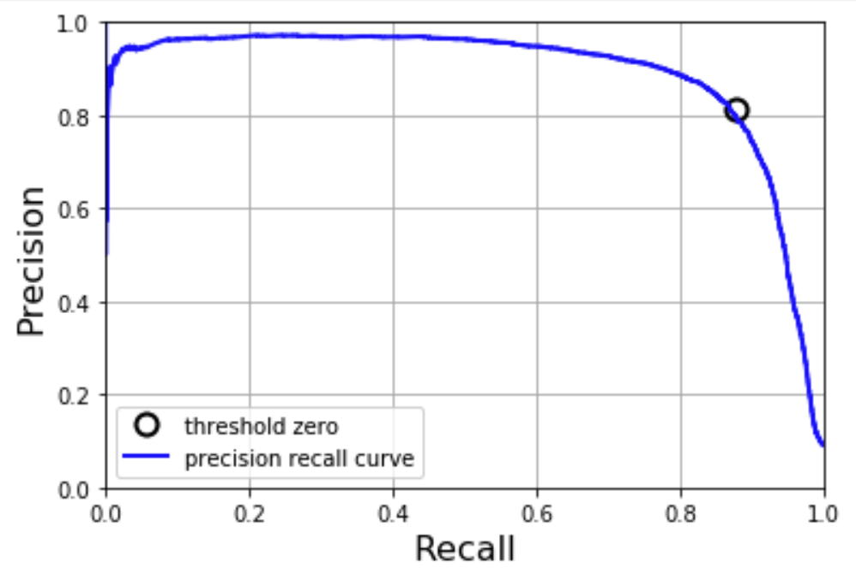
Precision vs Recall
Notes:
The pretty, lots-of-data-behind-it PR curve is a logarithmic decay where precision starts at 1 in the upper left corner and ends with precision at 0 in the lower right.
Not always so pretty, but the general idea holds up.

Slide 11
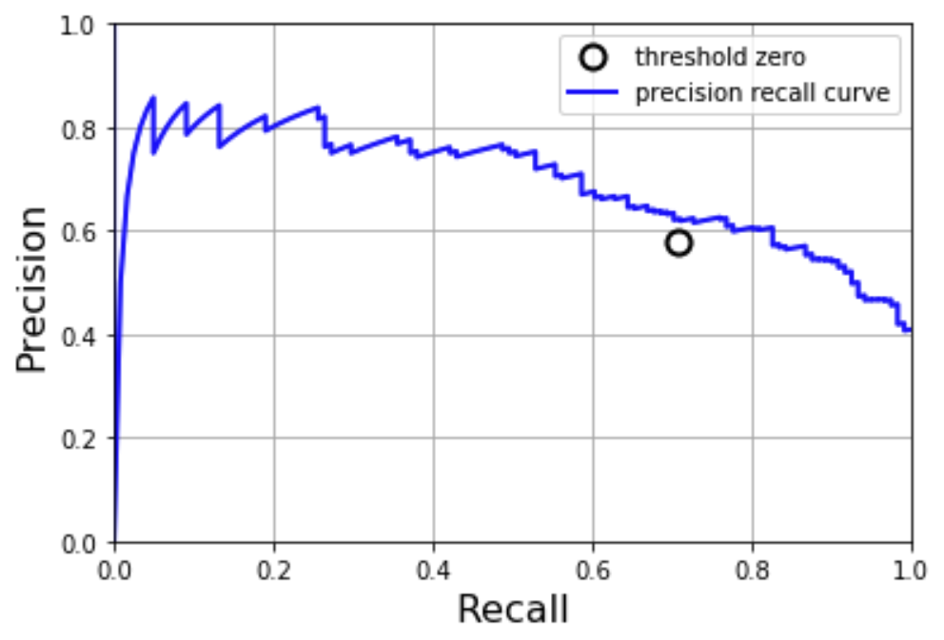
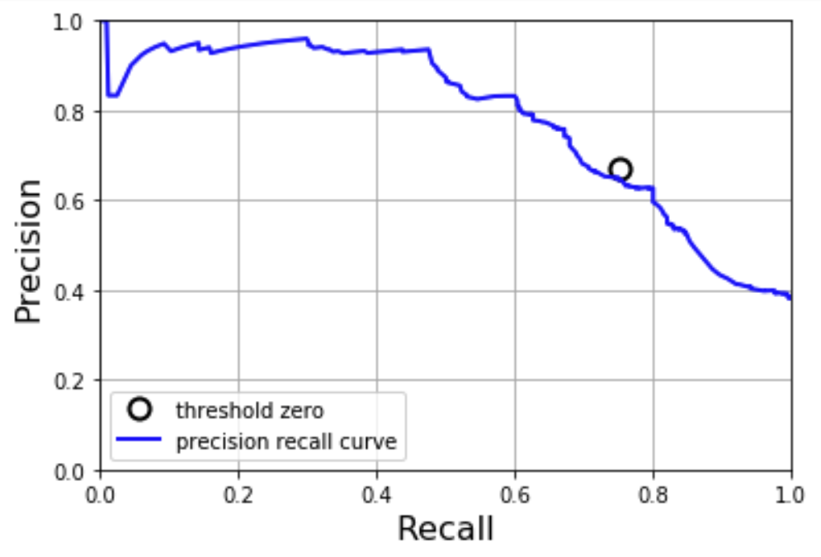
Precision vs Recall cont.
Horse colic dataset
Titanic dataset
Notes:
The area under the curve (AUC) is exactly what it sounds like. The PR curve divides the chart into two sides. The closer the curve is to the upper right the more space will be under that curve. AUC calculates the area that lies underneath the curve to provide a single generaic number for how well the model performs.

Slide 12
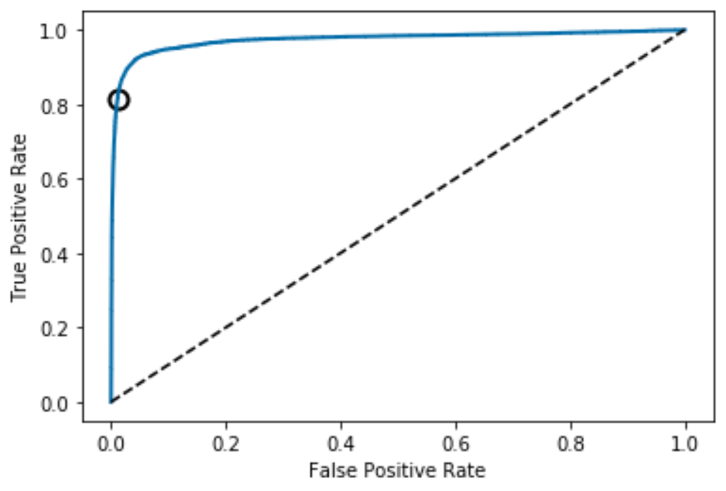
ROC AUC
Notes:
The ROC AUC is very similar to the PR AUC. The AUC is still the area under the curve. This time the curve is formed by setting the True Positive Rate (Recall / sensitivity) against the False Positive Rate (1 – specificity).
The better the model, the closer the curve will be to the upper left-hand corner of the plot. Random guessing results in a straight diagonal line that runs from the lower left to the upper right (the dotted line). The AUC portion of the ROC AUC work the same as the PR AUC - area under the curve literally measures what percentage of the chart falls under the curve.

Slide 13
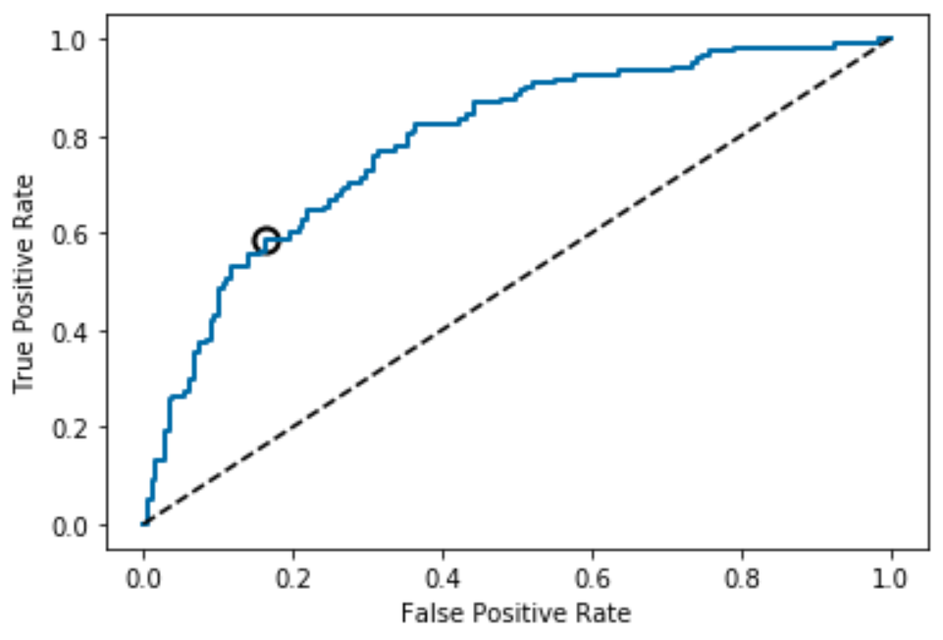
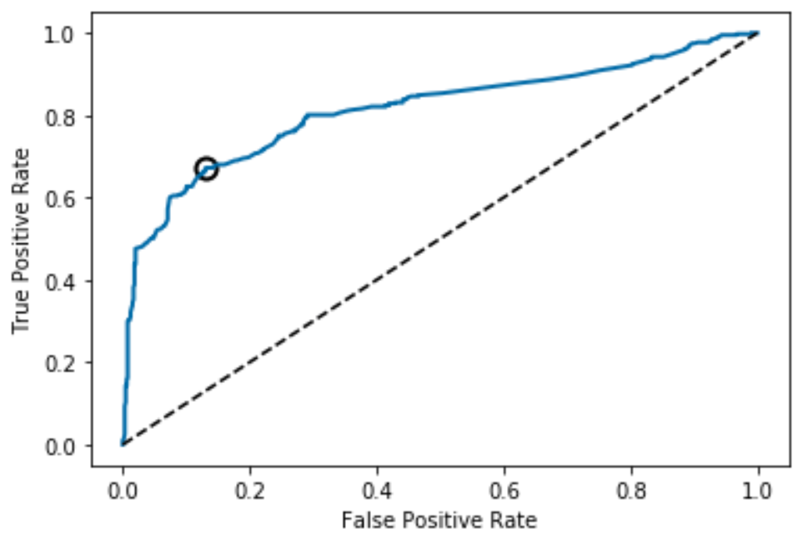
ROC AUC
Horse colic dataset
Titanic dataset
Notes:
The difference between PR AUC and ROC AUC is the curve that we use to specify the dividing line is the ROC curve instead of the PR curve.

Slide 14
PR AUC vs ROC AUC – MNIST
PR Curve
ROC Curve
AUC: 0.889513877990098
AUC: 0.9736067962917803
Notes:
MNIST is a set of hand written digits 0-9. The model was trained to predict a 5. As such, the positive class makes up about 10% and thus is an imbalanced dataset.

Slide 15
PR AUC vs ROC AUC– Horse Colic
PR Curve
ROC Curve
AUC: 0.6887544938462087
AUC: 0.7886526139845854
Notes:
This is the horse colic dataset. It’s smaller, with only 299 observations. This one is more evenly distributed with an approximate 60/40 split.

Slide 16
PR AUC vs ROC AUC - Titanic
PR Curve
ROC Curve
AUC: 0.7822274422984722
AUC: 0.8138539042821158
Notes:
This is from the Titanic dataset. In the training set there were a little over 1000 observations and also had about a 60/40 split.

Slide 17
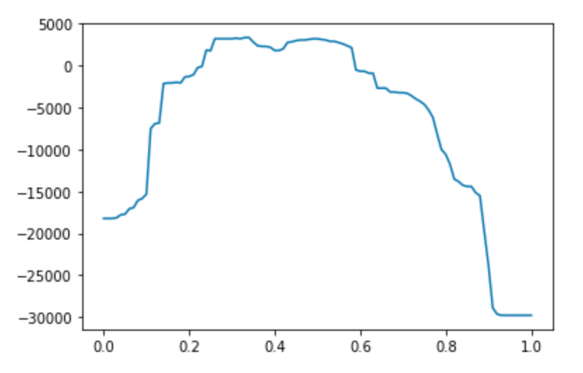
Profit calculation
Profit = xTP – yFP - zFN
Profit
Threshold
Notes:
Another option for choosing the threshold is to use the profit calculation. The profit calculation uses True Positives, False Positives, and False Negatives to determine the profit, or in our case, savings of using the model at different thresholds. We can use this to help determine the amount of claims to be reviewed and incorporate the cost of things like reviewing good claims as well as the limited resources (like Fraud Prevention team members).

Slide 18
Questions?

