Slide 1
Introduction to HPC

Slide 2
What is High performance computing (HPC)
Aggregating computer power to deliver higher performance than a personal computer
Use of super computers for solving complex computational problems

Slide 3
When to Use Super computers
Capacity computing
Simultaneously computing many problems
Cost effective way to compute at scale
May reduce the time to solution
Scaling up
Vertical scaling
Increasing the computer resources available to a problem
Scaling Out
Horizontal scaling
Increasing the number of computer available for problem

Slide 4
What to run on an HPC?
Stable, runs on linux, little interaction
Not a substitute for your computer
If you have a big job that needs to be done

Slide 5
Typical cases
computations need much more memory than what is available on your computer
the same program needs to be run multiple times (usually on different input data)
the program that you use takes too long to run, but it can be run faster in parallel (usually using MPI or OpenMP)
you need access to a GPU accelerator (your program needs to be written in a way that allows it to use your GPU).

Slide 6
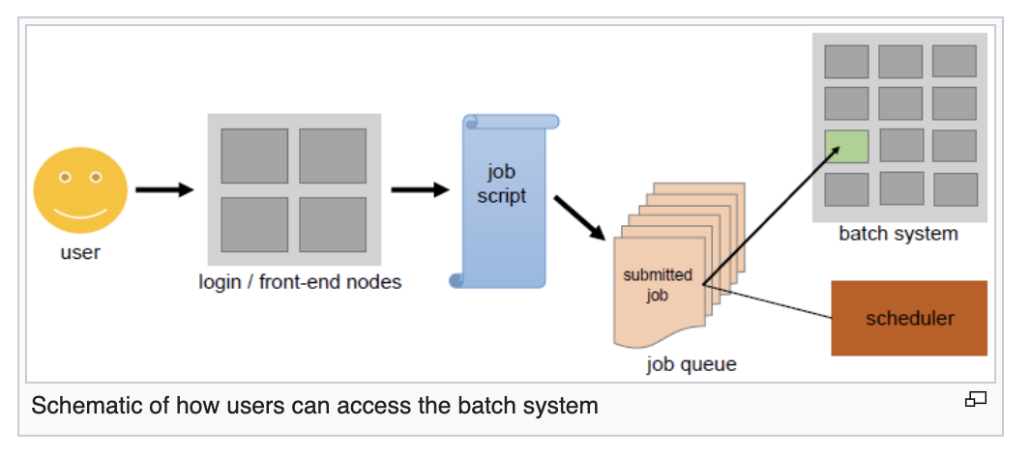
High Performance Computing (HPC)
Leveraging distributed compute resources to solve complex problems with large datasets and reduces compute time
Submit job to a cluster manager → manager finds the necessary resources doles out the job and returns the output to the user.

Slide 7
BATCH PROCESSING
Jobs that can run without end user interaction, or can be scheduled to run as resources permit, are called batch jobs.

Slide 8
PARALLEL COMPUTING
Parallel processing is a method of simultaneously breaking up and running program tasks on multiple microprocessors in order speed up performance time.
Parallel processing may be accomplished with a single computer that has two or more processors (CPUs) or with multiple computer processors connected over a computer network. Parallel processing may also be referred to as parallel computing.

Slide 9
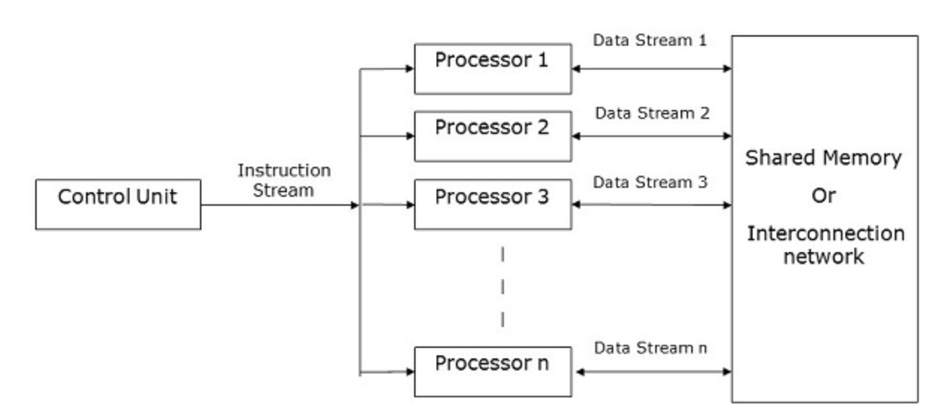
Parallel Computing

Slide 10
Cloud Computing vs. HPC
Cloud computing can cover a broad range, from high powered computing to more mundane tasks. It can be used for specialized tasks, as well as those you could carry out on your standard home computer.
The benefits of cloud computing lie more in its convenience than its power. It offers more powerful hardware, or more feature-rich software, than users would be able to otherwise access.
For businesses, cloud computing represents a cheaper way to scale capabilities. Plus, it means that the company doesn’t have to worry about expensive hardware and software upgrades. Meanwhile, the service provider will have multiple clients and can focus exclusively on those upgrades. These upgrades can then be provided to clients at a fraction of the traditional cost.

Slide 11
Cloud computing can be slower than an HPC
Nodes are not necessarily connected as fast – can be using resources spread out.
HPC could be a lot faster.

Slide 12
What to not do on an HPC
Not good for development
if trying to test code and write code having to go through a scheduler to execute every job will be ridiculous.

Slide 13
HPC Day 2

Slide 14
Goals for class
ssh and log in
Transferring data
2. SLURM scripts
3. aTRAM

Slide 15
High Performance Computing (HPC)
Submit job to a cluster manager → manager finds the necessary resources doles out the job and returns the output to the user.

Slide 16
High Performance Computing (HPC)
Submit job to a cluster manager → manager finds the necessary resources doles out the job and returns the output to the user.

Slide 17
How to Log in: Thursday
SSH or Secure Shell is a network communication protocol that enables two computers to communicate
http or hypertext transfer protocol, which is the protocol used to transfer hypertext such as web pages)
An inherent feature of ssh is that the communication between the two computers is encrypted meaning that it is suitable for use on insecure networks.
Command line or not
ssh {user}@{host}
ssh <username>@pronghorn.rc.unr.edu

Slide 18
Logging in continued
Will be asked for your password
If this is the first time you have logged in will ask if you want to save the host name – type yes

Slide 19

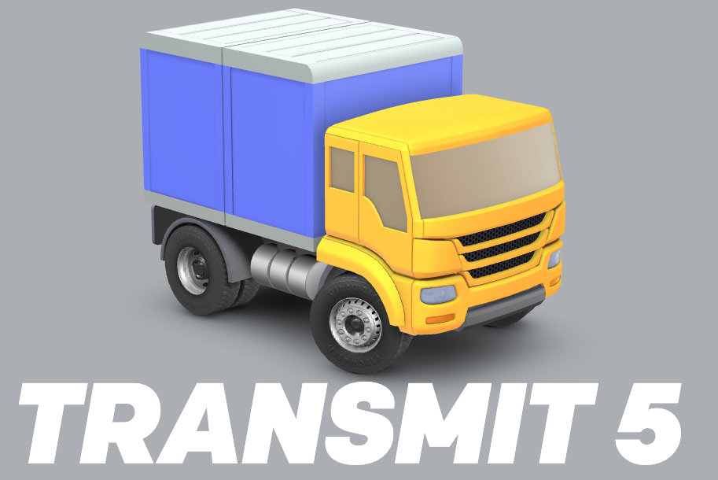

Uploading data files
Sftp - Secure File Transfer Protocol -- command line
sftp username@hostname
GUI
Cyberduck
Fetch
transmit
Notes:
Will be logged in with sftp will only be able to do a few things.
Can use put to add files from within your sftp file to your local computer or another server

Slide 20
How to log out
exit

Slide 21
High Performance Computing (HPC)
Submit job to a cluster manager → manager finds the necessary resources doles out the job and returns the output to the user.

Slide 22
SLURM SCHEDULER
cd /data/gpfs/assoc/biol_bids-1

Slide 23
Terminal Multiplexer
Tmux
Screen
Allow you to connect to one session and have multiple terminals

Slide 24
INTRODUCTION TO PRONGHORN

Slide 25
UNR HPC
A subdivision of the Office of information technology: cyberinfrastructure
John Anderson is the person to reach out to

Slide 26
Pronghorn
3,808 CPUS
27.5 TiB Memory
Ready for ML/AI Big data Simulation
Charging for use – goal to fund the refresh of pronghorn (building money for PHV2)

Slide 27
Active Services
Fee
Renter
Student Research – students not billed but you pay for this with your fees
“Free” - help you get rolling on a system set things up
Sponsored
Tester
No Longer have Investor or Shared Investor services

Slide 28
PH = Batch processing
Defer the execution of programs that require minimal human interaction until computational resources are available
Need a scheduler to do that
SLURM: -you write a slurm script that then asks for what you need
1 node 16 CPUS – slurm then holds your job until those resources are available.
Great for organizing lots of people
Not great for development or code testing
Write a line of code and have to wait until resources are available to make sure it works.
Will work for lots of things but not everything

Slide 29
Runs CentOS LINUX
Linux family of open-source operating systems
Programs must run on linux
Default interface: Command-Line (CLI)

Slide 30
Located in Bombproof facility
Citadel Campus – just south – connected to Las Vegas, SanFransisco (Silicon Valley)
25 miles east - near Tesla
Can take a tour – one of the best data processing center in the world

