Slide 1
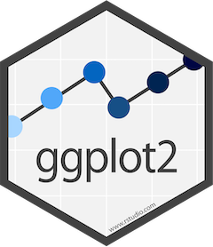
ggplot2 the grammar of graphics

Slide 2
Basic components of ggplot
ggplot uses a standardized syntax
Data
Understand your data and what it looks like
Aesthetics
aes
X & Y variable | size, shape, color of data
Geometry
geom
How you present your data
e.g. scatter plot, histogram, boxplot, etc.
Also, coordinates and themes
ggplot will use default if not specified

Slide 3
Basic structure in R
ggplot()

Slide 4
Basic structure in R
ggplot(data)

Slide 5
Basic structure in R
ggplot(data, aes(x, y))

Slide 6
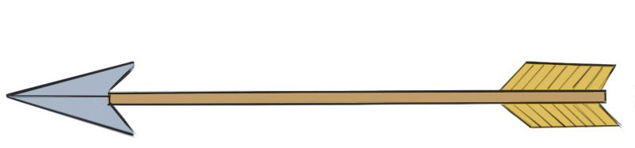
Basic structure in R
ggplot(data, aes(x, y)) +
geom_point(aes(color))

Slide 7
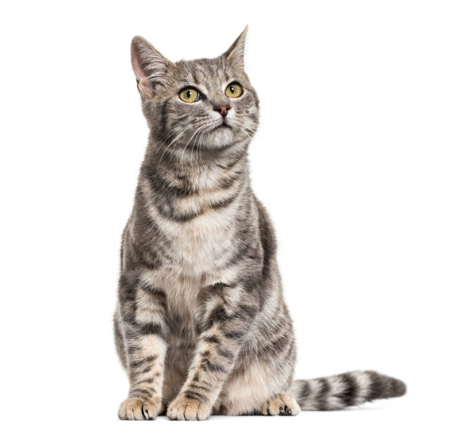
Example with cat data!
Our dataset is called cat_facts
Columns include:
Individual ID
Age
Weight
Shade
ggplot(data, aes(x, y)) +
geom_point(aes(color))
ggplot(cat_facts, aes(x = Age, y = Weight)) +
geom_point(aes(color = Shade))

Slide 8
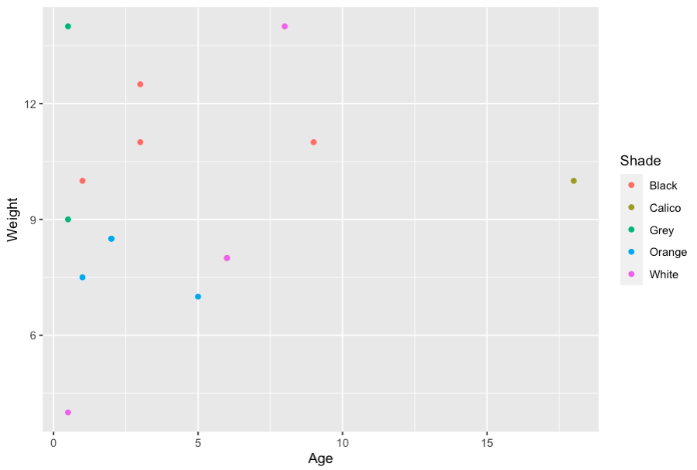
ggplot(cat_facts, aes(x = Age, y = Weight)) +
geom_point(aes(Shade))

Slide 9
Example with cat data!
ggplot(data, aes(x, y)) +
geom_point(aes(color))
ggplot(cat_facts, aes(x = Shade, y = Age))+
geom_boxplot()

Slide 10
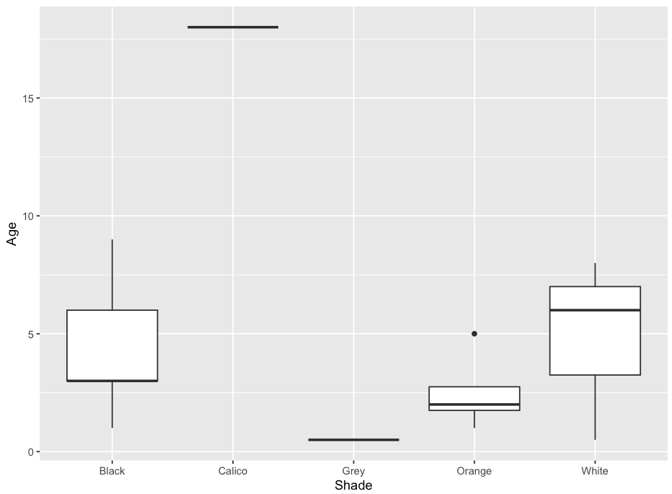
ggplot(cat_facts, aes(x = Shade, y = Age))+
geom_boxplot()

