Slide 1
frisbee
By dahomee forgues and julie-maude viel

Slide 2

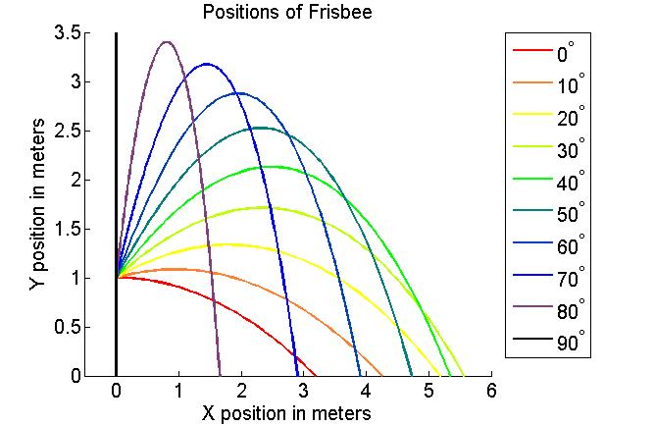
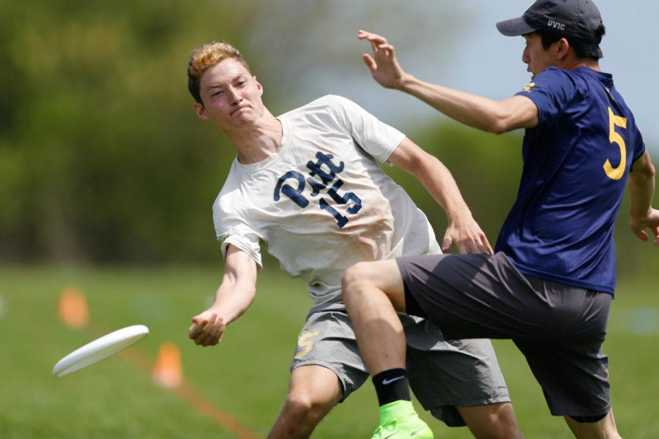
our project
At which angle should we throw a frisbee in order to reach a maximum distance?
Rise of sports using it
Data we can easily verify
Notes:
We chose to do our term project on frisbees because even though they are simple to use and that anyone can use them, the physics behind the flight of a frisbee is not as simple.
With the rise of sports like ultimate frisbee and disk golf where the accuracy of shots as well as the distance at which it lands are important, we were wondering at which angle a frisbee should be thrown in order to reach a maximum distance. It is also easy to verify because a lot of researches are available to us and also many people have actually tried this experiment.

Slide 3
Model
Euler’s method
Golden search
Optimization
Notes:
So, our term project being an optimization, we used the golden search method which we already used previously this semester.
The golden search allowed us to find the optimal angle of throw by taking in the distance reached as the angles it provided. Since we used it to find a minimum, we had to use the inverse function of the throw
to find the maximum angle.
To calculate the distance each throw generated, we used the euler’s method which takes into account the acceleration, the velocity, the angle, as well as the distance of the frisbee over time.

Slide 4
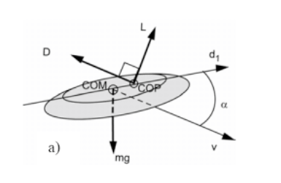

Theory
Drag force
$$Fd=− \frac{1}{2 }CdρAv^{2}$$
Lift force
$$Fl= \frac{1}{2 }ClρAv^{2}$$
Notes:
Equations
Fluid mechanics (
Cd = drag coefficient
P= density of fluid (in this case air)
A=area of frisbee (0.0531m² )
V=We assumed that the average velocity of throw to be 14 m/s
So, to be able to calculate the acceleration of the frisbee over time, different factors have to be taken into account:
The drag force is a force parallel to the velocity of the frisbee but in opposite direction whereas the lift for is perpendicular to the velocity.
Both forces are influenced by the

Slide 5
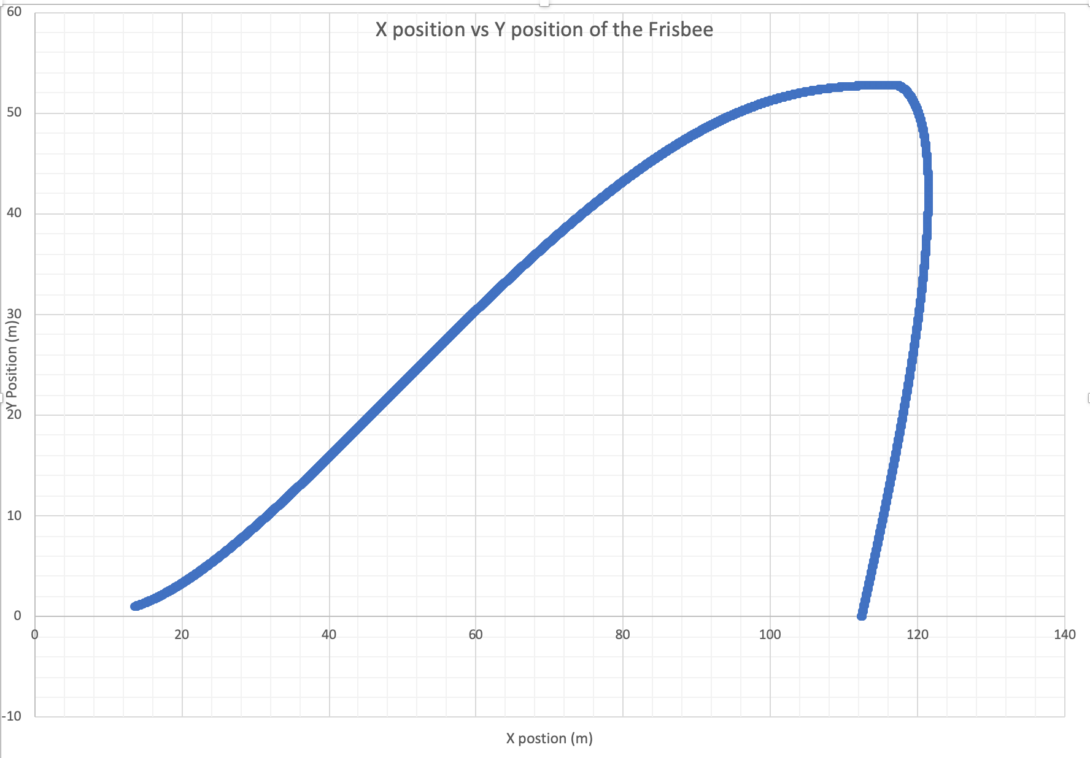
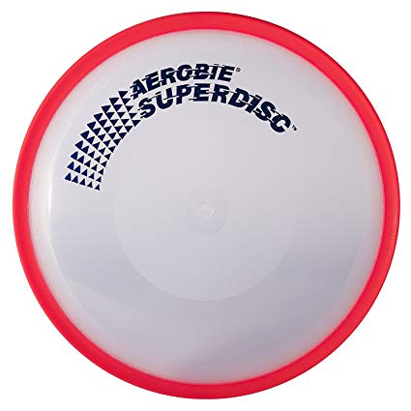
Results
Max distance: 112.3878 m
*Erin Hemmings(Word Record)
402 meters
Notes:
We have printed the x and y positions of the Frisbee and plot a trajectory graph. These values were updated many times and it allowed us to make a precise graph to get the maximum flight distance.
All these values were obtained using an optimal angle of throw.
We thought it was a big number, but we actually found out that the world record is 402 meters. The record has been made with a flying ring which is much faster, lighter and more stable than a frisbee.

