Slide 1
frisbee
By dahomee forgues and julie-maude viel

Slide 2

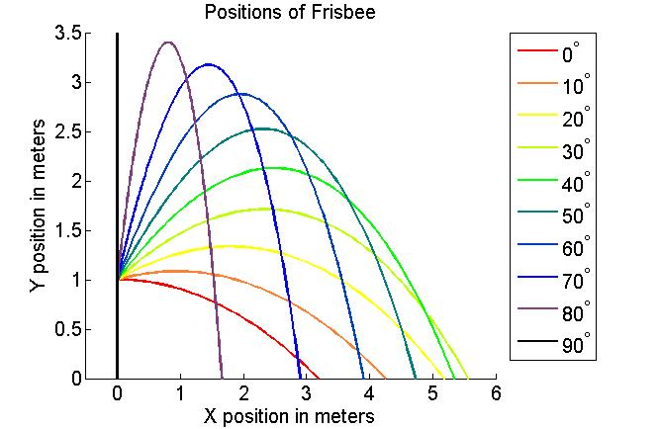
our project
What is the best possible angle of attack at which we can throw a frisbee to make sure we get the maximum flight distance ?

