Slide 1
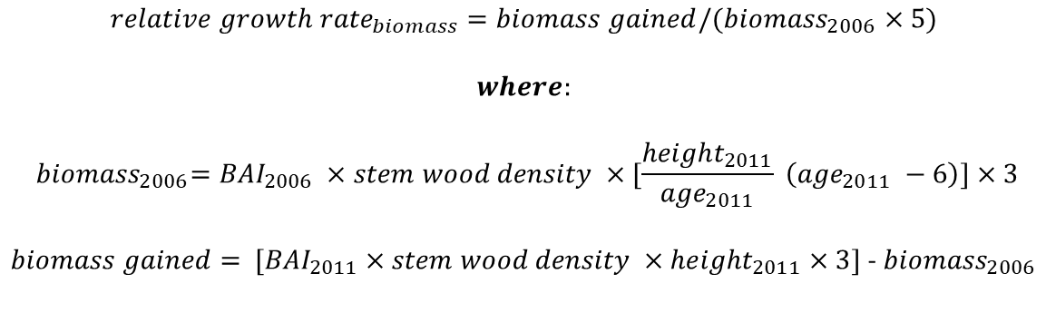
Ht 2012
Ht 2011
In general: Biomass (g) = Area (cm²) x Wood Density (g/cm³) x height (cm)
Ht 2010
$${relative growth rate}_{biomass}=biomass gained/({biomass}_{2006}×5)$$
$$where:$$
$${ biomass}_{2006}={BAI}_{2006} ×stem wood density ×[\frac{{height}_{2011}}{{age}_{2011}} \left({age}_{2011} −6\right)]×3$$
$biomass gained={ [BAI}_{2011} ×stem wood density ×{height}_{2011}×3]$ - ${biomass}_{2006}$
Ht 2009
Ht 2008
Ht 2007
Ht 2006
2012
Ht 2005
2011
2010
2009
2008
2007
2006
2005

Slide 2
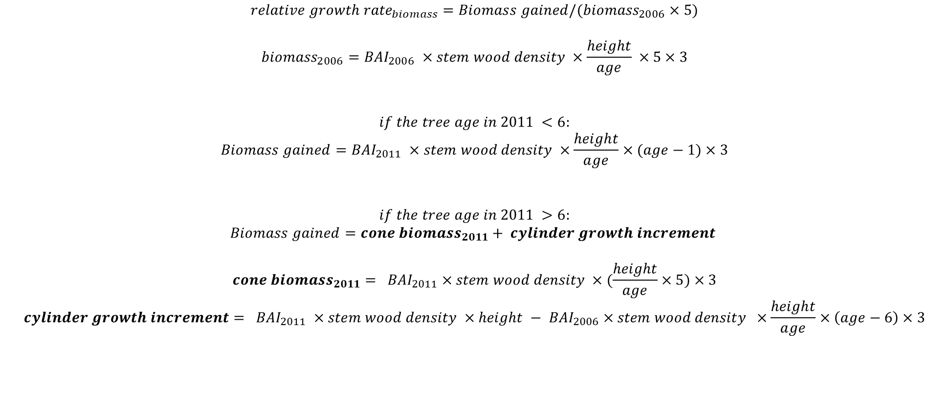
$${relative growth rate}_{biomass}=Biomass gained/({biomass}_{2006}×5)$$
$${biomass}_{2006}={BAI}_{2006} ×stem wood density ×\frac{height}{age} ×5×3$$
$$if the tree age in 2011 <6:$$
$$Biomass gained={BAI}_{2011} ×stem wood density ×\frac{height}{age}×(age−1)×3$$
$$if the tree age in 2011 >6:$$
$$Biomass gained={cone biomass}_{2011}+ cylinder growth increment$$
$${cone biomass}_{2011}{= BAI}_{2011} ×stem wood density ×(\frac{height}{age}×5)×3$$
$${cylinder growth increment= BAI}_{2011} ×stem wood density ×height −{ BAI}_{2006} ×stem wood density ×\frac{height}{age}×\left(age−6\right)×3$$

