Slide 1
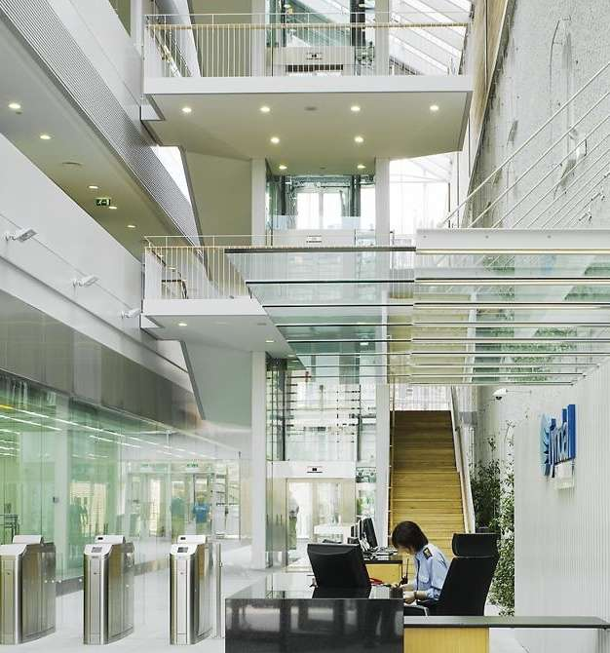
Development of a Bioinspired Gripper for Soft Robotics with Tactile Capabilities Literature
Julien Dubuc – BE at SeaTech (University of Toulon)

Slide 2
Literature REPORT

Slide 3
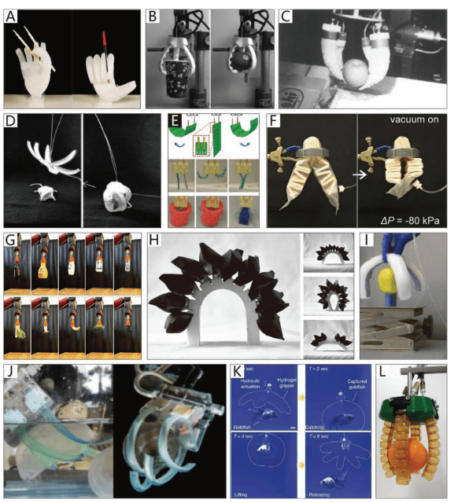
Most fluidic soft grippers copy animal hands but ignore the unique mechanics of plant-inspired continuum architectures like twisting. A clear taxonomy organized by biological impactive modes is missing.
Literature : Report
Bio-Inspired Soft Grippers Based on Impactive Gripping
Liang Zhou, Lili Ren,* You Chen, Shichao Niu,* Zhiwu Han, and Luquan Re
Question/Gap:
Method:
Categorization of impactive soft grippers into non-continuum bending (rigid frames + soft joints), continuum bending (leaf curls), and 3D twisting (tendrils).
Results:
Shifting to fully soft continuum structures distributes strains evenly, unlocking 3D twisting motions and stable packaging wraps.
Limitations:
Multi-material 3D printing delaminates easily. Continuous shapes are super hard to model mathematically.

Slide 4
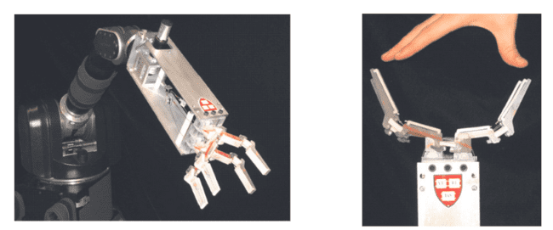
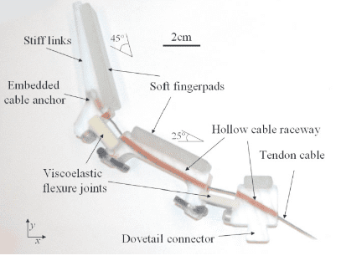
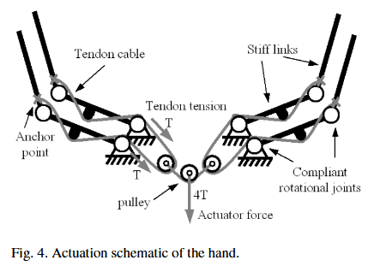
Classic robotic hands are fragile, heavy, and over-sensored.
Literature : Report
The Highly Adaptive SDM Hand: Design and Performance Evaluation Aaron M. Dollar Robert D. Howe
Question/Gap:
Method:
Designed a single-actuator, 4-finger underactuated gripper manufactured as a single block via Shape Deposition Manufacturing (SDM).
Results:
Reaches fully passive geometric shape-adaptation to arbitrary targets. Exhibits extreme impact robustness (survives a 15-meter drop test) and dampens joint oscillations naturally.
Limitations:
Blind grasping (zero sensors). Fixed stiffness limits precision.

Slide 5
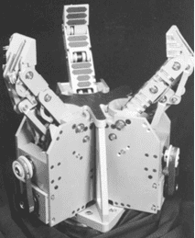
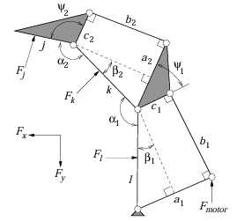
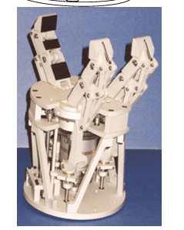
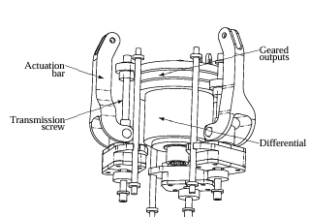
Anthropomorphic hands use too many motors (heavy + high energy drain).
Literature : Report
Underactuation in robotic grasping hands Thierry Lalibert´e†, Lionel Birglen†, and Cl´ement M. Gosselin†
Question/Gap:
Method:
3-finger underactuated hand using linkages, passive springs, and a mechanical differential.
Results:
Successfully built a 12-DoF hand driven by 6 motors, and minimized it further into a 10-DoF prototype running on just 2 motors. Good self-adapting grip.
Limitations:
Mechanical ratios limit the workspace. No tactile skin.

Slide 6
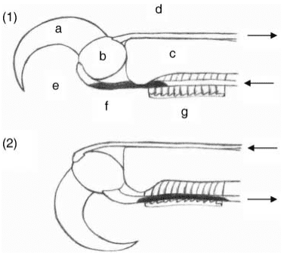
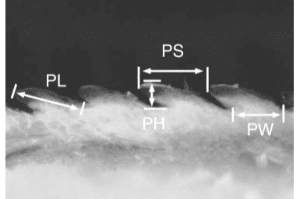
How do birds of prey hold prey without muscle fatigue?
Literature : Report
An ecomorphological study of the raptorial digitaltendon locking mechanismLUKE EINODER 1,2* & ALASTAIR RICHARDSON 1
Question/Gap:
Method:
Dissect bird feet to study the Tendon Locking Mechanism (TLM).
Results:
Nature uses a mechanical ratchet (tubercles) on the tendon to lock at 0 energy.
Limitations:
Shape varies wildly between species. Hard to copy into a universal CAD design.

Slide 7

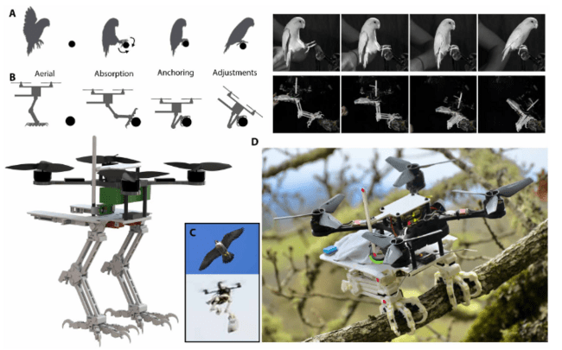
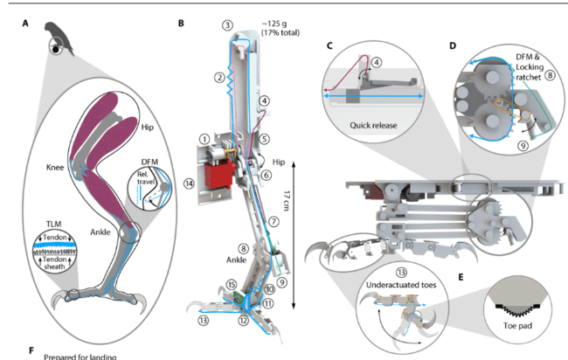
Drones waste battery hovering and can't grip natural surfaces.
Literature : Report
An ecomorphological study of the raptorial digitaltendon locking mechanismLUKE EINODER 1,2* & ALASTAIR RICHARDSON 1
Question/Gap:
Method:
Falcon-inspired bipedal gripper. Landing impact pulls the tendon to close claws, a ratchet locks it.
Results:
Wraps around a branch in < 50 ms.
Limitations:
Relies on extremely sparse sensor data (only one accelerometer, lacking full avian sensory fusion). Takes 20 seconds for the motor to release the tendon (too slow). Scaling it up adds dangerous inertia.

Slide 8
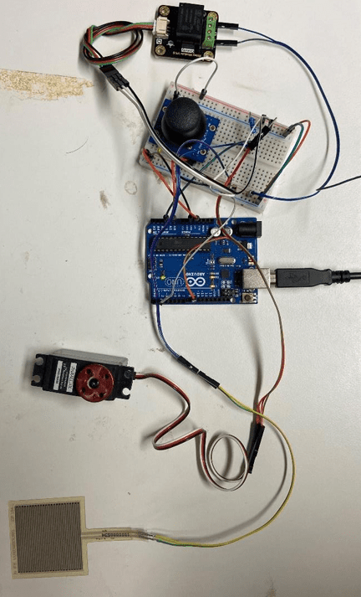
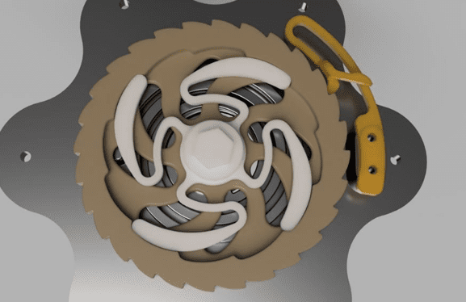
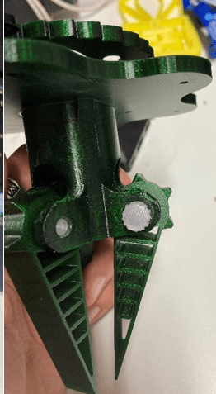
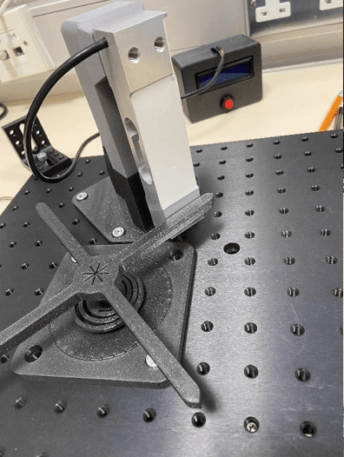
Industrial grippers drain power continuously to hold agricultural objects.
Literature : Report
lbayrak, F.A. (2024). Design of a compliant robotic gripper. EE4050 Final Year ProjectReport, University College Cork.
Question/Gap:
Method:
3-finger 3D printed compliant mechanism + 1 servo + spring-loaded ratchet + piezo sensors.
Results:
Drops motor power consumption by 15% during holding.
Limitations:
Spring release is violently fast (breaks fragile objects). Flexible parts wear out quickly.

Slide 9
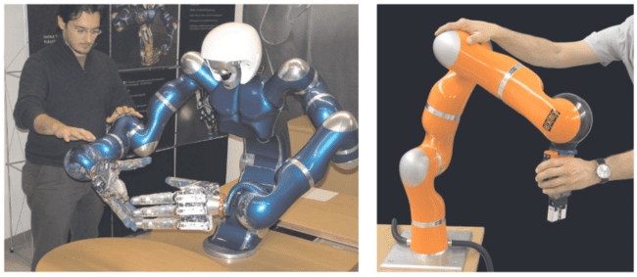
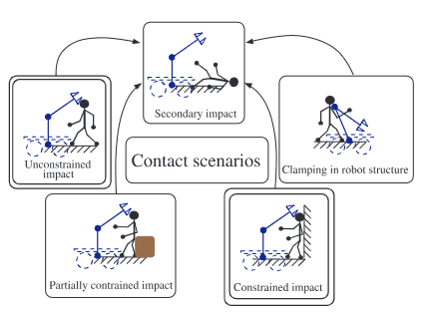
Lack of data on what actually injures humans during cobot collisions.
Literature : Report
Requirements for SafeRobots: Measurements,Analysis and NewInsights
Question/Gap:
Method:
Car-style crash tests on a dummy using cobots and industrial arms.
Results:
The worst danger is slow crushing (clamping) against an obstacle, not free impacts.
Limitations:
Software emergency stops are too slow. Robots MUST have physical soft skins/sensors.

Slide 10
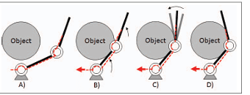
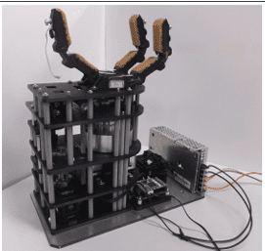
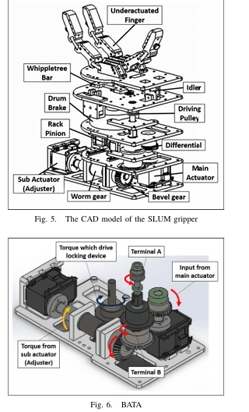
Joint locks are either too heavy (motors) or too rigid (dangerous in a crash).
Literature : Report
Self-locking Underactuated Mechanism for Robotic Gripper∗ Jui Hsu1,2, Eiichi Yoshida2,1, Kensuke Harada3 and Abderrahmane Kheddar2,4
Question/Gap:
Method:
1 motor + differential gear + non-backdrivable worm gear brake.
Results:
Fast shape adaptation (1.5s), then 0-energy holding (holds up to 10 kg).
Limitations:
Massive weight (3.5 kg). Requires a 2nd motor just to unlock the worm gear.

Slide 11
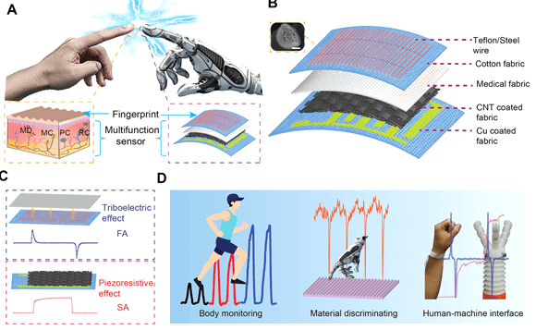
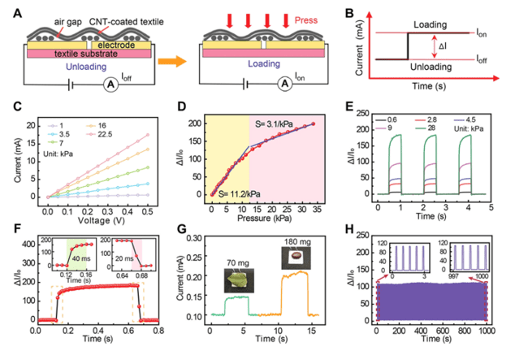
Silicone skins don't breathe and mix up static/dynamic pressure signals.
Literature : Report
Skin-inspired textile-based tactile sensors enable multifunctional sensing of wearables and soft robots☆
Yaokun Pang ª, Xianchen Xu
Question/Gap:
Method:
Fabric matrix. Cotton+CNT for static pressure, Teflon/Steel thread for sliding friction.
Results:
Separates both signals well, survives 1500 test cycles.
Limitations:
Sensitivity drops massively above 11 kPa. Needs Machine Learning to decode signals.

Slide 12
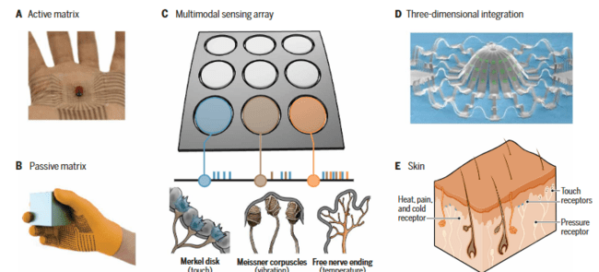
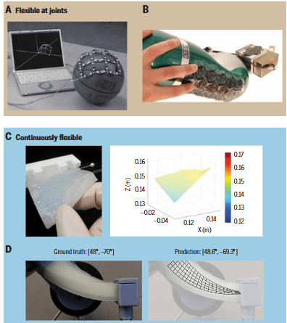
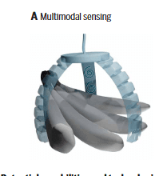
Too many sensors = too many wires and data noise.
Literature : Report
Electronic skins and machine learning for intelligent soft robots (Shih et al., 2020)
Question/Gap:
Method:
Active matrices to cut wires + AI to analyze data.
Results:
AI accurately guesses robot deformation and object slip.
Limitations:
Soft sensors have huge hardware drift. 3D simulations don't match physical reality.

Slide 13
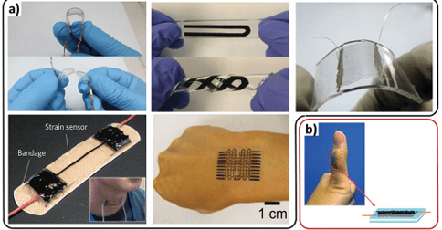
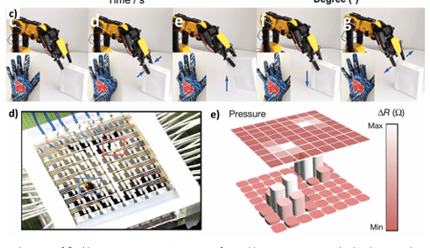
Classic metal strain gauges break when stretched.
Literature : Report
Stretchable, Skin-Mountable, and Wearable Strain Sensors and Their Potential Applications: A Review Morteza Amjadi , Ki-Uk Kyung , Inkyu Park , * and Metin Sitti
Question/Gap:
Method:
Compare capacitive vs resistive sensors (nanomaterials in silicone).
Results:
Capacitive = linear but low sensitivity. Resistive = hyper sensitive but highly non-linear.
Limitations:
Big trade-off between sensitivity and max stretch. Huge hysteresis due to silicone viscosity.

Slide 14
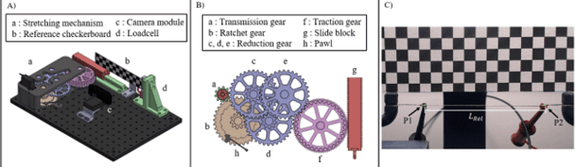
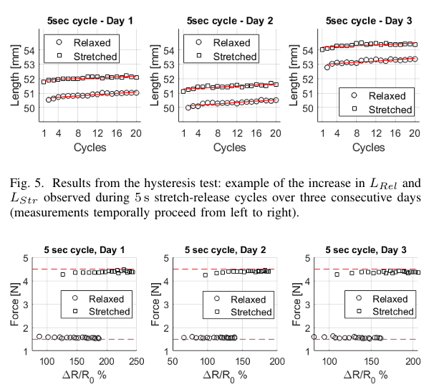
E-textile tests ignore that threads permanently stretch, ruining sensor data.
The Role of Length Shift in Assessing Force and Resistivity for Optimized e-Textile Sensors 1st Gianmarco Gola 2nd Matteo Menolotto …
Literature : Report
Question/Gap:
Method:
Developed a test protocol monitoring resistivity, force, and length simultaneously on a conductive yarn (Shieldex 117/17) using a Wheatstone bridge, AD623 amplifier, and camera-based image processing tracking.
Results:
Internal fibers rearrange permanently: the rest length shifts, altering the baseline resistance.
Limitations:
Electrical instability forces constant software recalibration.

Slide 15
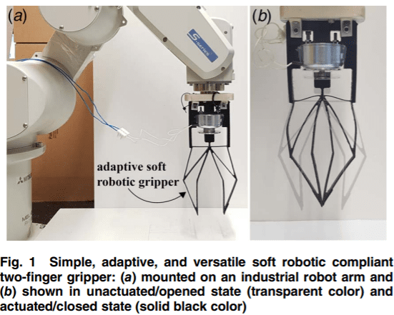
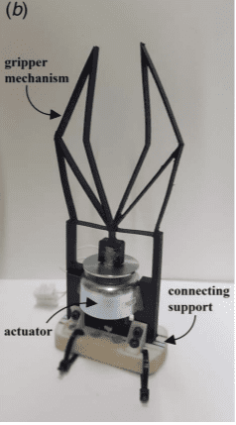
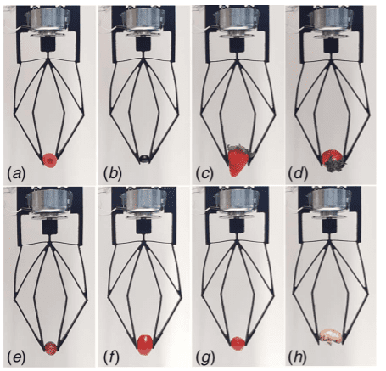
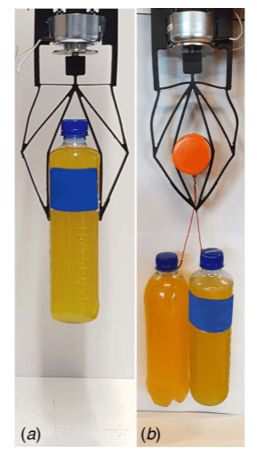
Soft grippers need complex vision and control to avoid breaking fragile items.
Literature : Report
A Novel Simple, Adaptive, and Versatile Soft-Robotic Compliant Two-Finger Gripper With an Inherently Gentle Touch Milojević et al., 2021
Question/Gap:
Method:
Monolithic 3D printed compliant design, just 1 ON/OFF actuator.
Results:
Blind, lightning-fast grip (30 ms) on eggs. Passive return to open state.
Limitations:
Zero force feedback sensors. Huge drop in force transmission if grabbed by the fingertips.

Slide 16
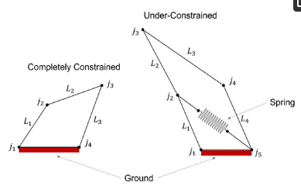
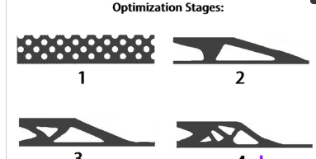
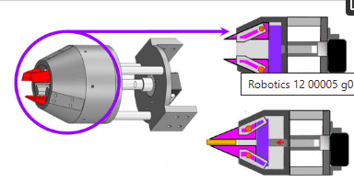
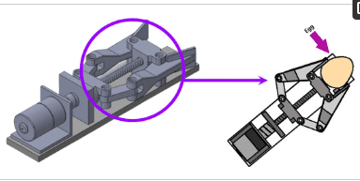
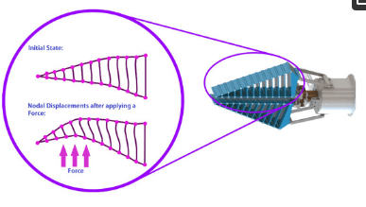
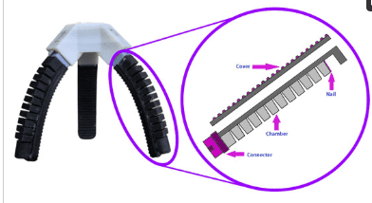
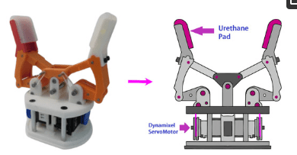
No universal gripper design exists (soft for fragile, rigid for heavy).
Literature : Report
Current Designs of Robotic Arm Grippers: A Comprehensive Systematic Review
by Jaime Hernandez, Md Samiul Haque Sunny
Question/Gap:
Method:
Systematic review of grippers over the last 4 years.
Results:
Best compromise = underactuated rigid linkages (slider-crank) + Gecko adhesives.
Limitations:
Adhesives clog with dust instantly. Precise force sensors are still missing.

Slide 17
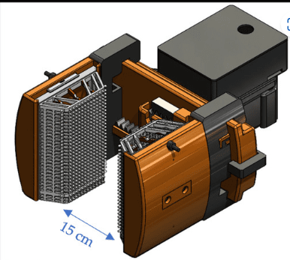
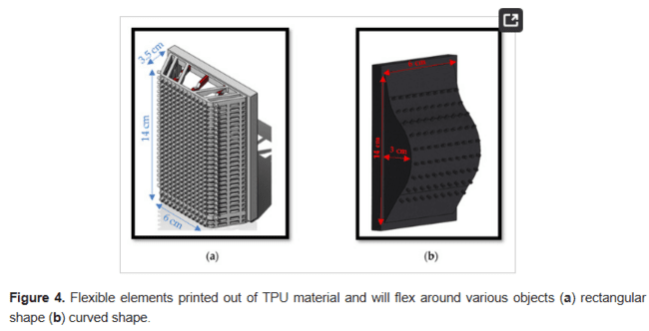
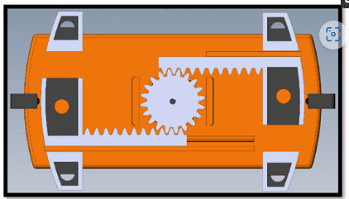
Rigid pincers break things; soft grippers struggle with size variety.
Literature : Report
Design and Implementation of a Compliant Gripper for Form Closure of Diverse Objects Kyler C. Bingham Matthew HesslerSafal Lama Taher Deemyad
Question/Gap:
Method:
Rigid rack-and-pinion base + massive, highly compressible 3D-printed TPU cushions.
Results:
Wraps perfectly around irregular shapes (glasses, eggs) without smart algorithms.
Limitations:
Huge dead weight (2.5 kg) ruins the robot arm's payload. Zero sensors.

Slide 18
Literature GRIPPER

Slide 19
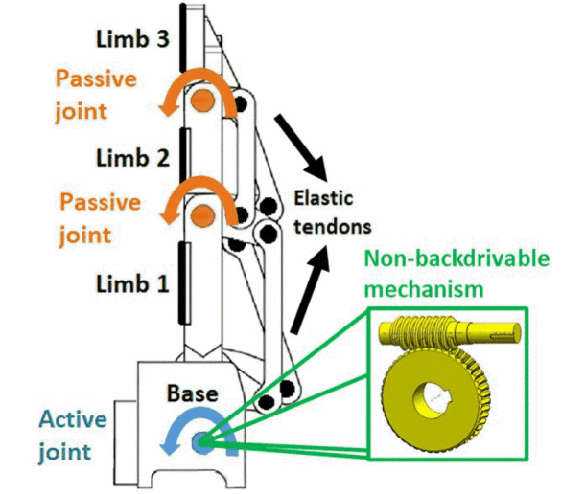
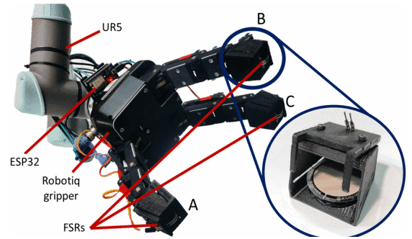
Non-backdrivable grippers (like worm gears) can't feel forces and easily crush objects.
Literature : Gripper
Force Control and Slip Detection for A Non-Backdrivable Robotic Gripper (Joshy et al., 2024)
Question/Gap:
Method:
Non-backdrivable mechanism. Add Force Sensitive Resistors (FSRs) and soft TPU pads to the fingers for real-time feedback.
Results:
Closed-loop control stabilizes the grip at 50 N and auto-adjusts if the object slips.
Limitations:
Hard contacts cause massive force spikes; soft pads are absolutely mandatory to absorb the impact.

Slide 20
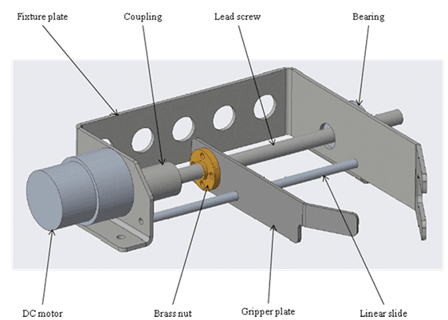
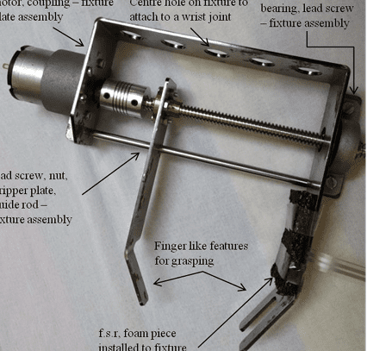
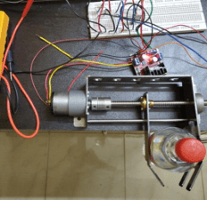
Industrial grippers use complex, heavy internal gears.
Literature : Gripper
DESIGN AND DEVELOPMENT OF A LEAD SCREW GRIPPER FOR ROBOTIC APPLICATION Krithikanand Krishnamoorthy
Question/Gap:
Method:
Build a simple sheet-metal gripper driven directly by a 24V DC motor, a lead screw, and an FSR sensor.
Results:
Outputs ~59 N of linear force, easily holding 3 kg water bottles.
Limitations:
Bare metal jaws are too slippery; rubber pads are needed to grip rigid objects properly.

Slide 21



Passive grippers usually need to crash into the ground to release an object.
Literature : Gripper
Passive Adaptive Object Prehension, Retention, and Release With a Mechanically Intelligent Gripper Ming Chun Chan , Student Member, IEEE, Jiayun Li
Question/Gap:
Method:
Uses Fin Ray fingers to grab, a linear ratchet to hold, and a gravity/spring system to drop.
Results:
100% passive grip and hold. Drops objects mid-air just by tilting the robot arm.
Limitations:
Fails on very short, tapered, or soft objects. The release mechanism breaks if the 3D print is slightly inaccurate.

Slide 22



Standard grippers can't pick up flat things (like coins) from a table.
Literature : Gripper
Picking, grasping, or scooping small objects lying on flat surfaces: A design approach Vincent Babin and Cle´ment Gosselin
Question/Gap:
Method:
Idle scooping: one finger acts as a wall, while a compliant thumb (using planetary gears) slides under the object.
Results:
Grabs thin objects without moving the robot arm during the scoop.
Limitations:
The thumb needs a slippery nail to slide under, but a sticky pad to hold the object (requires a complex retractable nail).

Slide 23


Gluing sensors onto soft robots is difficult and they peel off easily.
Literature : Gripper
Fabrication of a Soft Robotic Gripper With Integrated Strain Sensing Elements Using Multi-Material Additive Manufacturing Antonia Georgopoulou1,2*, Bram Vanderborght2 and Frank Clemens1
Question/Gap:
Method:
Use a dual-nozzle 3D printer to print the TPU gripper and the carbon-black conductive sensor simultaneously.
Results:
Sensors successfully detect if the gripper is open, closed, blocked, or holding a big/small object.
Limitations:
TPU material "creeps" over time, causing huge sensor drift and bad data if stretched beyond 30%.

Slide 24


Complex molding processes limit the rapid prototyping of soft grippers for fragile objects.
Literature : Gripper
3D Printed Soft Gripper for Automatic Lunch Box Packing
Zhongkui Wang, Damith Suresh Chathuranga, and Shinichi Hirai
Question/Gap:
Method:
Fully 3D-printed modular soft fingers utilizing a screwless snap-lock base for quick assembly (pneumatic).
Results:
The snap-lock mechanism enables extremely fast assembly, but multi-material structures generate high internal mechanical stress.
Limitations:
Multi-material printing creates internal stress. FEA simulations fail to predict the real bending.

Slide 25

Pneumatics waste air and fatigue the material just to hold an object.
Literature : Gripper
A Gecko-Inspired Soft Passive Gripper
Arthur Seibel * , Mert Yıldız and Berkan Zorluba¸
Question/Gap:
Method:
6 angled pneumatic fingers lined with Gecko-like adhesive.
Results:
100% passive holding at 0W. Air pressure is only used to detach/peel the gripper off.
Limitations:
Only works on flat objects, hates dust, zero sensors.

Slide 26




Micro-spines get stuck in rocks and adapt poorly to shapes.
Literature : Gripper
A mechanical adhesive gripper inspired by beetle claw for a rock
climbing robot
Peijin Zi, Kun Xu, Yaobin Tian, Xilun Ding
Question/Gap:
Method:
4 underactuated fingers armed with 20 steel spines each.
Results:
Grips and releases in <3s. Holds 47 N of force while weighing only 350g.
Limitations:
Steel spines bend permanently over time. No tactile skin for control.

Slide 27



Wires and batteries prevent the creation of micro-grippers.
Literature : Gripper
Advances in biomimetic stimuli responsive
soft grippers
ChangKyu Yoon
Question/Gap:
Method:
4D print smart materials (like hydrogels) that react to the environment.
Results:
100% autonomous folding triggered by light, pH, or heat.
Limitations:
Chemical reactions are extremely slow. Zero real-time haptic closed-loop control.

Slide 28


How to copy nature's multi-scale architectures for zero-energy adhesives.
Literature : Gripper
Biomimetics: lessons from nature – an overview
BY BHARAT BHUSHAN
Question/Gap:
Method:
Global review (gecko, frog pads, biological sensors).
Results:
Splitting contact pads at the nano-scale massively boosts adhesion without using glue.
Limitations:
Extremely hard to manufacture at scale. Artificial sensors are nowhere near biological speeds.

Slide 29


Elastomers are slow and constantly drain power.
Literature : Gripper
Mechanically controlled robotic gripper with
bistability for fast and adaptive grasping
To cite this article: Xianyang Cai and Bin Tang 2023 Bioinspir. Biomim.
Question/Gap:
Method:
Bistable jaw (acts like a light switch) mixing rigid PLA links and PVC sheets.
Results:
Lightning-fast closing (28 ms) and mechanical holding at 0W.
Limitations:
Extremely low payload capacity (<47 g) and entirely lacks any tactile or force feedback.

Slide 30





Underactuated kinematics are complex and manage grasping force poorly.
Literature : Gripper
Design and Analysis of Underactuated Robotic Gripper with Adaptive Fingers for Objects Grasping Tasks
Bin Gao, Shuai Yang, Haiyang Jin*, Ying Hu*, Xiaojun Yang, Jianwei Zhang
Question/Gap:
Method:
1 motor + self-locking worm gear + commercial FlexiForce sensors.
Results:
Passive locking (0W) achieved purely through worm gear friction.
Limitations:
Heavy design (2.2 kg). Commercial sensors suffer from severe hysteresis and drift.

Slide 31


Cast silicone is way too heavy.
Literature : Gripper
Design and Characterization of a Novel Fabric-based Robotic Arm for Future Wearable Robot Application Xinquan Liang, Hong Kai Yap, Jin Guo and Raye Chen Hua Yeow*
Question/Gap:
Method:
100% inflatable fabric arm (heat-sealed TPU-coated cloth).
Results:
Featherweight (80 g), lifts 1.6 kg, and can roll onto itself.
Limitations:
Pressure is capped at 30 kPa (burst risk). No haptic sensors.

Slide 32

Adding a 6-axis force sensor to the wrist takes up too much space and weight.
Literature : Gripper
Estimation of Wrist Force/torque for Robot Gripper using
Neural Network
Guo-zheng Yan and Ting Wu
Question/Gap:
Method:
AI (Neural Network) guesses the wrist force by reading tiny strain gauges placed on the fingers.
Results:
Accurate real-time estimation (<6% error) without a physical wrist sensor.
Limitations:
Requires a massive calibration dataset. Metal gauges don't work on soft fabrics.

Slide 33


Granular jamming (like coffee grounds) doesn't mold well around ultra-fragile objects.
Literature : Gripper
Investigation of Fluidic Universal Gripper for Delicate
Object Manipulation Changchun Wu 1, Hao Liu 1, Senyuan Lin 1, Yunquan Li 2 and Yonghua Chen
Question/Gap:
Method:
Grains floating in a fluid suspension + an inner airbag.
Results:
Wraps super smoothly, then freezes rock-solid.
Limitations:
Must constantly pump air to keep the grip locked (no 0W mode). No sensors.

Slide 34

Rigid arms can't stretch or coil around targets.
Literature : Gripper
Design of a biomimetic robotic octopus arm
To cite this article: C Laschi et al 2009 Bioinspir. Biomim
Question/Gap:
Method:
Silicone arm + Shape Memory Alloy (SMA) cables acting as muscles.
Results:
Bends, elongates, and squeezes exactly like a tentacle.
Limitations:
SMA is slow (needs time to cool down), highly energy-inefficient, and lacks a textile skin.

Slide 35



Standard soft grippers lift very little weight.
Literature : Gripper
Design and modeling of a high-load soft robotic
gripper inspired by biological winding*
Haili Li et al 2020 Bioinspir. Biomim
Question/Gap:
Method:
Pneumatic tube that coils around itself like a vine (winding).
Results:
Multiple loops massively increase the contact area and stability for heavy loads.
Limitations:
Needs continuous air supply to hold. No closed-loop control via sensors.

Slide 36



Changing the stiffness of a soft gripper usually requires heavy external power supplies.
Literature : Gripper
A novel design of a passive variable stiffness soft
robotic gripper Yu Shan et al 2022 Bioinspir. Biomim
Question/Gap:
Method:
Finger using reversible Layer Jamming, triggered purely by the physical impact against the object.
Results:
Becomes mechanically rigid upon impact, consuming 0 watts.
Limitations:
Extremely hard to tune the exact stiffness level. Zero electronic force skin.

Slide 37



Pneumatics require loud, heavy external compressors.
Literature : Gripper
Soft Pneumatic Gripper with Origami Pump (Kim & Cha, 2020)
Question/Gap:
Method:
Pneumatic fingers directly attached to a tiny origami bellows pump pulled by a wire.
Results:
Highly portable system driven by 1 small electric motor.
Limitations:
Low max pressure, the pulling wire fatigues and snaps over time, no textured sensors on fingertips.

Slide 38


Plant-like morphing (tendrils) is expensive to manufacture.
Literature : Gripper
A 3D Printed Paper‑Based Thermally Driven Soft Robotic Gripper
Inspired by CabbageFuwen Hu1 Limei Lyu1Yunhua He
Question/Gap:
Method:
3D print PLA directly onto a flexible sheet of paper to create structural ribs.
Results:
The plastic curls up on its own when heated. Ultra low-cost.
Limitations:
Thermal reaction is super slow. Cannot be controlled without changing the temperature of the entire room.

Slide 39


Rigid-arm mathematics completely fail on soft bodies.
Literature : Gripper
Soft Robotics Perspectives Review (Laschi & Cianchetti, 2014)
Question/Gap:
Method:
Focus on Morphological Computation (let the soft shape physically do the math by adapting).
Results:
Great synthesis on soft material paradigms.
Limitations:
Desperate lack of 3D simulation tools for soft parts and true tactile skins.

Slide 40



Gecko grippers require highly complex motions (stick flat, then peel away).
Literature : Gripper
Underactuated Gecko Adhesive Gripper (Hirano et al., 2020)
Question/Gap:
Method:
1 motor + tendons. Wraps and engages the directional glue in one single motion.
Results:
Perfect holding at 0W via Van der Waals forces.
Limitations:
Slips entirely on dusty or rough objects. No touch sensors.

Slide 41



Underactuation molds to the object but can't pull it into the palm.
Literature : Gripper
Underactuated Modular Finger with Pull-in Mechanism for a Robotic
Gripper Atsushi Kakogawa1, Hiroyuki Nishimura2, and Shugen Ma1
Question/Gap:
Method:
A differential gear links the finger closing to an internal roller rotating.
Results:
1 motor closes the hand AND rolls flat objects inward simultaneously.
Limitations:
The gear train is a mechanical nightmare. Huge friction, impossible to attach e-textiles.

Slide 42



Grabbing fabric usually requires energy-hungry suction cups.
Literature : Gripper
Passive Actuator-Less Gripper for Pick-and-Place of a Piece of Fabric Akira Seino , Member, IEEE, Fuyuki Tokuda
Question/Gap:
Method:
Motorless gripper. Pushing it against the table slides cams that pinch the fabric.
Results:
100% passive holding triggered simply by pressing down.
Limitations:
High internal friction. Cannot grab thick denim without physically redesigning the jaw opening.

Slide 43



Underactuated grippers waste time resetting after hitting the table.
Literature : Gripper
An Underactuated Robotic Gripper With Passive Inclined Motion and Active Locking for Efficient Grasping on Table Surface Yanlin Zhu1 and Wenzeng Zhang
Question/Gap:
Method:
Chebyshev linkage closing triggered by contact + worm gear to lock it.
Results:
Lightning-fast grip and a rock-solid lock (no back-driving possible).
Limitations:
Forces you to actuate a motor just to spin the locking screw. No force sensors.

Slide 44




Adding dexterity means adding tons of motors, weight, and cost.
Literature : Gripper
Underactuated Dexterous Robotic Grasping With Reconfigurable Passive Joints Marek Kopicki , Sainul Islam Ansary , Simone Tolomei , Franco Angelini and Piotr Skrzypczy´nski
Question/Gap:
Method:
Finger bases rotate freely, and a toothed ratchet locks them when the tendon is pulled.
Results:
Switches from a pinch grasp to a wrap grasp without extra motors.
Limitations:
To change the base angle, the robot arm has to intentionally bump the gripper against the environment. No real sensors.

Slide 45
Literature E-Textiles

Slide 46

Soft robots bend unpredictably, making it hard to track their 3D shape or grip force.
Literature : E-textiles
Human-Centered Sensor Technologies for Soft Robotic Grippers: A Comprehensive Review Md. Tasnim Rana 1,* , Md. Shariful Islam 2 1 andAzizurRahman
Question/Gap:
Method:
Embed multimodal sensors (touch, force, temperature) directly into the soft skin.
Results:
Gives the robot the situational awareness needed to handle fragile items and work safely near humans.
Limitations:
Too many sensors create a massive data bottleneck that overloads the microcontroller.

Slide 47


Standard elastomer conductive yarns have high friction, bad hysteresis, and poor sensitivity at low strains.
Literature : E-textiles
Stretchable and compliant textile strain sensors Johannes Mersch, Carlos A. Gomez Cuaran, Aleksandr Vasilev, Andreas Nocke, Chokri Cherif, and Gerald Gerlach
Question/Gap:
Method:
Braid silver-plated threads together to make highly stretchable resistive and capacitive textile sensors.
Results:
Braiding fixes the hysteresis and makes them super compliant, perfect for soft actuators.
Limitations:
Trade-off: tighter braids improve linearity but kill the sensor's sensitivity (lower gauge factor).

Slide 48
Literature RATCHET

Slide 49



Standard parallel grippers (open/close) can't screw a bolt.
Literature : Ratchet
A Mechanical Screwing Tool for Parallel Grippers—Design, Optimization, and
Manipulation Policies
Zhengtao Hu , Weiwei Wan , Keisuke Koyama , and Kensuke Harada
Question/Gap:
Method:
Passive mechanical tool (Scissors + double ratchet) converts the gripper's back-and-forth into 1-way rotation.
Results:
Screws nuts at 20 Nm (via gearbox) with 100% zero electronics.
Limitations:
Ratchet teeth create 5° of backlash (play/bounce). Springs are too weak.

Slide 50



Tendon-driven underactuation handles impacts poorly, and classic brakes kill flexibility.
Literature : Ratchet
Design and Development of a New Bioinspired Hybrid Robotic Gripper for Multi-Mode Robust Grasping
Xianli Wang and Qingsong Xu , Senior Member, IEEE
Question/Gap:
Method:
Asymmetric pneumatic ratchet joint (HRJ) + Granular Jamming finger pads.
Results:
Vacuum stiffens the finger, boosting grip hold by 205% and stiffness by 97%.
Limitations:
The 3D-printed resin ratchet snaps instantly if pushed past 50 kPa. Teeth limit fine-tuning.

Slide 51



Inflated silicone lifts very little weight and wastes air.
Literature : Ratchet
Self-locking mechanism for variable stiffness rigid–soft gripper
Xin-Yu Guo et al 2020 Smart Mat
Question/Gap:
Method:
Rigid exoskeleton clipped onto a silicone finger, locked by a mechanical ratchet.
Results:
When the finger inflates, the ratchet locks. Boosts payload to 9 kg with 0 holding energy.
Limitations:
Requires pumping air just to physically push the ratchet away during opening (not 100% passive).

Slide 52




Fluid fingertips mold well but fail at pinching flat paper.
Literature : Ratchet
Variable-Grasping-Mode Underactuated Soft Gripper With Environmental Contact-Based Operation
Toshihiro Nishimura Kaori Mizushima, Yosuke Suzuki, Tokuo Tsuji
Question/Gap:
Method:
Pincers with nails + soft cushions. Pressing against the table triggers a small ratchet that switches the grip mode (pinch vs wrap).
Results:
1 motor can grab soft tofu, 3 kg of steel, or a 0.5 mm sheet of paper.
Limitations:
The 3-tooth ratchet has too much bounce. Leaving the table slightly opens the gripper, requiring heavy software fixes to avoid dropping items.

Slide 53
Literature Review

Slide 54


Rigid grippers fail at handling unknown shapes without heavy computing.
Literature : Review
Soft Robotic Grippers
Jun Shintake, Vito Cacucciolo, Dario Floreano, and Herbert Shea
Question/Gap:
Method:
Global review classifying actuation, variable stiffness, and adhesion.
Results:
Proves that integrating stretchable sensors is the future of the field.
Limitations:
Huge challenges remain in attaching these sensors robustly and improving actuation speed.

Slide 55



A strictly inflatable finger will never work on all real-world textures.
Literature : Review
Bio-inspired multimodal soft grippers: a review Minshi Liang1,3, Jiaqi Zhu1,3, Xingxing Ke2, Zhiping Chai1, Han Ding1 and Zhigang Wu
Question/Gap:
Method:
Review of systems mixing fluid, gecko, suction, etc. (Multimodal).
Results:
Identified as the only way to build a truly universal hand.
Limitations:
Makes robots massive and heavy. Creates an urgent need for e-textiles to properly control this hardware mix.

Slide 56
Literature Assessment

Slide 57




Too many robotic gripper designs are just guessed by engineers.
Literature : Assessment
Topology Optimized Design, Fabrication, and Characterization of a Soft Cable-Driven Gripper Feifei Chen
Question/Gap:
Method:
Topology optimization math software used to 3D print the perfect functional shape.
Results:
The TPE finger curls perfectly around objects, holding 1 kg via 3 tendon cables.
Limitations:
The math algorithm ignores many physical constraints. Lack of tactile skin prevents fine control.

Slide 58
Tyndall National Institute,
Lee Maltings,
Dyke Parade,
Cork,
Ireland.
T12 R5CP
t: +353 21 490 4177
e: info@tyndall.ie
tyndall.ie
@tyndall-national-institute @TyndallInstitut
@tyndall_institute
@TyndallInstitute

