Slide 1
Large parsimony
INF589 - Final project
Julien Gadonneix, Rémi Pommé, Inès Fonquernie

Slide 2
Table Of contents
How could we address the large parsimony problem starting from that of small parsimony ?
Some definitions
Generation of inputs
Small parsimony strategy
Resolving the problem by using the nearest neighbor interchange strategy
Another strategy : pruning and regraphting strategy
Conclusion

Slide 3
Definitions
Small parsimony
Goal : find the most parsimonious labels for the tree's internal nodes. We already have a rooted phylogenetic tree, and each leaf is labelled with a sequence.
Large parsimony
Goal : find an unrooted tree that minimizes the parsimony score, i.e. the minimum number of evolutionary changes needed to explain the differences between the observed sequences.
Same problem on a larger scale
Input : Collection of strings of equal length
Output : Unrooted binary tree that minimizes the parsimony score among all possible

Slide 4
Generation of inputs - implementation
def generate_seq_aligned_naive(n,k):
alignment = []
bases = ["A", "C", "T", "G"]
epsilon_indel = 0.05
epsilon_mut = 0.1
seq = ""
for _ in range(n):
if np.random.rand()<epsilon_indel:
seq+="-"
else :
i = np.random.randint(4)
seq+=bases[i]
alignment.append(seq)
for _ in range(k-1):
seq = ""
for j in range(n):
if np.random.rand()<epsilon_indel:
seq = seq + "-"
elif np.random.rand()<epsilon_mut :
i = np.random.randint(4)
seq = seq+ bases[i]
else :
seq= seq + alignment[0][j]
alignment.append(seq)
return alignment
def generate_seq_unaligned_naive(n,k):
alignment = []
bases = ["A", "C", "T", "G"]
epsilon_mut = 0.05
seq = ""
sigma = n//8
length = int(np.random.normal(loc = n, scale = sigma))
for _ in range(length):
i = np.random.randint(4)
seq+=bases[i]
alignment.append(seq)
for _ in range(k-1):
seq = ""
length = int(np.random.normal(loc = n, scale = sigma))
for j in range(length):
if np.random.rand()<epsilon_mut or j >= len(alignment[0]):
i = np.random.randint(4)
seq = seq+ bases[i]
else :
seq= seq + alignment[0][j]
alignment.append(seq)
return alignment
Input n : the length of the desired alignment
k : the number of sequences in the alignment Output alignment : an array containing all the sequences aligned
Input n : the approximated length
k : the number of sequences Output alignment : an array containing all the sequences unaligned

Slide 5
Generation of inputs - implementation
def generate_seq_aligned(n,k):
alignment = []
bases = ["A", "C", "T", "G"]
epsilon_indel = 0.05
epsilon_mut = 0.1
seq = ""
for _ in range(n):
if np.random.rand()<epsilon_indel:
seq+="-"
if epsilon_indel == 0.05:
epsilon_indel = 0.4
else :
epsilon_indel = epsilon_indel * 0.9
else :
if epsilon_indel != 0.05:
epsilon_indel = 0.05
i = np.random.randint(4)
seq+=bases[i]
alignment.append(seq)
for _ in range(k-1):
seq = ""
for j in range(n):
if np.random.rand()<epsilon_indel:
seq = seq + "-"
if epsilon_indel == 0.05:
epsilon_indel = 0.4
else :
epsilon_indel = epsilon_indel * 0.9
elif np.random.rand()<epsilon_mut or(alignment[0][j]=="-" and np.random.rand()<0.7):
if epsilon_indel != 0.05:
epsilon_indel = 0.05
i = np.random.randint(4)
seq = seq+ bases[i]
else :
if epsilon_indel != 0.05:
epsilon_indel = 0.05
seq= seq + alignment[0][j]
alignment.append(seq)
return alignment
generate_seq_aligned dynamically adjusts the indel probability based on recent events.
This approach attempts to simulate some form of dependency between indel events, unlike generate_seq_aligned_naive, which uses a fixed probability for indels and mutations at each position.
Example of alignment obtained with generate_seq_aligned
'TTGAGAACACTAGT-' 'TTGAGAACGCTAGTA' 'TTTAGAA--CTAGT-' 'GTGAGAACACTAGTC'
Example of alignment obtained with generate_seq_aligned_naive
'-TGTAATCACTGTAC’
'-TGTAATTACTGTAC'
‘-TGTAATCACTTTA-’
'-TGTAATCACT-TA-'
Example of alignment obtained with generate_seq_unaligned_naive
'GAGGACATAGCACATTCAAC' 'GAGGACATAGCACATTCAACTG''GAGAACATAGTACATCCAAC' 'GAGGACATAGCACATTCAACG'

Slide 6
Generation of inputs - implementation
extend_or_truncate_sequence
Input
reference_seq : sequence of reference
target_length : target length of the sequence
Output
extended_seq : sequence truncated or extended to reach target length
generate_similar_sequences
Input
reference_seq : sequence of reference
num_sequences : number of sequences in the alignment
mutation_rate : mutation rate between the sequences
target_length : target length of the sequence Output
sequences : similar sequences
def extend_or_truncate_sequence(reference_seq, target_length):
seq_len = len(reference_seq)
if seq_len < target_length:
factor = (target_length + seq_len - 1) // seq_len
extended_seq = (reference_seq * factor)[:target_length]
else:
extended_seq = reference_seq[:target_length]
return extended_seq
def generate_similar_sequences(reference_seq, num_sequences, mutation_rate, target_length):
extended_ref_seq = extend_or_truncate_sequence(reference_seq, target_length)
sequences = [extended_ref_seq] for _ in range(num_sequences - 1):
new_seq = list(extended_ref_seq)
for i in range(target_length):
if random.random() < mutation_rate:
bases = ['A', 'C', 'G', 'T']
bases.remove(extended_ref_seq[i])
new_base = random.choice(bases)
new_seq[i] = new_base
sequences.append(Seq(''.join(new_seq)))
return sequences
simulate genetic sequences that share a common origin but have undergone random mutations over time, while controlling the total length of the sequences generated
reference_seq = Seq("ATCGATCGATCGATCG")
num_sequences = 5
mutation_rate = 0.3
target_length = 20
ATCGATCGATCGATCGATCG ATCAATTCATCTATCGCACG ATCGCGCGAACGATCGATCG ATCGACCGTCAAATAGATCG CTCAGTCGATTGTTCGCTCG

Slide 7
Generation of inputs - implementation
Generation of inputs
Distance matrix
Needleman-Wunsch
Building the guide tree
UPGMA
Alignment : Multiple Sequence Alignment
Small Parsimony score + corresponding tree

Slide 8
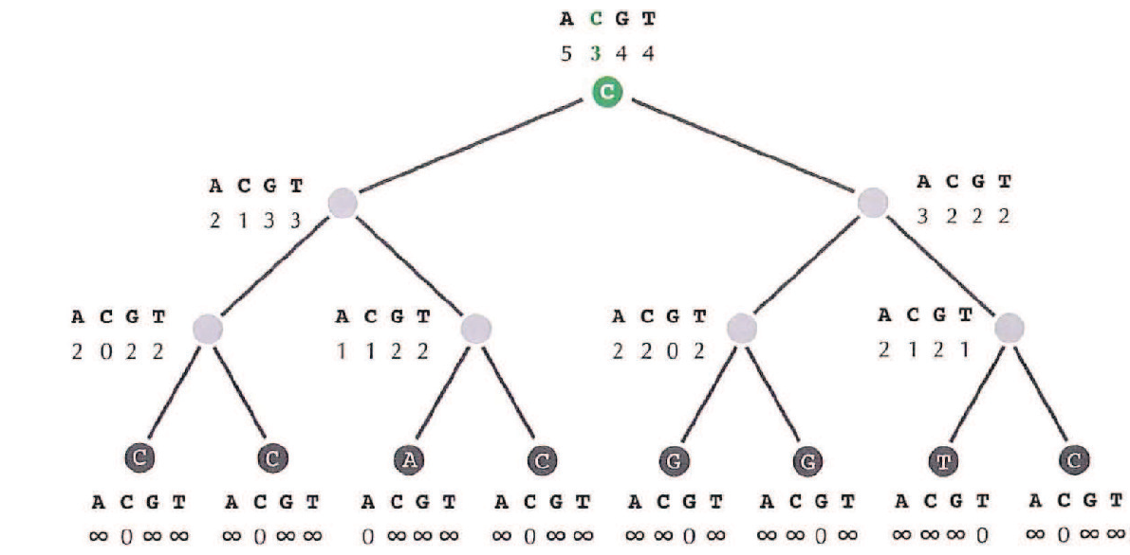
Small parsimony strategy
For a given position in the alignment, compute the scores of each base
Repeat this step for each column
Sum the scores of each column
Get the final minimum score (and an ancestor sequence)
The final score depends on the tree considered in the algorithm : it can be optimized

Slide 9
Nearest neighbor interchange strategy
Random tree
A
B
Evaluate it
Small parsimony score
C
D
Generate a new one
Nearest neighbor interchange
A
C
A
B
B
D
D
C
If no more possible interchange
Return best score and best tree

Slide 10
Nearest neighbor interchange - implementation
def nni_node_all(node):
subtrees_ = [node] if len(node.children) == 2 and all(len(child.children) == 2 for child in node.children):
subtrees_ = []
children0 = nni_node_all(node.children[0])
children1 = nni_node_all(node.children[1])
for child0 in children0:
for child1 in children1:
new_node = copy.deepcopy(node)
new_node.children[0] = child0
new_node.children[1] = child1
subtrees_.append(new_node) #No change : 1st version
new_node2 = copy.deepcopy(new_node)
new_node2.children[0].children[0], new_node2.children[1].children[0] = child1.children[0], child0.children[0]
subtrees_.append(new_node2) #2nd version
new_node3 = copy.deepcopy(new_node)
new_node3.children[0].children[0], new_node3.children[1].children[1] = child1.children[1], child0.children[0]
subtrees_.append(new_node3) #3rd version
elif len(node.children) ==2 :
subtrees_ = []
children0 = nni_node_all(node.children[0])
children1 = nni_node_all(node.children[1])
for child0 in children0:
for child1 in children1:
new_node = copy.deepcopy(node)
new_node.children[0], new_node.children[1] = child0, child1
subtrees_.append(new_node) return subtrees_
Previous steps :
Step 1 : Generate sequences
Step 2 : Build the tree using guide_tree
Step 3 : Convert the tree from tuple to an object
Output : list of all possible subtrees
Next steps :
Step 1 : Align the sequences using progressive_alignment
Step 2 : Calculate the minimal score using small parsimony

Slide 11
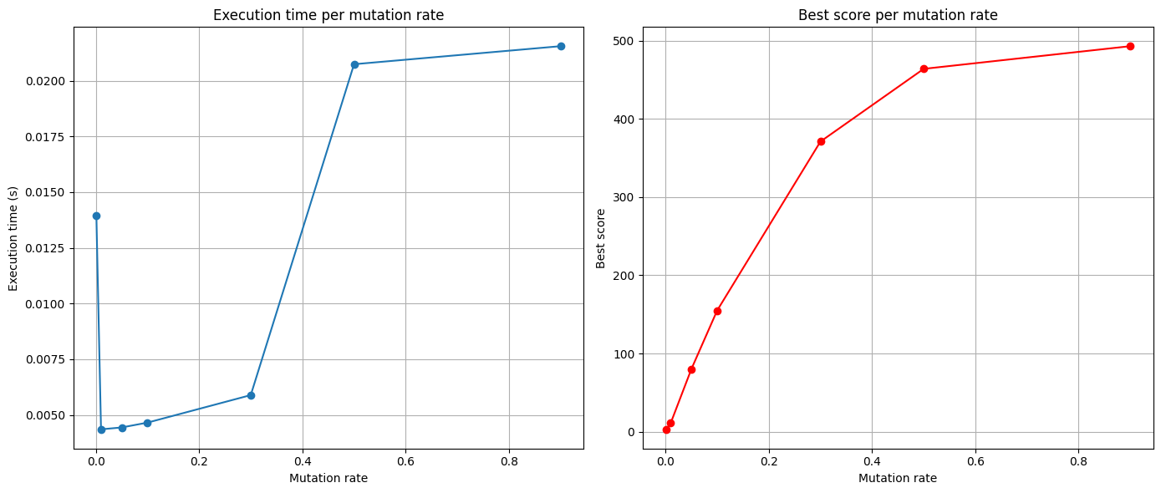
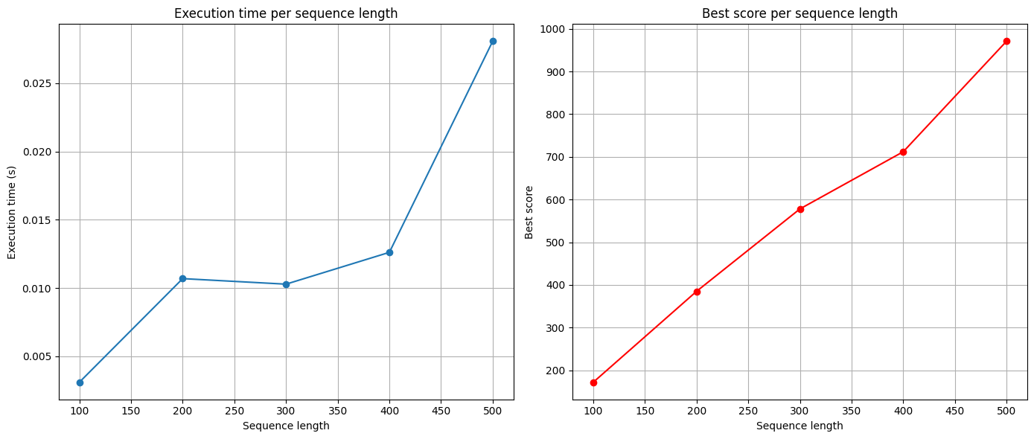
Nearest neighbor interchange – performance test
The variation of the execution time is difficult to interpret
Best score increases linearly with sequence length
Best score reaches a plateau at a certain mutation rate

Slide 12
def nni_node_optimized(node, msa):
if len(node.children) <= 1 or all(len(child.children) < 2 for child in node.children):
score = 1
return score, node _, best_score = small_parsimony(msa, node.to_tuple())
best_structure = node if len(node.children) == 2 and all(len(child.children) == 2 for child in node.children):
_, child0 = nni_node_optimized(node.children[0],msa)
_, child1 = nni_node_optimized(node.children[1],msa)
new_node = copy.deepcopy(node) #No change : 1st version
new_node.children[0] = child0
new_node.children[1] = child1
_, temp_score1 = small_parsimony(msa, new_node.to_tuple())
if temp_score1 < best_score:
best_score = temp_score1
best_structure = new_node
new_node2 = copy.deepcopy(new_node) #2nd version
new_node2.children[0].children[0], new_node2.children[1].children[0] = child1.children[0], child0.children[0]
_, temp_score2 = small_parsimony(msa, new_node2.to_tuple())
if temp_score2 < best_score:
best_score = temp_score2
best_structure = new_node2
new_node3 = copy.deepcopy(new_node) #3rd version
new_node3.children[0].children[0], new_node3.children[1].children[1] = child1.children[1], child0.children[0]
_, temp_score3 = small_parsimony(msa, new_node3.to_tuple())
if temp_score3 < best_score:
best_score = temp_score3
best_structure = new_node3
else :
_, child0 = nni_node_optimized(node.children[0], msa)
_, child1 = nni_node_optimized(node.children[1], msa)
new_node = copy.deepcopy(node) #3rd version
new_node.children[0], new_node.children[1] = child0, child1
_, temp_score = small_parsimony(msa, new_node.to_tuple())
if temp_score < best_score:
best_score = temp_score
best_structure = new_node
return best_score, best_structure
Nearest neighbor interchange - implementation
Previous steps :
Step 1 : Generate sequences
Step 2 : Build the tree using guide_tree
Step 3 : Convert the tree from tuple to an object
Step 4 : Align the sequences using progressive_alignment
Output : best score and tree

Slide 13
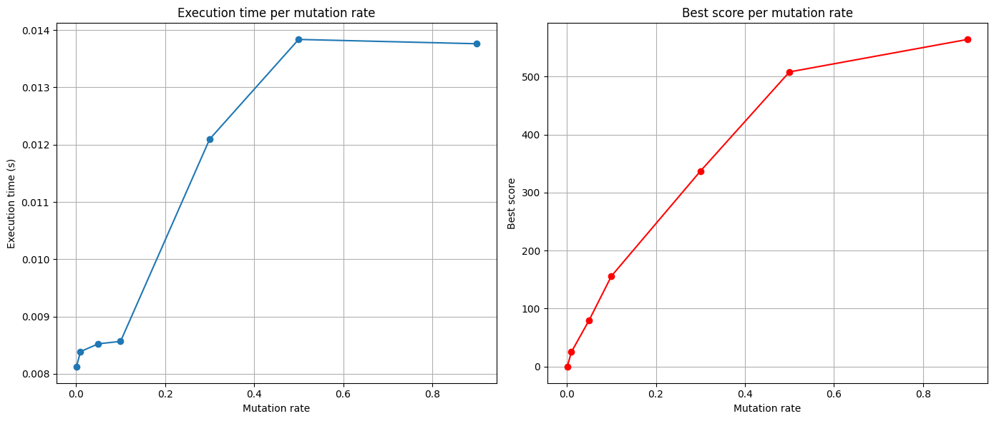
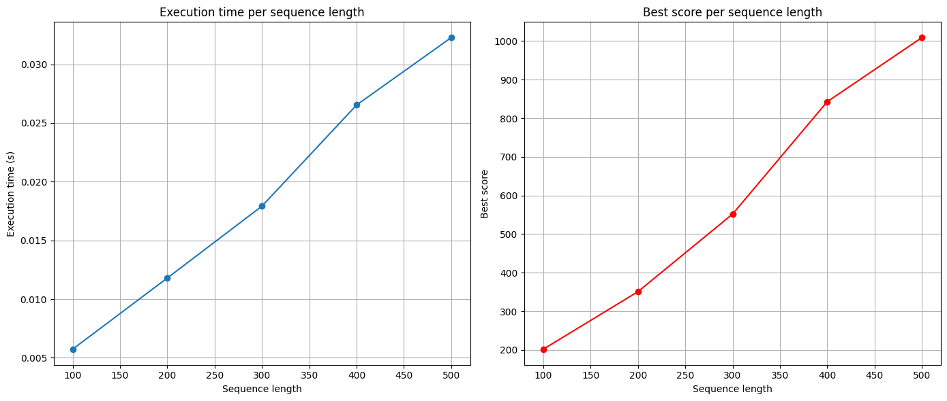
Nearest neighbor interchange – performance test
The variations of best score and execution time are the same
It increases linearly with sequence length
It reaches a plateau at a certain mutation rate

Slide 14
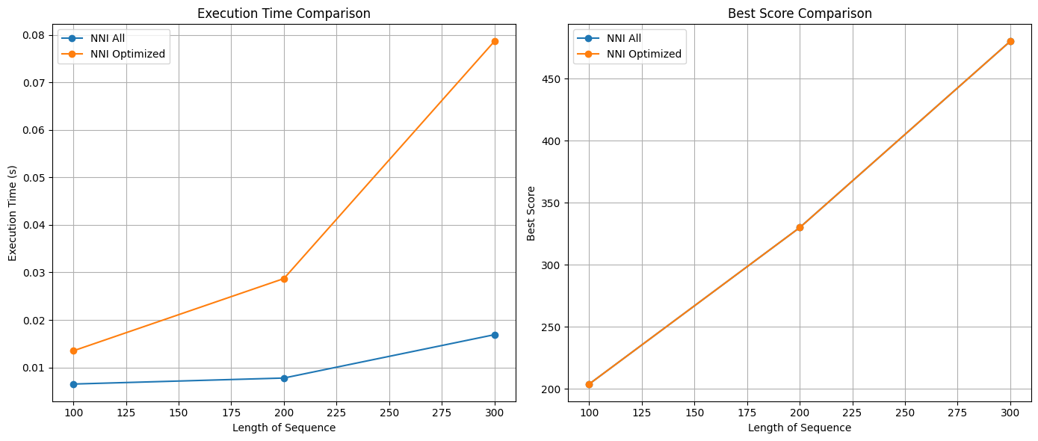
Nearest neighbor interchange – comparison
The size of the memory required is optimized, but the execution time can sometimes be better.
The best score obtained is the same.

Slide 15
Pruning and regraphting strategy
A1
Random tree
B
A2
Evaluate it
Small parsimony score
C
D
Generate a new one
Prune and regrapht
B
A1
C
If no more prune and regrapht
Return best score and best tree
A2
D

Slide 16
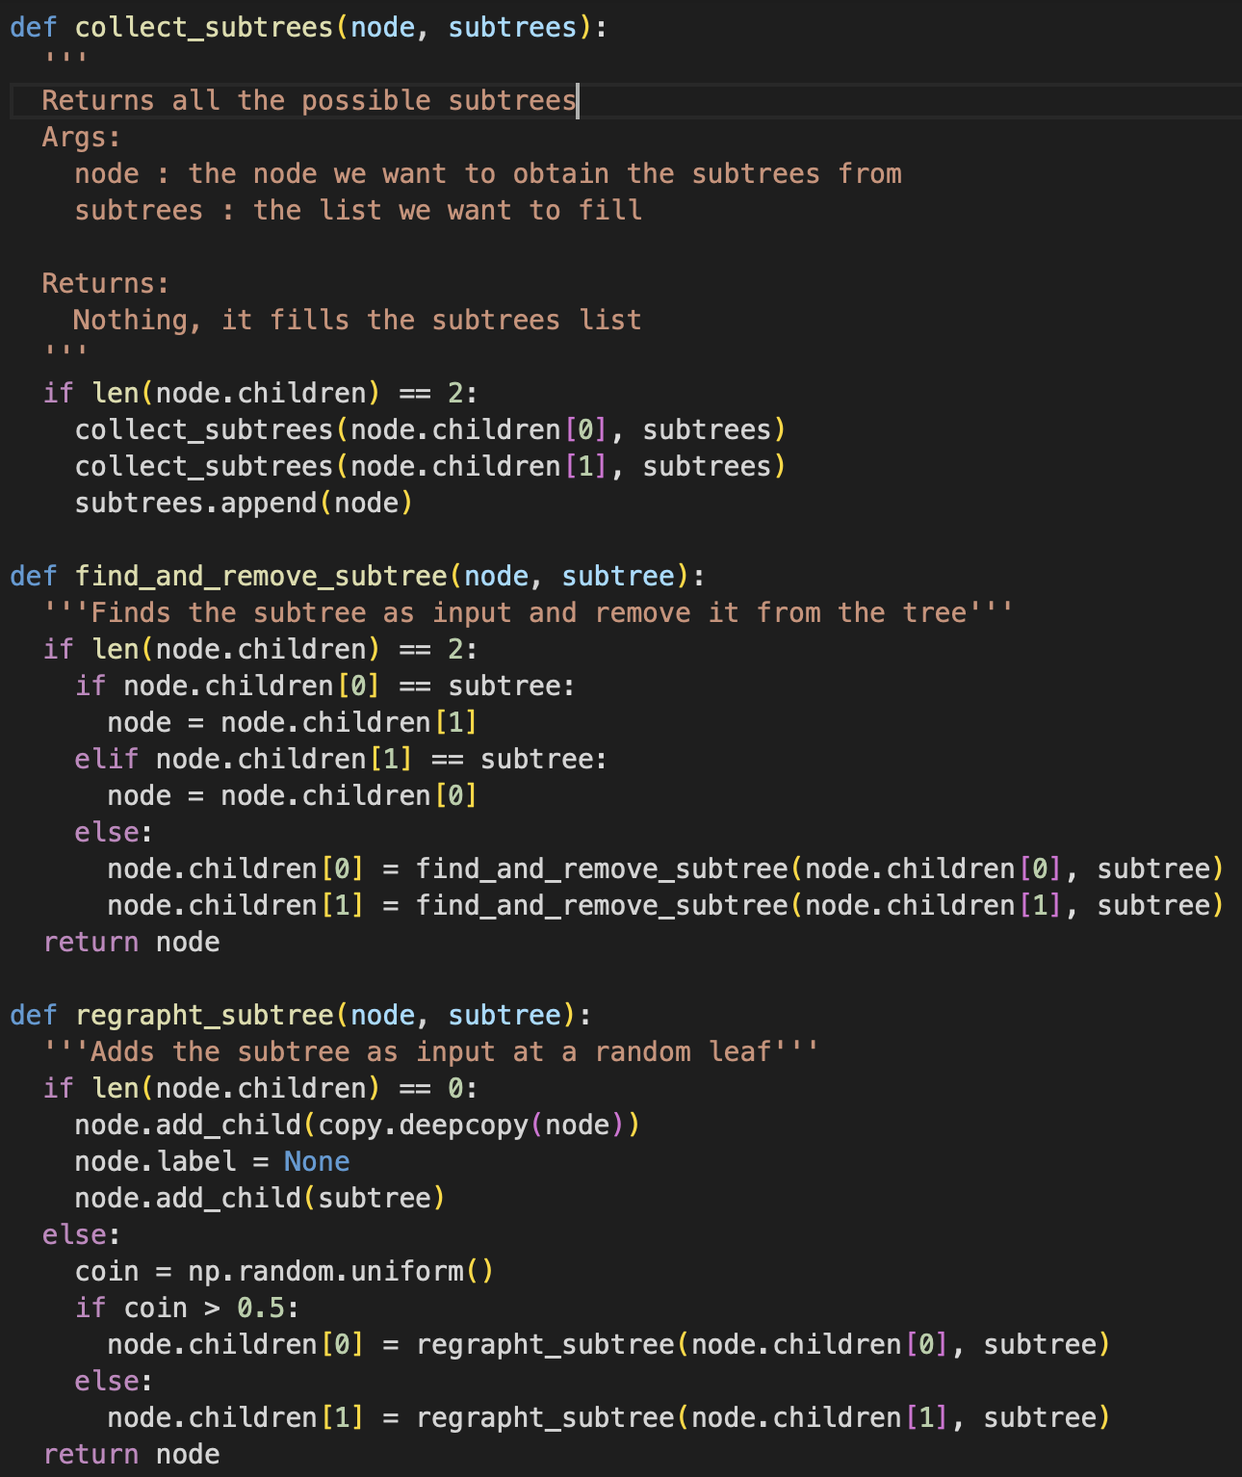
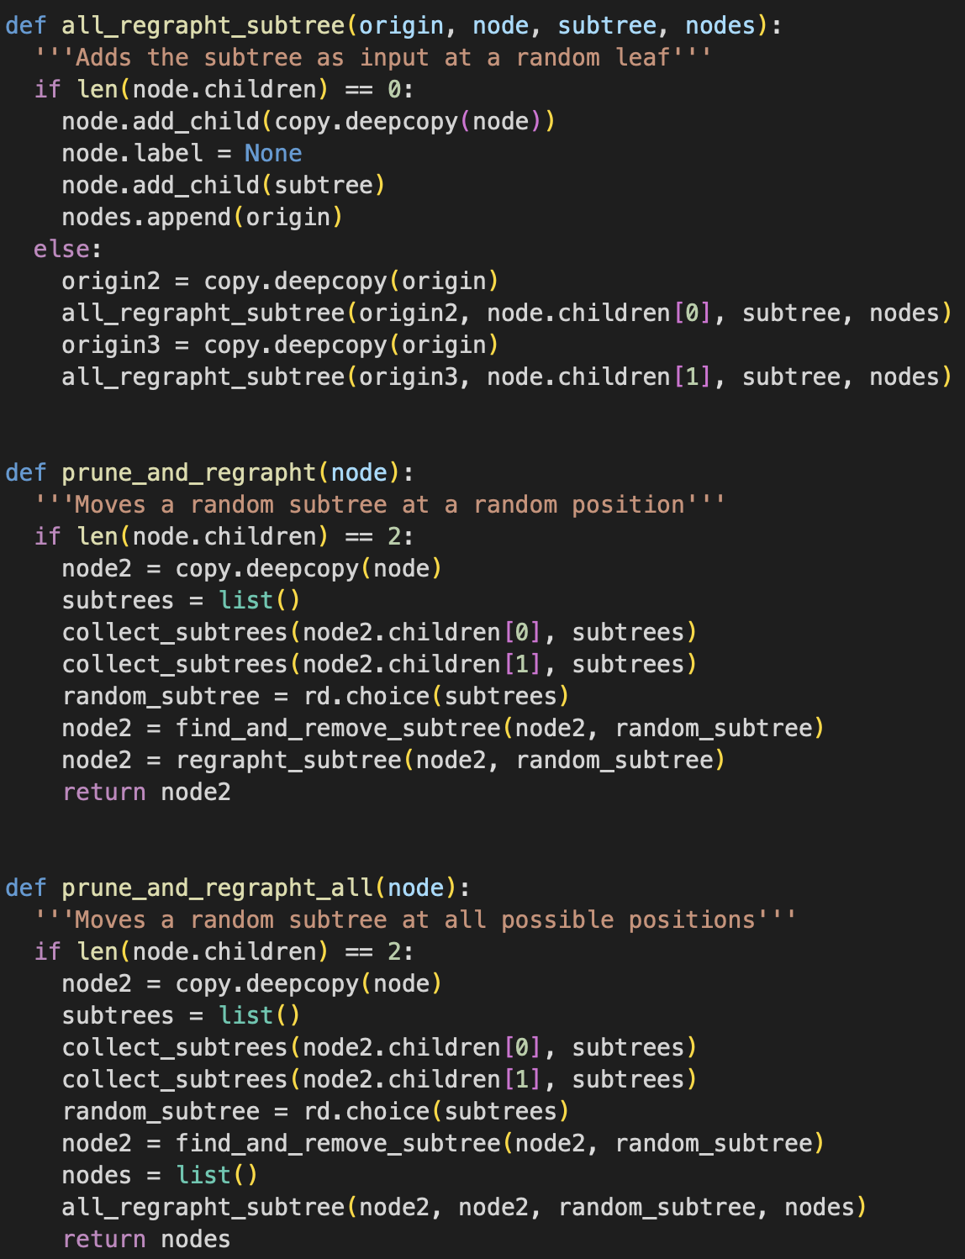
pruning and regraphting strategy– IMplementation

Slide 17
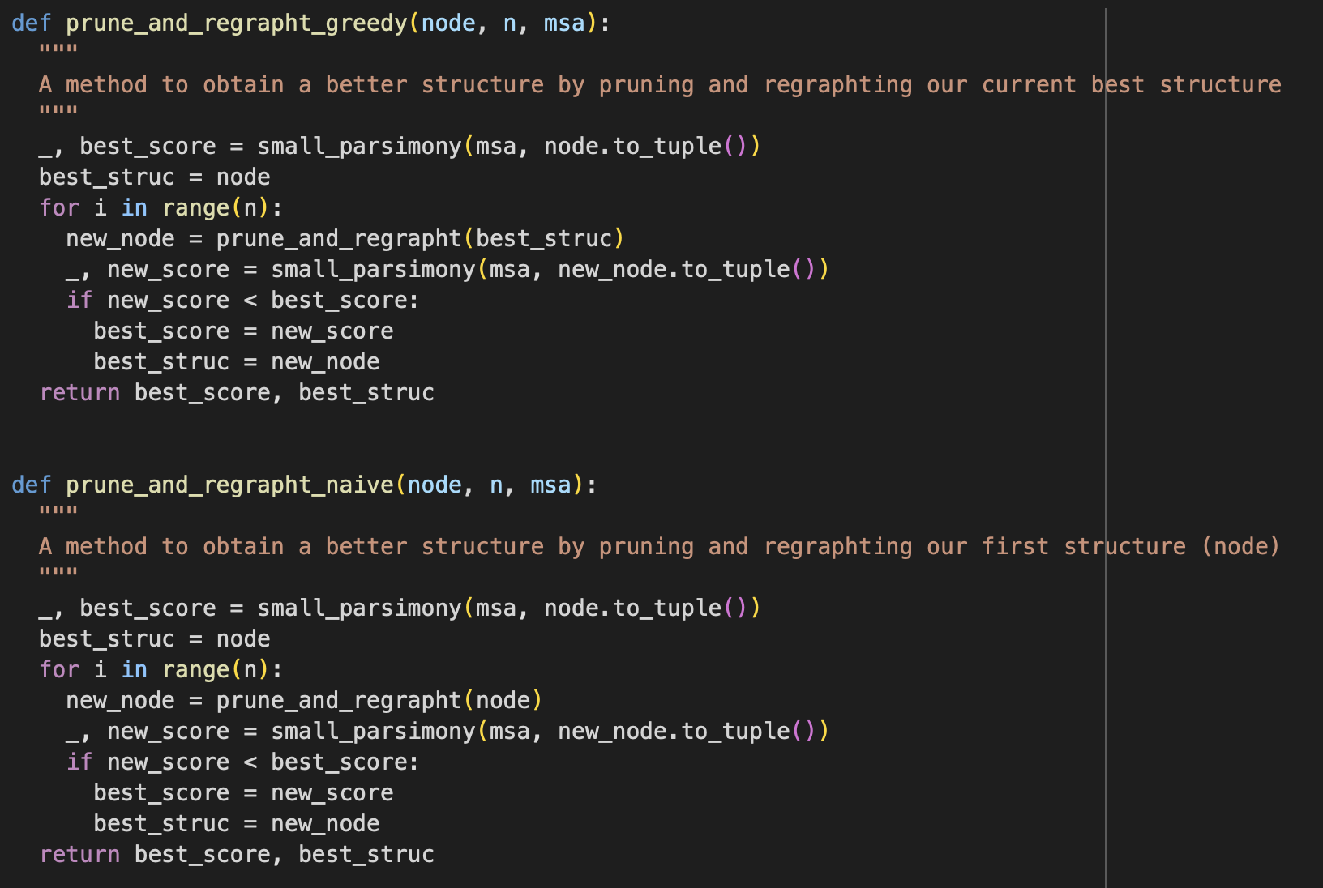
pruning and regraphting strategy– IMplementation
Previous steps :
Step 1 : Generate sequences
Step 2 : Build the tree using guide_tree
Step 3 : Convert the tree from tuple to an object
Step 4 : Align the sequences using progressive_alignment
Output : rearranged tree
Next step :
Step 1 : Repeat this action a huge number of times

Slide 18
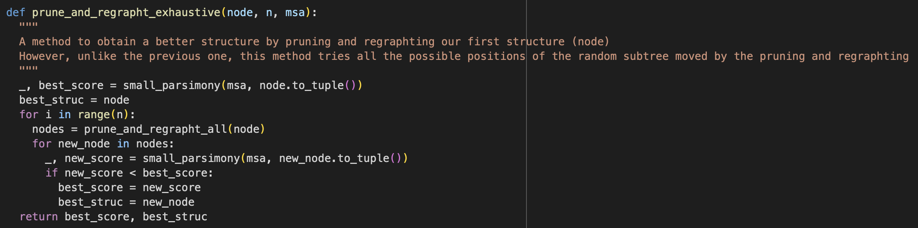
pruning and regraphting strategy– IMplementation
Previous steps :
Step 1 : Generate sequences
Step 2 : Build the tree using guide_tree
Step 3 : Convert the tree from tuple to an object
Step 4 : Align the sequences using progressive_alignment
Output : list of all
possible regraphted tree
Next step :
Step 1 : Repeat this action a huge number of times

Slide 19
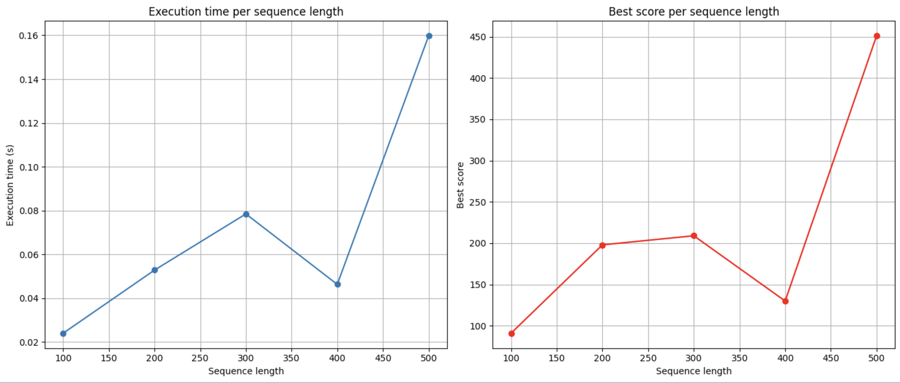
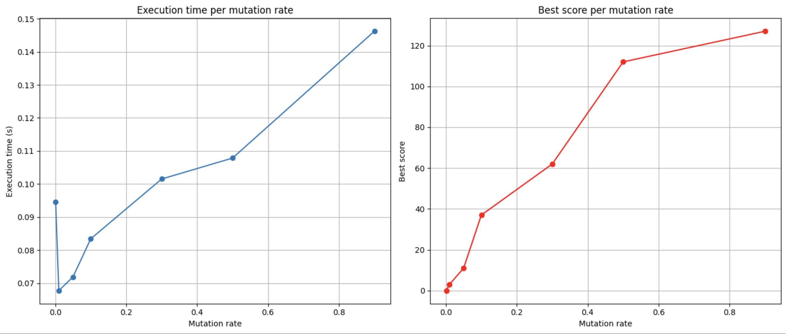
pruning and regraphting strategy– performance test
The variations of best score and execution time are the same
It increases linearly with sequence length
It increases linearly with mutation rate

Slide 20
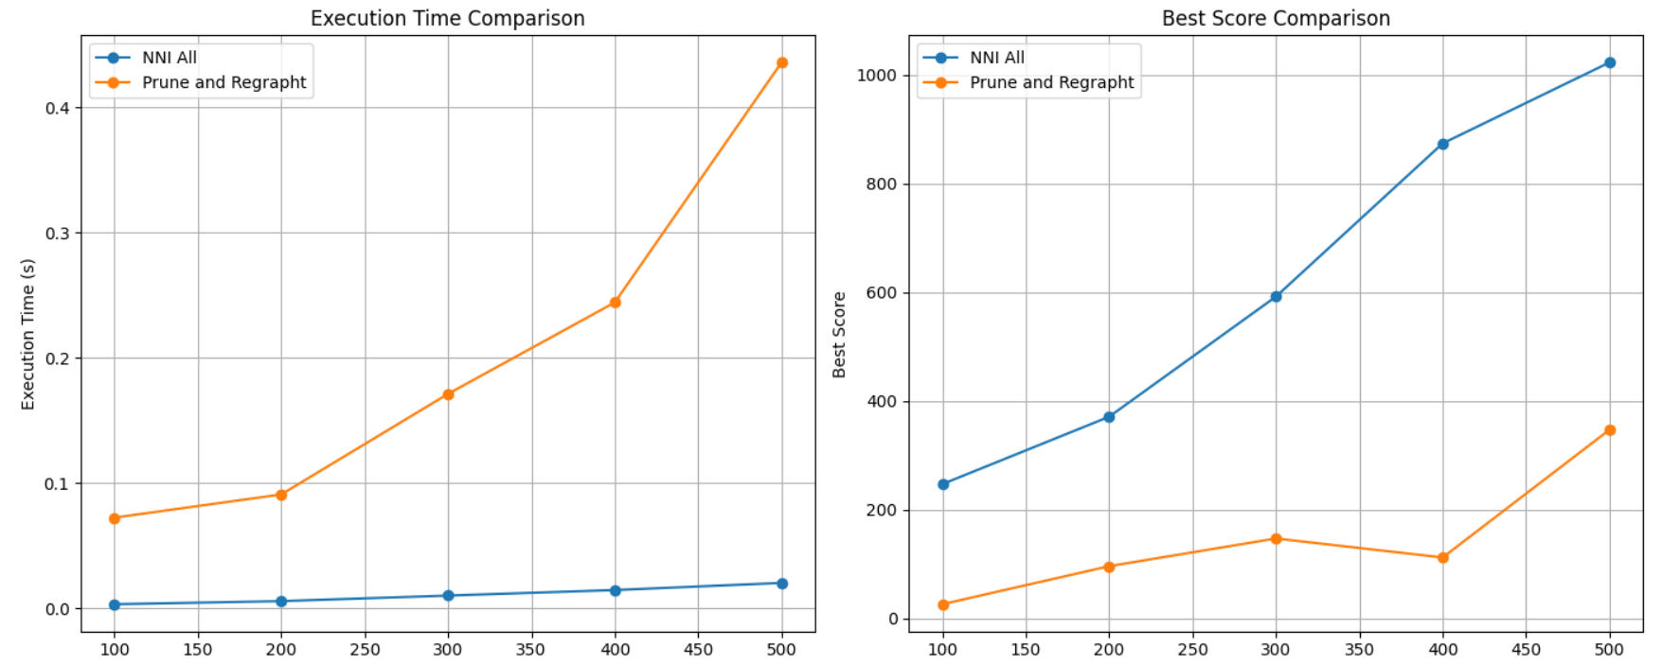
Comparison of the two strategies
Prune and regrapht strategy has better results than NNI
Prune and regrapht strategy has however a bigger execution time than NNI
The difference of results may be explained by the diversity of tree structure brought by the new strategy

Slide 21
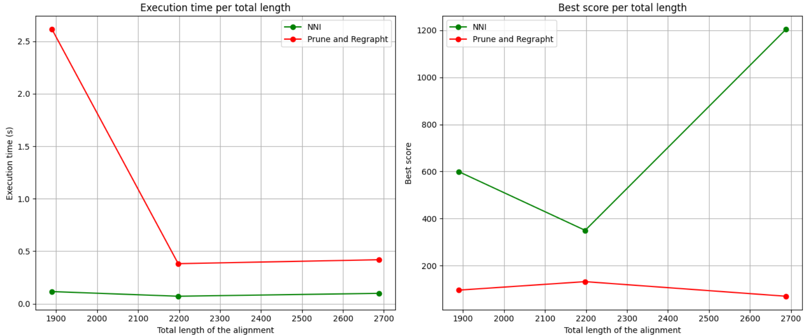
Comparison of the two strategies on real alignments
We observe the same difference of results, which depends on the alignments
The 1st alignment is composed of a large number of small sequences
The two other alignments are composed of a small number of large sequences

Slide 22



conclusion
How could we address the large parsimony problem starting from that of small parsimony ?
A solid constructive heuristic thanks to:
UPGMA
Multiple sequence alignment
Small parsimony
Efficient improving heuristics with the:
nearest neighbor interchange
pruning and regraphting

