Slide 1
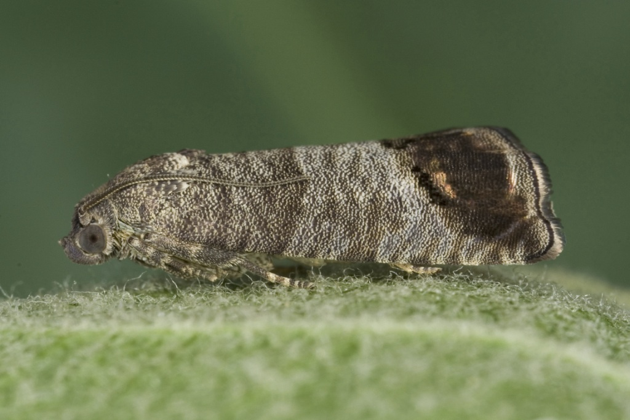
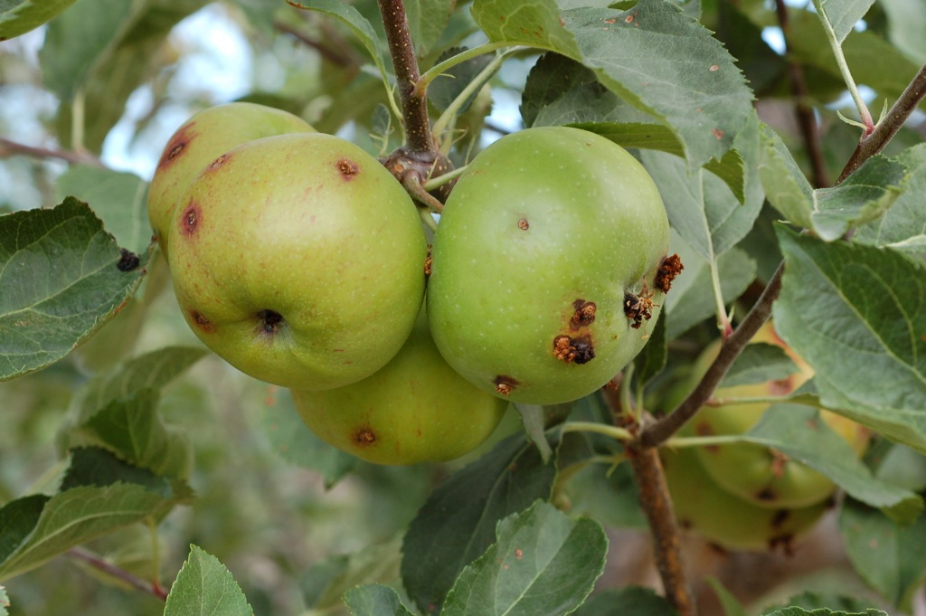
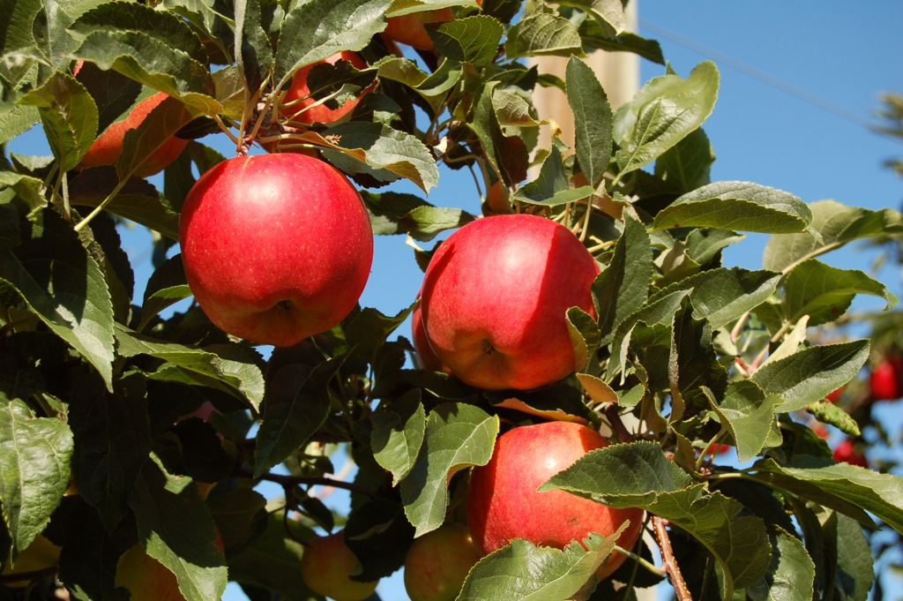



Building resilience of NW tree fruit to changing codling moth pressures
Kirti Rajagopalan, Vince Jones, Ute Chambers, Sonia Hall, Mingliang Liu, Sonia Hall

Slide 2
Our Vision
Management-oriented decision support for agriculture
Partnerships
Science community
Growers/users affected
Notes:
Do we want to ask for their help here or a bit later?

Slide 3
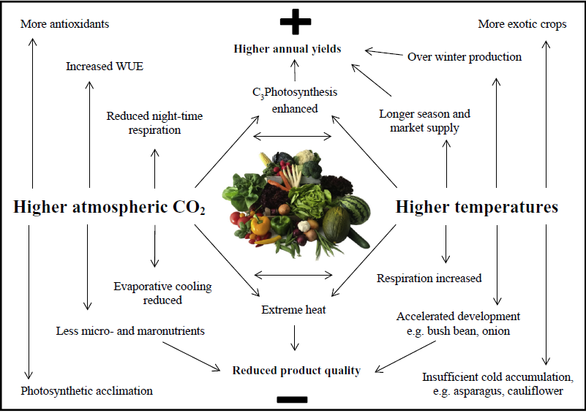
Climate change: implications for agriculture
Bisbis et.al. 2018.
Pests, diseases, water availability for irrigaion
Notes:
General implications of climate change for production….
End with a mention of relative advantages of PNW as compared to other regions..

Slide 4
Tree Fruit Production Risks: Ongoing Work
This project:
Codling moth pest pressures under a warmer climate
Other production risks:
Insufficient chill accumulation
Elevated sunburn risk
Cold damage risk
Honeybee forage and bloom timing being out of sync

Slide 5
Background

Slide 6
Broad overview
Temperature makes the tree fruit world go around!
Tree growth, harvest time
Insects
Diseases
Climate Change Scenarios
Summary at TFREC
Diapause Induction
Limits the number of generations
A certain percentage of larvae of every generation enter diapause
After ≈21 August, all larvae are induced into diapause
Must complete the development from young larvae to overwintering stage to survive
Effects on management
Notes:
What I’ll cover very briefly for a point source, using the Tree Fruit Research and Extension Center as an example. The web site actually has the phenology and other changes over the major fruit growing regions.

Slide 7
Climate Change Scenarios
climate spiral
Representative Concentration Pathways
Standardized greenhouse gas concentration trajectories
RCP 4.5
CO₂ emissions peak around 2040, then decline
650 ppm CO₂ after 2100
+3.25°F mean increase
RCP 8.5
CO₂ emissions rise throughout the 21st century
CO₂ ppm1380 ppm and still rising at 2100
+6.6°F mean increase
The standardized RCP conditions used in climate models
Many different climate models, but all use the same RCP scenarios
Notes:
I just copied this from the presentation I gave Valent. The idea is to give them a broad overview of climate change terminology that is used in the web site, but also to give them some background on the process and how it works.

Slide 8
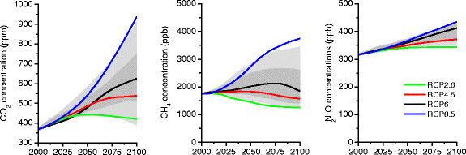
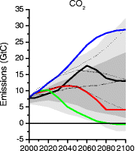
Climate Change Scenarios
Notes:
These two are fuzzy

Slide 9
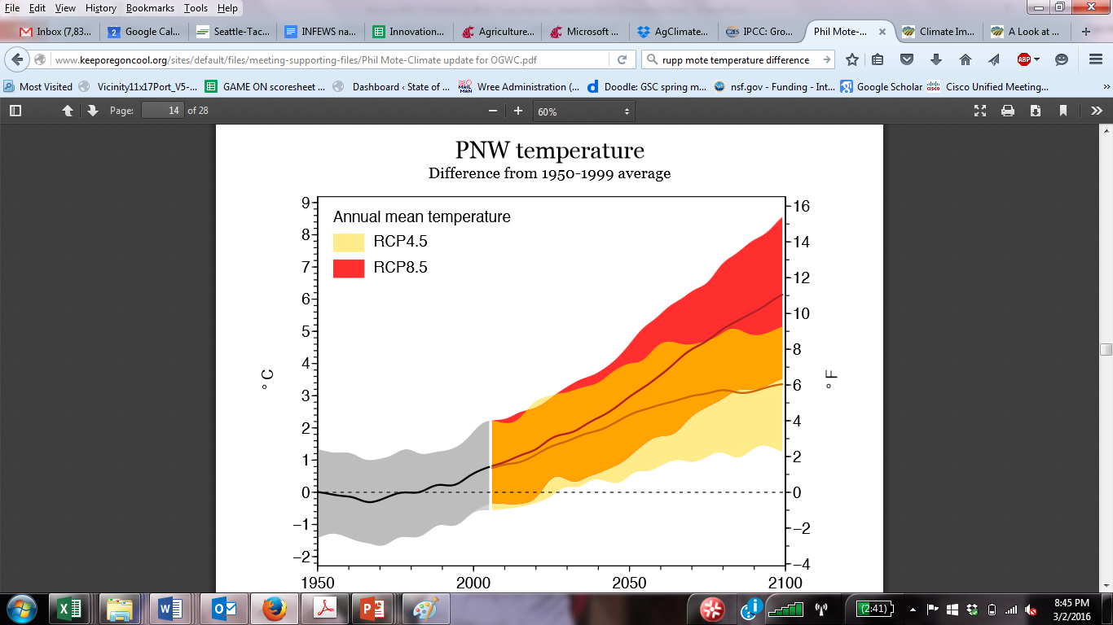
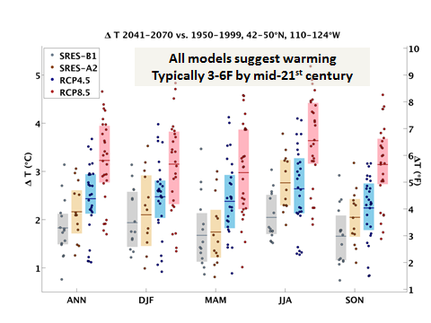
Temperature Projections for PNW
Notes:
The graph on the lower right is fuzzy

Slide 10
How to use the scenario’s
Run the same climate scenarios on 10+ Global Climate Change (GCM) models to get an ensemble forecast
http://www.climatologylab.org/tools.html
Each model will give slightly different version depending on the assumptions of the model
Take the median results of the 10+ models
Sort the results from lowest to highest and use the one in the middle
The climate change scenarios are available on-line
Can do this on a point basis (e.g., a 4x4 km grid) or regional
Notes:
Again, taken from Valent presentation. I wanted to let them know this isn’t just a single model, but a compilation of multiple ones and that we’re giving the middle of the road results.

Slide 11
How DD accumulations change throughout the season
135%
126%
116%
161%
140%
121%
219%
146%
178%
Biggest change percentage wise is Jan-April
Second largest change percentage wise is Sep-Dec.

Slide 12
Overall Effects at TFREC
Period | 1st moth | Total DD by 5 Nov | No. larval Gen. by 5 Nov
Historical | 4/29 | 3132 | 2.81
2040 | 4/19 (-10 d) | 3761 | 3.26
2060 | 4/11 (-18d) | 4194 | 3.8
2080* | 4/3 (-26d) | 4633 | 4+
*DD accumulations ran beyond current cm model by ≈170 DD
CM climate change effects
Notes:
This is the first coarse view of how different things might be

Slide 13
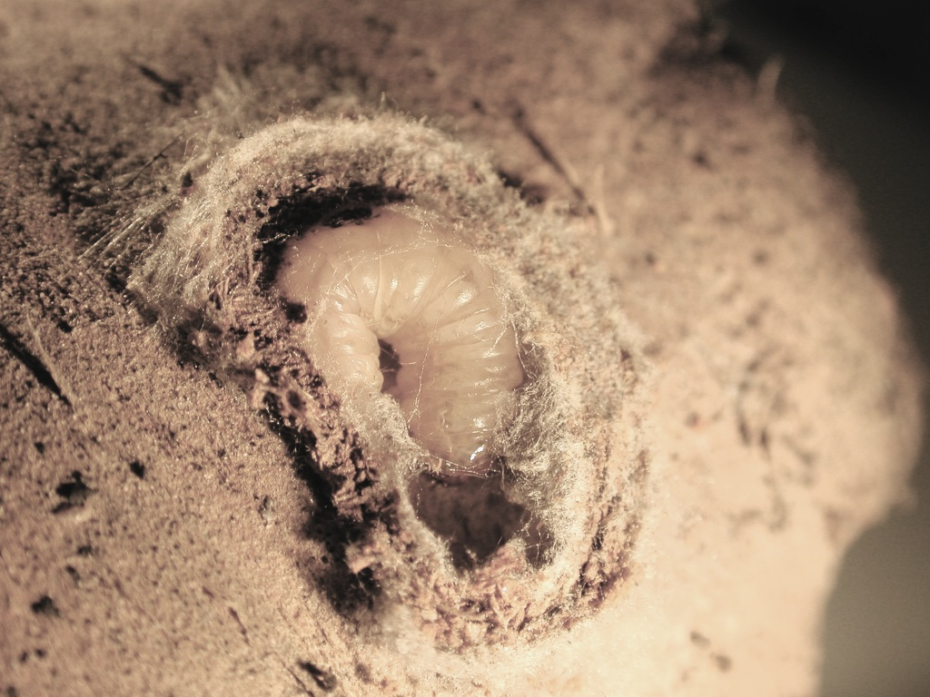
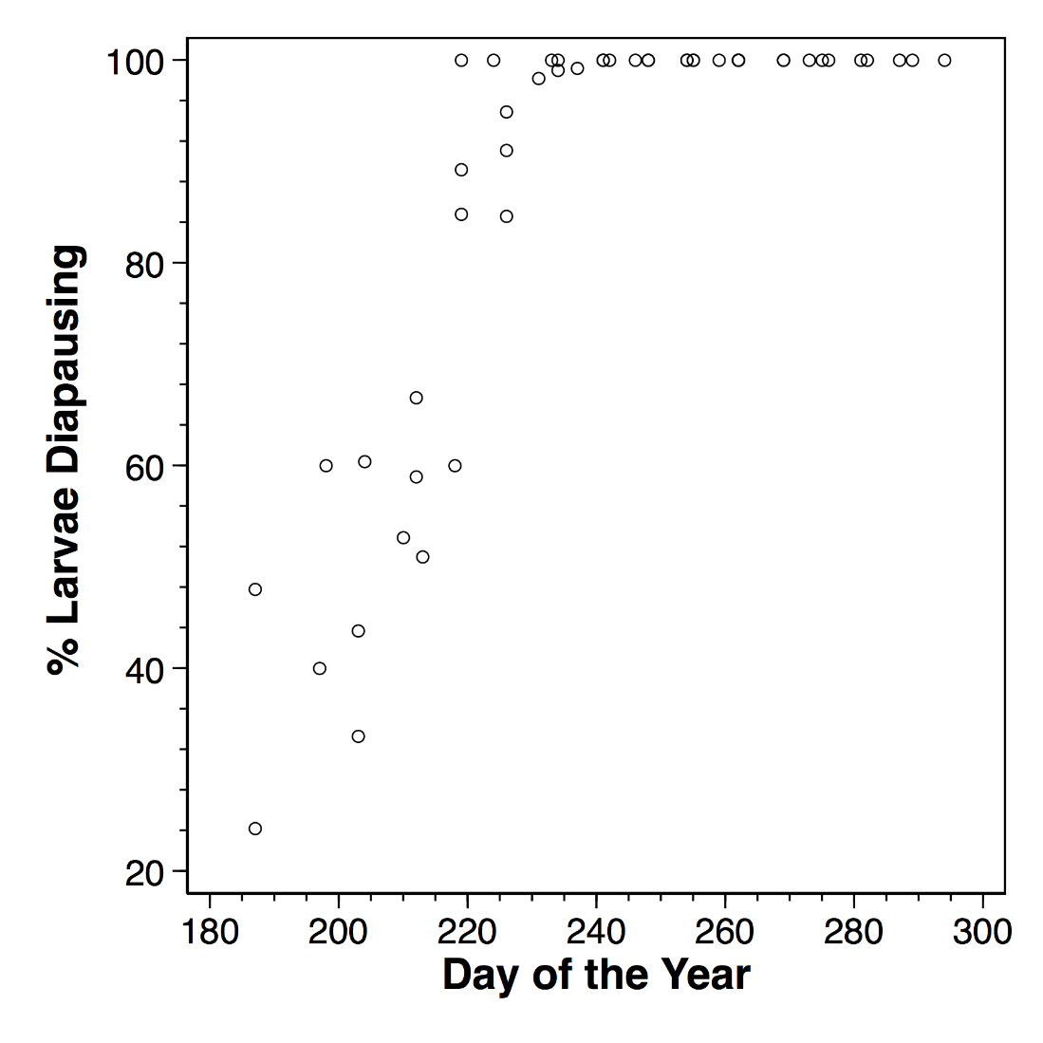
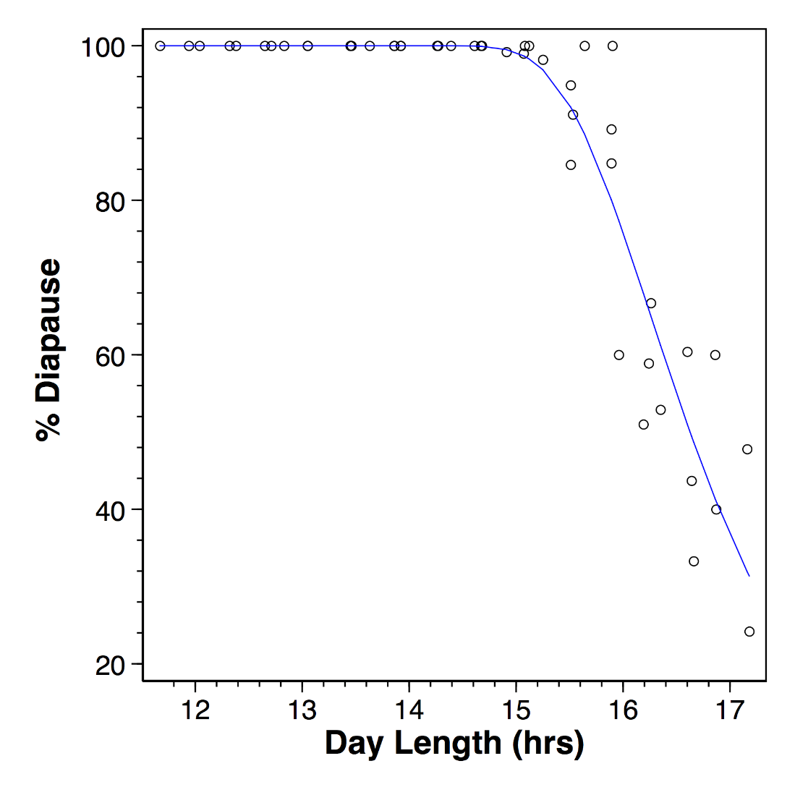
Diapause Induction (real data!)
CM climate change effects
Notes:
This is to help them understand the importance of diapause and how the change in times for first larval emergence explained in the next few slides will happen

Slide 14
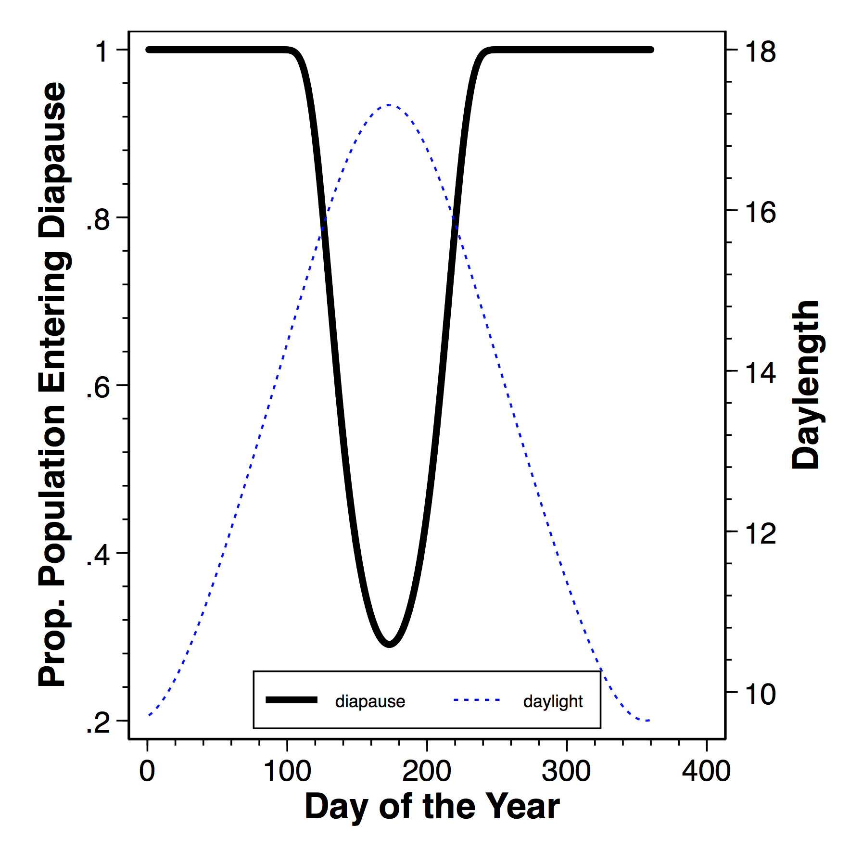
CM climate change effects
Notes:
Explain the diapause – photoperiod relationship as seen on the web site.

Slide 15
Next Steps

Slide 16
Next steps
Pest pressure analogs
Better characterization of management implications

Slide 17
Climatic condition analogs
WA State
Rest of the US
Location of Interest
Future Climate
Current Climate
Are there locations in the US whose current climatic conditions resemble WA State future expected climate?
What can we learn from analog locations?

Slide 18

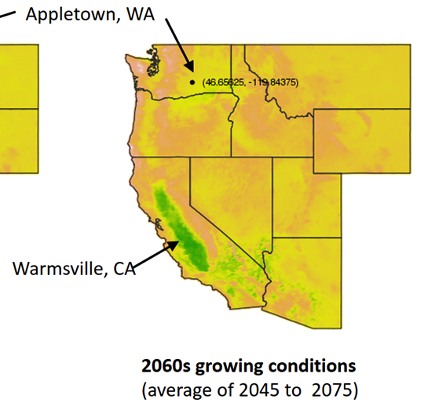
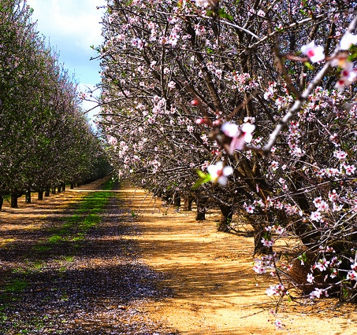
Growing condition analogs
Notes:
This is another conceptual way to present the future forecasted changes. Rather than presenting in a graph or map of the %change relative to historical average, this uses the concept of a spatial analog (another location that currently has growing conditions similar to what we would expect in the future. This is far more useful way to represent the magnitude of what a few degrees of warming looks like.
Economics:…..

Slide 19
Background for Management Discussion

Slide 20
Pesticide & MD effects
Used climate change data for TFREC and used RCP 8.5 (severe)
Considered the effects of both MD & pesticides & combination
Included consideration of diapause induction
Pesticides alone – compared the effects of treating the first two generations using a delayed first cover strategy
Oil at 375 DD
Oil + pesticide at 525 DD, 14 day residue, kills 90% neonate larvae
Pesticide applied 2 weeks later
Repeat procedure in second generation (1375, 1525 DD, + 14 days)
MD
Assumed a 3 day delay in mating
Also looked at using delayed first cover in first generation only
CM climate change effects
Notes:
To get to the management effects caused by climate change

Slide 21
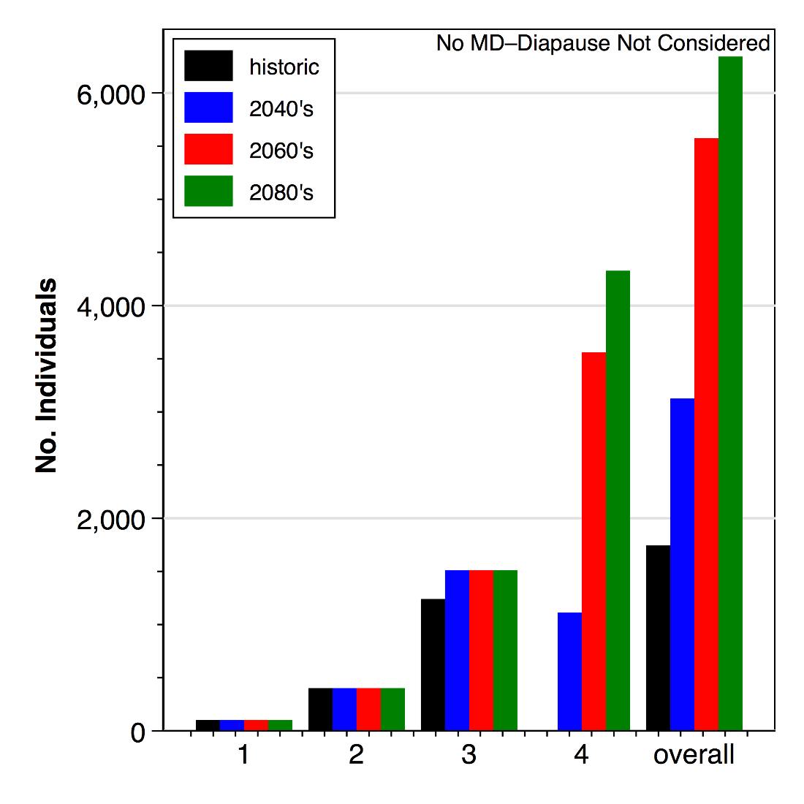
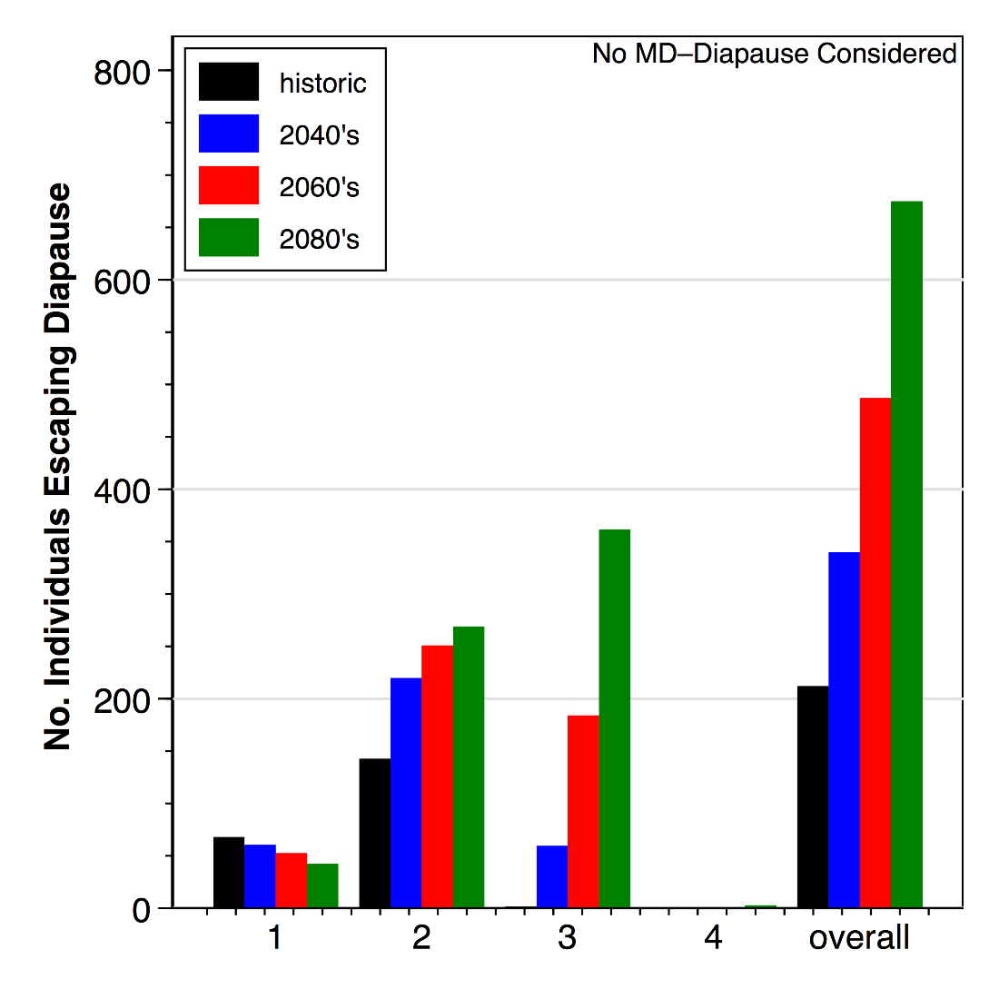
No. Control larvae in different time periods RCP 8.5
2080’s ran past the model by ≈170 DD
Larval Generation
Larval Generation
CM climate change effects
Notes:
Shows control effects only by larval generation. On the left no diapause consideration, on the right considering diapause. In the first and second larval generations, you can see the diapause effects. A point to make Is that the difference in the scale on the left and right is the difference in overwintering individuals. The other big takeaway is the importance of diapause and the huge difference in population as you add more generations.

Slide 22
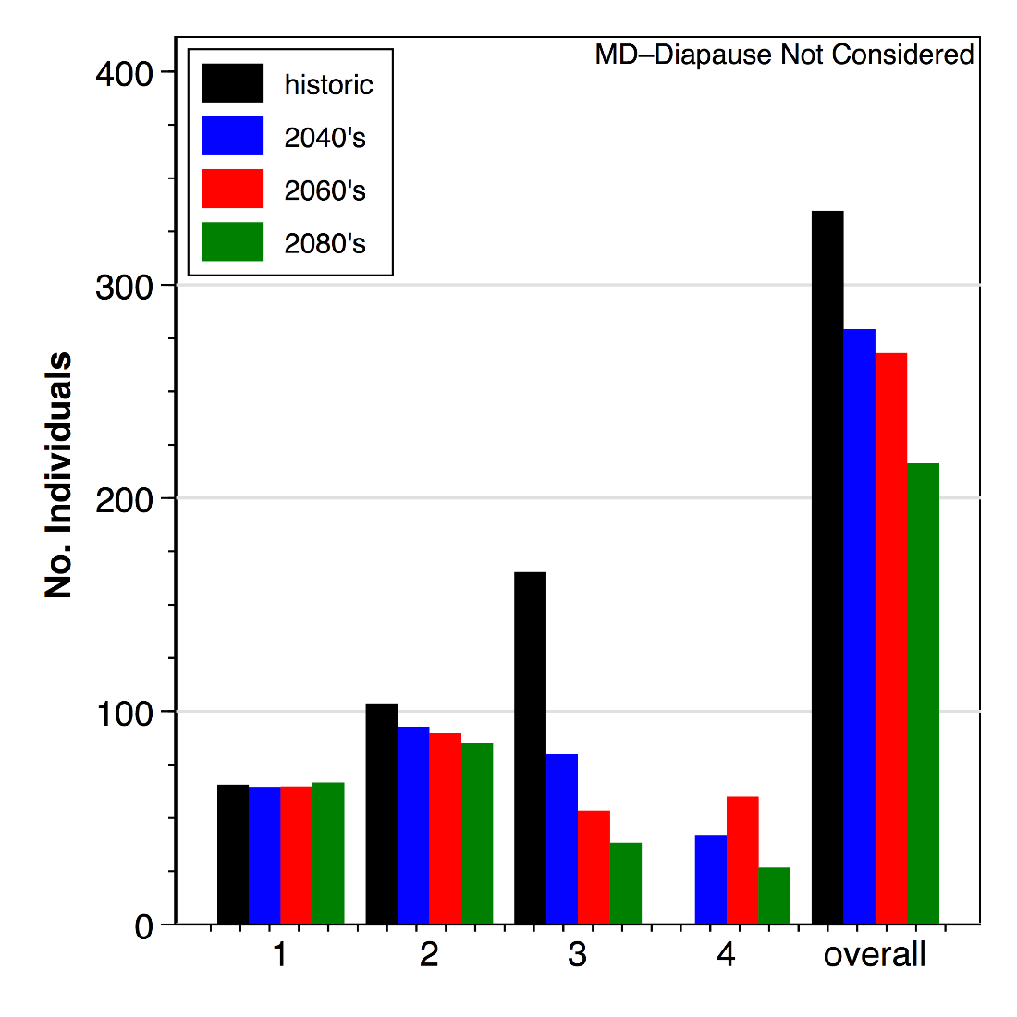
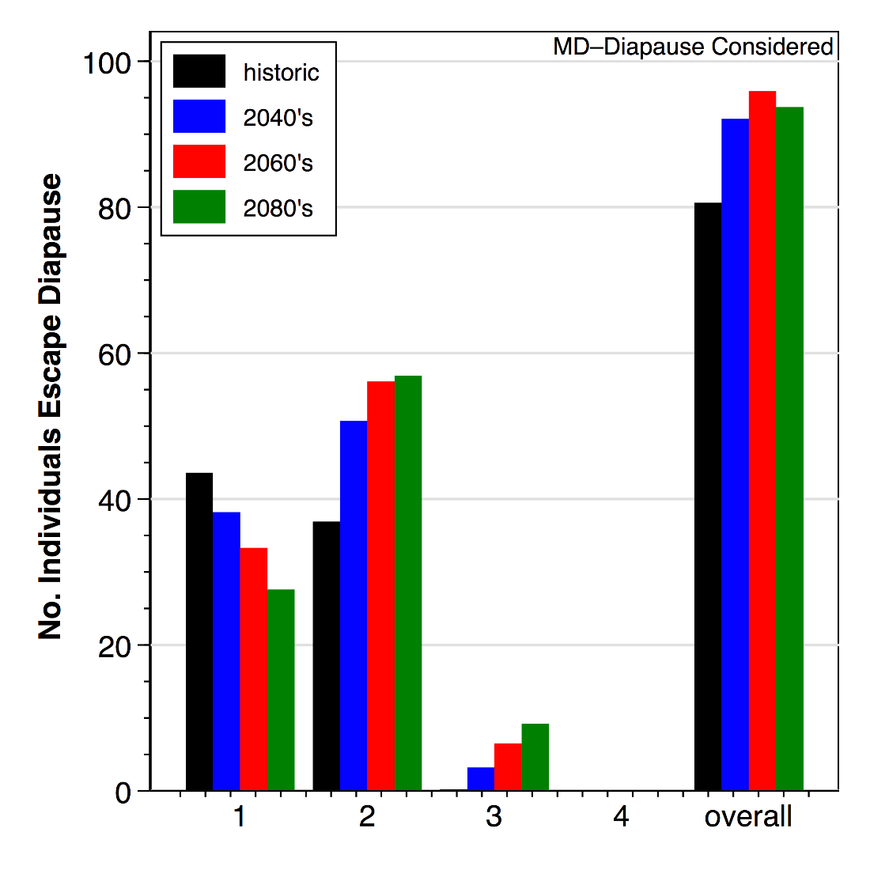
Controls with MD
Larval Generation
Larval Generation
CM climate change effects
Notes:
Shows the same as the last slide, but under mating disruption (no pesticides applied) by generation – same highlight of the diapause effects. Big point here is that MD really reduces the population level you have to deal with compared to the control no MD treatment.

Slide 23
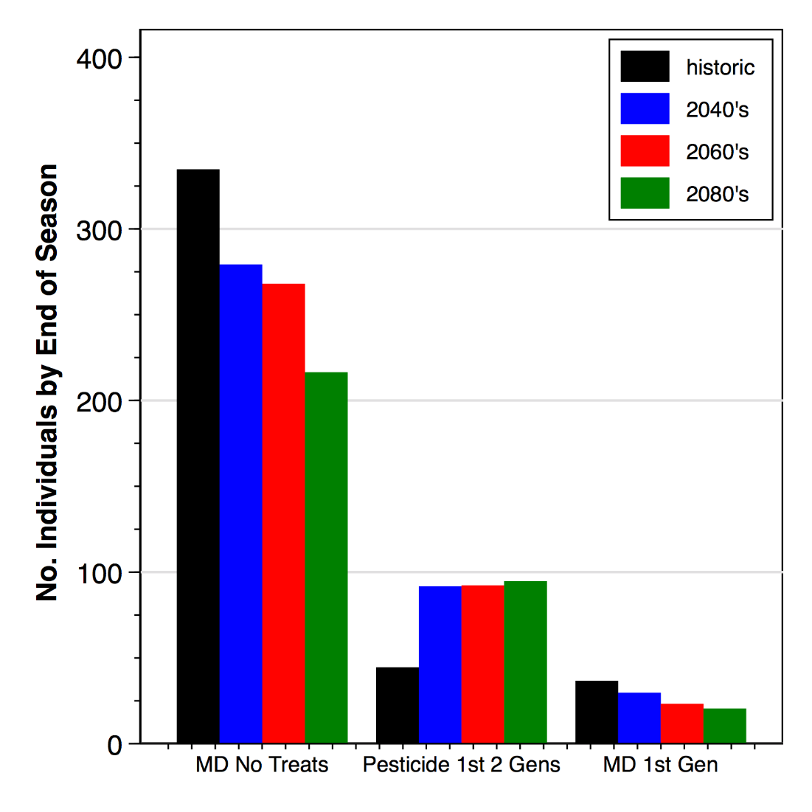
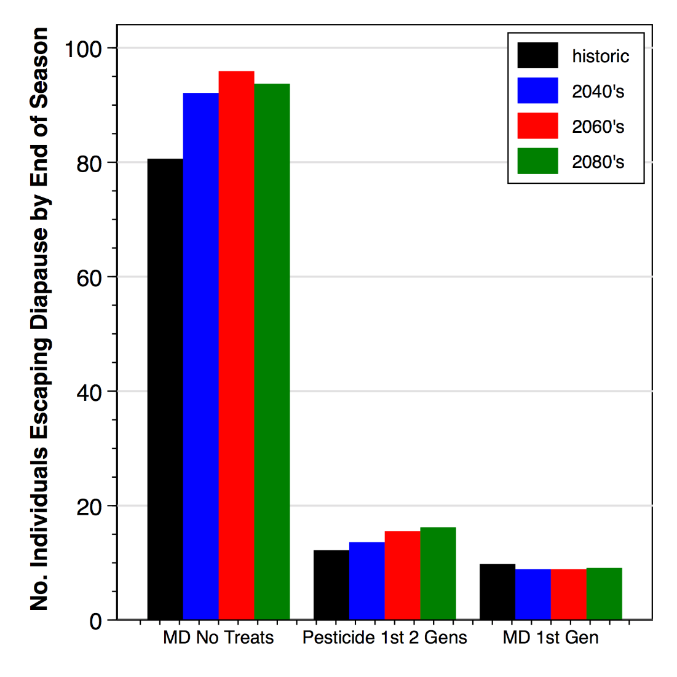
Mating disruption versus pesticides – seasonal totals
Pesticide 1st 2 generations has no MD
MD 1st generation – has MD all season + 1st gen treated as above
CM climate change effects
Notes:
In this one, the generational totals are not brought out, just the total by the end of the season. The first cluster of bars is using MD by itself, no pesticides. The second group is pesticides by themselves with them applied as in slide #7 – the first two generations are treated with the most effective timing (timings are DD based, but the second spray of a generation is by residue longevity). The third cluster is using MD but treating the first generation alone.

Slide 24
What happens when it gets warmer for CM management?
More generations = more pest pressure
Overwintering populations may be higher
Mating disruption and pesticides both work better when it is warmer
Treatment windows are narrower
Missing the right timings will allow more individuals to escape control if you are late
Crops will be off the tree earlier, so later generations may not have as many hosts to attack
Warmer fall means that some insects that escape diapause induction in the late fall, will make it to the overwinter stage
Notes:
Just generalities that we need to explore in greater detail.

Slide 25
How late can an egg be laid and reach OW stage
Period | Date | DD 20 Aug -15 Nov
Historic | 24 Aug | 815*
2040 | 31 Aug (+7 d) | 1002
2060 | 6 Sept (+13 d) | 1154
2080 | 10 Sept (+ 17 d) | 1318
*730 DDF required for development from egg-through larval stage

Slide 26
From Full Diapause Induction to 15 Nov.
DD required
To reach OW stage

