Slide 1

i
✓
✓

Slide 2

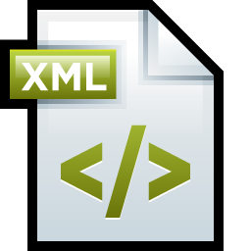
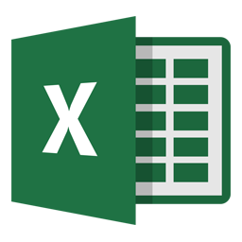
Functional code diagram
Add XML automatically or Manually
Read XML File
Apply Change
Interface
Run
XML Schema
CSV File
User Input:
Select data to retrieve
Enter URL link or CSV with several URL link (For batch running)
Enter OutPut name and path

