Slide 1

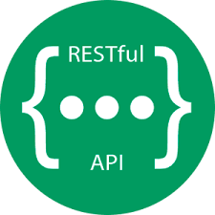













Front-end web application
Back-end (REST API)
Base de données (relationnelle)
Entities Services
Security (Json Web Token)
Ressources REST
Modules
Modules
Contrat d’API
Data Transfer Objects (DTO)
Modules
Components
Components
Components
Logic
Services
Data mappers (Mapstruct)
View
Style
Component
Domain Objects
Component
Repositories
Spring Data
(+ JPA)
Routing

