Slide 1
NBA Odds Project
Predict odds for winning the 2018/2019 NBA Championship

Slide 2
Framing the Problem
Available data:
Player-level: fine-grained but missing roster modifications for 2018 offseason
Team-level: less granular but we have everything needed
Methodology: Four Factors (Dean Oliver, 2002)
Focus on 4 team-level aggregate stats (effective FG%, turnover %, off. Rebound %, FT rate)
Target to predict: number of playoff wins
Proxy for championship winning odds (use sum of all predicted playoff wins and transform share by team into odds)

Slide 3
Implementation – 4 modes
Prepare: compute team-level stats aggregated over regular seasons from 2000/2001 to 2016/2017 (inspired by Four Factors approach)
Train: train a ML model on aggregated data
LightGBM with hyper-parameters tuned using Bayesian Optimisation
Predict before 2018/2019 regular season
Perform inference using 2017/2018 regular season stats
Predict before 2018/2019 playoffs
Perform inference using 2018/2019 regular season stats

Slide 4
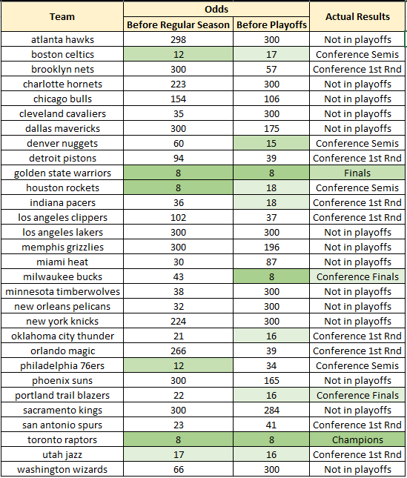
Results & Analysis
Nailed the 2 finalists!
Odds for both TOR and GSW were the lowest in preseason and stayed at same level after the regular season
TOR low preseason odds a bit surprising:
In real life K. Leonard + M. Gasol joined the team after the 2016/2017 season
But they also were great in the 2016/2017 regular season (not in playoffs)
Conference finalists had also low odds before the playoffs
MIL preseason odds were high but they had a great regular season with a new coach (coach of the year M. Budenholzer) and improvement from MVP G.Antetokounmpo

Slide 5
Ideas for Improvements
Simulate the game on a possession-level:
Predict possessions/g, who’s on the floor for each possession (player minutes, coaching substitution patterns), possession outcome
Simulate each game thousands of time and average outcomes
Model homecourt advantage, days of rest impact, referee foul whistling tendencies
Use spatial data
Model individual matchups
Some players defend really some other specific players

Slide 6

Many more details in the README!
NOTE:
To change images on this slide, select a picture and delete it. Then click the Insert Picture icon
in the placeholder to insert your own image.

