Slide 1


VS
A Data Analytics Capstone Project by Julien Gerlock

Slide 2


Overview
Inspiration & Goals
2013
NPSL
2018
USL
2020
MLS

Slide 3
Data Questions
How successful has Nashville SC been relative to other expansion teams in MLS history?
How successful is Nashville SC as a club relative to other teams in the MLS currently?
Does being on Nashville SC increase a players transfer market value?

Slide 4
Data Sources
Wikipedia
Historic league tables
MLS Website
Club level statistics
NSC Website
Player level statistics
Transfermarkt US
Club and player level transfer market values

Slide 5
Data Question #1
2005 | LA Chivas Salt Lake City
2006 | Houston
2007 | Toronto
2008 | San Jose
2009 | Seattle
2010 | Philadelphia
2011 | Vancouver Portland
2012 | Montreal
2015 | NYC Orlando
2017 | Atlanta Minnesota
2018 | Los Angeles
2019 | Cincinnati
2020 | Nashville Miami
2021 | Austin
How successful has Nashville SC been in their first and second season relative to other expansion teams in MLS history?
Notes:
- 19 expansion teams

Slide 6
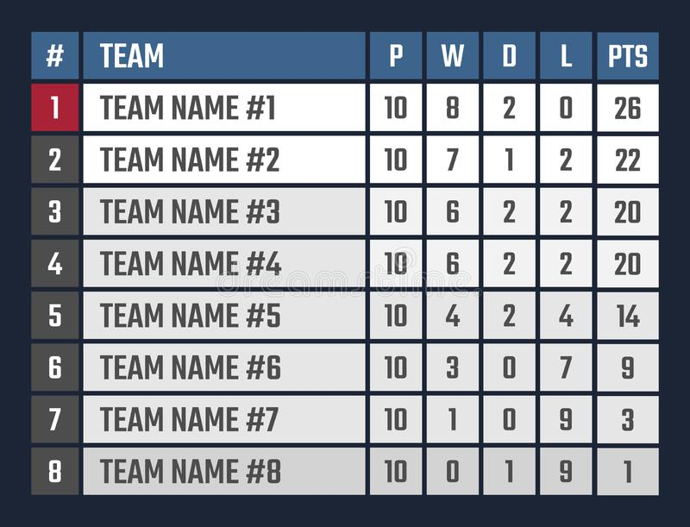
League Tables
Notes:
- 19 expansion teams

Slide 7
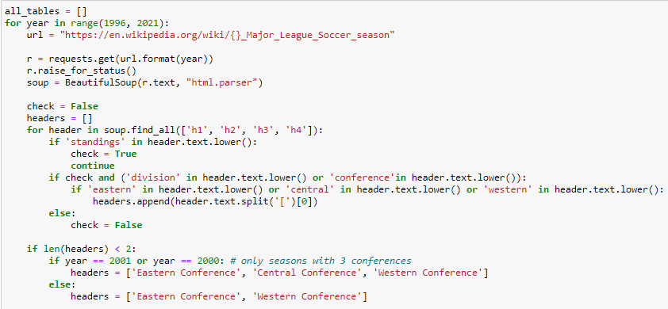
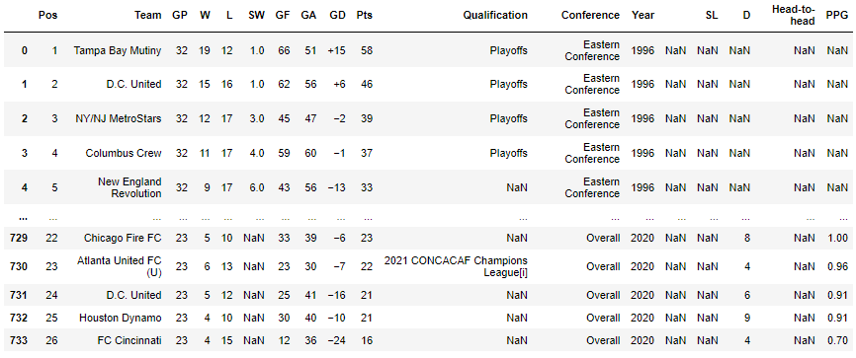
Process
Python Web Scrape

Slide 8
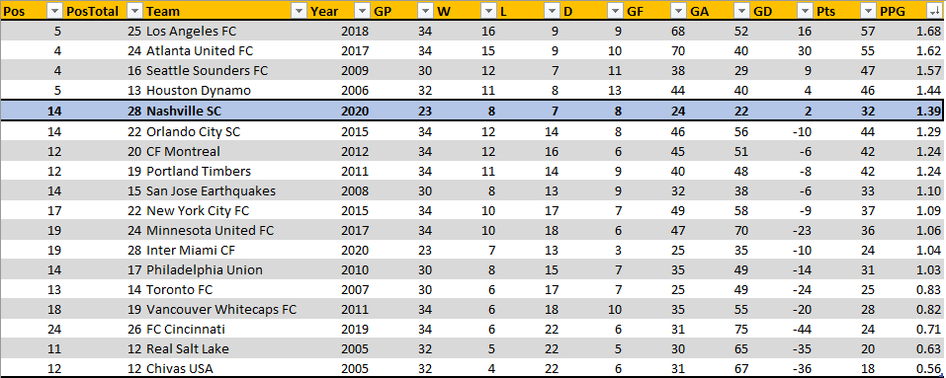
Process
Excel Clean Up
5th Highest PPG of Expansion Teams in 1st Season

Slide 9
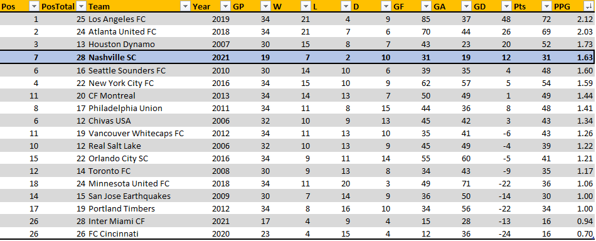
Process
Excel Clean Up
4th Highest PPG of Expansion Teams in 2nd Season

Slide 10
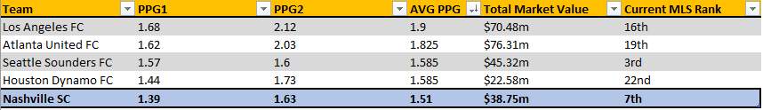
Findings: Data Question 1
Nashville SC has the 5th highest average points per game in the 1st and 2nd season of all expansion teams in MLS history
Of these best performing teams in their 1st and second seasons, we have the 2nd best rank in the league currently (2021)

Slide 11
Data Questions 2 & 3
How successful is Nashville SC as a club relative to other teams in the MLS currently?
How does being on Nashville SC affect a players transfer market value?
Dashboard

