Slide 1
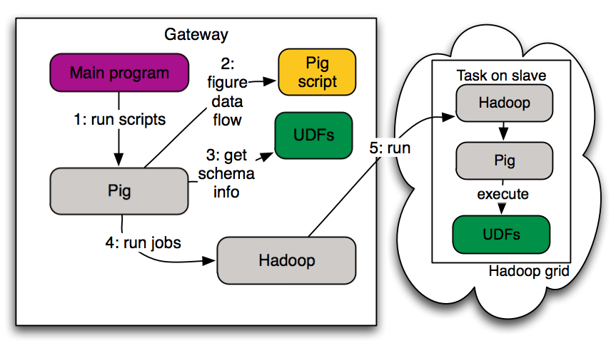
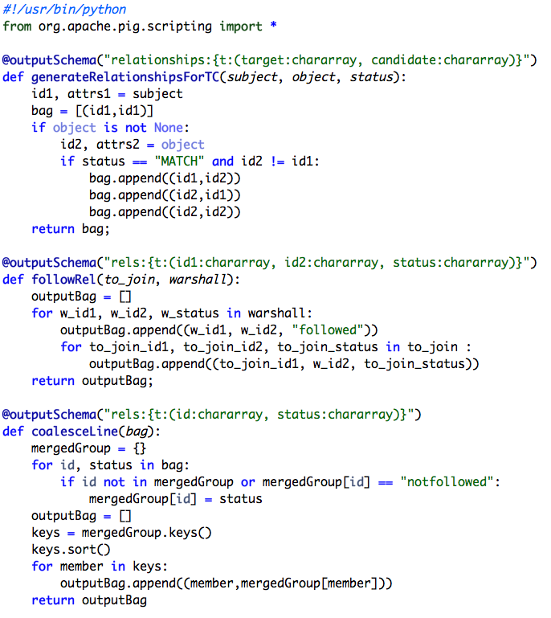
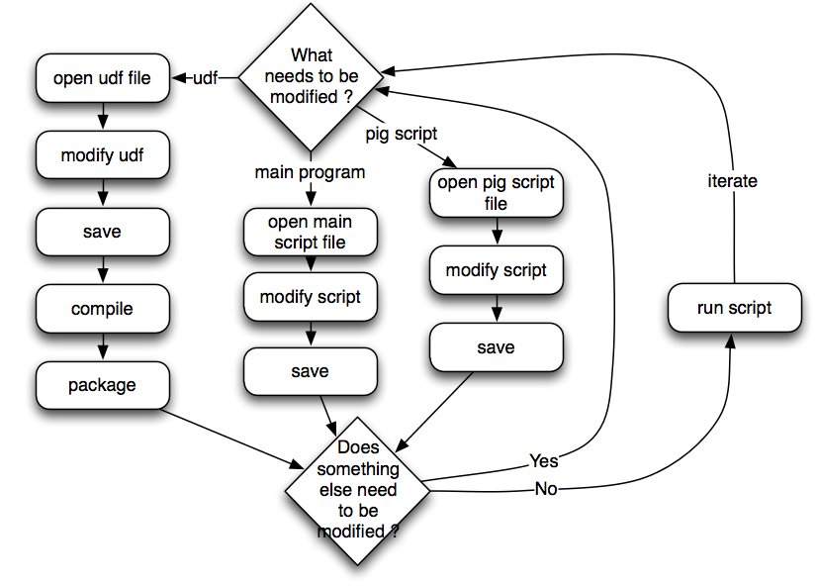
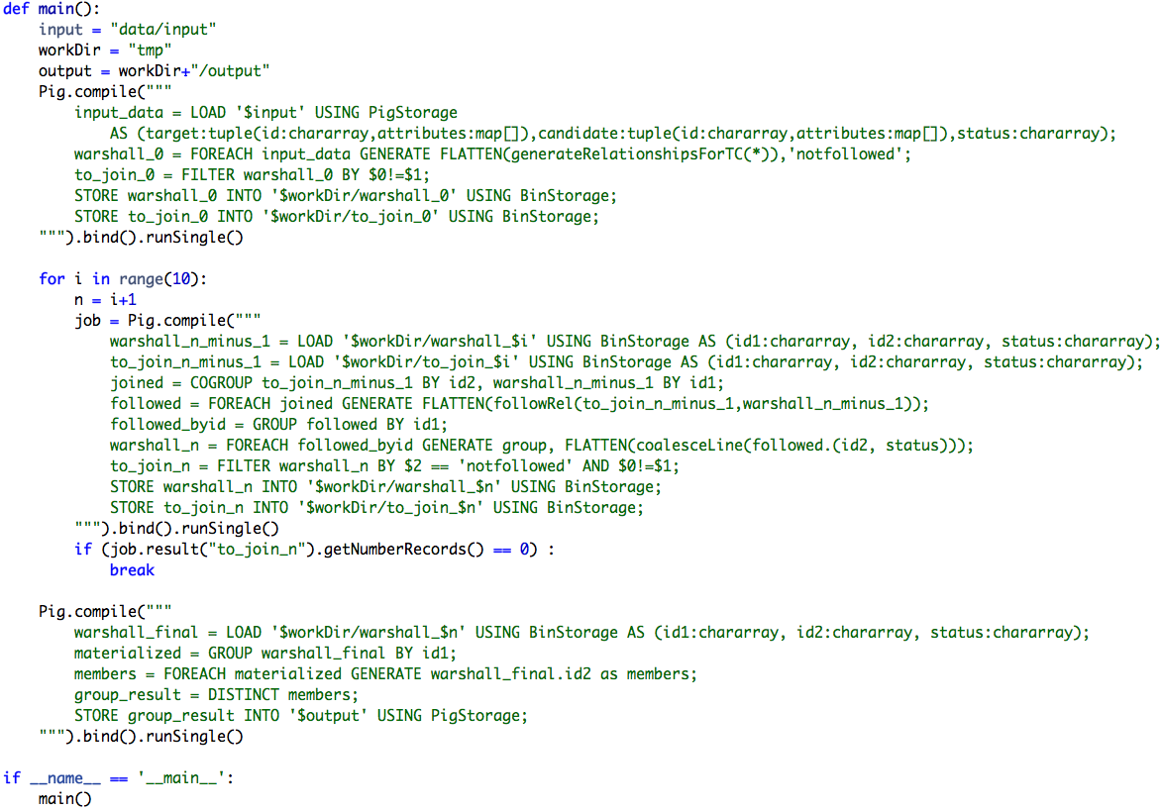
PIG Scripting
Making Pig Turing-complete through embedding in a scripting language
Julien Le Dem - Yahoo
Overview
Pig execution model
- Map/Reduce: a solution to process big data.
- Pig: makes it easier to manipulate data on the grid.
- Pig scripting: makes Pig easier with iterative algorithms and User Defined Functions.
Jiras: PIG-1479, PIG-1794 (in 0.9), PIG-928 (in 0.8)
Example: Transitive closure
- Iterative process: requires a loop and a termination condition
- Requires multiple join/group by: typical Pig usage
- Requires User Defined Functions
Solution 1: plain Pig
Solution 2: using Pig scripting
7 files required:
1 file required:
UDFs take the elements of the tuple as parameters, not a tuple.
Modification flow:
Modification flow:
The output schema is specified using a decorator (it can be a function if you need to manipulate the input schema)
UDFs use standard Python constructs (tuple/list/dictionary) automatically converted to Pig.
Python functions are automatically available as UDFs
Embedded Pig calls in Python
Python variables can be used in the pig scripts $n, $i, ...
Unfortunately this solution does not fit here.
It requires 7 artifacts:
3 Java UDFs: 3 classes must be compiled and packaged in a jar. The average UDF size is 50 to 100 lines of code.
3 Pig scripts in 3 separate files: init, main loop content, finalization. The average Pig script size is 5 to 10 lines.
Main program: executes and coordinates the Pig scripts. It contains about 50 lines of code.
This solution does fit on the poster.
It requires 1 artifact, containing:
3 UDFs provided as functions: The average UDF size is 8 to 12 lines of code.
3 Pig queries: init, main loop content, finalization. Each Pig query adds an average 5 to 10 lines.
Main function: executes and coordinates the Pig scripts. It adds about 10 lines to the script.
Access to the output of pig scripts

