Slide 1


Parquet
overview
Julien Le Dem
Twitter
http://parquet.github.com

Slide 2
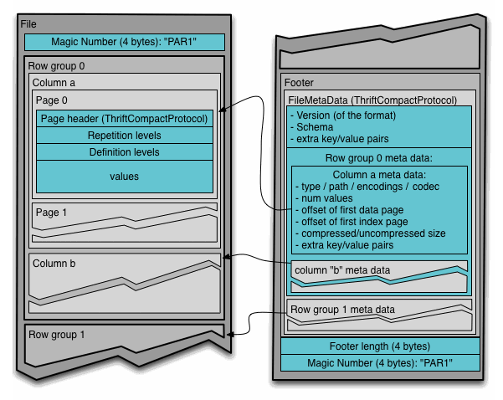
Format
Schema definition: for binary representation
Layout: currently PAX, supports one file per column when Hadoop allows block placement policy.
Not java centric: encodings, compression codecs, etc are ENUMs, not java class names. i.e.: formally defined. Impala reads Parquet files.
Footer: contains column chunks offsets

Slide 3
Format
Row group: A group of rows in columnar format.
  Max size buffered in memory while writing.
  One (or more) per split while reading.
  roughly: 10MB < row group < 1 GB
Column chunk: The data for one column in a row group.
  Column chunks can be read independently for efficient scans.
Page: Unit of compression in a column chunk
  Should be big enough for compression to be efficient.
  Minimum size to read to access a single record (when index pages are available).
  roughly: 8KB < page < 100KB

Slide 4
Dremel’s shredding/assembly
Schema:
message Document {
required int64 DocId;
optional group Links {
repeated int64 Backward;
repeated int64 Forward; }
repeated group Name {
repeated group Language {
required string Code;
optional string Country; }
optional string Url; }}
Columns:
DocId
Links.Backward
Links.Forward
Name.Language.Code
Name.Language.Country
Name.Url
Reference: http://research.google.com/pubs/pub36632.html
Each cell is encoded as a triplet: repetition level, definition level, value.
This allows reconstructing the nested records.
Level values are bound by the depth of the schema: They are stored in a compact form.
Example:
 | Max repetition level | Max definition level
DocId | 0 | 0
Links.Backward | 1 | 2
Links.Forward | 1 | 2
Name.Language.Code | 2 | 2
Name.Language.Country | 2 | 3
Name.Url | 1 | 2

Slide 5
Abstractions
Column layer:
  Iteration on triplets: repetition level, definition level, value.
  Repetition level = 0 indicates a new record.
  When dictionary encoding and other compact encodings are implemented, can iterate over encoded or un-encoded values.
Record layer:
  Iteration on fully assembled records.
  Provides assembled records for any subset of the columns, so that only columns actually accessed are loaded.

Slide 6
Extensibility
Schema conversion:
  Hadoop does not have a notion of schema.
  However Pig, Hive, Thrift, Avro, ProtoBufs, etc do.
Record materialization:
  Pluggable record materialization layer.
  No double conversion.
  Sax-style Event base API.
Encodings:
  Extensible encoding definitions.
  Planned: dictionary encoding, zigzag, rle, ...

