Slide 1
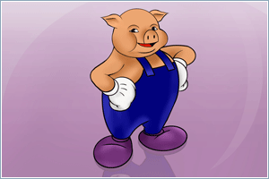
Embedding Pig in scripting languages
What happens when you feed a Pig to a Python?
Julien Le Dem – Principal Engineer - Content Platforms at Yahoo!
Pig committer
julien@ledem.net
@julienledem

Slide 2
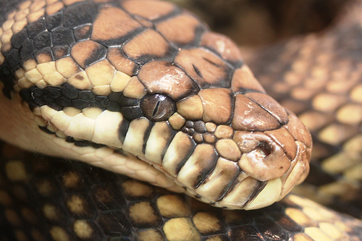
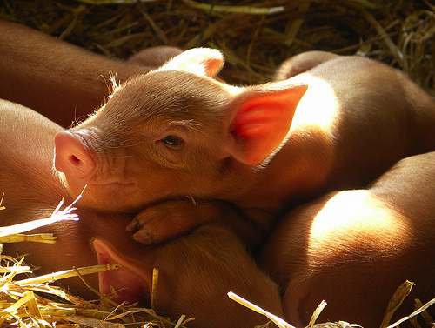
Disclaimer
No animals were hurt
in the making of this presentation
I’m cute
I’m hungry
Picture credits:
OZinOH: http://www.flickr.com/photos/75905404@N00/5421543577/
Stephen & Claire Farnsworth: http://www.flickr.com/photos/the_farnsworths/4720850597/

Slide 3
What for ?
Simplifying the implementation of
iterative algorithms:
Loop and exit criteria
Simpler User Defined Functions
Easier parameter passing

Slide 4
Before
The implementation
has the following
artifacts:

Slide 5
Pig Script(s)
warshall_n_minus_1 = LOAD '$workDir/warshall_0'
USING BinStorage AS (id1:chararray, id2:chararray, status:chararray);
to_join_n_minus_1 = LOAD '$workDir/to_join_0'
USING BinStorage AS (id1:chararray, id2:chararray, status:chararray);
joined = COGROUP to_join_n_minus_1 BY id2, warshall_n_minus_1 BY id1;
followed = FOREACH joined
GENERATE FLATTEN(followRel(to_join_n_minus_1,warshall_n_minus_1));
followed_byid = GROUP followed BY id1;
warshall_n = FOREACH followed_byid
GENERATE group, FLATTEN(coalesceLine(followed.(id2, status)));
to_join_n = FILTER warshall_n BY $2 == 'notfollowed' AND $0!=$1;
STORE warshall_n INTO '$workDir/warshall_1' USING BinStorage;
STORE to_join_n INTO '$workDir/to_join_1 USING BinStorage;

Slide 6
External loop
#!/usr/bin/python
import os
num_iter=int(10)
for i in range(num_iter):
os.system('java -jar ./lib/pig.jar -x local plsi_singleiteration.pig')
os.rename('output_results/p_z_u','output_results/p_z_u.'+str(i))
os.system('cp output_results/p_z_u.nxt output_results/p_z_u');
os.rename('output_results/p_z_u.nxt','output_results/p_z_u.'+str(i+1))
os.rename('output_results/p_s_z','output_results/p_s_z.'+str(i))
os.system('cp output_results/p_s_z.nxt output_results/p_s_z');
os.rename('output_results/p_s_z.nxt','output_results/p_s_z.'+str(i+1))

Slide 7
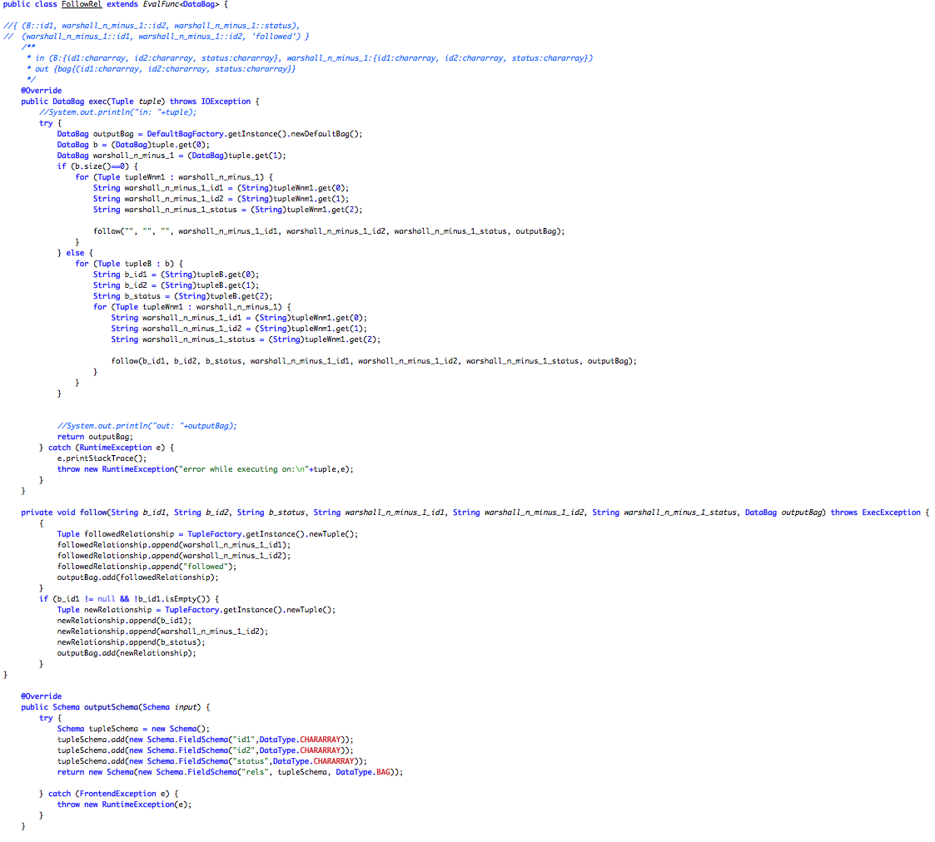
Java UDF(s)

Slide 8
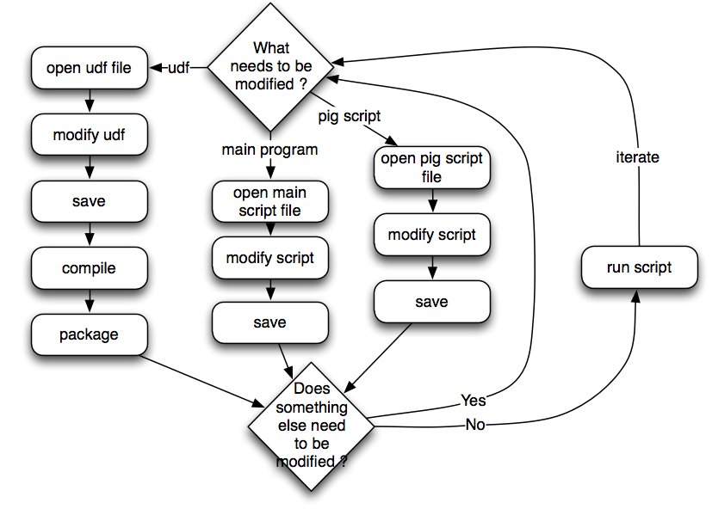
Development Iteration

Slide 9
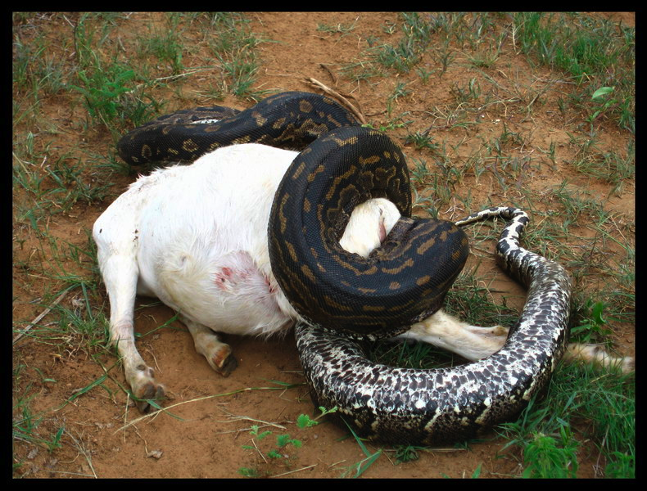
So… What happens?
Credits:
Mango Atchar: http://www.flickr.com/photos/mangoatchar/362439607/

Slide 10
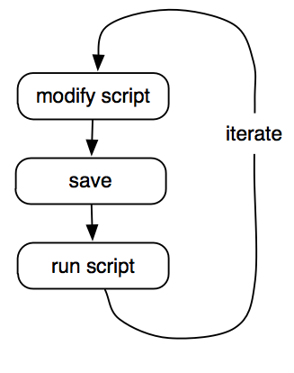
After
One script (to rule them all):
- main program
- UDFs as script functions - embedded Pig statements
All the algorithm in one place

Slide 11
References
It uses JVM implementations of scripting languages (Jython, Rhino).
This is a joint effort, see the following Jiras:
in Pig 0.8: PIG-928 Python UDFs
in Pig 0.9: PIG-1479 embedding, PIG-1794 JavaScript support
Doc: http://pig.apache.org/docs/

Slide 12
Examples
1) Simple example: fixed loop iteration
2) Adding convergence criteria and accessing intermediary output
3)More advanced example with UDFs

Slide 13

1) A Simple Example
PageRank:
A system of linear equations (as many as there are pages on the web, yeah, a lot):
It can be approximated iteratively: compute the new page rank based on the page ranks of the previous iteration. Start with some value.
Ref: http://en.wikipedia.org/wiki/PageRank

Slide 14
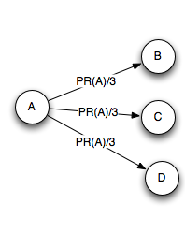
Or more visually
Each page sends a fraction of its PageRank to the pages linked to. Inversely proportional to the number of links.

Slide 15
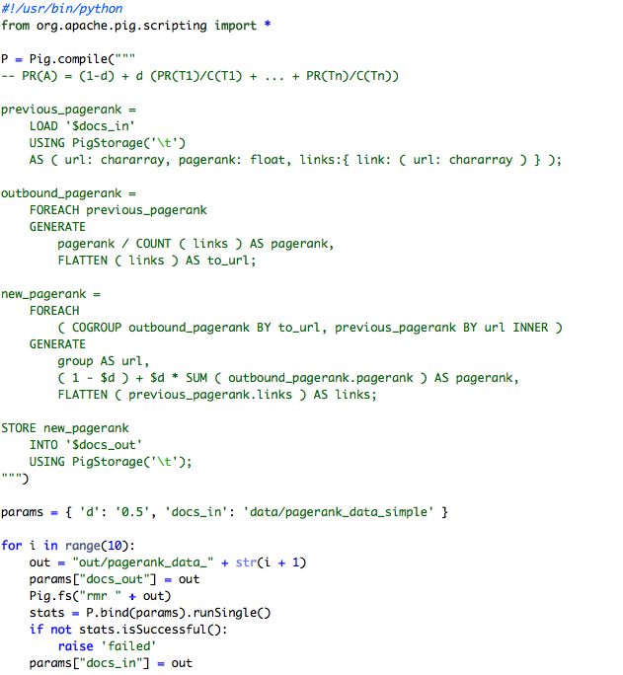

Slide 16
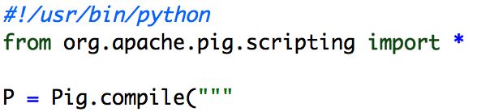
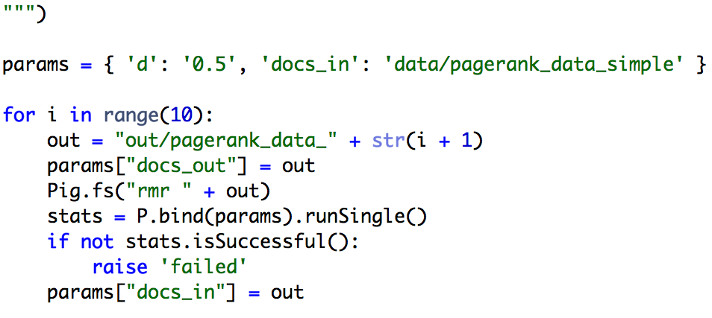
Let’s zoom in
pig script: PR(A) = (1-d) + d (PR(T1)/C(T1) + ... + PR(Tn)/C(Tn))
Iterate 10 times
Pass parameters as a dictionary
Pass parameters as a dictionary
Just run P, that was declared above
The output becomes the new input

Slide 17
Practical result
Applied to the English Wikipedia link graph:
http://wiki.dbpedia.org/Downloads36#owikipediapagelinks
It turns out that the max PageRank is awarded to:
http://en.wikipedia.org/wiki/United_States
Thanks @ogrisel for the suggestion

Slide 18
2) Same example, one step further
Now let’s say that we define a threshold as a convergence criteria instead of a fixed iteration count.

Slide 19
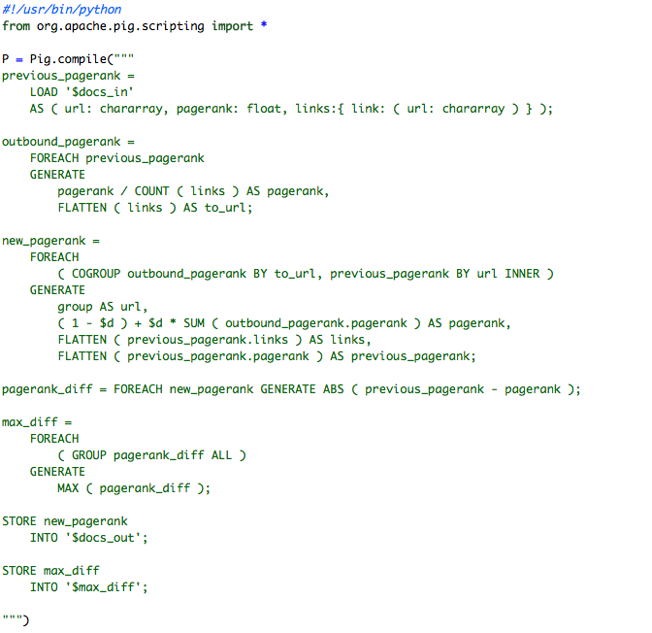
Same thing as previously
Computation of the maximum difference with the previous iteration
… continued next slide

Slide 20
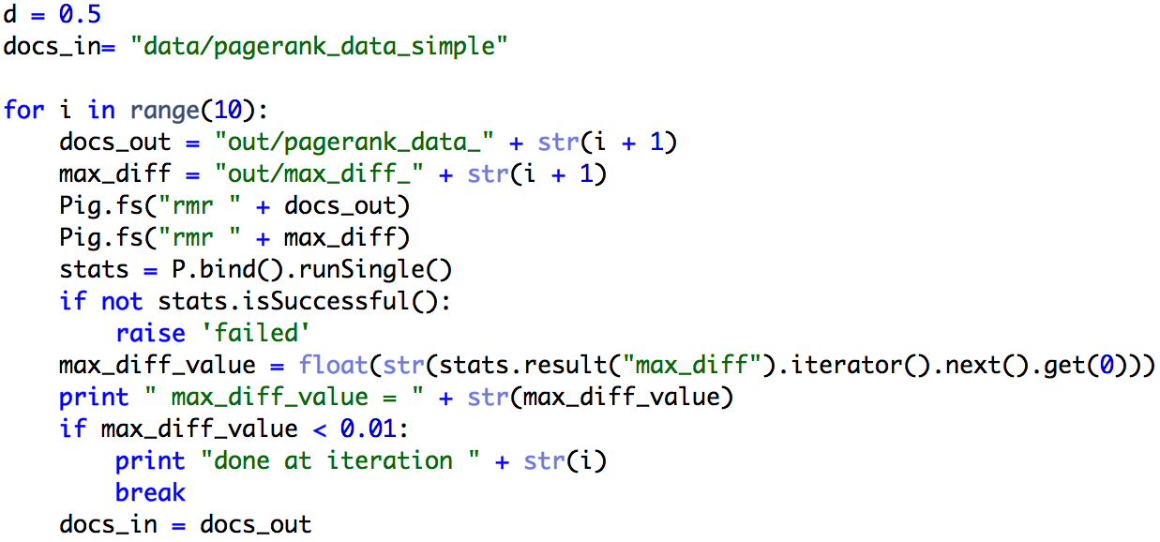
The main program
The parameter-less bind() uses the variables in the current scope
We can easily read the output of Pig from the grid
Stop if we reach a threshold

Slide 21
3) Now something more complex
Compute a transitive closure:
find the connected components of a graph.
- Useful if you’re doing de-duplication
- Requires iterations and UDFs

Slide 22
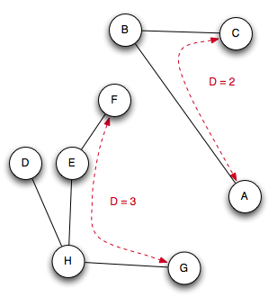
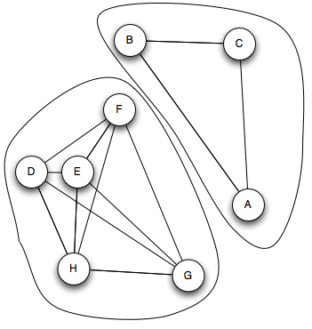
Or more visually
Turn this: Into this:

Slide 23
Convergence
Converges in :
log₂(max(Diameter of a component))
Diameter = “the longest shortest path”
Bottom line: the number of iterations will be reasonable.

Slide 24
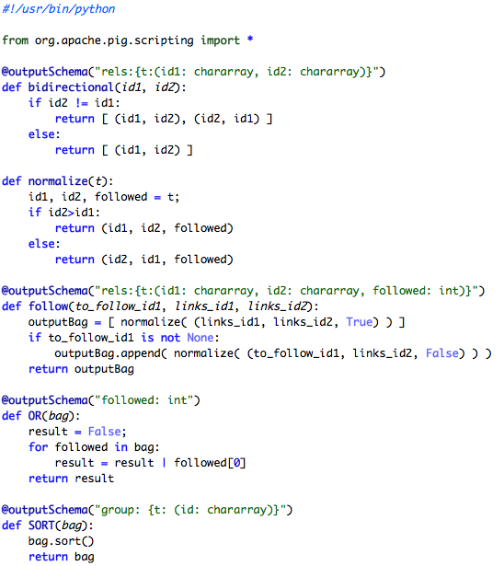
UDFs are in the same script as the main program
Zoom next slide
Page 1/3

Slide 25
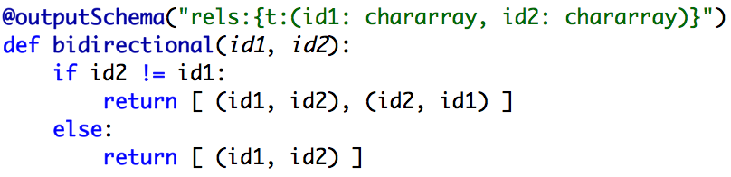
Zoom on UDFs
The output schema of the UDF is defined using a decorator
The native structures of the language can be used directly

Slide 26
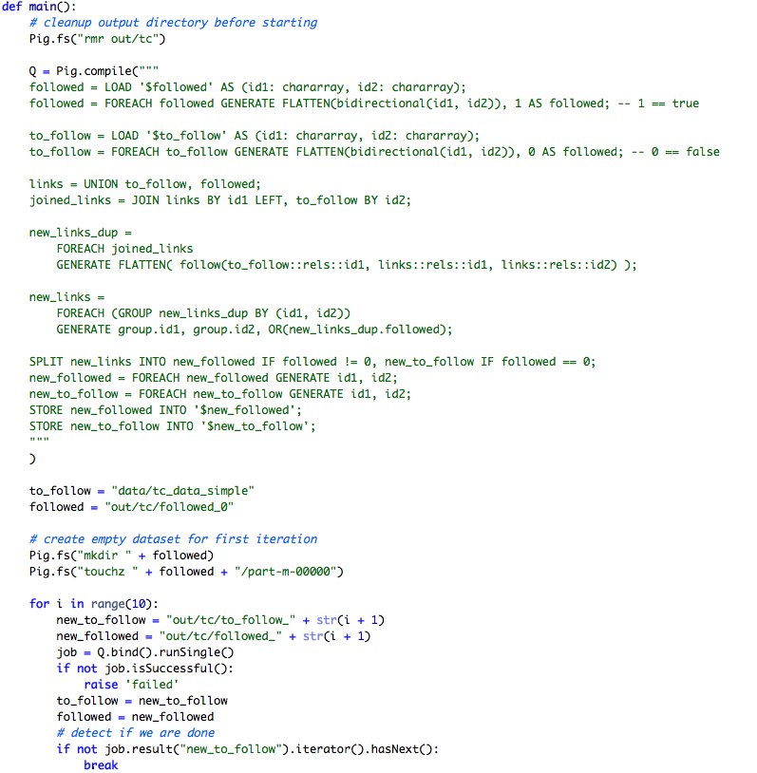
Zoom next slides
Zoom next slides
Page 2/3

Slide 27
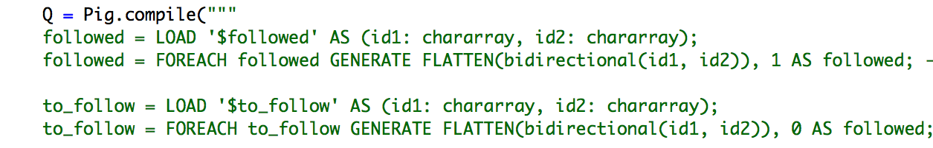
Zoom on the Pig script
…
UDFs are directly available, no extra declaration needed

Slide 28
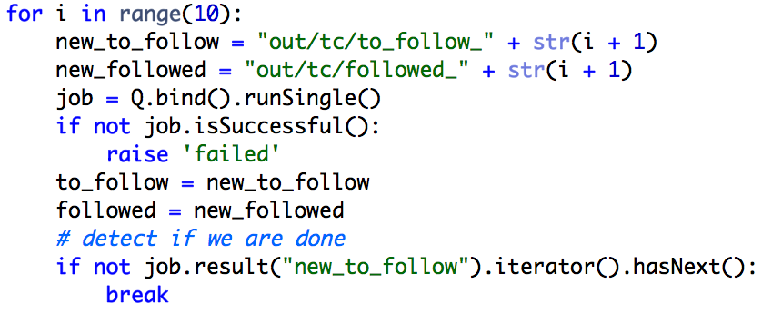
Zoom on the loop
Iterate a maximum of 10 times
(2^10 maximum diameter of a component)
Convergence criteria: all links have been followed

Slide 29
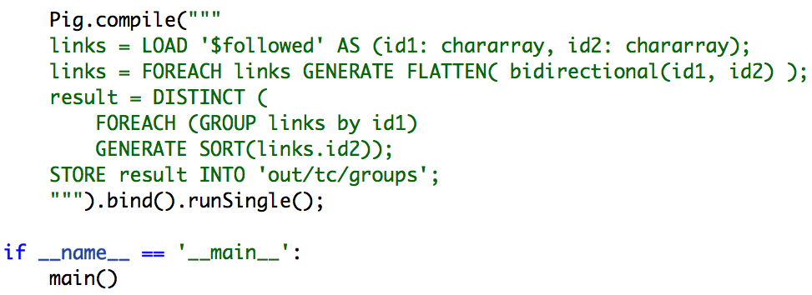
Final part: formatting
Turning the graph representation into a component list representation
This is necessary when we have UDFs, so that the script can be evaluated again on the slaves without running main()
Page 3/3

Slide 30
One more thing …
I presented Python but JavaScript is available as well (experimental).
The framework is extensible. Any JVM implementation of a language could be integrated (contribute!).
The examples can be found at:
https://github.com/julienledem/Pig-scripting-examples

Slide 31
Questions?
?
?

