Slide 1
Azure Cosmos DB
Technical Deep Dive
<Speaker>
<date>

Slide 2
System Topology (Behind The Scenes)
Planet Earth
Azure regions
Datacenters
Stamps
Fault domains
Container
Resource Manager
RSM
…
Resource Governor
Index Manager
Language Runtime(s) Hosts
…
Transport
Bw-tree++/ LLAMA++
Admission control
Log Manager
Query Processor
Various agents
Database engine
IO Manager
Cluster
Machine
Replica
Database engine
Notes:
The Cosmos DB service is deployed worldwide across all Azure regions including the sovereign and government clouds. We deploy and manage the Cosmos DB service on stamps of machines, each with dedicated local SSDs. The Cosmos DB service is layered on top of Azure Service Fabric, which is a foundational distributed systems infrastructure of Azure. Cosmos DB uses Service Fabric for naming, routing, cluster and container management, coordination of rolling upgrades, failure detection, leader election (within a resource partition) and load balancing capabilities. Cosmos DB is deployed across one or more Service Fabric clusters, each potentially running multiple generations of hardware and of varying number of machines (currently, between 60-800 machines).
Machines within a cluster typically are spread across 10-20 fault domains. The resource partitions is a logical concept. Physically, a resource partition is implemented in terms of a group of replicas, called replica-sets. Each machine hosts replicas corresponding to various resource partitions within a fixed set of processes. Replicas corresponding to the resource partitions are placed and load balanced across these machines. Each replica hosts an instance of Cosmos DB’s schema-agnostic database engine, which manages the resources as well as the associated indexes. The Cosmos DB database engine, in-turn, consists of components including implementation of several coordination primitives, the JavaScript language runtime, the query processor, the storage and indexing subsystems responsible for transactional storage and indexing of data, respectively. To provide durability and high availability, the database engine persists its index on SSDs and replicates it among the database engine instances within the replica-set(s) respectively. While the index is always persisted on local SSDs, the log is persisted either locally, on another machine within the cluster, or remotely across cluster or a datacenter within a region. The proximity of the index and log is configurable based on the price and latency SLA. The ability to dynamically configure the proximity between the database engine (compute) and log (storage) at the granularity of replicas of a resource partition is crucial for allowing tenants to dynamically select various service tiers.

Slide 3
Resource Hierarchy
CONTAINERS
  Logical resources “surfaced” to APIs as tables, collections or graphs, which are made up of one or more physical partitions or servers.
RESOURCE PARTITIONS
  Consistent, highly available, and resource-governed coordination primitives
  Consist of replica sets, with each replica hosting an instance of the database engine
Tenants
Follower
Tables
Collections
Graphs
Follower
Leader
Forwarder
To remote resource partition(s)
Containers
Replica Set
Resource Partitions

Slide 4
Partitioning
Leveraging Azure Cosmos DB to automatically scale your data across the globe
This module will reference partitioning in the context of all Azure Cosmos DB modules and APIs.

Slide 5
Partitions
Partition Key: User ID
Cosmos DB Container
(e.g. Collection)
Logical Partitioning Abstraction
Behind the Scenes:
Physical Partition Sets
hash(User ID)
Psuedo-random distribution of data over range of possible hashed values

Slide 6
Partitions
hash(User ID)
Pseudo-random distribution of data over range of possible hashed values
Andrew
Mike
…
Bob
Dharma
Shireesh
Karthik
Rimma
Alice
Carol
…
…
Partition 1
Partition 2
Partition n
Frugal # of Partitions based on actual storage and throughput needs
(yielding scalability with low total cost of ownership)

Slide 7
Partitions
hash(User ID)
Pseudo-random distribution of data over range of possible hashed values
Andrew
Mike
…
Bob
Dharma
Shireesh
Karthik
Rimma
Alice
Carol
…
…
Partition 1
Partition 2
Partition n
What happens when partitions need to grow?

Slide 8
Partitions
hash(User ID)
Pseudo-random distribution of data over range of possible hashed values
  Partition Ranges can be dynamically sub-divided to seamlessly grow database as the application grows while simultaneously maintaining high availability.
  Partition management is fully managed by Azure Cosmos DB, so you don't have to write code or manage your partitions.
Dharma
Shireesh
Karthik
Rimma
Alice
Carol
…
Dharma
Shireesh
…
Rimma
Karthik
…
+
Partition x
Partition x1
Partition x2

Slide 9
Creating Unlimited Containers

Slide 10
Partition Design
IMPORTANT TO SELECT THE “RIGHT” PARTITION KEY
  Partition keys acts as a means for efficiently routing queries and as a boundary for multi-record transactions.
KEY MOTIVATIONS
  Distribute Requests
  Distribute Storage
  Intelligently Route Queries for Efficiency

Slide 11

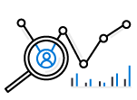



Partition Design
EXAMPLE SCENARIO
  Contoso Connected Car is a vehicle telematics company. They are planning to store vehicle telemetry data from millions of vehicles every second in Azure Cosmos DB to power predictive maintenance, fleet management, and driver risk analysis.
  The partition key we select will be the scope for multi-record transactions.
WHAT ARE A FEW POTENTIAL PARTITION KEY CHOICES?
  Vehicle Model
  Current Time
  Device Id
  Composite Key – Device ID + Current Time
Example – Contoso Connected Car
Notes:
Design Goals for Choosing a Good Partition Key
Distribute the overall request + storage volume
Avoid “hot” partition keys
Partition Key is scope for [efficient] queries and transactions
Queries can be intelligently routed via partition key
Omitting partition key on query requires fan-out
Steps for Success
Ballpark scale needs (size/throughput)
Understand the workload
# of reads/sec vs writes per sec
Use 80/20 rule to help optimize bulk of workload
For reads – understand top X queries (look for common filters)
For writes – understand transactional needs
understand ratio of inserts vs updates
General Tips
Don’t be afraid of having too many partition keys
Partitions keys are logical
More partition keys => more scalability

Slide 12
Partition Key Choices
VEHICLE MODEL (e.g. Model A)
Most auto manufactures only have a couple dozen models. This will create a fixed number of logical partition key values; and is potentially the least granular option.
Depending how uniform sales are across various models – this introduces possibilities for hot partition keys on both storage and throughput.
CURRENT MONTH (e.g. 2018-04)
Auto manufacturers have transactions occurring throughout the year. This will create a more balanced distribution of storage across partition key values.
However, most business transactions occur on recent data creating the possibility of a hot partition key for the current month on throughput.
Storage Distribution
Throughput Distribution
Storage Distribution
Throughput Distribution
Rodel
Rodel
2018-03
2018-03
Prisma
Prisma
2018-04
2018-04
Turlic
Turlic
2018-05
2018-05
Coash
Coash
2018-06
2018-06
Example – Contoso Connected Car
Notes:
Date of flight
Use the example of a user searching for a flight. The user typically enters a date and the search is focused on that specific date
Search requests will target a predictable partition
Searching for a different date requires a new query
Searching across multiple dates (functionality not available with every airline) will create cross-partition queries

Slide 13
Partition Key Choices
DEVICE ID (e.g. Device123)
Each car would have a unique device ID. This creates a large number of partition key values and would have a significant amount of granularity.
Depending on how many transactions occur per vehicle, it is possible to a specific partition key that reaches the storage limit per partition key
COMPOSITE KEY (Device ID + Time)
This composite option increases the granularity of partition key values by combining the current month and a device ID. Specific partition key values have less of a risk of hitting storage limitations as they only relate to a single month of data for a specific vehicle.
Throughput in this example would be distributed more to logical partition key values for the current month.
Storage Distribution
Throughput Distribution
Storage Distribution
Throughput Distribution
C49E27EB
C49E27EB
C49E27EB-2018-05
C49E27EB-2018-05
FE53547A
FE53547A
C49E27EB-2018-06
C49E27EB-2018-06
E84906BE
E84906BE
4376B4BC-2018-05
4376B4BC-2018-05
4376B4BC
4376B4BC
4376B4BC-2018-06
4376B4BC-2018-06
Example – Contoso Connected Car
Notes:
Aircraft Type
Imbalance of aircraft types when comparing smaller vs. bigger routes

Slide 14
Partition Granularity
SELECT THE “RIGHT” LEVEL OF GRANULARITY FOR YOUR PARTITIONS
Partitions should be based on your most often occurring query and transactional needs. The goal is to maximize granularity and minimize cross-partition requests.
RODEL
RODEL_2017
RODEL_2017_LX
RODEL_2017_EX
RODEL_2018
RODEL_2018_LX
Don’t be afraid to have more partitions! More partition keys = More scalability
Example – Contoso Connected Car

Slide 15
Partition Granularity
SELECT THE “RIGHT” LEVEL OF GRANULARITY FOR YOUR PARTITIONS
Consider storage & throughput thresholds
Consider cross-partition query likelihood
RODEL
RODEL_2017
RODEL_2017_LX
RODEL_2017_EX
RODEL_2018
RODEL_2018_LX
Don’t be afraid to have more partitions! More partition keys = More scalability
Example – Contoso Connected Car

Slide 16
Partition Granularity
A CROSS-PARTITION QUERY IS NOT ALWAYS A BLIND FAN OUT QUERY
SELECT * FROM C
RODEL
RODEL_2017
RODEL_2017_LX
RODEL_2017_EX
RODEL_2018
RODEL_2018_LX
SELECT * FROM C WHERE partitionKey IN (A, B, C)
Example – Contoso Connected Car
Notes:
Cross-Partition query != Blind Fan Out
A query that has SELECT * FROM c WHERE partitionKey IN (A, B, C) can be run across the minimum number of partitions; where as a query that omits the partition key must blindly fan out.
Cross-partition queries aren’t inherently a bad thing. The reason why you’ll want to minimize fan-out is we don’t want to add the wasted effort for checking partitions that don’t have any relevant data

Slide 17
PARTITION KEY SELECTION
Contoso Connected Car is collecting and storing vehicle telemetry data from millions of vehicles. The team has decided to partition based on a composite key consisting of device id + current time when the interaction occurred.
Airport
Airport
Airport
Airport
Airport
Airport
Example – Contoso Connected Car
Notes:
The interaction data will likely be used to make future business decisions
Which features should we add?
Who’s content should we include?
Are there any widespread issues or bugs?

Slide 18
Partition Key Scenario
Interaction that occurred on: September 25, 2016 at 4:15 AM UTC
C49E27EB-2016
C49E27EB-2016-09
C49E27EB-2016-09-25
C49E27EB-2016-09-25-04
C49E27EB-2016-09-25-04-15
Example – Contoso Connected Car
Notes:
Example of partition key scenario

Slide 19
Partition Key Scenario
Interaction that occurred on: September 25, 2016 at 4:15 AM UTC
Will this partition be larger than the current max storage for a single partition key?
C49E27EB-2016
C49E27EB-2016-09
A higher cardinality key allows Azure Cosmos DB to grow and evenly distribute your data; but may also impact ease of querying
C49E27EB-2016-09-25
C49E27EB-2016-09-25-04
C49E27EB-2016-09-25-04-15
Example – Contoso Connected Car
Notes:
Example of partition key scenario
Max Storage for a Single Partition Key
10 GB, 10,000 RU/s
If you have a single-partition container, your container’s max size is 10 GB
A higher cardinality of partition key allows the system to grow and evenly distribute volume
There is zero value in artificially limiting the number of partition keys. Partition key values are already logical partitions that get co-located on a smaller number of physical partitions. There is no good reason to artificially limit the cardinality of the number of logical partition keys

Slide 20
Partitions
Best Practices: Design Goals for Choosing a Good Partition Key
  Distribute the overall request + storage volume
    Avoid “hot” partition keys
  Partition Key is scope for multi-record transactions and routing queries
    Queries can be intelligently routed via partition key
    Omitting partition key on query requires fan-out
Steps for Success
  Ballpark scale needs (size/throughput)
  Understand the workload
  # of reads/sec vs writes per sec
    Use pareto principal (80/20 rule) to help optimize bulk of workload
    For reads – understand top 3-5 queries (look for common filters)
    For writes – understand transactional needs
General Tips
  Build a POC to strengthen your understanding of the workload and iterate (avoid analyses paralysis)
  Don’t be afraid of having too many partition keys
    Partitions keys are logical
    More partition keys  more scalability

Slide 21
Partition Key storage limits
HTTP 403
Containers support unlimited storage by dynamically allocating additional physical partitions
Storage for single partition key value (logical partition) is quota'ed to 10GB.
When a partition key reaches its provisioned storage limit, requests to create new resources will return a HTTP Status Code of 403 (Forbidden).
  Azure Cosmos DB will automatically add partitions, and may also return a 403 if:
  An authorization token has expired
  A programmatic element (UDF, Stored Procedure, Trigger) has been flagged for repeated violations
Notes:
The next could of slides have example strategies that take advantage of the 403 status code

Slide 22
Design patternS for Large partition keYs
"LINKED LIST APPROACH" BY SREADING DATA ACROSS INCREMENTAL PARTITION KEY VALUES
  For workloads that exceed quotas for a single partition key value, you can logically spread items across multiple partition keys within a container by using a suffix on the partition key value.
  As a partition fills up, you can determine when to increment the partition key value by looking for the 403 status code in your application’s logic.
HTTP 403
HTTP 403
Notes:
You can endlessly increment partition key suffixes to work around any technical limitations for a specific partition (throughput and storage)

Slide 23
DESIGN PATTERNS FOR LARGE PARTITION KEYS
"CIRCULAR BUFFER" APPROACH BY REUSING UNIQUE IDS
  As you insert new items into a container’s partition, you can increment the unique id for each item in the partition.
  When you get a 403 status code, indicating the partition is full, you can restart your unique id and upsert the items to replace older documents.
15
HTTP 403
ARD
15
2
3
4
5
6
7
8
9
10
11
12
13
14
Notes:
Using this example, you have effectively created a fixed-size collection of items that replaces the oldest items (determined by sorted unique key).

Slide 24
HOT/COLD Partitions
PARTITION USAGE CAN VARY OVER TIME
Partitions that are approaching thresholds are referred to as hot. Partitions that are underutilized are referred to as cold.
Abstract Storage or Throughput Threshold
Hot Partition
Partition
Partition
Cold Partition
Cold Partition

Slide 25
Query FAN-OUT
CROSS-PARTITION QUERIES CAN BE PERFORMED SERVER-SIDE OR CLIENT-SIDE
  Cross-partition queries are opt-in
  Cross-partition queries can be tuned and parallelized
  Creates a bottleneck
  Must wait for all partitions to return before the query is “done”

Slide 26
CROSS-PARTITION SDK EXAMPLE
IQueryable<DeviceReading> crossPartitionQuery = client.CreateDocumentQuery<DeviceReading>(
  UriFactory.CreateDocumentCollectionUri("db", "coll"),
  new FeedOptions {
  EnableCrossPartitionQuery = true,
  MaxDegreeOfParallelism = 10,
  MaxBufferedItemCount = 100
  })
  .Where(m => m.MetricType == "Temperature" && m.MetricValue > 100)
  .OrderBy(m => m.MetricValue);

Slide 27

CROSS-PARTITION SDK EXAMPLE
var querySpec = {
query: 'SELECT * FROM container c’
};
var feedOptions = {
enableCrossPartitionQuery = true
maxDegreeOfParallelism = 10
};
client.queryDocuments(collectionLink, querySpec, feedOptions)
.toArray(function (err, results) {
}

Slide 28

CROSS-PARTITION SDK EXAMPLE
FeedOptions options = new FeedOptions();
options.setEnableCrossPartitionQuery(true);
Iterator<Document> it = client.queryDocuments(
collectionLink,
"SELECT * from r",
options
).getQueryIterator();

Slide 29
Cross-Partition Query

Slide 30
Query FAN OUT
QUERYING ACROSS PARTITIONS IS NOT ALWAYS A BAD THING
If you have relevant data to return, creating a cross-partition query is a perfectly acceptable workload with a predictable throughput.
In an ideal situation, queries are filtered to only include relevant partitions.
BLIND QUERY FAN-OUTS CAN ADD UP
You are charged ~1 RU for each partition that doesn’t have any relevant data.
Multiple fan-out queries can quickly max out RU/s for each partition

Slide 31
Query FAN OUT
CONCURRENCY AND FAN-OUT QUERIES
>10,000 fan-out queries in a second can leave all partitions hot
Example: Query on a vehicle database, partitioned by model name, where the query is filtering by year without filtering to only include relevant partitions.
All partitions are likely hot
10,000 queries per second checking this partition
10,000 queries per second checking this partition
SELECT * FROM car a WHERE a.year = “2015”
>10,000 more queries
per second
10,000 queries per second checking this partition
PK = origin
SELECT * FROM car a WHERE a.year = “2016”
Example – Contoso Connected Car

Slide 32
Query FAN OUT
CONCURRENCY AND FAN-OUT QUERIES
Filtering queries to only include relevant partition key values reduces the amount of wasted effort and focuses queries on those relevant partitions.
Only relevant queries checking this partition
Only relevant queries checking this partition
SELECT * FROM car a
WHERE a.model = “TURLIC” AND a.year = “2015”
>10,000 more queries
per second
Only relevant queries checking this partition
PK = origin
SELECT * FROM car a
WHERE a.model = “COASH” AND a.year = “2016”
Example – Contoso Connected Car

Slide 33
Client-Side Query FAN-OUT
USING CLIENT-SIDE THREADS AND PARRALELISM TO FAN-OUT QUERIES ACROSS PARTITIONS
  Leverage existing client device power
  Perform queries in parallel across units
  Potentially process early-finish results before parallel requests are complete

Slide 34
Hands-On Exercise
Creating a
Multi-Partition Solution
Tasks:
Create Unlimited Container
Execute Cross-Partition Queries

Slide 35
Modeling & Planning
Modeling data & configuring containers to take advantage of Azure Cosmos DB strengths.
This module will reference modeling in the context of all Azure Cosmos DB modules and APIs.

Slide 36
Containers
CONTAINERS
Containers do NOT enforce schema
There are benefits to co-locate multiple types in a container
Annotate records with a "type" property
CO-LOCATING TYPES IN THE SAME CONTAINER
Ability to query across multiple entity types with a single network request.
Ability to perform transactions across multiple types
Cost: reduce physical partition footprint

Slide 37
Co-Locating Types
Ability to query across multiple entity types with a single network request.
For example, we have two types of documents: cat and person.
{
"id": "Andrew",
"type": "Person",
"familyId": "Liu",
"worksOn": "Azure Cosmos DB"
}
{
"id": "Ralph",
"type": "Cat",
"familyId": "Liu",
"fur": {
"length": "short",
"color": "brown"
}
}
We can query both types of documents without needing a JOIN simply by running a query without a filter on type:
SELECT * FROM c WHERE c.familyId = "Liu"
If we wanted to filter on type = “Person”, we can simply add a filter on type to our query:
SELECT * FROM c WHERE c.familyId = "Liu" AND c.type = "Person"

Slide 38
Updating Normalized Data
{
"id": "08259",
"ticketPrice": 255.00,
"flightCode": "3754",
"origin": {
"airport": "SEA",
"gate": "A13",
"departure": "2014-09-15T23:14:25.7251173Z"
},
"destination": {
"airport": "JFK",
"gate": "D4",
"arrival": "2014-09-16T02:10:10.2379581Z"
},
"pilot": [{
"id": "EBAMAO",
“name": "Hailey Nelson"
}]
}
UPDATES ARE ATOMIC
Update operations update the entire document, not specific fields or “parts” of the document.
DE-NORMALIZED DOCUMENTS CAN BE EXPENSIVE TO UPDATE
De-normalization has benefits for read operations, but you must weigh this against the costs in write operations.
De-normalization may require fanning out update operations.
Normalization may require chaining a series of requests to resolve relationships.

Slide 39
Updating Normalized Data
Normalized: Optimized for writes over reads
De-normalized: Optimized for reads over writes
{
"id": "08259",
"pilot": [{ "id": "EBAMAO", “name": "Hailey Nelson“ }]
},
{
"id": "08259",
"ticketPrice": 255.00,
"flightCode": "3754"
},
{
"id": "08259",
"origin": {
"airport": "SEA", "gate": "A13",
"departure": "2014-09-15T23:14:25.7251173Z"
},
"destination": {
"airport": "JFK", "gate": "D4",
"arrival": "2014-09-16T02:10:10.2379581Z"
}
}
{
"id": "08259",
"ticketPrice": 255.00,
"flightCode": "3754",
"origin": {
"airport": "SEA",
"gate": "A13",
"departure": "2014-09-15T23:14:25.7251173Z"
},
"destination": {
"airport": "JFK",
"gate": "D4",
"arrival": "2014-09-16T02:10:10.2379581Z"
},
"pilot": [{
"id": "EBAMAO",
“name": "Hailey Nelson"
}]
}

Slide 40
Updating Normalized Data
{
"id": "08259",
"flightCode": "3754",
"pilot": [{ "id": "EBAMAO", “name": "Hailey Nelson“ }]
},
{
"id": "08259",
"flightCode": "3754",
"ticketPrice": 255.00,
"origin": {
"airport": "SEA", "gate": "A13",
"departure": "2014-09-15T23:14:25.7251173Z"
},
"destination": {
"airport": "JFK", "gate": "D4",
"arrival": "2014-09-16T02:10:10.2379581Z"
}
}
THE SOLUTION IS TYPICALLY A COMPROMISE BASED ON YOUR WORKLOAD
Examine your workload. Answer the following questions:
Which fields are commonly updated together?
What are the most common fields included in all queries?
Example: The ticketPrice, origin and destination fields are often updated together. The pilot field is only rarely updated. The flightCode field is included in almost all queries across the board.

Slide 41
Short-Lifetime Data
Some data produced by applications are only useful for a finite period of time:
  Machine-generated event data
  Application log data
  User session information
  It is important that the database system systematically purges this data at pre-configured intervals.

Slide 42
Time-to-Live (TTL)
AUTOMATICALLY PURGE DATA
  Azure Cosmos DB allows you to set the length of time in which documents live in the database before being automatically purged. A document's "time-to-live" (TTL) is measured in seconds from the last modification and can be set at the collection level with override on a per-document basis.
  The TTL value is specified in the _ts field which exists on every document.
  The _ts field is a unix-style epoch timestamp representing the date and time. The _ts field is updated every time a document is modified.
  Once TTL is set, Azure Cosmos DB will automatically remove documents that exist after that period of time.

Slide 43
Expiring Records Using Time-to-Live
TTL BEHAVIOR
  The TTL feature is controlled by TTL properties at two levels - the collection level and the document level.
  DefaultTTL for the collection
    If missing (or set to null), documents are not deleted automatically.
    If present and the value is "-1" = infinite – documents don’t expire by default
    If present and the value is some number ("n") – documents expire "n” seconds after last modification
  TTL for the documents:
    Property is applicable only if DefaultTTL is present for the parent collection.
    Overrides the DefaultTTL value for the parent collection.
  The values are set in seconds and are treated as a delta from the _ts that the document was last modified at.
Document
Document
TTL
Default TTL
Collection
Notes:
As soon as the document has expired (ttl + _ts <= current server time), the document is marked as "expired”. No operation will be allowed on these documents after this time and they will be excluded from the results of any queries performed.
The documents are physically deleted in the system, and are deleted in the background opportunistically at a later time.
This does not consume any Request Units (RUs) from the collection budget.

Slide 44
Pruning old records using TTL Values

Slide 45
Turnkey Global Distribution
High Availability
  Automatic and Manual Failover
  Multi-homing API removes need for app redeployment
Low Latency (anywhere in the world)
  Packets cannot move fast than the speed of light
  Sending a packet across the world under ideal network conditions takes 100’s of milliseconds
  You can cheat the speed of light – using data locality
    CDN’s solved this for static content
    Azure Cosmos DB solves this for dynamic content

Slide 46
Turnkey Global Distribution
Automatic and transparent replication worldwide
Each partition hosts a replica set per region
Customers can test end to end application availability by programmatically simulating failovers
All regions are hidden behind a single global URI with multi-homing capabilities
Customers can dynamically add / remove additional regions at any time
Container
Partition-key = "airport"
"airport" : "LAX"
"airport" : “AMS"
"airport" : “MEL"
Writes/
Reads
Reads
Reads
West US
Writes/
Reads
30K transactions/sec
Reads
Reads
Global Distribution (of resource partitions)
West Europe
30K transactions/sec
Local Distribution (via horizontal partitioning)

Slide 47
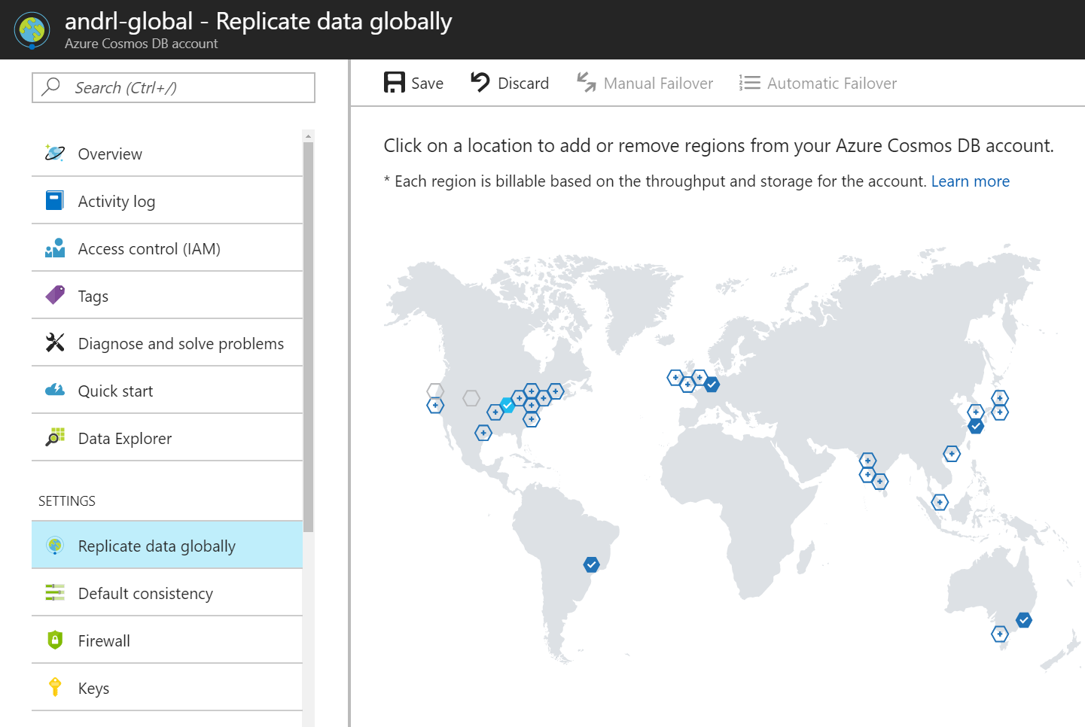
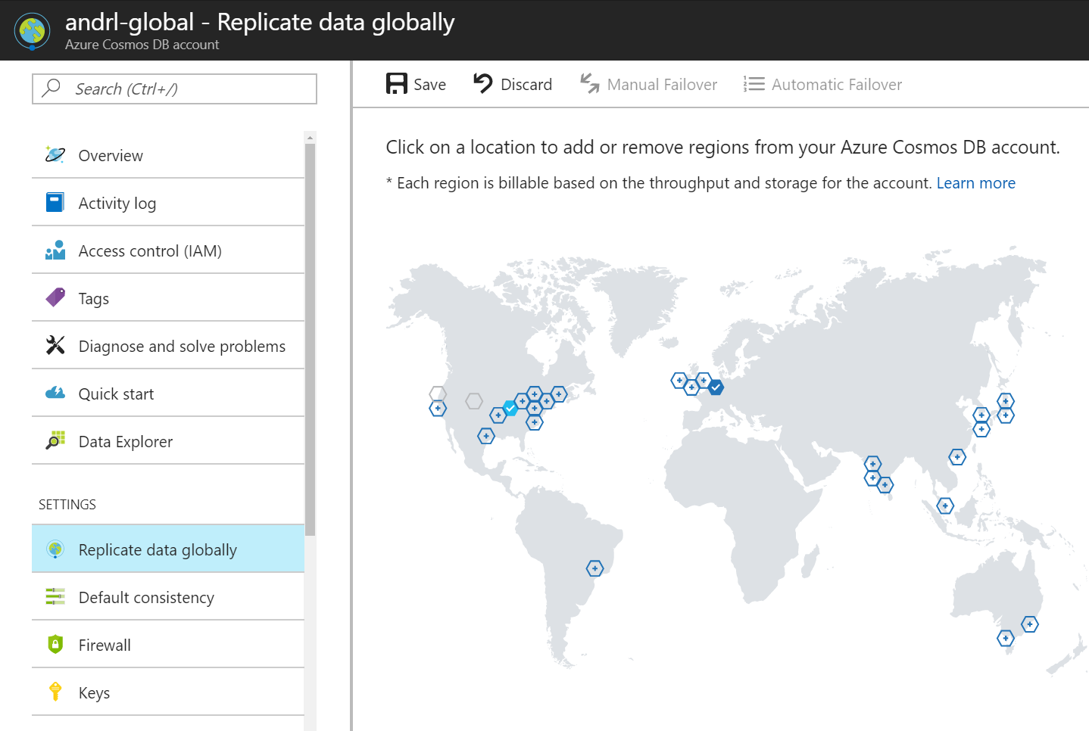

Replicating Data Globally

Slide 48
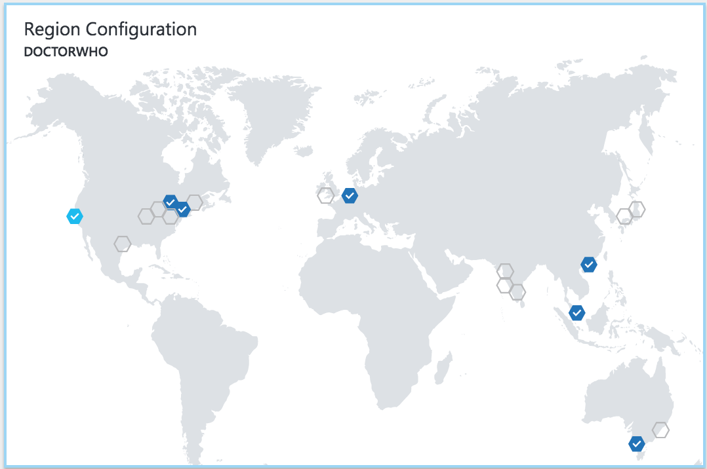
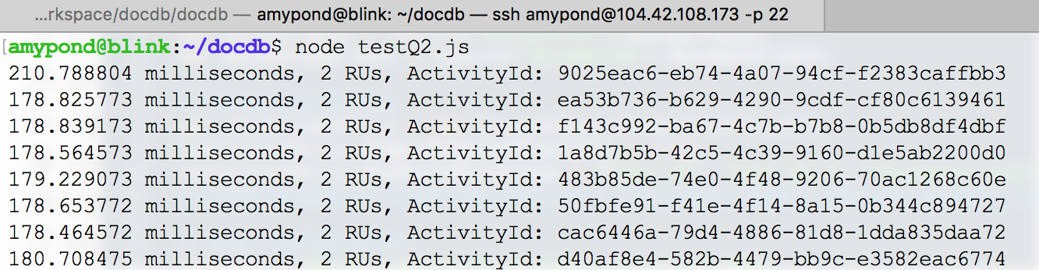
Replicating Data Globally

Slide 49
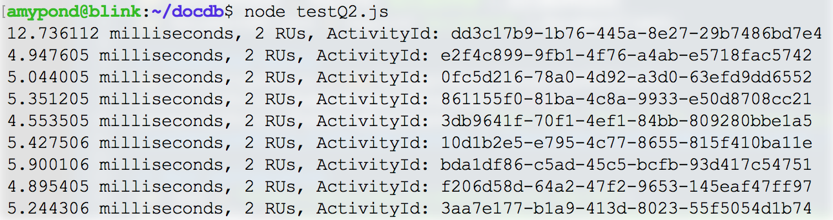
Replicating Data Globally

Slide 50
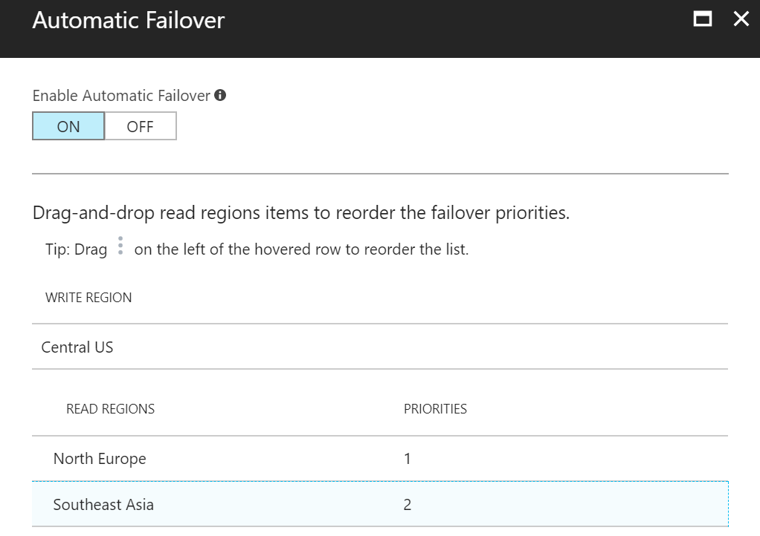
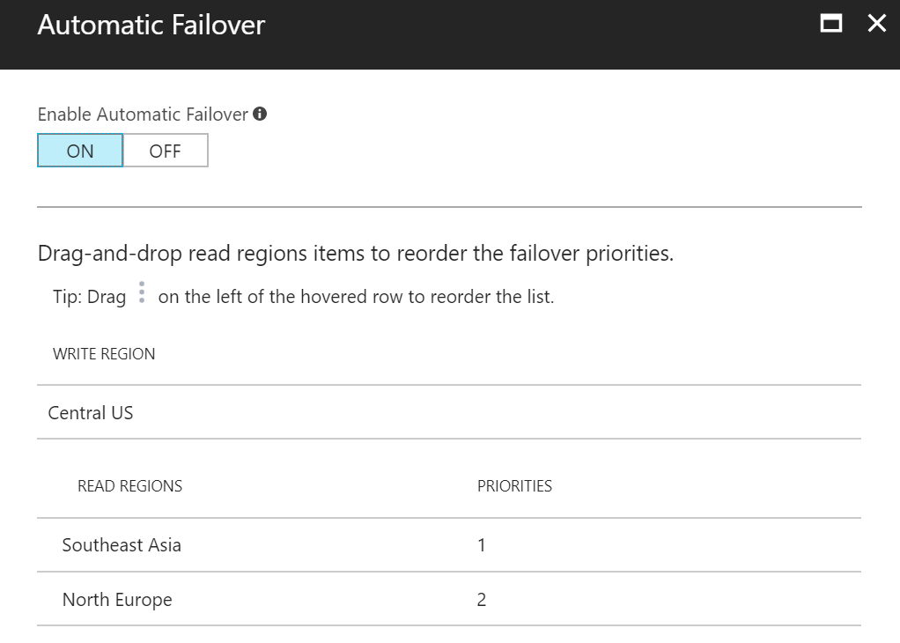
Automatic Failover

Slide 51
Automatic Failover
DocumentClient client;
ConnectionPolicy policy = new ConnectionPolicy()
{
ConnectionMode = ConnectionMode.Direct,
ConnectionProtocol = Protocol.Tcp
};
policy.PreferredLocations.Add(LocationNames.CentralUS); //first preference
policy.PreferredLocations.Add(LocationNames.SoutheastAsia); //second preference
policy.PreferredLocations.Add(LocationNames.NorthEurope); //third preference
client = new DocumentClient(new Uri(endpointUri), PrimaryKey, connectionPolicy: policy);

Slide 52
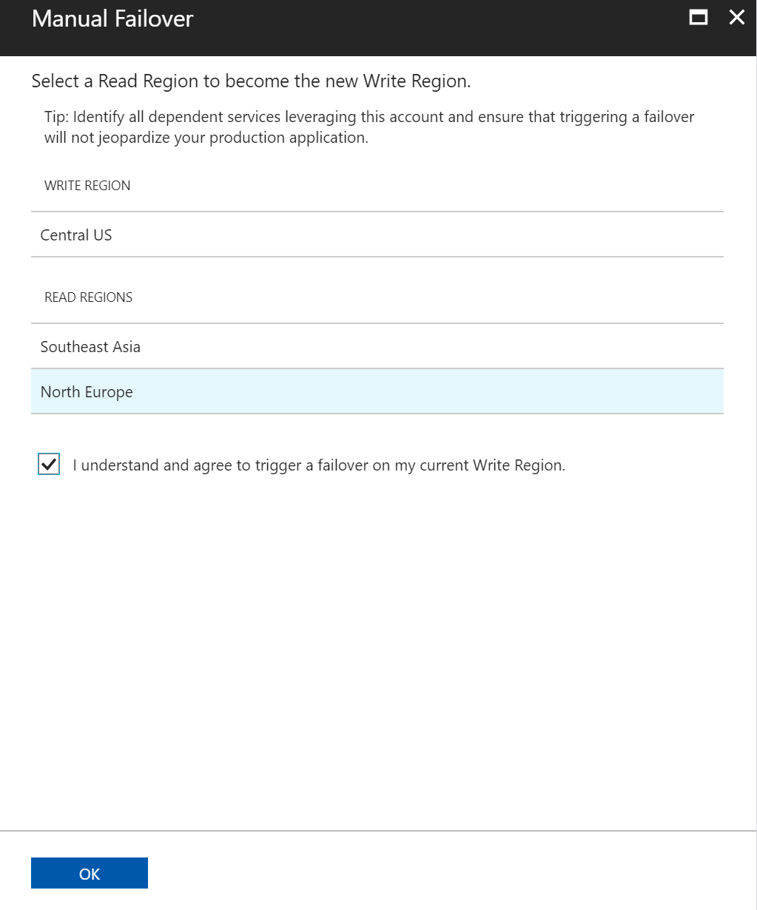
Manual Failover

