Slide 1
Azure Cosmos DB Technical Deep Dive
<Speaker>
<date>

Slide 2
Modern apps face new challenges
Managing and syncing data distributed around the globe
Delivering highly-responsive, real-time personalization
Processing and analyzing large, complex data
Scaling both throughput and storage based on global demand
Offering low-latency to global users
Modernizing existing apps and data

Slide 3




Azure Cosmos DB
Core (SQL) API
Table API
MongoDB
Column-family
Document
Key-value
Graph
Guaranteed low latency at the 99th percentile
Elastic scale out
of storage & throughput
Five well-defined consistency models
Turnkey global distribution
Comprehensive SLAs

Slide 4
Azure Cosmos DB
A FULLY-MANAGED GLOBALLY DISTRIBUTED DATABASE SERVICE BUILT TO GUARANTEE
EXTREMELY LOW LATENCY AND MASSIVE SCALE FOR MODERN APPS

Slide 5
Turnkey global distribution
PUT YOUR DATA WHERE YOUR USERS ARE IN MINUTES
Automatically replicate all your data around the world, and across more regions than AWS and Google Cloud Platform combined.
Available in all Azure regions
Manual and automatic failover
Automatic & synchronous multi-region replication

Slide 6
ELASTIC SCALE OUT OF STORAGE AND THROUGHPUT
SCALES AS YOUR APPS’ NEEDS CHANGE
Independently and elastically scale storage and throughput across regions – even during unpredictable traffic bursts – with a database that adapts to your app’s needs.
Elastically scale throughput from 10 to 100s of millions of requests/sec across multiple regions
Support for requests/sec for different workloads
Pay only for the throughput and storage you need

Slide 7
GUARANTEED LOW LATENCY
PROVIDE USERS AROUND THE WORLD WITH FAST ACCESS TO DATA
Serve <10 millisecond read and write requests at the 99th percentile from the region nearest to users, while delivering data globally.

Slide 8
FIVE WELL-DEFINED CONSISTENCY MODELS
CHOOSE THE BEST CONSISTENCY MODEL FOR YOUR APP
Offers five consistency models
Provides control over performance-consistency tradeoffs, backed by comprehensive SLAs.
An intuitive programming model offering low latency and high availability for your planet-scale app.
Strong
Bounded-stateless
Session
Consistent prefix
Eventual

Slide 9

Multiple data models and apis
USE THE MODEL THAT FITS YOUR REQUIREMENTS, AND THE APIS, TOOLS, AND FRAMEWORKS YOU PREFER
Choose from multiple APIs to access and query data, including SQL, MongoDB, Cassandra, Gremlin, Table, etcd, and Spark.
Use key-value, tabular, graph, and document data
Data is automatically indexed, with no schema or secondary indexes required.
Core (SQL) API
Table API
MongoDB
Column-family
Document
Key-value
Graph

Slide 10
COMPREHENSIVE SLAs
RUN YOUR APP ON WORLD-CLASS INFRASTRUCTURE
Azure Cosmos DB is the only service with financially-backed SLAs for single-digit millisecond read and write latency at the 99th percentile, 99.999% high availability and guaranteed throughput and consistency
Latency
High Availability
Throughput
Consistency
<10 ms
99.999%
Guaranteed
Guaranteed
99th percentile
Notes:
HA 99.999% for multi-region read; 99.99% for single region deployments

Slide 11
Handle any data with no schema or indexing required
Azure Cosmos DB’s schema-less service automatically indexes all your data, regardless of the data model, to delivery blazing fast queries.
Automatic index management
Synchronous auto-indexing
No schemas or secondary indices needed
Works across every data model
GEEK
Item | Color | Microwave safe | Liquid capacity | CPU | Memory | Storage
Geek mug | Graphite | Yes | 16ox | ??? | ??? | ???
Coffee Bean mug | Tan | No | 12oz | ??? | ??? | ???
Surface book | Gray | ??? | ??? | 3.4 GHz Intel Skylake Core i7-6600U | 16GB | 1 TB SSD

Slide 12
Trust your data to industry-leading Security & Compliance
Azure is the world’s most trusted cloud, with more certifications than any other cloud provider.
Enterprise grade security
Encryption at Rest
Encryption is enabled automatically by default
Comprehensive Azure compliance certification
Notes:
Encryption at Rest
Always encrypted at rest and in motion
Data, index, backups, and attachments encrypted
Encryption is enabled automatically by default
No impact on performance, throughput or availability
Transparent to your application
Comprehensive Azure compliance certification
ISO 27001, ISO 27018, EUMC, HIPAA, PCI
SOC1 and SOC2 (Audit complete, Certification in Q2 2017)
FedRAMP, IRS 1075, UK Official (IL2) (Q2 2017)
HITRUST (H2 2017)

Slide 13
Top 10 reasons why customers use Azure Cosmos DB
The 1st and only database with global distribution turnkey capability
Deliver massive storage/throughput scalability database
Provides guaranteed single digit millisecond latency at 99th percentile worldwide
Natively supports different types of data at massive scale
Boasts 5 well-defined consistency models to pick the right consistency/latency/ throughput tradeoff
Enables mission critical intelligent applications
Gives high flexibility to optimize for speed and cost
Tackles big data workloads with high availability and reliability
Provides multi-tenancy and enterprise-grade security
Naturally analytics-ready and perfect for event-driven architectures

Slide 14
Powering global solutions
Azure Cosmos DB was built to support modern app patterns and use cases.
It enables industry-leading organizations to unlock the value of data, and respond to global customers and changing business dynamics in real-time.
Data distributed and available globally
Build real-time customer experiences
Ideal for gaming, IoT & eCommerce
Simplified development with serverless architecture
Run Spark analytics over operational data
Lift and shift NoSQL data
Puts data where your users are
Enable latency-sensitive personalization, bidding, and fraud detection.
Predictable and fast service, even during traffic spikes
Fully-managed event-driven micro-services with elastic computing power
Accelerate insights from fast, global data
Lift and shift MongoDB and Cassandra workloads

Slide 15


Data distributed and available globally
Put your data where your users are to give real-time access and uninterrupted service to customers anywhere in the world.
Turnkey global data replication across all Azure regions
Guaranteed low-latency experience for global users
Resiliency for high availability and disaster recovery
Azure region A
<10 ms
Azure Cosmos DB (app + session state)
Browser
Azure Traffic Manager
Azure region B
<10 ms
Globally distributed across regions
Azure region C
<10 ms

Slide 16



Build Real-Time Customer experiences
Online Recommendations Service HOT path
Offer latency-sensitive applications with personalization, bidding, and fraud-detection.
Machine learning models generate real-time recommendations across product catalogues
Product analysis in milliseconds
Low-latency ensures high app performance worldwide
Tunable consistency models for rapid insight
Azure Service Fabric
(Personalization Decision Engine)
Azure Cosmos DB
(distributed model store)
Azure Data Factory
(scheduled job to refresh persisted models)
Shoppers
.com
(Product Details Page)
Azure Event Hub
Azure Data Lake Storage
(offline raw data)
Apache Spark on Azure Databricks
Offline Recommendations Engine COLD path
Notes:
Old copy: Gather insight and deliver personalized recommendations, updates, and content to customers.
Architecture design – remove any ASOS-specific elements; remove header and sub-header

Slide 17


Ideal for gaming, IoT and ecommerce
Maintain service quality during high-traffic periods requiring massive scale and performance.
Instant, elastic scaling handles traffic bursts
Uninterrupted global user experience
Low-latency data access and processing for large and changing user bases
High availability across multiple data centers
Azure CDN
Azure Storage (Game files)
Azure API Apps (Game backend)
Azure Cosmos DB (Game database)
Azure Databricks (Game analytics)
Azure Functions
Azure Notification Hub (Push notifications)

Slide 18





Massive Scale Telemetry Stores for IOT
Diverse and unpredictable IoT sensor workloads require a responsive data platform
Seamless handling of any data output or volume
Data made available immediately, and indexed automatically
High writes per second, with stable ingestion and query performance
Azure IoT Hub
Apache Storm on Azure HDInsight
Azure Cosmos DB
(Telemetry & device state)
Azure Web Jobs (Change feed processor)
Azure Storage (archival)
Logic apps

Slide 19
simplified development with serverless architecture
Azure Functions
(E-commerce Checkout, API)
Azure Cosmos DB
(Order event score)
Experience decreased time-to-market, enhanced scalability, and freedom from framework management with event-driven micro-services.
Seamless handling of any data output or volume
Data made available immediately, and indexed automatically
High writes per second, with stable ingestion and query performance
Real-time, resilient change feeds logged forever and always accessible
Native integration with Azure Functions
Change feed
Azure Functions
(Microsoft 1: Tax)
Azure Functions
(Microsoft 2: Payment)
Azure Functions
(Microsoft N: Fulfillment)

Slide 20


Run spark over operational data
Accelerate analysis of fast-changing, high-volume, global data.
Real-time big data processing across any data model
Machine learning at scale over globally-distributed data
Speeds analytical queries with automatic indexing and push-down predicate filtering
Native integration with Spark Connector
Data nodes
Master node
Gateway nodes
Spark-Cosmos DB connector (Java)
Worker nodes

Slide 21
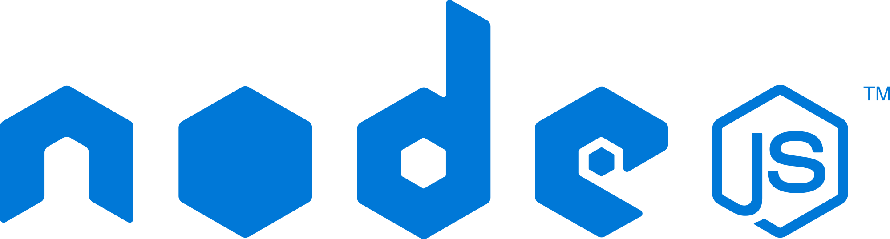



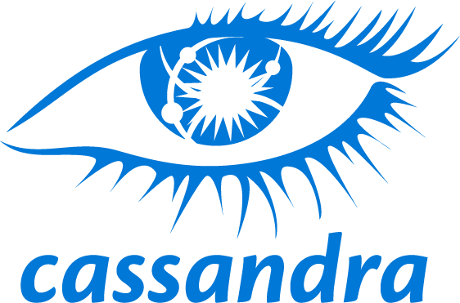
Lift and shift nosql apps
Make data modernization easy with seamless lift and shift migration of NoSQL workloads to the cloud.
Azure Cosmos DB APIs for MongoDB and Cassandra bring app data from anywhere to Azure Cosmos DB
Leverage existing tools, drivers, and libraries, and continue using existing apps’ current SDKs
Turnkey geo-replication
No infrastructure or VM management required
.NET
NoSQL wire protocol
Azure Cosmos DB APIs for MongoDB and Cassandra

Slide 22
Azure cosmos db
A globally distributed, massively scalable, multi-model database service.
Multi-model data with your favorite API
Elastically scale storage and throughput
Multiple, well-defined consistency levels
<10ms latency guarantees at the 99th percentile
Industry-leading SLAs across performance, latency, availability and throughput
Lift and shift MongoDB apps
Run Spark over operational data
Build real-time customer experiences
Ideal for IoT, gaming and eCommerce

Slide 23
Resource Model
Leveraging Azure Cosmos DB to automatically scale your data across the globe
This module will reference partitioning in the context of all Azure Cosmos DB modules and APIs.
Account
Database
Database
Database
Database
Database
Container
Database
Database
Item
Notes:
A tenant of the Cosmos DB service starts by provisioning a database account. A database account manages one or more databases. A Cosmos DB database manages users, permissions and containers. A Cosmos DB resource container is a schema-agnostic container of arbitrary user-generated JSON items and JavaScript based stored procedures, triggers and user-defined-functions (UDFs). Entities under the tenant’s database account – databases, users, permissions, containers etc. are referred to as resources.
Each resource is uniquely identified by a stable and logical URI and represented as a JSON document. The overall resource model of an application using Cosmos DB is a hierarchical overlay of the resources rooted under the database account, and can be navigated using hyperlinks. Except for the item resource, which is used to represent arbitrary user defined JSON content, all other resources have a system-defined schema.
Container and item resources are further projected as reified resource types for a specific type of API interface. For example, while using document-oriented APIs, container and item resources are projected as collection (container) and document (item) resources, respectively; likewise, for graph-oriented API access, the underlying container and item resources are projected as graph (container), node (item) and edge (item) resources respectively; while accessing using a key-value API table (container) and item/row (item) are projected.

Slide 24
Account URI and Credentials
Account
********.azure.com
Database
Database
Database
IGeAvVUp …
Database
Database
Container
Database
Database
Item

Slide 25
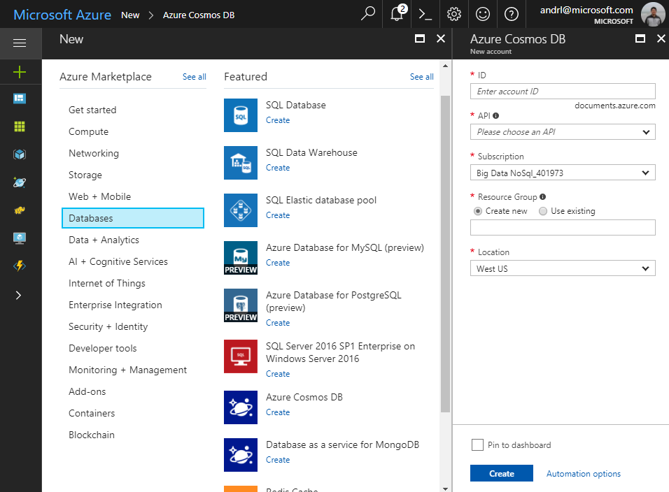
Creating Account
Account
Database
Database
Database
Database
Database
Container
Database
Database
Item

Slide 26
Database Representations
Account
Database
Database
Database
Database
Database
Database
Database
Container
Collection
Database
Database
Database
Database
Item
Document

Slide 27
Container Representations
Account
Database
Database
Database
Database
=
Database
Container
Collection
Graph
Table
Database
Database
Item

Slide 28
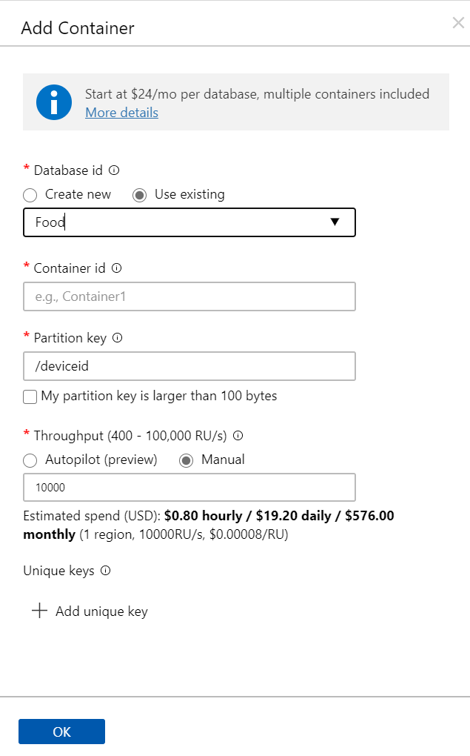
Creating Collections – SQL API
Account
Database
Database
Database
Database
Database
Container
Database
Database
Item

Slide 29
Container-Level Resources
Account
Database
Database
Database
Database
Database
Container
Database
Database
Sproc
Trigger
UDF
Conflict
Item

