Slide 1

❤️ React

Slide 2
A lot of React-based projects at Mozilla
Activity Stream
Developer tools : Debugger, Network Monitor, Web Console, Responsive Mode, JSON View
Gecko Profiler

Slide 3
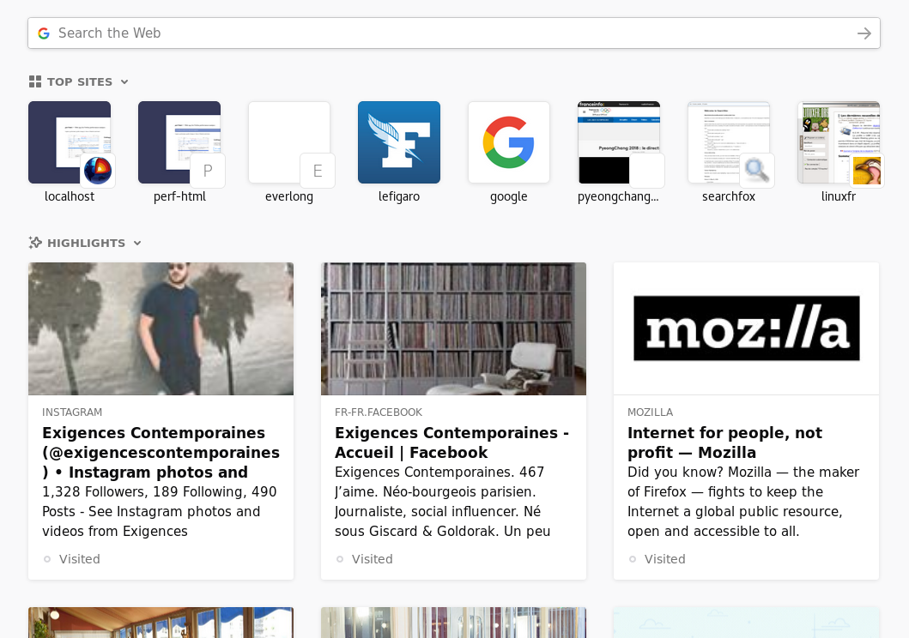
Activity Stream
This is the page for an empty « new tab »
Project is on github : https://github.com/mozilla/activity-stream
Needs a clone of all of mozilla
Available bugs on bugzilla :
https://mzl.la/2KAWVSE

Slide 4
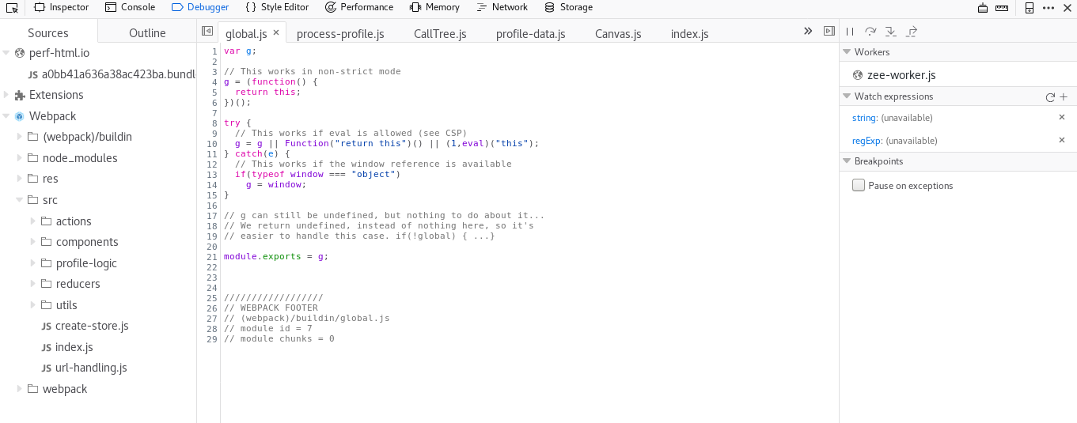
The Debugger

Slide 5
The Debugger
On GitHub : https://github.com/devtools-html/debugger.html/
Doesn’t need a full clone of Firefox to start
Does a great work to help contribution
Has good first issue bugs, label good first issue
or help wanted
Easy to work with

Slide 6
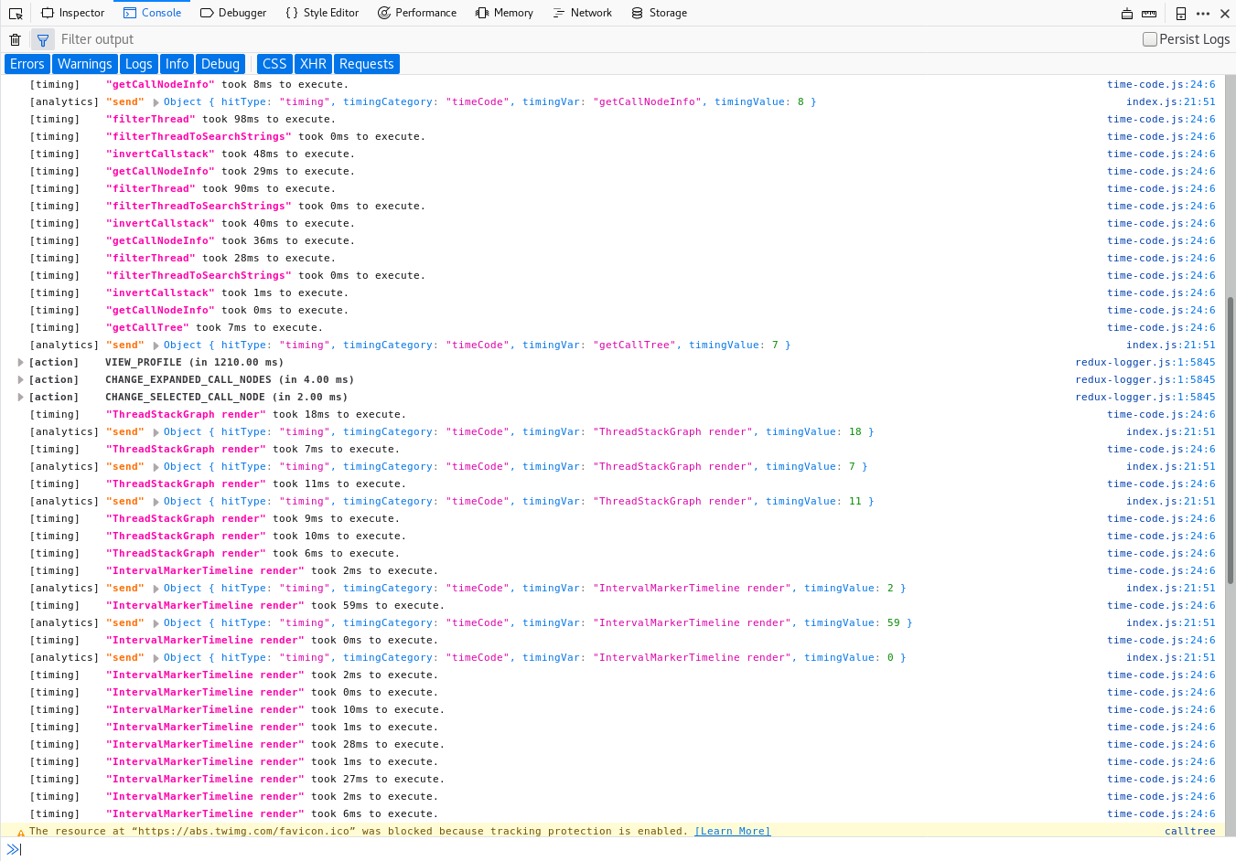
The Web Console

Slide 7
The Web Console
Developed inside the Firefox code base :
https://searchfox.org/mozilla-central/source/devtools/client/webconsole
A few mentored bugs : https://mzl.la/2IuV9C4
React without JSX
Start with :
https://developer.mozilla.org/en-US/docs/Mozilla/Developer_guide/Build_Instructions/Simple_Firefox_build
(https://mzl.la/2rSy99X)
Use artifact builds

Slide 8
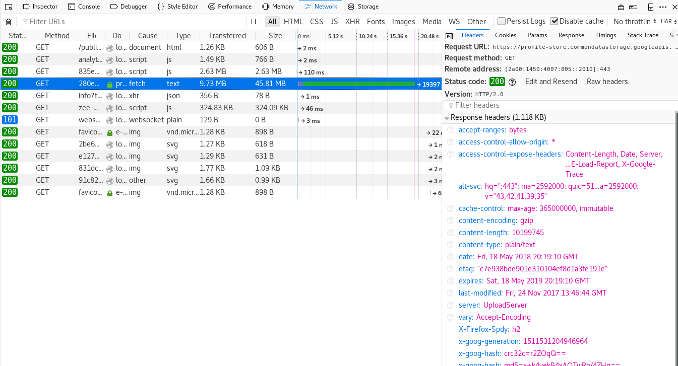
The Net Monitor

Slide 9
The Net Monitor
Developed inside the Firefox code base too
https://searchfox.org/mozilla-central/source/devtools/client/netmonitor
More mentored bugs : https://mzl.la/2rSx3Ln
React without JSX as well
Start with :
https://developer.mozilla.org/en-US/docs/Mozilla/Developer_guide/Build_Instructions/Simple_Firefox_build
(https://mzl.la/2rSy99X )
Use artifact builds

Slide 10
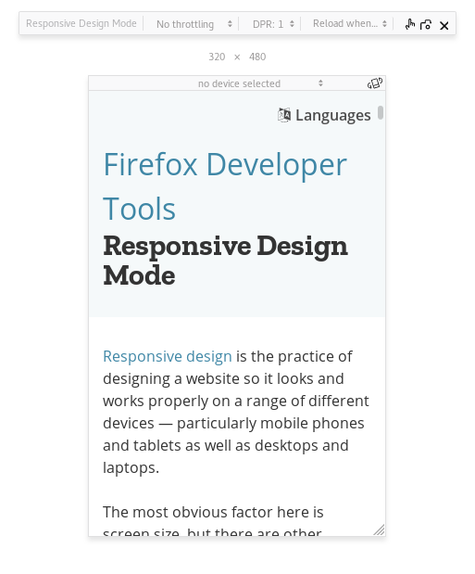
Responsive Mode

Slide 11
Responsive Mode
Same characteristics :
https://searchfox.org/mozilla-central/source/devtools/client/responsive.html
A few mentored bugs : https://mzl.la/2rSpVyw
Good opportunity to have an impact : very few people working on this tool

Slide 12
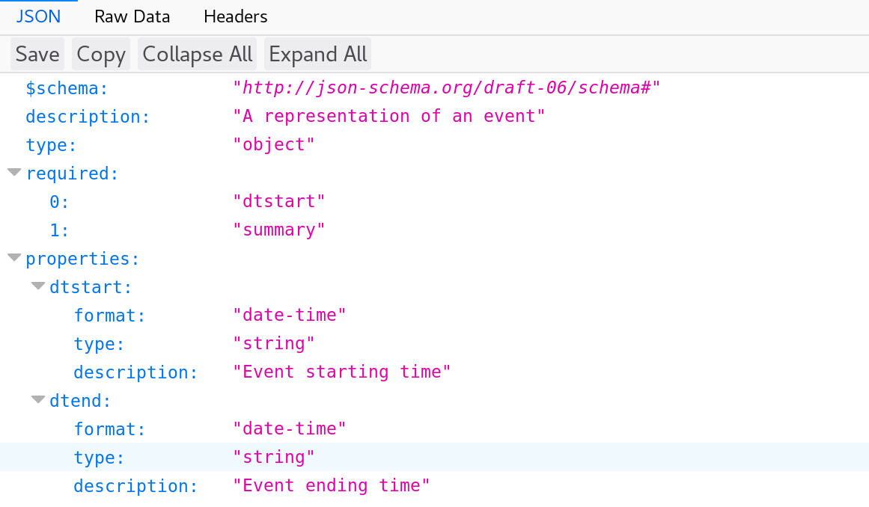
JSON Viewer

Slide 13
JSON Viewer
Developed in Firefox as well :
https://searchfox.org/mozilla-central/source/devtools/client/jsonview
Not very maintained these days, good opportunity to have an impact
List of bugs : https://mzl.la/2IuXLjm

Slide 14
Others in devtools…
The new accessibility tool :
https://searchfox.org/mozilla-central/source/devtools/client/accessibility
The new profiler panel :
https://searchfox.org/mozilla-central/source/devtools/client/performance-new
The memory tool :
https://searchfox.org/mozilla-central/source/devtools/client/memory
The new application panel :
https://searchfox.org/mozilla-central/source/devtools/client/application

Slide 15
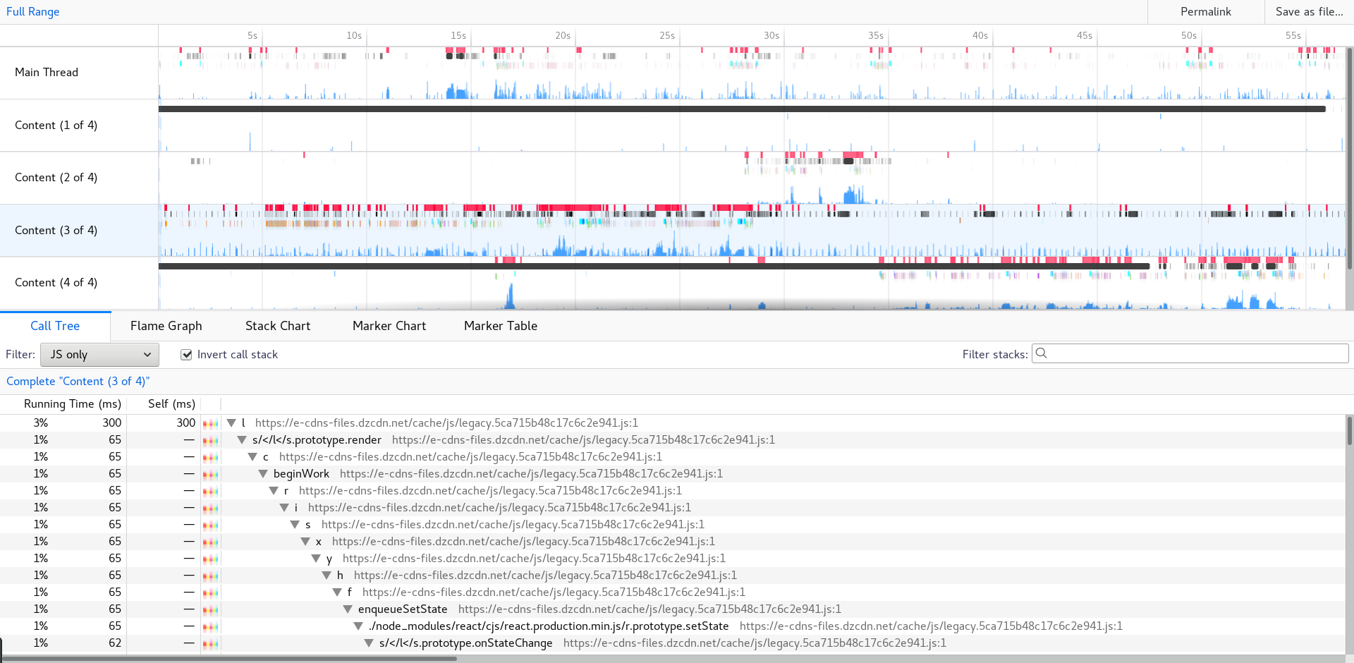
The Gecko Profiler

Slide 16
The Gecko Profiler
Development happens exclusively on github :
https://github.com/devtools-html/perf.html/
Labels help wanted and good first issue
❤️ Super nice team ❤️
Very normal React + Redux application
Domain can be complex, but super interesting

