Slide 1
Supporting student Python fluency at GFI
An all-in-one framework using an integrated Git + VSC solution
Vår Dundas & Julien-Pooya Weihs GFI workshop 19/6/2023

Slide 2
1. Current situation

Slide 3
challenges with programming
As a lecturer
Mostly deeply involved in MatLab or Frotran, not necessarily Python
Possible missmatch between science done and the teaching to students
Big step from field data to meaningful datasets, need to be able to convert scripts for use
As a TA
Heterogeneous student group in terms of programming level (in 2nd year)
Final programming goal not perfectly defined
As a student (hypothetical/reported)
Lack of experience with programming and working routines (algorythmic thinking, ’programming-mindset’ incl. finding answers, etc.)
Lack of motivation to start (need to make it more relevant), not sure where to begin with programming, unclear benefits overall
Little assessment for programming tasks during studies, sometimes no programming in exams (‘motivation-forcing’)
INF100 teaching may not be entirely applicable to future uses at GFI
Possible deficit in hands-on experience with code and possible deviations from scripts

Slide 4
Identified Status-quo
Programming is necessary in scientific life/studies/career
Students feel overwhelmed
Single course formally covering the topic: INF100
Educational research shows that repetition and continuity is key to learning — not a one-time training program
Different competing environments for Python: CoCalc, Anaconda, ActivePython...
Teaching staff struggle too
With lectures including programming
Because of experience bias expecting students to know all about Python,
Programming is complex topic to teach (linguistics, scientific semantics, use cases…)

Slide 5
GFI course structure

Slide 6
A sustainable solution for all users
Introduce programming in an incremental way
Help students out of their struggles
Provides students with professional skills (programming + data management)
Offer sustainable support for teaching staff
Create collaboration at all levels of teaching and learning environment
Support integrating programming into all courses

Slide 7
2. Light Theory
Git + Visual Studio Code as a framework

Slide 8
Git
A Version Control System (VCS, not to be confused with VSC…)
Tracks history of changes to a project
Allows recovery of any earlier version
A transparent system for users and developers, showing
Which changes were made
Who made the changes
When the changes were made
Why the changes were made
Compatible with virtually any kind of file format
Every collaborator of a project has a full local copy of the project and project history
Changes registered and tracked between local copy and cloud-based version of the project
Source: GitHub

Slide 9
GitHUB
Web-based platform for software project development using version control
Allows multiple people to work on project simultaneously by tracking changes
Over 100 million developers and more than 386 million repositories (3/23)
New industry standard for programming, data management
Commonly used for open-source projects, 40 million public repositories (3/23)
Public repositories: 1700 hit for “climate models”, 1000 hits for “oceanography”, 2600 hits for “meteorology” (3/23)
Source: GitHub

Slide 10
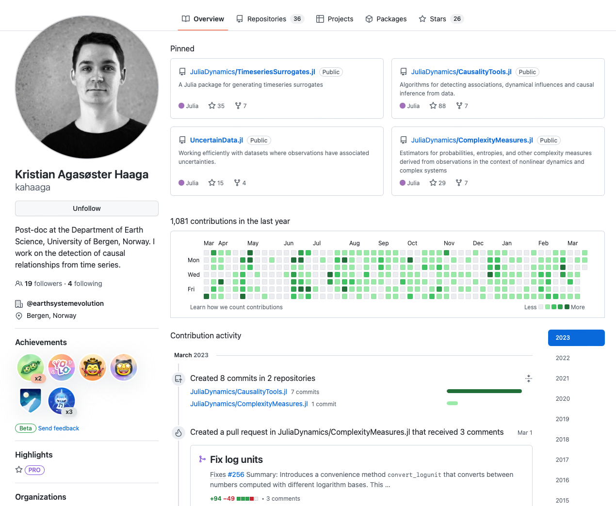
Github profile
Source: GitHub

Slide 11
Visual studio code
Free and open-source code editor developed on… GitHub!
Wide range of features (code completion, debugging tools, integrated terminal)
Full integration and synchronization of projects with GitHub
Most popular coding environment (74% of 71000 respondants, 2022)
Supporting more than 100 programming languages
Over 45000 extensions (3/23) to add features and customize workflow with language interpreters, compilers, renderers, etc.
Source: Stack Overflow, Visual Studio Code

Slide 12
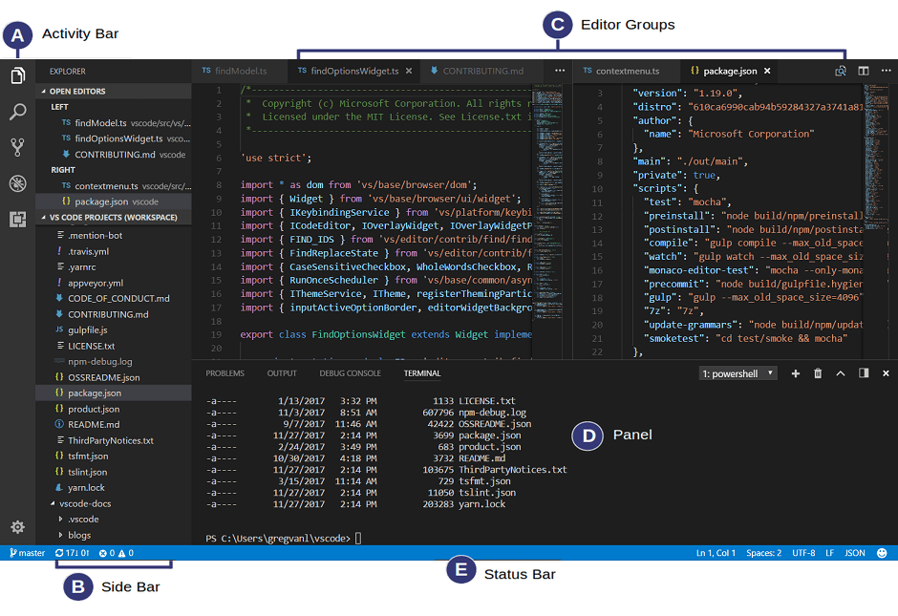
User interface

Slide 13
3. Setting up
Visual Studio Code + GitHub
Git commands: Terminal + GitHub Desktop

Slide 14
Visual Studio Code
Download VSC software:
Go to code.visualstudio.com
Click on Download, select appropriate OS license, confirm
Install according to your OS, launch VSC
Install some extensions:
Python/isort/Pylance/etc.
Jupyter Keymap/Notebook Renderers/Slide Show/etc.

Slide 15
GitHub + Python
Create account on GitHub:
Go to github.com
Click on Sign up, follow steps
If you already have an account, sign into it
That was (probably) it for GitHub!
Check if you already have Python 3 installed on your computer:
Open Terminal and run:
$ python3 --version
If you don’t have it yet, download Python 3:
Go to python.org/downloads
Click on Download
Install according to the installer

Slide 16
Common git commands
Staging area
Copy files/repositories:
Clone (your own repository: cloud → local)
Fork (someone else’s repository: cloud → cloud)
Download changes:
Fetch (look for updates on Git platform)
Pull (download Git changes: cloud → local)
Merge (import changes into file)
Upload changes:
Stage (add single Git change into a bulk)
Commit (save Git-bulk locally)
Push (publish Git-bulk: local → cloud)
Stage (Terminal)
Commit (Terminal)
Working directory
Commit (GitHub desktop)
Local repository
Merge (Terminal)
Open in VSC (GitHub desktop)
Push
Pull
Remote/cloud repository
Fetch

Slide 17
Exercises
On GitHub, follow irendundas and julienweihs so that we can see what you do
GitHub ↔︎ Visual Studio Code interactions:
On GitHub, go to Profile → My Repositories → New, give a name, create
Set up in (GitHub) Desktop, choose local path for repository, clone
Open in Visual Studio Code, create new file hello.md, write *italic* on line 1, save
On GitHub Desktop, commit and push changes (new file), view on GitHub
Click on ‘hello.md’, write __bold__ on line 2, commit changes
On GitHub Desktop, fetch and pull origin, open on VSC

Slide 18
Exercises
Python & Jupyter running and updating:
On GitHub, find GEOF repository, locate jupyterdemo-folder and pythondemo.py, download, place in your local test repository
On GitHub Desktop, commit and push changes (new files), then open in VSC
On VSC, select pythondemo.py, try to explain what the code does, run the file
If required packages not yet installed, see commented lines (conda virtual environment installation tutorial possible on request)
In jupyterdemo-folder, select jupyterdemo.ipynb, explain and run each cell
Add colors to plots, run cell and save file
On GitHub Desktop, commit and push changes (update to file), view on GitHub

Slide 19
4. ideal-world solution
GitHub + VSC for teaching and collaboration
Advantages and potential according to the literature, to GFI, to the developers
Our tree structure suggestion across GEOF courses

Slide 20
insights from the literature
Advantages
Limitations
Collaboration: improves communication and teamwork skills
Version control: track changes and revert to previous versions if necessary
Feedback: pull-request feature is a platform for discussion between users
Transparency of activity: holds users accountable for their contributions
Opportunity: students develop technical skills at industry-standard
Learning curve for beginners unfamiliar with Git-environment
Unthinkable to have a degree in geophysics without robust coding skills
Develop shared base of knowledge
May not be suitable for grading assignments
Grade student work on mitt.uib
Some may be uncomfortable sharing work
Possibility to use private repositories at any time
Zagalsky, Alexey et al. “The Emergence of GitHub as a Collaborative Platform for Education.” (2015)
Kertész, Csaba. “Using GitHub in the classroom - a collaborative learning experience.” (2015)
Feliciano, Joseph et al. “Student experiences using GitHub in software engineering courses: a case study.” (2016)
Glazunova, Olena G. et al. “The effectiveness of GitHub cloud services for implementing a programming training project: students’ point of view.” (2021)

Slide 21
What is currently done at GFI
Existing repositories for GFI courses (3/23):
Public: GEOF211, GEOF212, GEOF321 (in development), GEOF337 (user’s personal), GFPy toolbox
Private: GEOF105 (probably many more)
What some course repository owners say:
“strong tool for shared projects […] with well-structured way to decide of changes”
“shifting the access of the course material to GitHub would certainly be a great step”
“the repository can live on, beyond my association with the course”
“I can more easily track the development of the course materials”
“perfect for sharing my Jupyter notebooks”

Slide 22
Motivation for implementation
Complete project folders available on single web-based platform
Shared documents always up to date for everyone
Teaching staff can access and use common data/toolboxes/libraries
Streamlines course management for both students and teaching staff
Transparency about workflow and individual contributions
Possible private repositories for data protection and security

Slide 23
common platform for Courses at gfi
GFI-level GitHub environment for courses — GEOF1xx, GEOF2xx, GEOF3xx
For students
support learning with modern tools for scientific programming & collaborative project management
address programming anxiety
develop new skills
For teaching staff
support teaching by creating continuity between courses and over several years
foster collaborative approach on course design (peer-peer, Students as Partners)
develop new culture of programming to transmit to students

Slide 24
Public repository
GEOF repository
Managers:
Vår
Julien
Msc student?
GEOF100 folder
GEOF105 folder
…
Common resources folder
‘Get started’ folder
Managers:
Lecturers
TAs
Managers:
Lecturers
TAs
Managers:
Lecturers
TAs
Managers:
Everyone?
Courses
Exercices
Labwork
Fieldwork
Courses
Exercices
Labwork
Fieldwork
Courses
Exercices
Labwork
Fieldwork
Data
Packages
Manuals
Codes
Tutorials
Q&A
Fork & Pull
Push
Student forked local repository
Commit
Student working repository
Merge

Slide 25
Exercises
Flat hierarchy (simple): everybody collaborates at the same level
On GitHub, find GEOF repository, go to Discussions → Workshop 19/6/23, write a comment to be added to the repository as a collaborator
Make teams of 2 people (A & B ‘colleagues’ simulation with Git-interactions):
A creates a folder, B adds a simple Python file and all necessary additional files to run the code successfully with 1 easy-to-fix intentional mistake in it
A runs the code and finds mistake, files an Issue about it on the Github page
B replies to Issue with code snippet to correct mistake
A fixes mistake, runs the code successfully and closes Issue
Repeat the other way around (A adds the Python file with mistake, B finds mistake, etc.)

Slide 26
Exercises
Academic hierarchy (more complex): teacher leads course, student takes course
Make new teams of 2 people (T-teacher and S-student simulation with Git-interactions):
T creates a course folder in GEOF repository, creates an assignment.md file containing a realistic question, places it inside the course folder (extra 🌶️: S is removed from collaborators of GEOF)
S forks and clones GEOF once T confirms question is ready, adds answer to assignment.md, pushes changes into fork, opens pull request for merging fork into main branch, register T as reviewer for the pull request
T reviews pull request from S, approves pull request, merges into main branch (extra 🌶️: we try some branch protection rules and moderation options from GitHub)
Repeat the other way around (T becomes S, S becomes T, redo the exercise)

Slide 27
Exercises
Captain and crew (just like before): a single teacher runs a group work in class
You are all in the same team (classroom group project simulation with Git-interactions, irendundas and julienweihs are the teachers):
Everyone forks and clones GEOF repository (extra 🌶️: everyone is removed from collaborators of GEOF)
Go to Collaboration → collaborationdemo.ipynb, follow instructions for personal contribution to file, modify file accordingly, push changes into fork, open pull request for merging into main branch, register irendundas and julienweihs as reviewer
Teachers will review pull request
Depending on teachers reviews on pull request, amend file again on fork, resubmit opened pull request
Once accepted, enjoy result on main branch after complete round of submissions

Slide 28
5. Looking ahead
GitLab as best practice

Slide 29
Gitlab
Alternative to GitHub, Git repository with subdomains hosted by UiB:
Level 1: subdomain (i.e git.app.uib.no/gfi)
Level 2: group (GFI)
Level 3: subgroup (GEOF courses)
Level 4: subsubgroup (semesters: H23, V24, etc.)
Level 5: course material (assignments, solutions, space for TAs, etc)
Level 6: student space (access to common material and personal files)
Allows for entirely customizable user rights and accesses across tree structure
Seems to lift most/all limitations from GitHub for educational purposes
Current best-practice at INF department: git.app.uib.no/ii

Slide 30
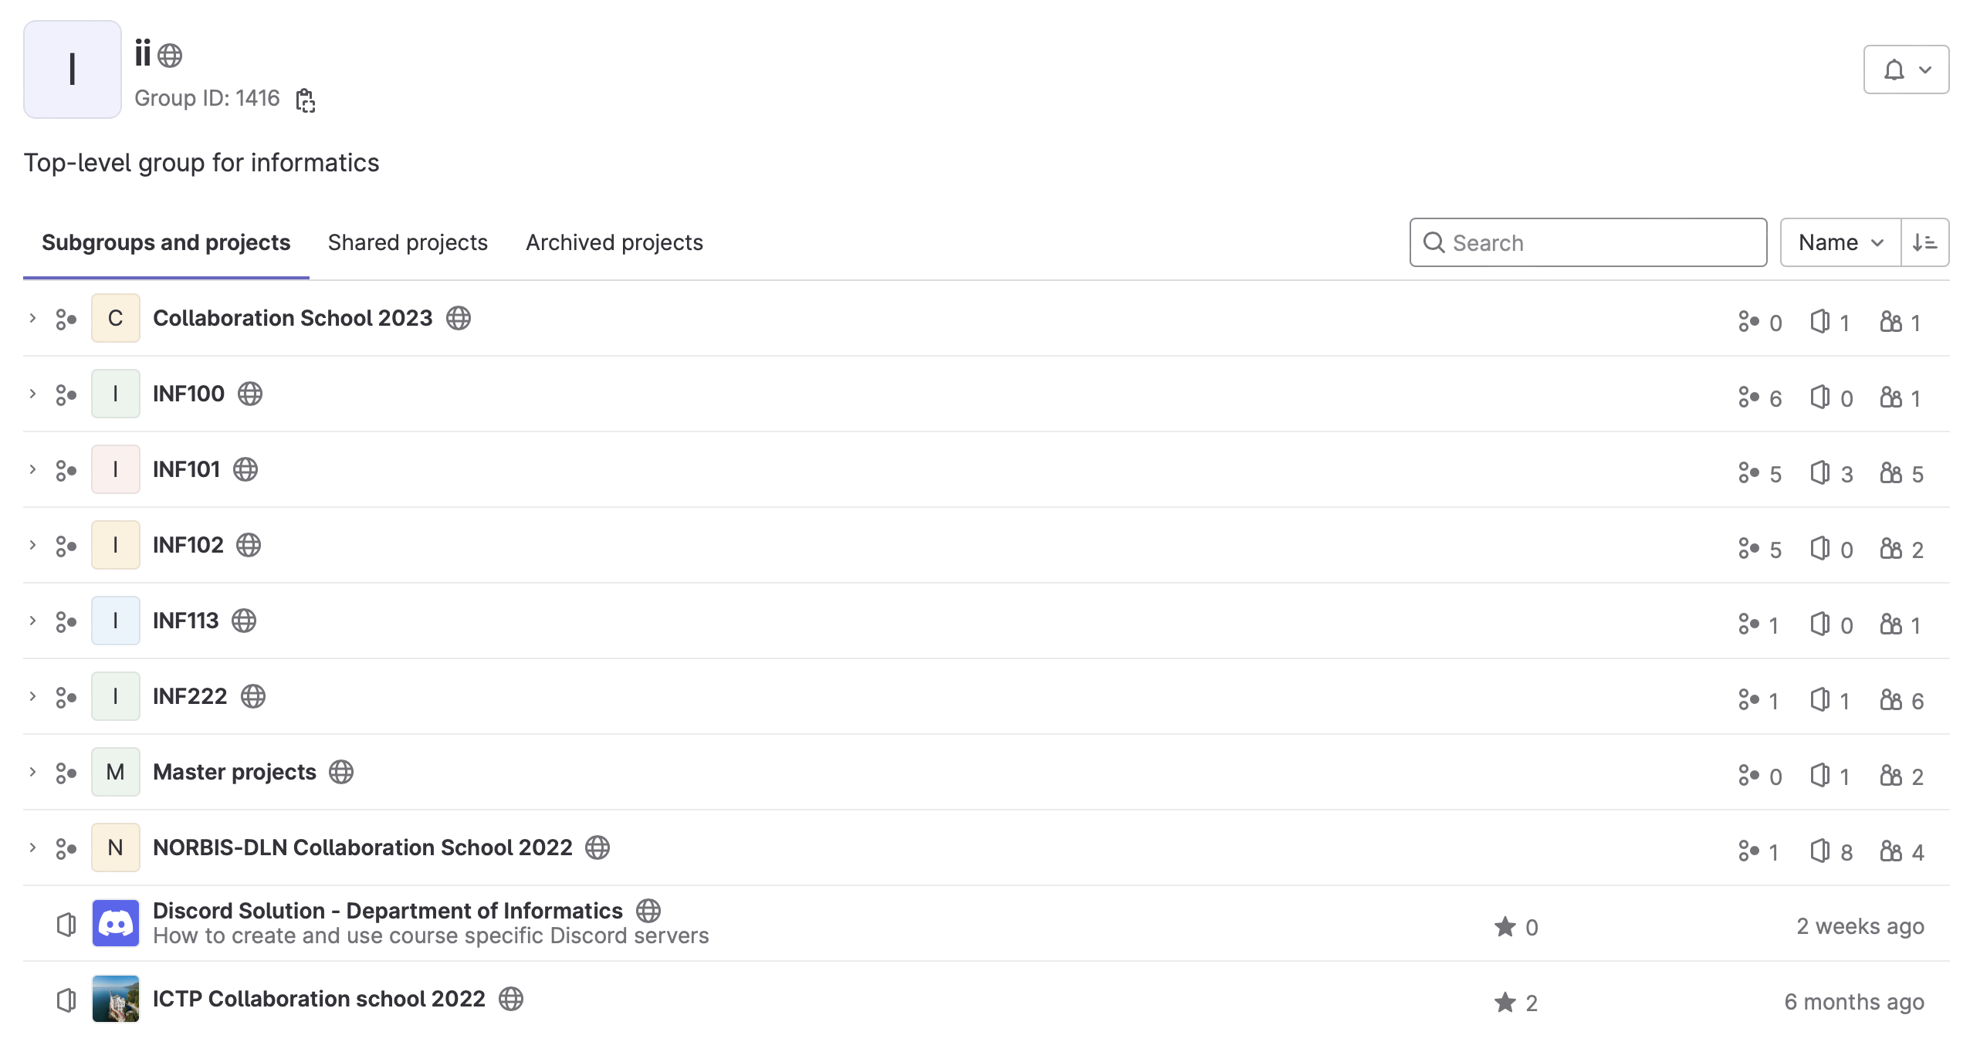
Department interface

Slide 31
6. H23 and further
Vision for the future of programming at GFI
Pilot courses
Educational research

Slide 32
Possible future steps
Short-term implementation:
Creation of tutorials + handbook for installation/setup/use/collaboration with GitHub + VSC
User workshops for students
User workshops for teaching staff
Jupyter notebooks to familiarise new students with python scientific coding
Medium-term evolution:
Opening of space for more creativity in teaching (lectures, assessment, activities)
Expansion to MatNat? (research-based)
Long-term developments:
New culture of programming for students
???

Slide 33
Where we need you
Pilot courses in H23
2-3 courses in which we focus our efforts for Git + VSC framework
Train both students and teaching staff
Develop knowledge base for future expansion to larger GEOF choice of courses
Need for interested lecturers and TAs to collaborate and implement
Educational research from H23
Wish to document process across multiple semesters to create robust portfolio
Looking to confirm hypothesis that framework supports programming fluency amongst students, helps lecturers, reduces struggles for both parties over time
Need for development of metric (qualitative and/or quantitative) and data collection instrument, collecting samples before/during/after semesters
Looking for interested people to collaborate/write an article with

Slide 34
Thank you
We are grateful for any thoughts, comments, suggestions, recommendations, initiative, and participation!
Write us via email or on the GEOF repository (in Issues or Discussions, depending on the nature of the input)

Slide 35
Some resources
Vår’s Introduction to Python for geophysicists and tutorial Jupyter notebooks
https://www.earthdatascience.org/courses/intro-to-earth-data-science/
Research group on Informatics Didactics at UiB (Prof. David Grellscheid, Sondre Bolland & Co.)
https://www.atlassian.com/git/tutorials/atlassian-git-cheatsheet

