Slide 1



Getting started with Python and Git
APECS 2023 – Data sharing and outreach
Vår Dundas & Julien-Pooya Weihs
Geophysical Institute, University of Bergen
Notes:
last-year oceanography PhD at GFI and BCCR in Bergen, actually do Antarctic research.
Focus on warm currents that cross the continental shelf due to storm forcing. Modelling and observations (some pictures from Antarctica, gfi). Almost tempted to start working with the warm currents around Svalbard after this though …
But! what I will talk about now is actually based on the duty work I've done at my institute.
It’s a project I collaborate on with Julien-Pooya Weihs, who is doing his PhD on didactics in geophysics.

Slide 2
Do you use programming?
Do you use python?
Do you use Git?
Do you teach or supervise?
Notes:
Before I start, I'd love to get a sense of how familiar you are with the topics. Can we do a quick show of hands, just so that I have a small overview.

Slide 3
How it started
“Get started with Python programming using VSCode and Git”
Seminars in python programming with “Ekte Data” (“Real Data”)
How can we reduce the size of this threshold?
Julien: Programming is a major threshold for our students
Improve the infrastructure to make it easier to get started
Var.Dundas@uib.no, 30. October 2023
Notes:
To give some context to this project I want to explain a bit how it started.
In my duty work with “Ekte Data” I have created and given some intro courses in python programming. The point of “Ekte Data” is to teach Python by using Real Data instead of text book examples. The idea is that this makes it easier and more interesting to learn because you see the actual benefit early on.
To make it accessible for anyone, I started sharing it all on GitHub.
Then my colleague, Julien, who's a TA in one of the main courses at my institute came to me and said that programming is a major threshold for the students in our undergrad program.
Julien is doing his PhD in didactics in geophysics and had some good ideas about how we could try to improve the infrastructure of learning python programming at our institute together .
And this setup that Julien and I are now working on at GFI in Bergen is what I'll present briefly now: How to get started with Python programming and Git.

Slide 4
This is for you if …
You're trying to get started with python programming and GitHub yourself,
You're teaching courses where the students need programming,
Or maybe you're supervising someone who could use some help with getting?
Or if you work with similar solutions and challenges, and have input!
Var.Dundas@uib.no, 30. October 2023
Notes:
So this pitch is for you if you're trying to get started with python programming and GitHub yourself, if you're teaching courses where the students need programming, or maybe you're supervising someone who could use some help with getting started with the programming aspects? And if you're working on similar things as Julien and I, it would be very interesting to chat afterwards!

Slide 5
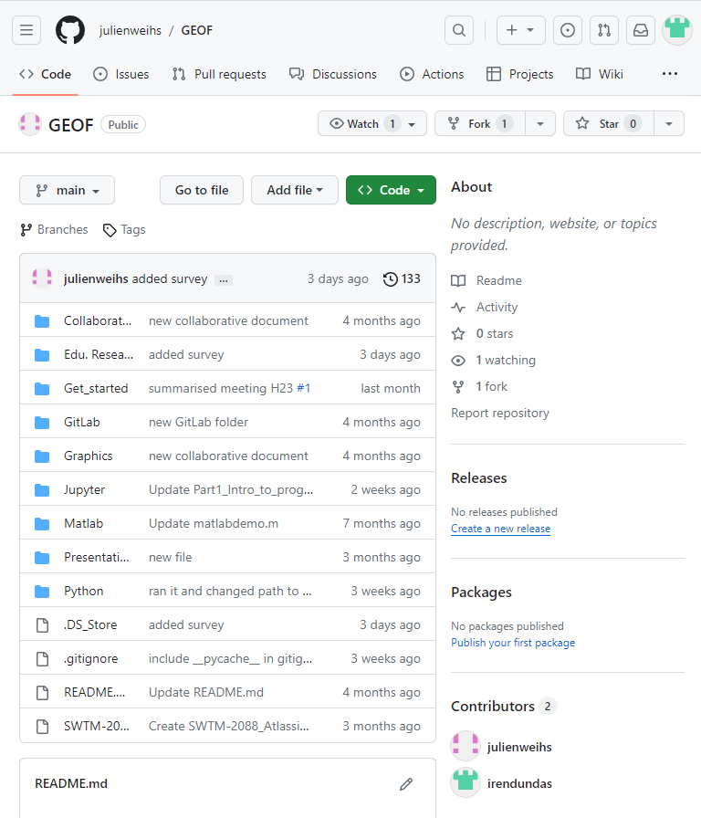
Where to start …
The more options, the harder to choose, the harder to get started
So why our “get started”: specifically tailored for natural sciences
Tools: Jupyter notebook, VSCode, Git
Work-in-progress, but several of the resources are already out
Var.Dundas@uib.no, 30. October 2023
Notes:
- In any case – there's a ton of solutions, tutorials and options out there, which doesn't make it easier, it just raises the threshold to get started. With too many options it's hard to choose.
And here I am suggesting an additional option…
So Julien and I are proposing a "get-started" setup that is specifically tailored for natural sciences using Jupyter Notebooks in VSCode, with all the code and resource material stored on GitHub.
This is still a work in progress, but several of our resources are already out there, and we update our GitHub continuously.

Slide 6
The basis of our idea
Learn Python programming through exercises that are close to your field
Get used to GitHub at the same time
For the students: use the same setup for all courses to limit time spent on installations and confusion.
Var.Dundas@uib.no, 30. October 2023
Notes:
- In any case – there's a ton of solutions, tutorials and options out there, which doesn't make it easier, it just raises the threshold to get started. With too many options it's hard to choose.
And here I am suggesting an additional option…
So Julien and I are proposing a "get-started" setup that is specifically tailored for natural sciences using Jupyter Notebooks in VSCode, with all the code and resource material stored on GitHub.
This is still a work in progress, but several of our resources are already out there, and we update our GitHub continuously.

Slide 7
The aim
Get comfortable with Python so that you can analyze your data,
Use version control and learn how to collaborate in code,
Get through point 1) and 2) without getting absolutely frustrated with installation details and tutorials that do not resemble anything you actually want to do
Var.Dundas@uib.no, 30. October 2023
Notes:
- In any case – there's a ton of solutions, tutorials and options out there, which doesn't make it easier, it just raises the threshold to get started. With too many options it's hard to choose.
And here I am suggesting an additional option…
So Julien and I are proposing a "get-started" setup that is specifically tailored for natural sciences using Jupyter Notebooks in VSCode, with all the code and resource material stored on GitHub.
This is still a work in progress, but several of our resources are already out there, and we update our GitHub continuously.

Slide 8
1) Get comfortable with Python
The original main motivation of creating the exercises and tutorials.
It’s absolutely necessary for our students, but the mandatory courses do not provide what’s needed and online resources are difficult to navigate.
Var.Dundas@uib.no, 30. October 2023
Notes:
In the seminars I usually have I would spend some time here discussing the benefit of python over e.g. excel, but I don’t think that’s necessary here.
I don’t think I need to convince anyone here of the usefulness of programming

Slide 9
2) Version control and collaborative code
We need an efficient way to share and collaborate on code that can be maintained between semesters, TA’s, and lecturers.
By using GitHub as our platform knowledge of Git comes as a side effect for the user
Back up your work
Version control on your work – you can mess up your script and it’s OK
Improve quality and reduce risk of errors with collaborative coding
Var.Dundas@uib.no, 30. October 2023
Notes:
Our reason for also focusing so much on point 2) is that we want our students to get used to this kind of tools as it's a great strategy for backing up your work, and collaborative coding is a skill that can really improve the quality and reduce errors in your code. In our setup, using GitHub is kind of a "side effect" - it's not the main focus of the course material, but we provide a manual on how to set it up and the basics of how to use it.

Slide 10
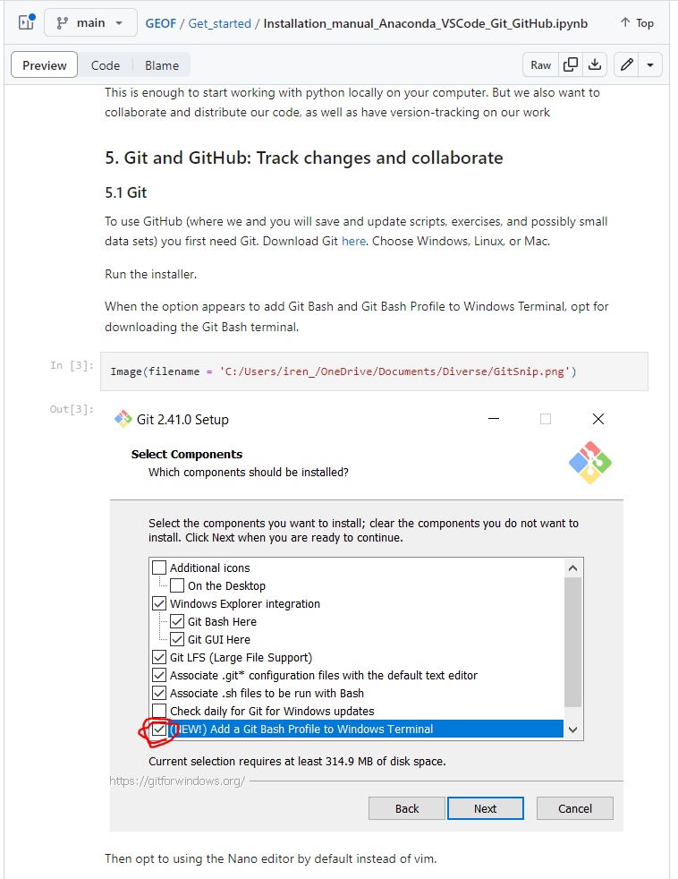
2) Version control and collaborative code
You don’t need to dive into all the functionality of Git at once!
If you’re new to Git I would
Check out our setup manual
Create a GitHub account
Make a private repository
Start using this in your work. All you need is:
Git add
Git commit
Git push
Var.Dundas@uib.no, 30. October 2023
Notes:
I think it's important to note that when it comes to GitHub – you don't have to use all the functionality straight away. Because there is a lot of great functionality you can use when collaborating on code – but it's also very useful for your private projects. I use it for all the work I do on my PhD, and it's really nothing different than just having it all locally on my computer except that I have backup and version control automatically, and that it was really easy to share scripts with a master student I've been co-supervising whenever he needed help. I have this work private, while the stuff I make for the python course is public.

Slide 11
3) Minimize frustration
Lower the initial threshold so that it’s possible to get started
While “learning Python” is the end goal of this project, the need to lower the threshold in the reason this project is needed.
It has to be easy to start, and it has to be clear why it’s useful in the long run
Var.Dundas@uib.no, 30. October 2023
Notes:
Point 3) about frustration is something I'm sure everyone can relate to at some level. With our students, we want to minimize the initial frustration that stops you from even getting started by implementing the same setup for all courses they take. Lowering the initial threshold is one of Julien and mine main motivations for starting this project. It's really common to have this fear of new installation and of opening an empty script. We want to limit this by selecting one setup that can be used throughout their undergrad and potentially into their PhD but also out of academia.

Slide 12
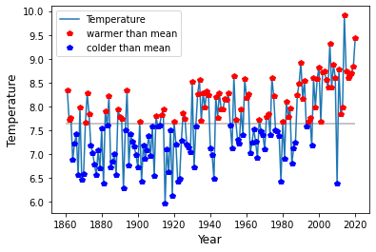
3) Minimize frustration
Resemblance to actual scientific workflow
Examples and exercises using real data
Based on the idea from “Ekte Data” that learning through real-world examples facilitates more efficient and engaged learning than text-book examples
… I’m sure you’re all super interested in temperature in Bergen the past 160 years
Var.Dundas@uib.no, 30. October 2023
Notes:
We're also very tired of having to learn through courses and tutorials that have no resemblance to a scientific workflow. I don't know how many games our undergrads have to make before they actually load a real data set with real data into their scripts, but it seems to be a depressing amount. So our tutorials are centered around actual real data sets.
This brings me back to the origin of the actual programming exercises we provide which I originally wrote for a project called "Ekte Data". This translated directly into "Real Data" and builds on the idea that learning through real world examples facilitates more efficient and engaged learning than text book examples.
I'm guessing that not all of you are passionately concerned about the temperature and precipitation evolution in Bergen, which is what several of the tutorials and exercises use as examples, but at least it's actual data to work with.
You can of course also load your own data into the exercises as long as they're on a similar format.

Slide 13



The setup we’ve chosen
Jupyter Notebook
Notes and code
VSCode
Script, file structure, and terminal
Integrated Git for those who want this
GitHub
Var.Dundas@uib.no, 30. October 2023
Notes:
So we've chosen to use Jupyter notebooks in VSCode. We want to be consistent so we had to make a choice. Jupyter notebooks are a great tool for creating exercises since you can take notes and write code in the same document , and VSCode is a tidy and nice interface that allows you to see your script, file structure and terminal at the same time. It can also be connected to Git, which some people really like.

Slide 14
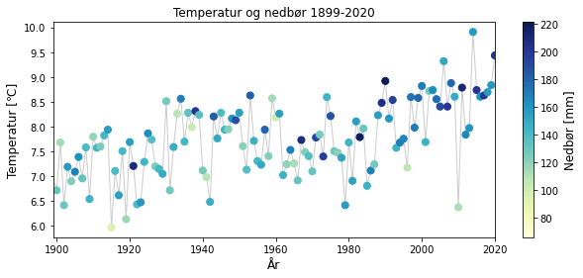
What do we provide?
A help to lower the threshold to get started
Once started it’s easier to continue learning on your own
Intro to scientific programming in python
Variables, arrays, packages, functions, and indexing – “how to think code”
Loops and if-statements, documentation, and errors
No need to use Git – but you can if you want to!
Var.Dundas@uib.no, 30. October 2023
Notes:
The idea is that once you're familiar with the basics it's easier to continue learning on your own, reading documentation, and realizing the possibilities you have with knowing some coding and Python specifically.
So what we offer is a help to get started with scientific programming in Python with the side benefit of also getting used to the more simple aspects of Git.
Since many of us work with NetCDF data, I'm considering writing an exercise that specifically uses xarray, which is an amazing tool. We're also very open for other specific suggestions of topics for exercises we could make.
It can be tricky to get into the way of thinking when coding, I for sure struggled in the beginning, but we hope that this exercise set and setup helps getting past this threshold.

Slide 15
What do we provide?
Installation guide to set up:
Anaconda
VSCode
Git
GitHub
Still a work in progress https://github.com/julienweihs/GEOF/tree/main
Ideas of topics for exercises are welcome!
https://github.com/julienweihs/GEOF/tree/main
sd
Var.Dundas@uib.no, 30. October 2023
Notes:
Since many of us work with NetCDF data, I'm considering writing an exercise that specifically uses xarray, which is an amazing tool. We're also very open for other specific suggestions of topics for exercises we could make.
It can be tricky to get into the way of thinking when coding, I for sure struggled in the beginning, but we hope that this exercise set and setup helps getting past this threshold.

Slide 16
Take-home message
If you want to get started with python or have students that need programming – check out our GitHub
https://github.com/julienweihs/GEOF/tree/main
Start using Git!
Version control, backup, and collaboration
If you have similar challenges or solutions regarding programming with students at your institute, I’d love to discuss more!
Var.Dundas@uib.no, 30. October 2023
Notes:
We’ll continue updating the repo

Slide 17
Take home messages
If you want to get started with python or have students that need programming – check out our GitHub
Start using Git!
Version control, backup, and collaboration
If you have similar challenges or solutions regarding programming with students at your institute, I’d love to discuss more!

