Slide 1

Software Engineering
T2 – Software Processes
3MIEIC04_B
(20th October 2017)
Bárbara Silva up201505628@fe.up.pt
Julieta Frade up201506530@fe.up.pt
Ventura Pereira up201404690@fe.up.pt

Slide 2
Unified Software Development Process
The Four Phases:
Inception;
Elaboration;
Conception;
Transition.
Characteristics

Slide 3
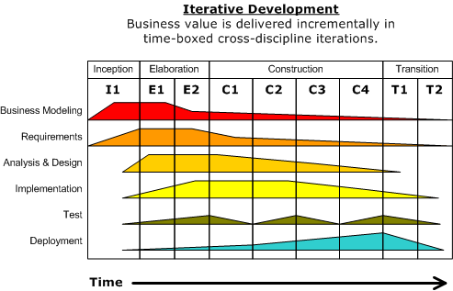
What’s a software phase?
Series of cycles;
Each cycle
contains four phases;
Span of time between two major milestones.

Slide 4
Inception
The first phase

Slide 5

Inception
Goal: viability of the proposed system.
Tasks:
System’s scope;
Outlining a candidate architecture;
Indentify risks;
Start the business.

Slide 6
Inception
When can we move on?
Before moving on torwads the next step, the Major milestone
must be achieved:
Do the major stakeholders agree on the scope of the proposed system?
Is a specific set of critical high-level requirements adressed by it’s architeture?
Is the business case enough for a green light?

Slide 7
Elaboration
The second phase

Slide 8
Elaboration
What do we want to achieve at this stage?
Build is the key word. As engineers, the ability to build the new system, given
some constrains, such as the financial, schedule ones, must be established.

Slide 9

Elaboration
What exactly do we need to do?
Understanding the majority of the remaining functional requirements;
To expand the previous candidate
architecture into a full architectural baseline
. Make it na internal release of the sstem focused
on describing the architecture;
Adressing major risks on na ongoing basis;
To finish the business case and prepare a project plan, detailed enough, to guide us
through the next phase.

Slide 10
Elaboration
0
When can we move on?
The major milestone must be achieved.
The user case model must capture most of the functional requirements;
The architetural baseline must be a small system that will serve as a solid
foundation;
Business case has received a green light, there’s a project plan for the next
phase.

Slide 11
Conception
The third phase

Slide 12

Conception
What’s the primary goal?
Create a system capable of operating in beta
customer environments.
How?
Build the system iteratively and
incrementally, making sure that the
viability of the system is always evidente
in executable form.

Slide 13
Conception
What must be achieved?
The initial operational Capability.
How do we know?
A set of beta customers has a more or less fully operational system in their
hands.

Slide 14
Transition
The final phase

Slide 15
Transition
What’s the purpose?
The roll out of the fully functional system to customers.
How do we do it?
Correct defects, modify the system to correct previously unidentified
problems.

Slide 16

Transition
What comes next?
Product release!

Slide 17
Characteristics

Slide 18
Iterative Incremental

Slide 19
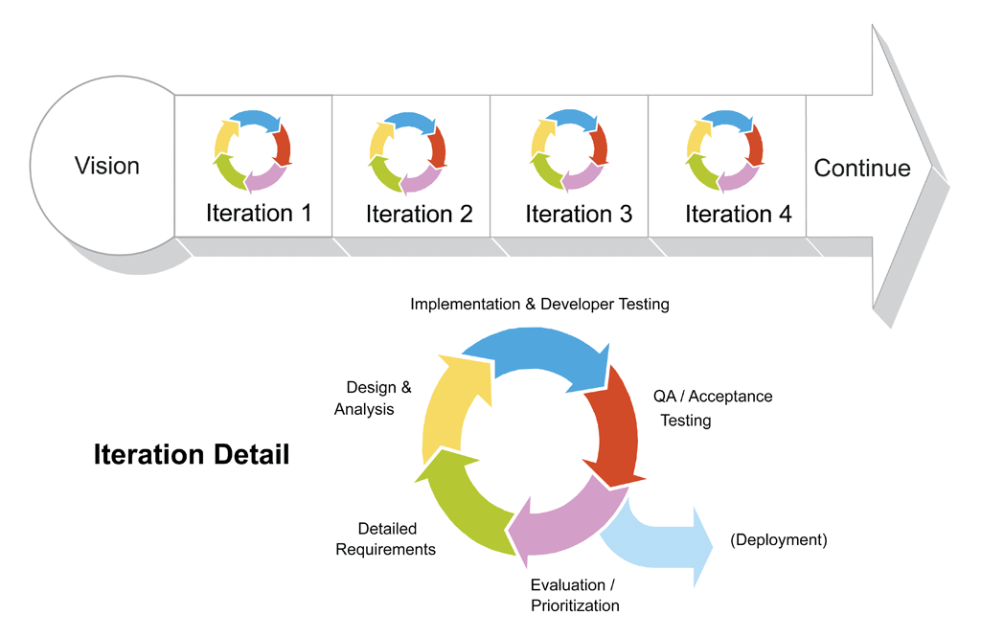
Iterative and incremental
The last three phases that we’ve seen
are divided into a series of
timeboxed iterations.
Each iteration results in an increment.
It represents added or improved
functionalities compared with the
previous release.

Slide 20
Use-case driven

Slide 21
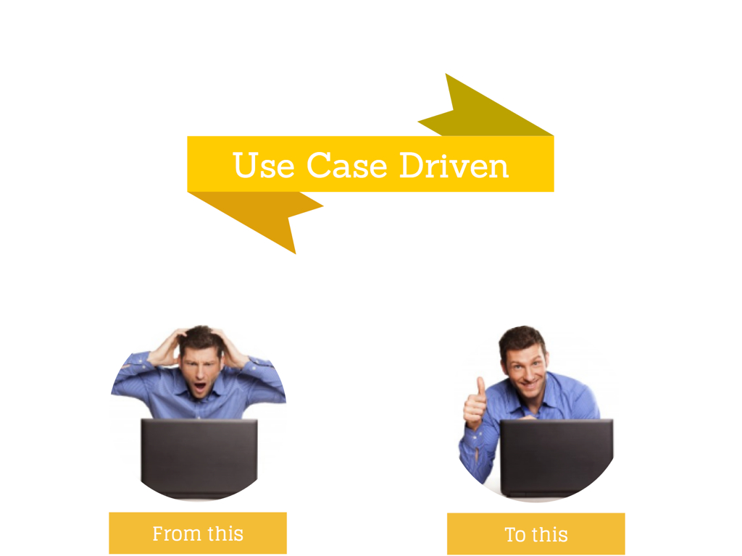
Use-case driven
Used to capture functional requirements;
Refine the content of the iterations;
Set of use cases or requirements scenarios.

Slide 22
Architecture-centric

Slide 23
Architecture-centric
Since no single model is suficiente to cover all aspects of a system,
the Unified Process supports multiple architectural models
and views.
Created during the Elaboration phase;
Partial implementation of the system serves to validate the architecture and act as a Foundation for the
rest of the development.

Slide 24
Risk-focused

Slide 25

Risk-focused
The project team must focus on adressing
the most critical
risks early in the project life cycle;
Each iteration, especially in the
Elaboration phase, must be
select to ensure the greatest risks are adressed first.

