Slide 1
Domino's Project
Julieta Taseva
Teodora Georgieva

Slide 2
Main Functionalities
Register
Login
Logout
Add address
Choose address
Choose pizza
Modify pizza
Make order
Modify order

Slide 3
Used technologies
Java EE
MySQL
Hibernate
Maven
Spring Boot
Lombok
BCrypt
Spring Data JPA
Swagger
Log4j
IntelliJ Idea
GIT
Postman

Slide 4
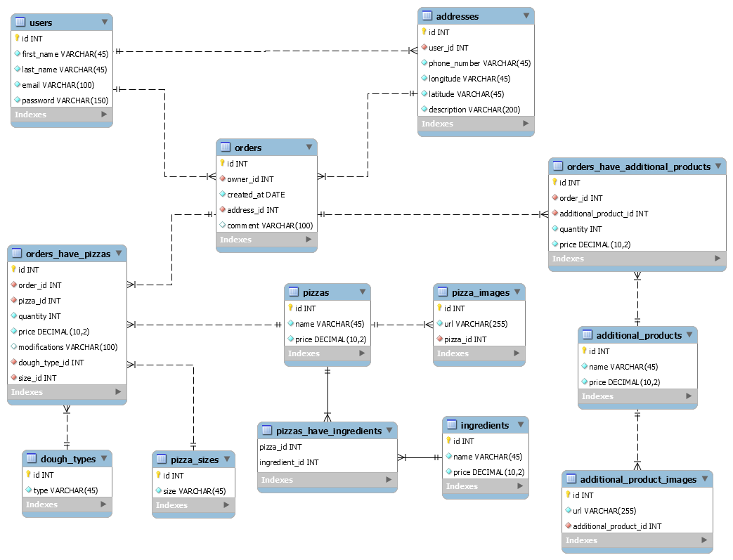
Database Diagram

Slide 5
Class diagram
Controllers
Additional Product Controller
Address Controller
Cart Controller
Ingredient Controller
Order Controller
Pizza Controller
User Controller
Session Manager
Services
Additional Product Service
Address Service
Cart Service
Ingredient Service
Order Service
Pizza Service
User Service

Slide 6
Class diagram
Repositories
Additional Product Repository
Additional Product Order Repository
Address Repository
Cart Repository
Ingredient Repository
Order Repository
Pizza Repository
Pizza Order Repository
User Repository

Slide 7
Class Diagram Models
POJOs
Additional Product
Additional Product Order
Address
Dough
Ingredient
Order
Pizza
Pizza Order
Pizza Size
User
DTOs
Additional Product DTO – 3 types
Address DTO – 2 types
Cart DTO
Dough DTO
Error DTO
Ingredient DTO – 2 types
Order DTO – 2 types
Pizza DTO – 8 types
User DTO – 4 types
Success DTO

Slide 8
Class Diagram Models
DAOs
Additional Product DAO
Dough DAO
Order DAO
Pizza DAO
Pizza Size DAO

Slide 9
DEMO

Slide 10
Thank you for your attention!

