Slide 1

z00m!
Team: Gryffindor
Master Project Class
Midterm Presentation
Juliet C. Rubin, Tilman Dingler, Nabeeh Ghanem
March, 22nd, 2011
Notes:
General Feedback:
- watch out for small fonts
- use diagrams (data flow between front-end, middleware and back-end)
- more slide-flow (?)
- page numbers on slides
- make it longer (about 15mins)
- talk about tools and architectures

Slide 2



Team Gryffindor
Juliet C. Rubin
jcrubin@usfca.edu
(310) 279 7633
Game Engine Designer
Tilman Dingler
tvdingler@usfca.edu
(415) 738 9947
Back-End Designer
Nabeeh Ghanem
nghanem@usfca.edu
(510) 919 2743
Front-End Designer

Slide 3


Team Gryffindor
Jon Rahoi
jon@rahoi.com
(415) 669-4173
Project Sponsor

Slide 4
Agenda
The Challenge: Combining News with Locations
Creating a Game With a Purpose
z00m! - A Multiplayer GWAP
Conclusion
Q & A
Notes:
Agenda Storyline

Slide 5

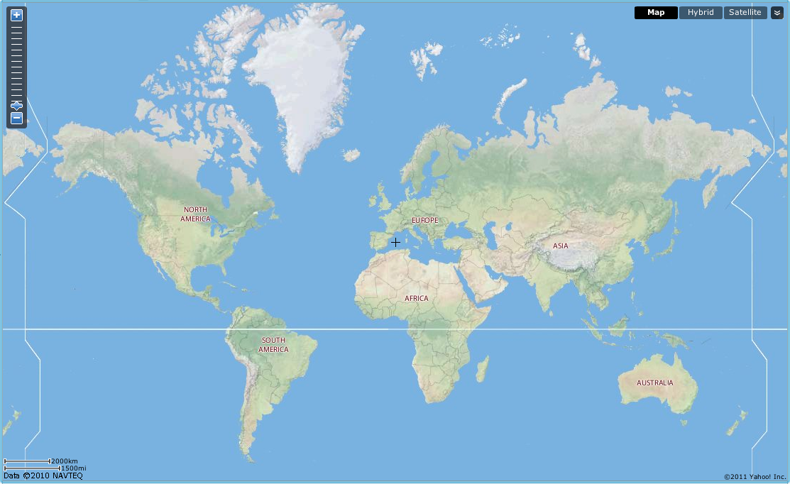

The Yahoo! Local Challenge

Slide 6
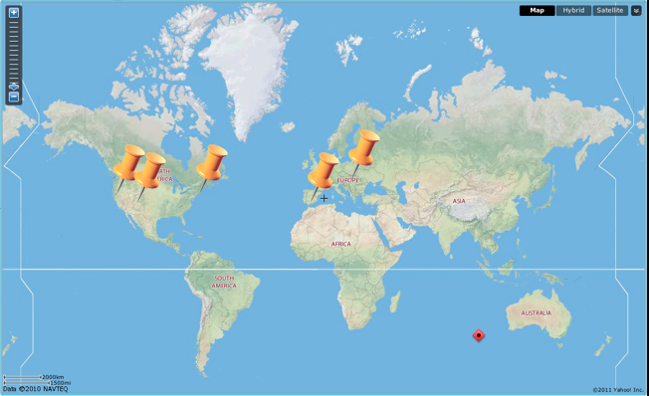
The Yahoo! Local Challenge
Combining articles and geo-location
Approaches
  Data Mining Techniques
  Human Input
How can we get humans to geo-tag articles?

Slide 7
Agenda
The Challenge: Combining News with Locations
Creating a Game With a Purpose
z00m! - A Multiplayer GWAP
Conclusion
Q & A
Notes:
Agenda Storyline

Slide 8

Games With A Purpose
Played on a Computer
Serve some purpose
Harness human abilities
Entertain
Coined by Lenore Blum and
  Luis von Ahn

Slide 9
Agenda
The Challenge: Combining News with Locations
Creating a Game With a Purpose
z00m! - A Multiplayer GWAP
Conclusion
Q & A
Notes:
Agenda Storyline

Slide 10


Goal Behind the Scenes
Database
Feeding location data into Yahoo!’s database

Slide 11


z00m! - A Multiplayer GWAP
2 Player Game
Goal: narrow down an article to a location as far as you can
Gameplay based on agreement

Slide 12
Narrowing Down Locations
Country
State
Region
City
Neighbourhood
+ Score
Notes:
country
state
region
city
neighbourhood

Slide 13



z00m! in Action
1. Pair up players
Player 1
Player 2
Server

Slide 14

z00m! in Action
2. Start game
3. Locate article
Article
Tagcloud
Location Map

Slide 15
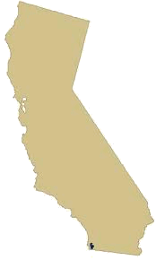

z00m! in Action
4. Compare choices
=!
Disagreement >> New Article

Slide 16
z00m! in Action
4. Compare choices
==
+ Score
Agreement >> Next Zoom Level
>> Next Article

Slide 17
z00m! in Action
5. Game end
==
Score
Score
After Timeout (4min)

Slide 18

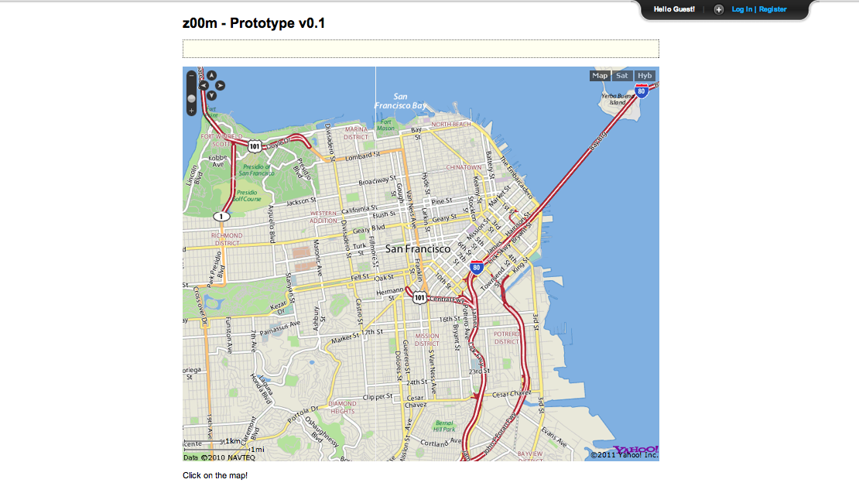
Live DEMO

Slide 19
z00m! - Behind the Scenes
Player 1
Player 2
Server
Shared Database
Proprietary Database

Slide 20
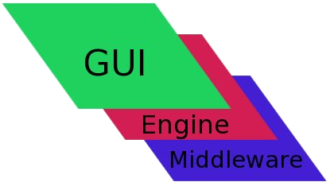
z00m! - Front-End

Slide 21
z00m! - Front-End
HTML
CSS

Slide 22

z00m! - Front-End
Engine APIs
  YUI3
  Yahoo! Maps

Slide 23
z00m! - Behind the Scenes
Player 1
Player 2
Server
Shared Database
Proprietary Database

Slide 24


z00m! - Back-End
express
mongoose
dnode

Slide 25
z00m! - Behind the Scenes
Player 1
Player 2
Server
Shared Database
Proprietary Database

Slide 26

z00m! - Back-End
1. Shared Database with Geo-tagger team
2. Proprietary Database

Slide 27
Agenda
The Challenge: Combining News with Locations
Creating a Game With a Purpose
z00m! - A Multiplayer GWAP
Conclusion
Q & A
Notes:
Agenda Storyline

Slide 28
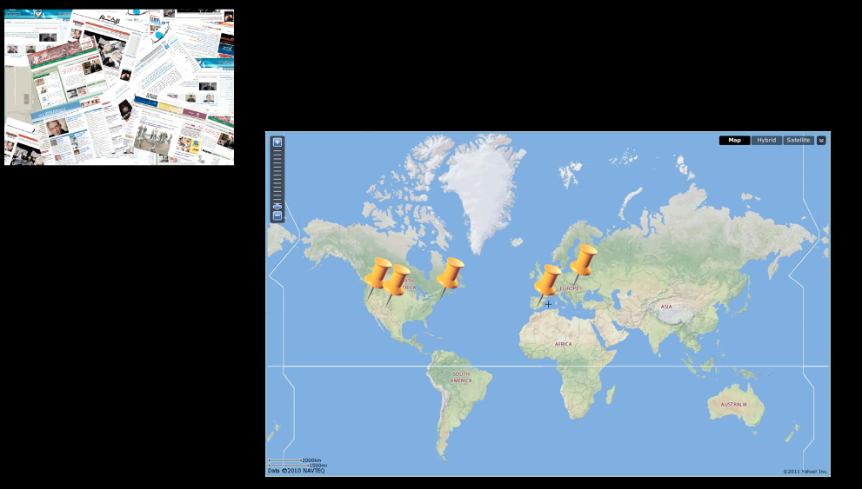
Conclusion
z00m! - a multiplayer GWAP
based on agreement
connects articles with geo-location

Slide 29
Conclusion
Why does this work?
incentives to be accurate
spam-resistant
multiple location votes
uses pre-tagged articles OR raw articles

Slide 30


Thanks!
Team Gryffindor
Tilman Dingler
Nabeeh Ghanem
Juliet C. Rubin

