Slide 1


Bankrate (RV interview)
Letao (Julietta) Zhu

Slide 2
Agenda
Executive Summary
Data and Methods
Findings and Impacts

Slide 3
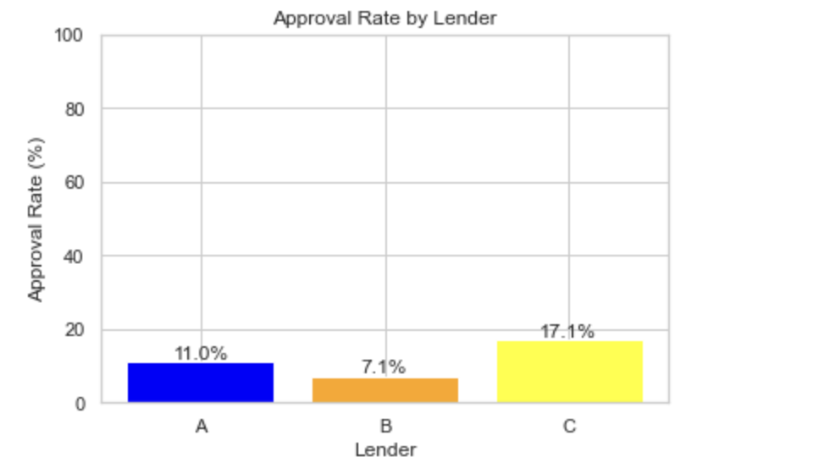
Bankrate stands to add $2M to its commission revenue with a better matching model
$2.6M
commission revenue
$4.5M
Low approval rates among banks
Potential commission revenue*
* represents revenue growth potential of >.7x; key drivers include value recovered from miss-matching

Slide 4




Executive Summary -
With Optimized Matching, Bankrate gains $2M
Background
Bankrate, a 3rd party agency helping consumers select their best loan option, want to improve commission revenue with a better and smarter matching system.
3 Questions
3 Methods
What feature matter the most to determine loan approval?
Any differences in who gets approved across lenders?
Other ways to monetize?
Random forest binary classifier
feature importance to determine differences in three lenders
Expected value from the product of approval probability and unit revenue
Recs
Use exiting data/info about consumers to generate differential recommendations of lenders, leveraging a machine learning model for accurate assignment.
Gather additional consumers information to continuously enhance the accuracy and effectiveness of the prediction model.

Slide 5
Agenda
Executive Summary
Data and Methods
Findings and Impacts

Slide 6
We leveraged leading data science methods for targeted analysis
Analysis Part
Variables, Packages, and Process
Binary Classification & Feature Importance Analysis
RandomForestClassifier in the sklearn package in python
Construct 2 new variables: housing_ratio & loan_income_ratio
Build a general approval model and separate models for each lender using a random forest approach.
Analyze feature importance to identify significant predictors.
Differential Approval and Revenue Prediction
Investigate top 4 features and examine differences in approval criteria among lenders.
Predict approval probabilities for each lender on a test set.
expected revenue per customer analysis
Optimizing Revenue through Lender Recommendation
Recommend the lender with the highest expected revenue for each customer.
Compare the predicted revenue with current revenue

Slide 7


Our analysis can be further reinforced if key assumptions and limitations are overcome
Assumptions
Loan approval failures of an otherwise creditworthy user occur solely due to incorrect lender recommendation
There’s only one uniform loan product for all lenders
Fixed commission for all loans
Model trustworthiness
Limitations
Lack of information about loan products such as interest rate
Lack of cost information (consumer acquisition expenses, operation costs, etc)
Lack of information about other ways of monetization (e.g. from consumers instead of lenders)

Slide 8
Agenda
Executive Summary
Data and Methods
Findings and Impacts

Slide 9
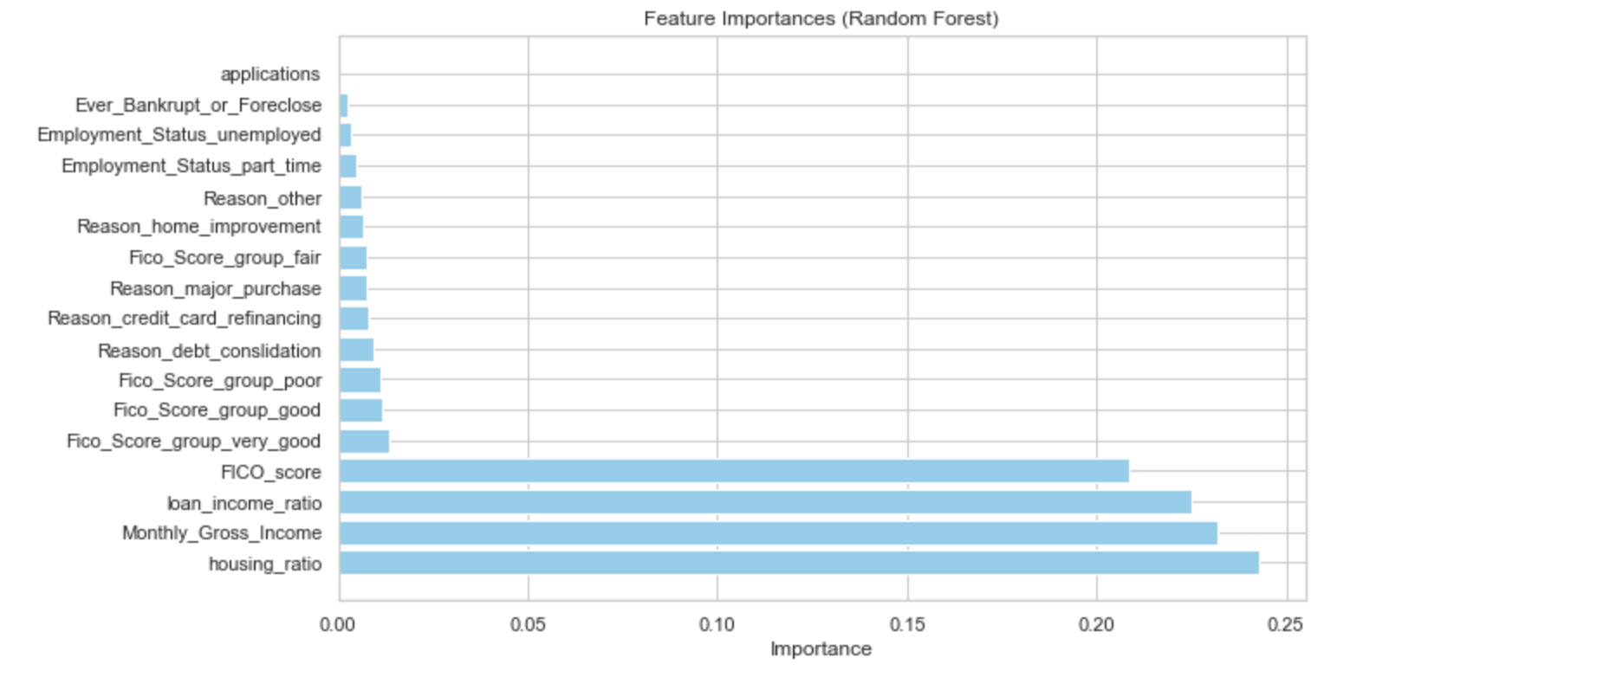
1
Analyze feature importances to identify significant predictors
The model have a 88% accuracy score on test set.
This graph shows us which features are the most important when determine approval
Top 4 predictors: housing_ratio, Monthly_Gross_Income, FICO_score, loan_income_ratio
Notes:
PROOF THAT UNDERSTOCKING IS A REAL PROBLEM: This graph aggregates the data based on period and displays the total doses purchased (by every customer for every drug) each period as well as our total projected consumption per month. The shaded area represents moments where HCPs are understocking. Blue: Actual dose orders per period Red: Our projected consumption per month

Slide 10
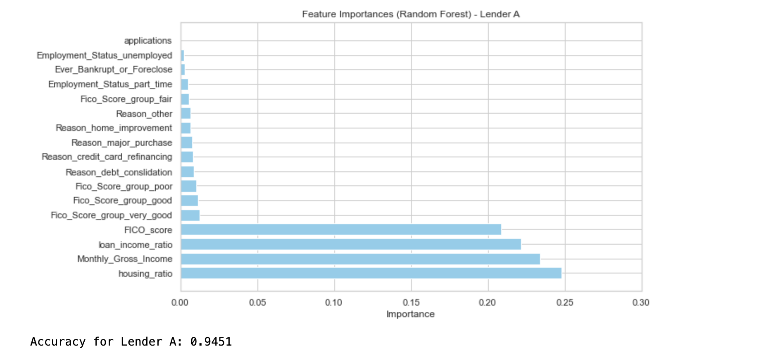
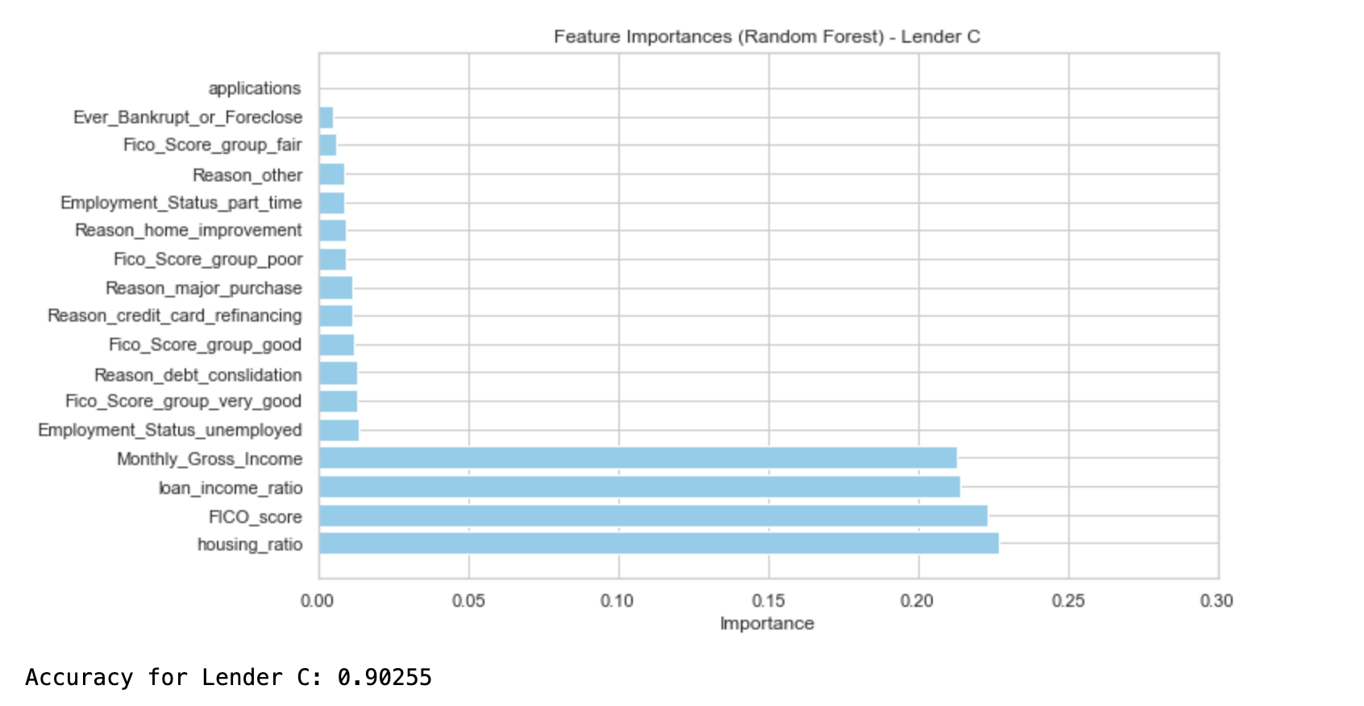
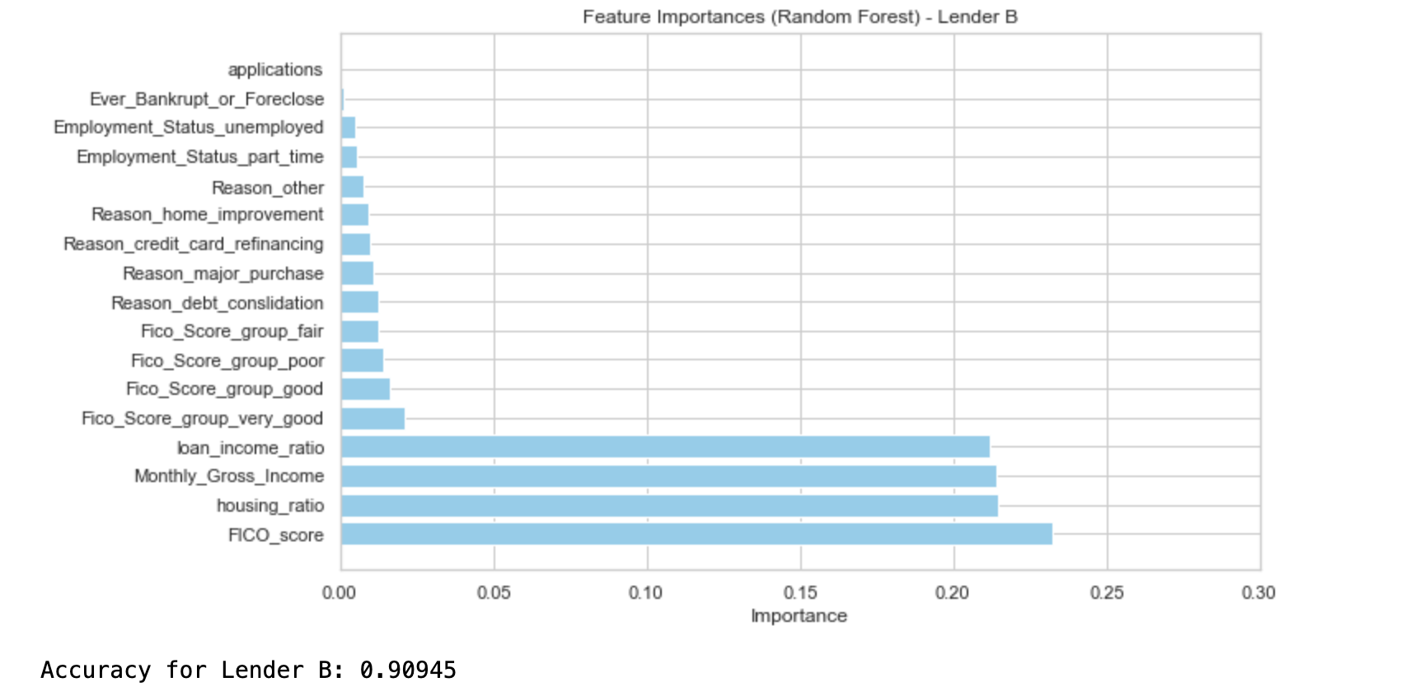
Investigate differences in what matters the most for each lender
2
The top 4 features are consistent across group
There are differences in the order of the variable importance. To see if the differences in order are significant, We can look at these 4 features separately (next page)
Notes:
This graph is similar to the one above, except it looks at the doses purchased and predicted for a specific random customer. This one is good to include because it shows less seasonality, we see many shaded areas indicating lots of room for potential revenue

Slide 11
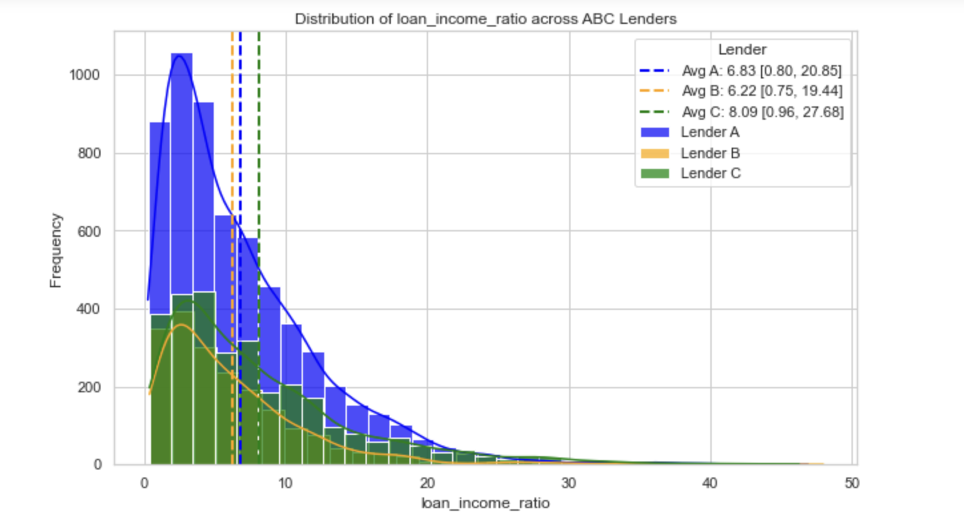
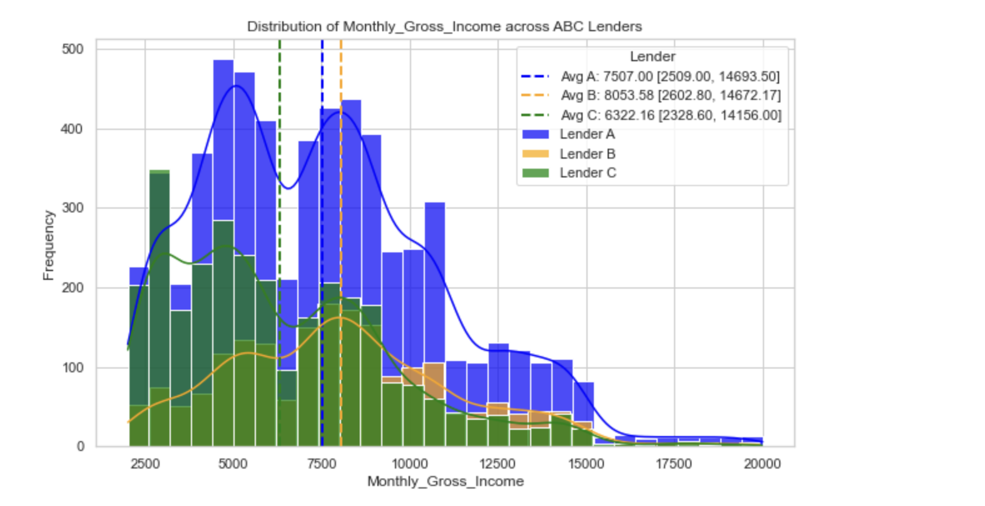
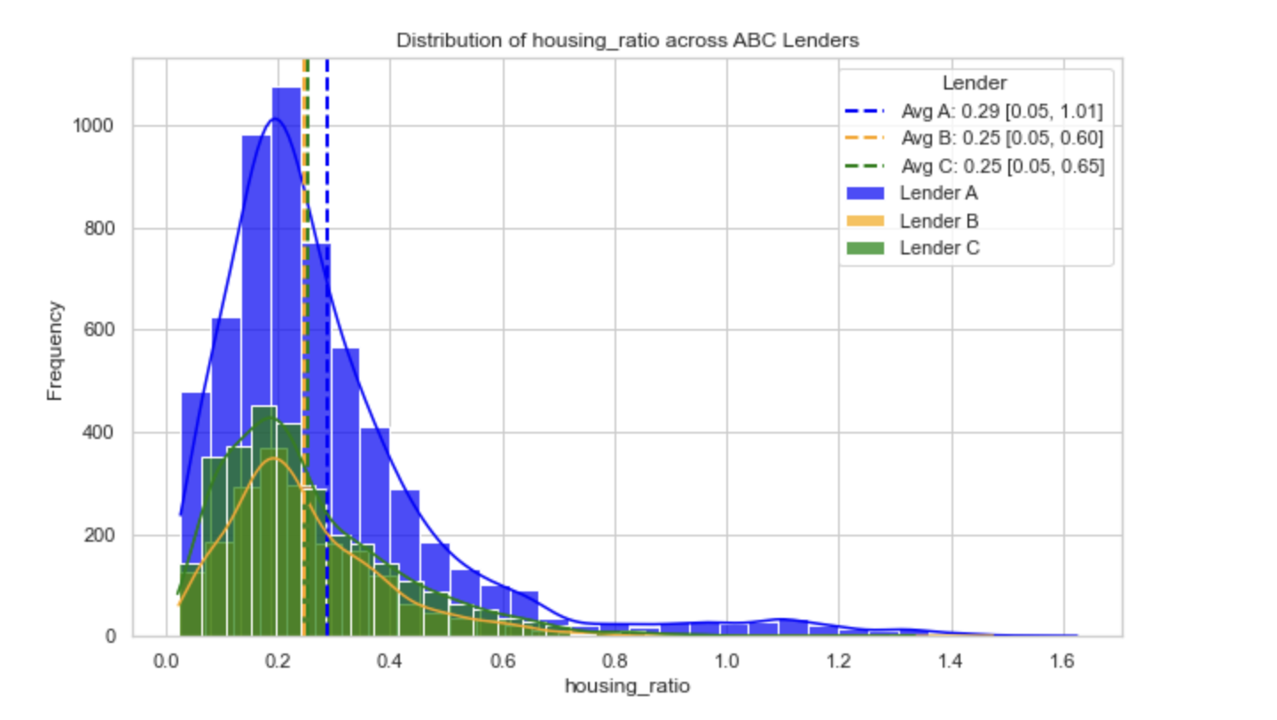
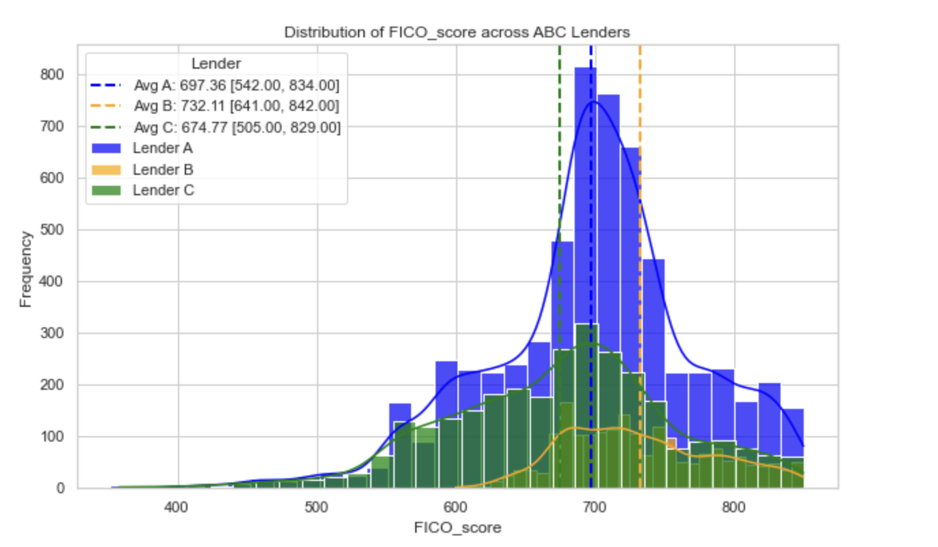
Investigate top 4 features and examine differences in approval criteria among lenders.
2
Lender B requires higher monthly income and FICO score; Lender C have relatively lower requirement to approve a loan
In the next step, we can use machine learning predictive model to handle complex non-linear patterns that’s not shown on these graphs

Slide 12
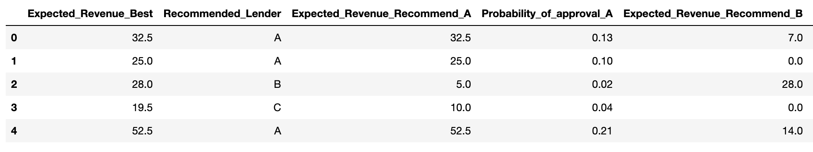
Recommend the lender with the highest expected revenue for each customer
3
Use separate models to predict a probability of approval for each lender for a held-out test set
Calculate expected revenue and determine the lender with the highest expected revenue
We will get a 70 percent revenue growth compared to the initial earning hence estimated $2M increase in revenue

