Slide 1
Recursive movements – returns to previously visited area

Slide 2
Data exploration using recursion
Recursive movements – returns to previously visited area

Slide 3
Data exploration using recursion
Recursive movements – returns to previously visited area

Slide 4
Data exploration using recursion
Recursive movements – returns to previously visited area

Slide 5
Data exploration using recursion
Recursive movements – returns to previously visited area

Slide 6
Data exploration using recursion
Recursive movements – returns to previously visited area
Recursive movements – returns to previously visited area
-> nesting, denning
-> resource locations such as water points
-> trapline foraging behavior for pollinators
-> path recursion in large-scale movement pattern – e.g. migration
-> predator-prey interactions

Slide 7
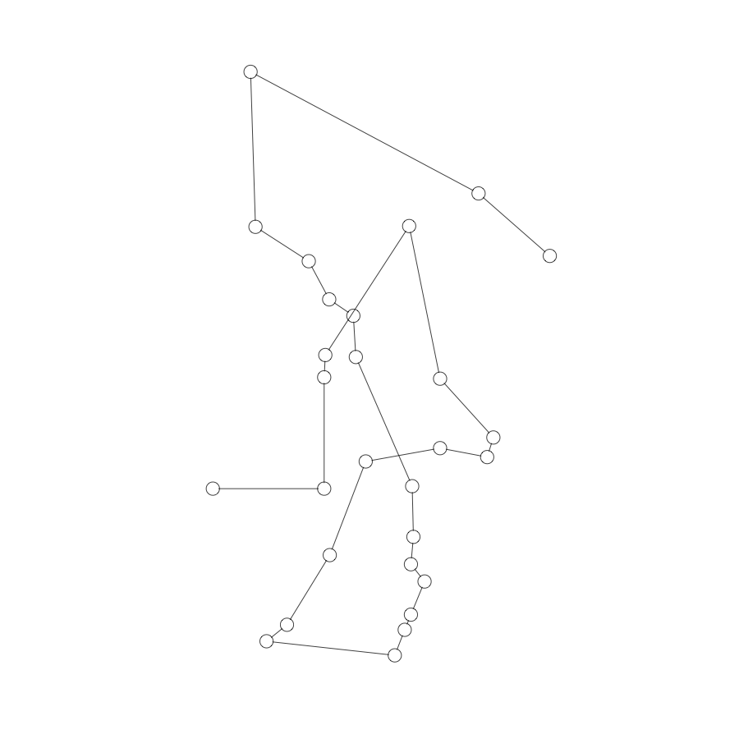

Slide 8
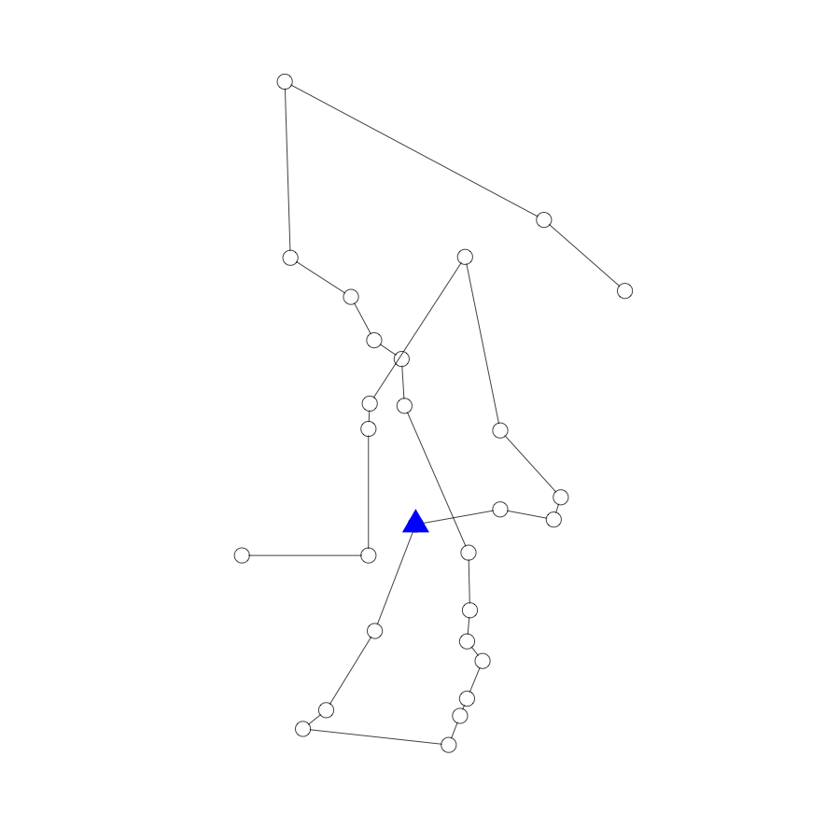

Slide 9
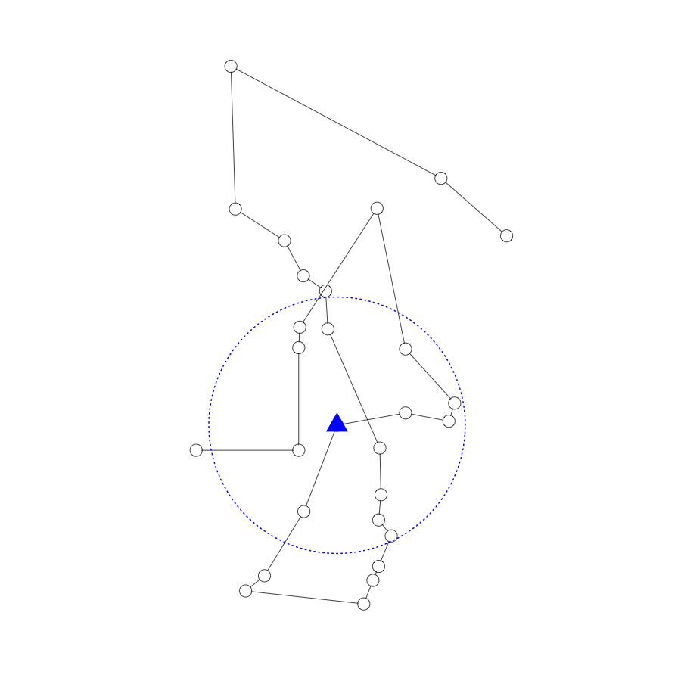

Slide 13
1
2
Revisitations
First passage time
Utilization
Time since last visit
3

Slide 14
Exit Time
Revisitations
First passage time
Utilization
Time since last visit
Entrance Time

Slide 15
Entrance Time
Entrance Time
Exit Time
Revisitations
First passage time
Utilization
Time since last visit
Exit Time
Entrance Time
Exit Time

Slide 16
Entrance Time
Exit Time
Revisitations
First passage time
Utilization
Time since last visit
Entrance Time
Exit Time

Slide 18
Revisitations
First passage time
Utilization
Time since last visit

Slide 19
Data exploration using recursion
library(recurse)
-> requires regularly sampled data
-> results dependent on radius/buffer that defines recursion
- choose ecological meaningful values
-> autocorrelation – cannot use statistical tests assuming independence
-> sufficient number of relocation within buffer needed
for “first passage time”, “utilization” and “time since last visit”

Slide 20
library(recurse)
x y coordIdx visitIdx entranceTime exitTime timeInside timeSinceLastVisit
1 340611.9 62801.22 1 1 2014-01-23 11:30:42 2014-01-23 13:38:00 2.1217860 hours NA hours
2 340611.9 62801.22 1 2 2014-01-24 09:38:05 2014-01-24 10:41:11 1.0518268 hours 20.00137478 hours
3 340611.9 62801.22 1 3 2014-01-24 10:46:09 2014-01-24 19:18:10 8.5337491 hours 0.08251897 hours
4 340611.9 62801.22 1 4 2014-01-25 04:28:43 2014-01-25 09:39:56 5.1870403 hours 9.17575500 hours
5 340611.9 62801.22 1 5 2014-01-25 10:52:23 2014-01-25 14:20:32 3.4691658 hours 1.20747072 hours
6 340611.9 62801.22 1 6 2014-01-26 04:44:32 2014-01-26 04:55:47 0.1877439 hours 14.39987584 hours
7 340611.9 62801.22 1 7 2014-01-26 14:07:13 2014-01-26 14:19:02 0.1969768 hours 9.19054172 hours
8 340611.9 62801.22 1 8 2014-02-06 05:28:55 2014-02-06 07:10:36 1.6947342 hours 255.16447040 hours
9 340624.2 62828.47 2 1 2014-01-23 11:30:42 2014-01-23 13:41:17 2.1766256 hours NA hours
10 340624.2 62828.47 2 2 2014-01-24 09:29:23 2014-01-24 19:16:39 9.7876942 hours 19.80164622 hours
11 340624.2 62828.47 2 3 2014-01-25 04:29:28 2014-01-25 09:40:19 5.1808158 hours 9.21353189 hours
12 340624.2 62828.47 2 4 2014-01-25 10:47:35 2014-01-25 14:19:06 3.5252083 hours 1.12131196 hours

Slide 21
library(recurse)
x y coordIdx visitIdx entranceTime exitTime timeInside timeSinceLastVisit
1 340611.9 62801.22 1 1 2014-01-23 11:30:42 2014-01-23 13:38:00 2.1217860 hours NA hours
2 340611.9 62801.22 1 2 2014-01-24 09:38:05 2014-01-24 10:41:11 1.0518268 hours 20.00137478 hours
3 340611.9 62801.22 1 3 2014-01-24 10:46:09 2014-01-24 19:18:10 8.5337491 hours 0.08251897 hours
4 340611.9 62801.22 1 4 2014-01-25 04:28:43 2014-01-25 09:39:56 5.1870403 hours 9.17575500 hours
5 340611.9 62801.22 1 5 2014-01-25 10:52:23 2014-01-25 14:20:32 3.4691658 hours 1.20747072 hours
6 340611.9 62801.22 1 6 2014-01-26 04:44:32 2014-01-26 04:55:47 0.1877439 hours 14.39987584 hours
7 340611.9 62801.22 1 7 2014-01-26 14:07:13 2014-01-26 14:19:02 0.1969768 hours 9.19054172 hours
8 340611.9 62801.22 1 8 2014-02-06 05:28:55 2014-02-06 07:10:36 1.6947342 hours 255.16447040 hours
9 340624.2 62828.47 2 1 2014-01-23 11:30:42 2014-01-23 13:41:17 2.1766256 hours NA hours
10 340624.2 62828.47 2 2 2014-01-24 09:29:23 2014-01-24 19:16:39 9.7876942 hours 19.80164622 hours
11 340624.2 62828.47 2 3 2014-01-25 04:29:28 2014-01-25 09:40:19 5.1808158 hours 9.21353189 hours
12 340624.2 62828.47 2 4 2014-01-25 10:47:35 2014-01-25 14:19:06 3.5252083 hours 1.12131196 hours

Slide 22
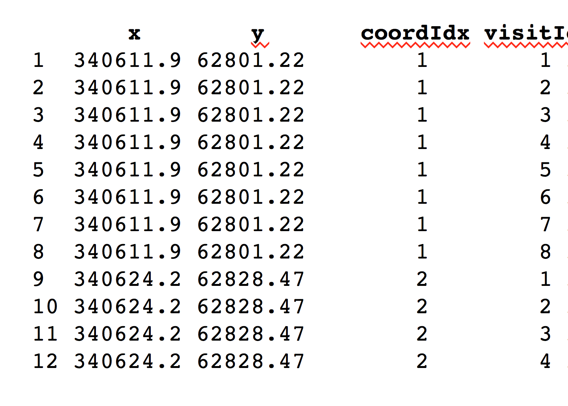
library(recurse)

Slide 23
library(recurse)
x y coordIdx visitIdx entranceTime exitTime timeInside timeSinceLastVisit
1 340611.9 62801.22 1 1 2014-01-23 11:30:42 2014-01-23 13:38:00 2.1217860 hours NA hours
2 340611.9 62801.22 1 2 2014-01-24 09:38:05 2014-01-24 10:41:11 1.0518268 hours 20.00137478 hours
3 340611.9 62801.22 1 3 2014-01-24 10:46:09 2014-01-24 19:18:10 8.5337491 hours 0.08251897 hours
4 340611.9 62801.22 1 4 2014-01-25 04:28:43 2014-01-25 09:39:56 5.1870403 hours 9.17575500 hours
5 340611.9 62801.22 1 5 2014-01-25 10:52:23 2014-01-25 14:20:32 3.4691658 hours 1.20747072 hours
6 340611.9 62801.22 1 6 2014-01-26 04:44:32 2014-01-26 04:55:47 0.1877439 hours 14.39987584 hours
7 340611.9 62801.22 1 7 2014-01-26 14:07:13 2014-01-26 14:19:02 0.1969768 hours 9.19054172 hours
8 340611.9 62801.22 1 8 2014-02-06 05:28:55 2014-02-06 07:10:36 1.6947342 hours 255.16447040 hours
9 340624.2 62828.47 2 1 2014-01-23 11:30:42 2014-01-23 13:41:17 2.1766256 hours NA hours
10 340624.2 62828.47 2 2 2014-01-24 09:29:23 2014-01-24 19:16:39 9.7876942 hours 19.80164622 hours
11 340624.2 62828.47 2 3 2014-01-25 04:29:28 2014-01-25 09:40:19 5.1808158 hours 9.21353189 hours
12 340624.2 62828.47 2 4 2014-01-25 10:47:35 2014-01-25 14:19:06 3.5252083 hours 1.12131196 hours

Slide 24
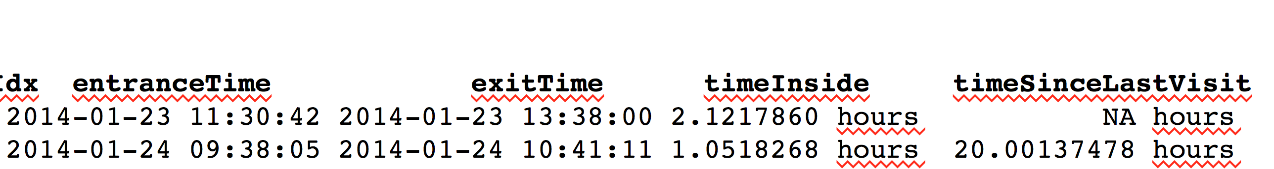
library(recurse)
x y coordIdx visitIdx entranceTime exitTime timeInside timeSinceLastVisit
1 340611.9 62801.22 1 1 2014-01-23 11:30:42 2014-01-23 13:38:00 2.1217860 hours NA hours
2 340611.9 62801.22 1 2 2014-01-24 09:38:05 2014-01-24 10:41:11 1.0518268 hours 20.00137478 hours
3 340611.9 62801.22 1 3 2014-01-24 10:46:09 2014-01-24 19:18:10 8.5337491 hours 0.08251897 hours
4 340611.9 62801.22 1 4 2014-01-25 04:28:43 2014-01-25 09:39:56 5.1870403 hours 9.17575500 hours
5 340611.9 62801.22 1 5 2014-01-25 10:52:23 2014-01-25 14:20:32 3.4691658 hours 1.20747072 hours
6 340611.9 62801.22 1 6 2014-01-26 04:44:32 2014-01-26 04:55:47 0.1877439 hours 14.39987584 hours
7 340611.9 62801.22 1 7 2014-01-26 14:07:13 2014-01-26 14:19:02 0.1969768 hours 9.19054172 hours
8 340611.9 62801.22 1 8 2014-02-06 05:28:55 2014-02-06 07:10:36 1.6947342 hours 255.16447040 hours
9 340624.2 62828.47 2 1 2014-01-23 11:30:42 2014-01-23 13:41:17 2.1766256 hours NA hours
10 340624.2 62828.47 2 2 2014-01-24 09:29:23 2014-01-24 19:16:39 9.7876942 hours 19.80164622 hours
11 340624.2 62828.47 2 3 2014-01-25 04:29:28 2014-01-25 09:40:19 5.1808158 hours 9.21353189 hours
12 340624.2 62828.47 2 4 2014-01-25 10:47:35 2014-01-25 14:19:06 3.5252083 hours 1.12131196 hours

Slide 25
Detecting revisits in a movement trajectory
Berger-Tal, O. & Bar-David, S.
Recursive movement patterns: review and synthesis across species
Ecosphere, Ecological Society of America, 2015, 6, 1-12
http://onlinelibrary.wiley.com/doi/10.1890/ES15-00106.1/full
Benhamou, S. & Riotte-Lambert, L.
Beyond the Utilization Distribution: Identifying home range areas that are intensively exploited or repeatedly visited
Ecological Modelling, 2012, 227, 112-116
http://www.sciencedirect.com/science/article/pii/S030438001100603X
Bar-David, S.; Bar-David, I.; Cross, P. C.; Ryan, S. J.; Knechtel, C. U. & Getz, W. M.
Methods for assessing movement path recursion with application to African buffalo in South Africa
Ecology, Ecological Society of America, 2009, 90, 2467-2479
http://onlinelibrary.wiley.com/doi/10.1890/08-1532.1/abstract
Detecting periodicity
March, D.; Palmer, M.; Alós, J.; Grau, A. & Cardona, F.
Short-term residence, home range size and diel patterns of the painted comber Serranus scriba in a temperate marine reserve
Marine Ecology Progress Series, 2009, 400, 195
Li, Z.; Han, J.; Ding, B. & Kays, R.
Mining periodic behaviors of object movements for animal and biological sustainability studies
Data Mining and Knowledge Discovery, Springer, 2012, 24, 355-386
Riotte-Lambert, L.; Benhamou, S. & Chamaillé-Jammes, S.
Periodicity analysis of movement recursions
Journal of Theoretical Biology, 2013, 317, 238-243
Guillaume Péron G., Fleming C, de Paula R & Calabrese MC
Uncovering periodic patterns of space use in animal tracking data with periodograms, including a new algorithm for the Lomb-Scargle periodogram and improved randomization tests
Movement Ecology, 2016, 4:19

