Slide 1
An overview of SQL
Big Data Engineering
Julie Weeds
March 2020

Slide 2
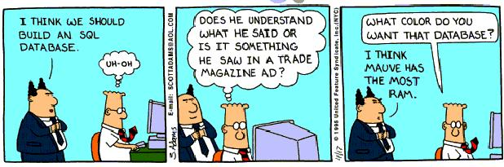

Slide 3
Structured Query Language
Pronounced “Sequel”
Originally called Sequel but changed for trademark reasons
Dates to 1974
Written by IBM (Chamberlin and Boyce)
Based on “A Relational Model of Data for Large Shared Data Banks” by Edward Codd
First commercialised by Oracle
Standardised in 1986

Slide 4
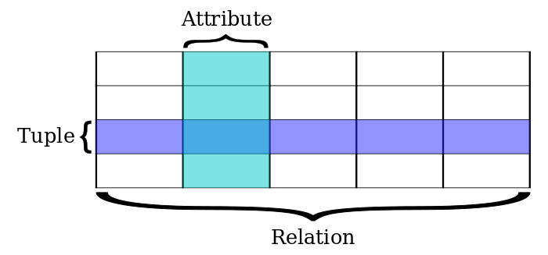
Relational terminology (from Codd)

Slide 5
Relational Database
Every row in a table has the same attributes (columns)
Relations are either tables or views on those tables
A primary key for each row uniquely identifies it
A foreign key points to another table’s primary key

Slide 6
Relational database
Id | Firstname | Lastname | birthdate
2587 | John | Hopkins | 5/12/1973
7789 | Henry | Gleeson | 1/5/1985
22398 | Eleanor | Gleeson | 10/6/1996

Slide 7
Why are we looking at SQL today?
SQL and variations are widely used
Not just for relational databases
Hive / SparkSQL
SQL over big data using map-reduce techniques
Siddhi / KSQL / StreamingSQL
SQL queries over real-time streaming data
Other SQL interfaces
e.g. SQL into Sloan Digital Sky Survey
Notes:
Siddhi = open-source software for processing data streams in real time, written in Java, optimised for high performance; used by companies like Uber and Ebay
KSQL = strraming sql for apache karka
Sloan digital sky survey = detailed three dimensional maps of the universe

Slide 8
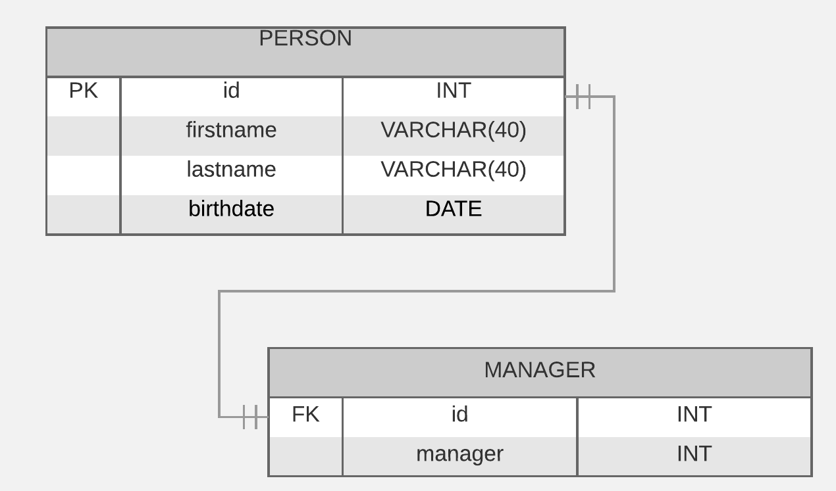
Entity Relationship Diagram
PK, FK
FK

Slide 9
SQL STATEMENTS corresponding to the previous diagram
CREATE TABLE Person (
id INT,
firstname VARCHAR(40),
lastname VARCHAR(40),
birthdate DATE,
PRIMARY KEY (id)
);
CREATE TABLE Manager (
id INT,
manager INT,
PRIMARY KEY (id),
FOREIGN KEY (id) REFERENCES Person(id)
FOREIGN KEY (manager) REFERENCES Person(id)
);

Slide 10
INSERT
INSERT INTO Person (id, firstname, lastname, birthdate) values (564, "Henry", "Gleeson", "1968-12-5");
INSERT INTO Person (id, firstname, lastname, birthdate) values (2343, "Eleanor", "Gleeson", "1995-1-9");

Slide 11
SELECT
SELECT * FROM Person;
id firstname lastname birthdate
---------- ---------- ---------- ----------
564 Henry Gleeson 1968-12-5
2343 Eleanor Gleeson 1995-1-9

Slide 12
SELECT
SELECT * FROM Person WHERE id = 564;
id firstname lastname birthdate
---------- ---------- ---------- ----------
564 Henry Gleeson 1968-12-5

Slide 13
SELECT
SELECT * FROM Person WHERE firstname = ”Eleanor";
id firstname lastname birthdate
---------- ---------- ---------- ----------
2343 Eleanor Gleeson 1995-1-9

Slide 14
SELECT
SELECT firstname, lastname FROM Person ORDER BY firstname;
firstname lastname
---------- ----------
Eleanor Smith
Henry Gleeson

Slide 15
SELECT
SELECT lastname FROM Person ORDER BY firstname;
lastname
----------
Gleeson
Gleeson
duplicate rows means that an SQL database is not really a relational database

Slide 16
SELECT
SELECT DISTINCT lastname FROM Person ORDER BY firstname;
lastname
----------
Gleeson

Slide 17
SELECT
SELECT firstname, lastname FROM Person ORDER BY lastname LIMIT 1;
firstname lastname
---------- ----------
Henry Gleeson

Slide 18
SELECT
SELECT AVG(birthdate) FROM Person;
AVG(birthdate)
--------------
1981.5

Slide 19
Functions
MIN
MAX
AVG
COUNT
SUM

Slide 20
OTHER COMMANDS
DELETE
DELETE FROM person WHERE ID=564;
UPDATE
UPDATE PERSON
SET firstname = Henrietta WHERE ID=564;

Slide 21
JOIN
SELECT DISTINCT lastname, firstname FROM Person INNER JOIN Manager ON Person(id) = Manager(id)
firstname lastname
---------- ----------
Eleanor Smith
What does this tell us about Eleanor Smith?

Slide 22
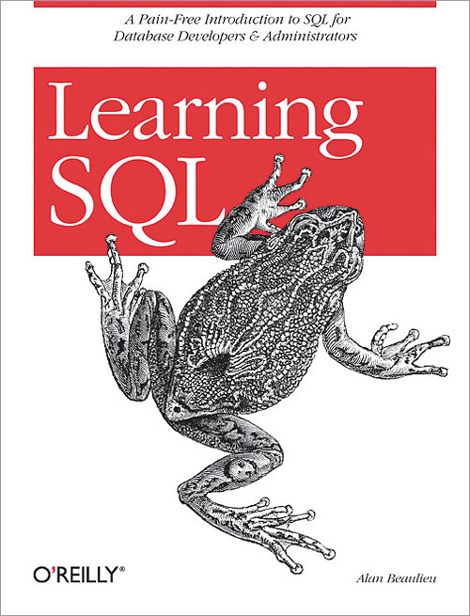
This is a very brief introduction!
We will learn more from the exercises
There are lots of resources on the Web

Slide 23

Apache Hive http://hive.apache.org
Just like SQL except it generates Map Reduce jobs
Works on Hadoop and Spark
Embedded into Spark as SparkSQL
Includes DDL (Data Definition Language) as well as SQL
Makes many processing tasks very simple

Slide 24
Hive example
CREATE TABLE page_view(viewTime INT, userid BIGINT,
page_url STRING, referrer_url STRING,
ip STRING COMMENT 'IP Address of the User')
COMMENT 'This is the page view table'
PARTITIONED BY(dt STRING, country STRING)
STORED AS SEQUENCEFILE;
LOAD DATA LOCAL INPATH /tmp/pv_2008-06-08_us.txt INTO TABLE page_view PARTITION(date='2008-06-08', country='US')
INSERT OVERWRITE TABLE xyz_com_page_views
SELECT page_views.*
FROM page_views
WHERE page_views.date >= '2008-03-01' AND page_views.date <= '2008-03-31' AND
page_views.referrer_url like '%xyz.com';

Slide 25
SparkSQL
Integrates into existing Spark programs
Mixes SQL with Python, Scala or Java
Integrates data from CSV, Avro, Parquet, JDBC, ODBC, JSON, etc
Including joins across them
Fully supports Apache Hive
If you build it with Hive support
Fits into the resilient scalable model of Spark

Slide 26
Spark SQL example
from pyspark.sql import SQLContext, Row
sqlContext = SQLContext(sc)
lines = sc.textFile("examples/src/main/resources/people.txt")
parts = lines.map(lambda l: l.split(","))
people = parts.map(lambda p: Row(name=p[0], age=int(p[1])))
schemaPeople = sqlContext.createDataFrame(people)
schemaPeople.registerTempTable("people")
teenagers = sqlContext.sql("SELECT name FROM people WHERE age >= 13 AND age <= 19")
teenNames = teenagers.map(lambda p: "Name: " + p.name)
for teenName in teenNames.collect():
print(teenName)

Slide 27
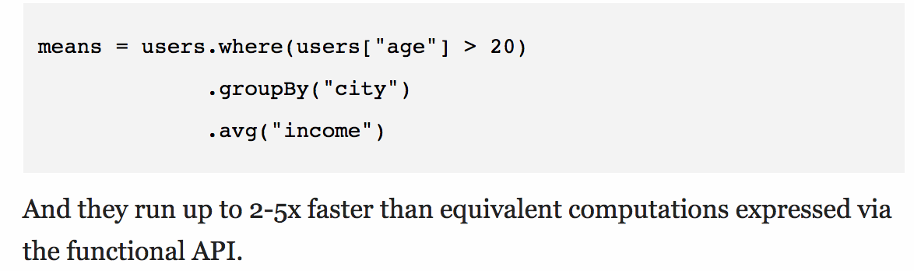
DataFrame Based on Python and R dataframes
Column based object used by SQL
Offers SQL like programming
Supports algebraic optimisation and code gen
E.g. in Scala:

Slide 28
More SQL
df. select('postcode’,’id'). withColumn('first_pc', split(df.postcode, ‘\s’[0]). where((col("first_pc") == 'SW11') or (col("first_pc") == 'OX1')). groupBy('first_pc'). agg({"id": "count"}).show()
Notes:
What is this trying to do?
What errors can you see?
The [0] should be outside the brackets on the 4th line. There is also a probem with using withColumn like this.
There is an end bracket missing at the end of the where statement
Can’t use split like this

Slide 29
User Defined Functions
In SQL a User Defined Function is an extension that helps perform other functions in SQL
In Spark we can add our own functions (e.g. written in Python)
def squared(s):
return s * s
sqlContext.udf.register("squared", squared) SELECT squared(age) as agesquared from PERSON

Slide 30
Questions?

